Slide 1
The ASH Toolkit
Emily Reed, Public Health Registrar, ASH Email: Emily.reed@ash.org.uk

Slide 2
Background
2022 – ASH Supra-local tobacco control report
2022-2023 – funded by the NHS public health team and jointly commissioned by the RDsPH, with additional support from a PH registrar to:
support Humber and North Yorkshire in the discovery and development phase of their Centre of Excellence in Tobacco Control
use learning from this and established regional programmes to produce a toolkit to guide other areas hoping to collaborate on tobacco control

Slide 3
Rationale
Resources that can support ICSs/regions that are wanting to go further and faster in driving down smoking prevalence in their areas
Intended to help:
Make the case for system-wide tobacco control and gain necessary funding
Map existing activity
Develop the strategy
Calculate and allocate a budget

Slide 4
What this is about?
Collaborative model across entire system: NHS, local authorities, third sector, etc.
Multi-stranded tobacco control approach - not only about delivery smoking cessation

Slide 5
The toolkit
Includes:
A “creating conditions for success” poster
A “DPH briefing paper”
A “local authority mapping template”
A “budget calculations template”
A “paper to an ICB board”
A "making the case” slide set
A “supporting spreadsheet”
A “building the strategy” slide set
The “Fresh programme overview” slide set.

Slide 6
1. Creating conditions for success poster
Helps the user understand the process and what might be needed to get a regional programme off the ground
Based on information from Humber & North Yorkshire about their journey to a regional programme

Slide 7
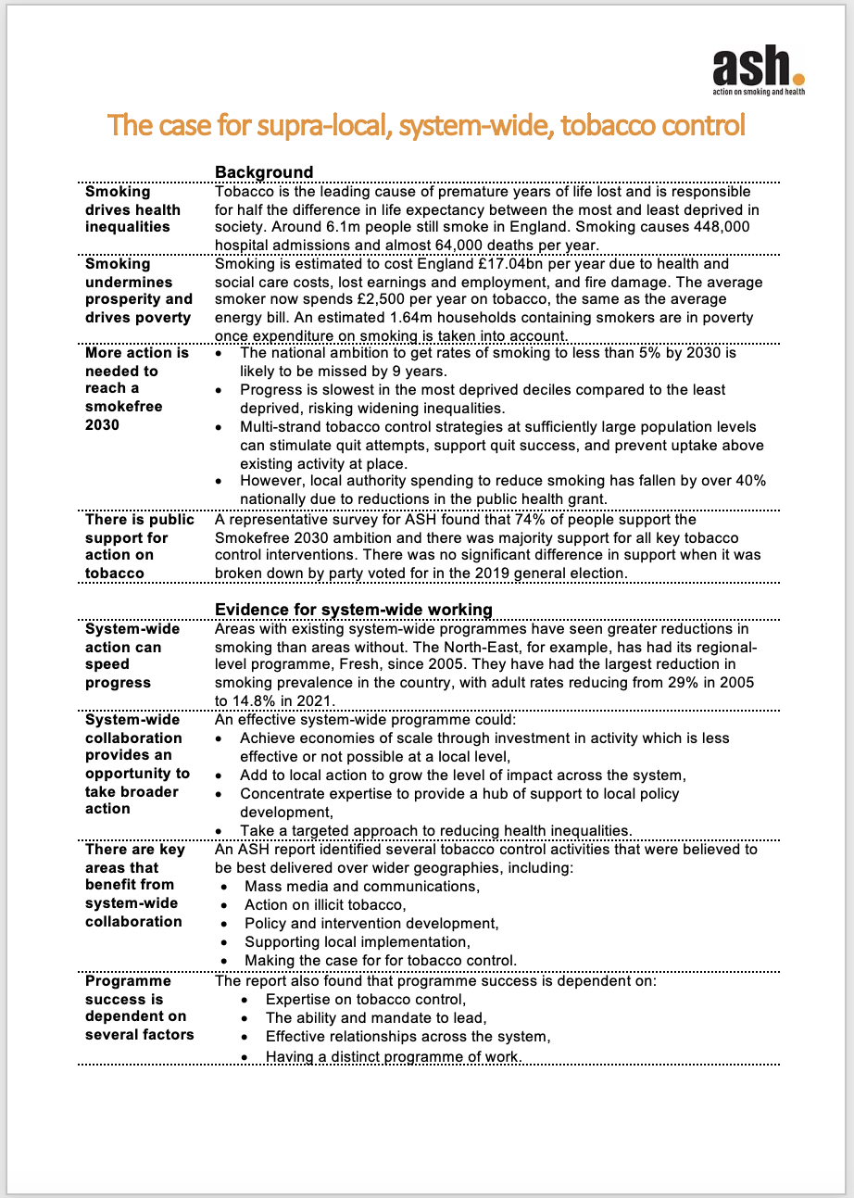
2. DPH briefing paper
Local Directors of Public Health will be key drivers of any system-wide programme, acting as champions and leaders to bring together different agencies
Can help to make the case to DsPH and bring them into the planning process.
Generic paper that can be used as a starting point and be adapted for local use

Slide 8
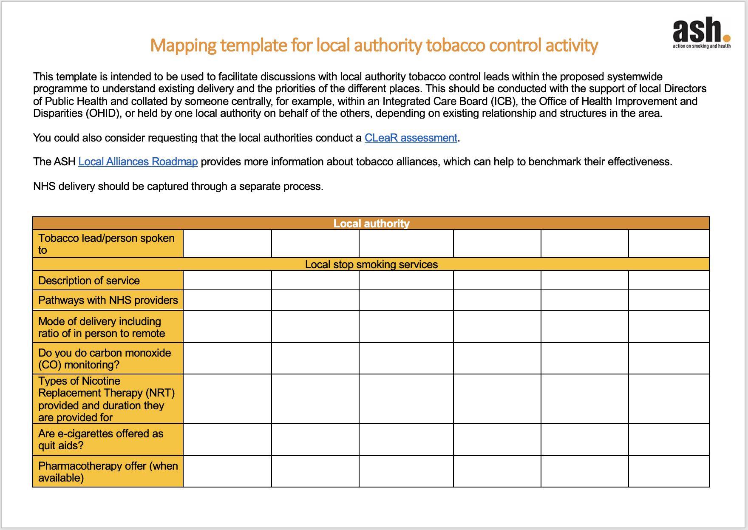
3. Local authority tobacco control mapping
Template to support ICSs/regions to map existing tobacco control in their region based on discussions with LA tobacco control leads and trading standards

Slide 9
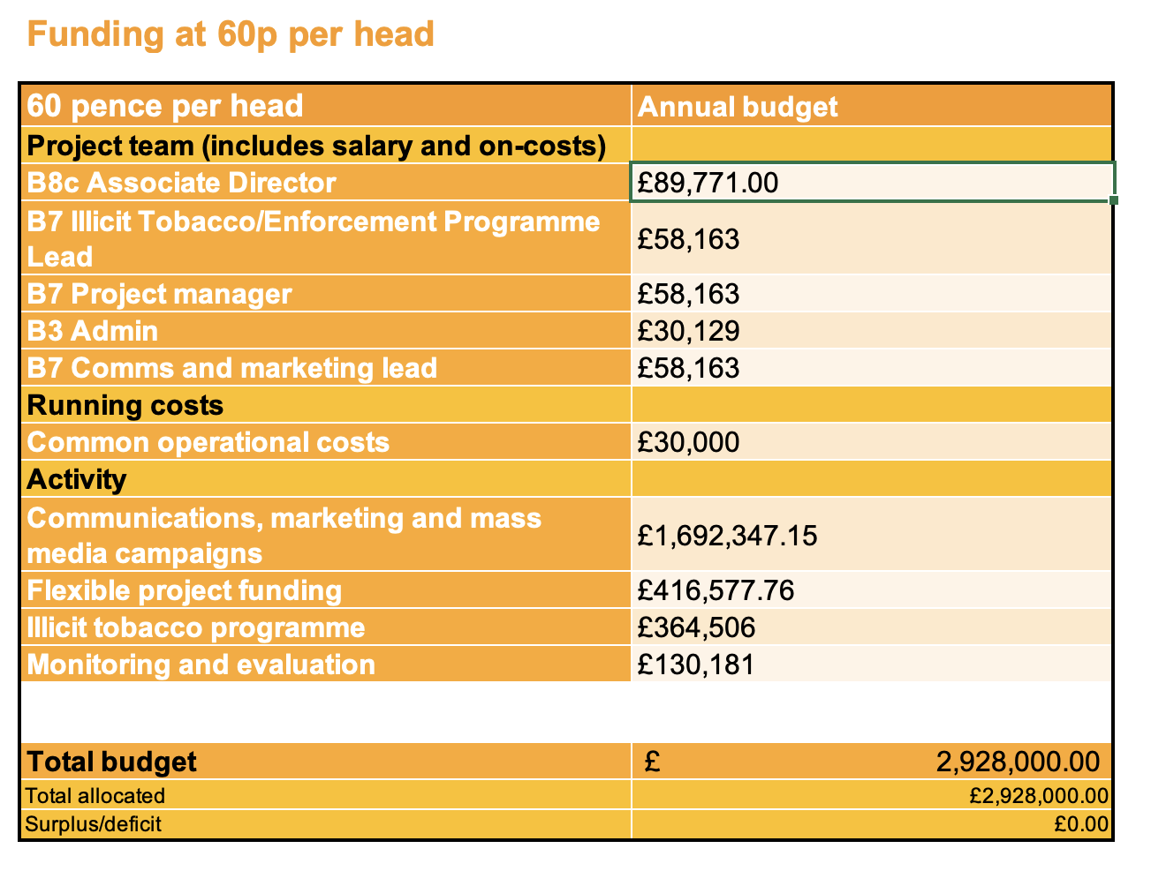
4. Budget calculator
Calculates budgets at 45p, 60p and 80p per head of population by inputting ICS population
Intended as a guide only
Provides rough suggested allocation of the budget at different funding levels
Allocates staff and operational costs first
Then prioritises communications then further interventions
Notes:
East mids as an example – this kind of scale.

Slide 10
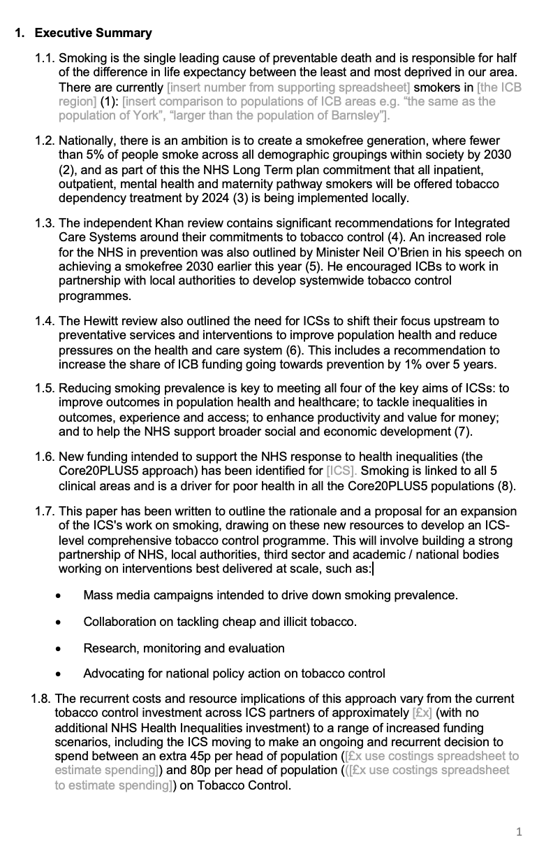
5. Paper to an ICB board
Generic paper that can be used as a starting point and be adapted for local use
Targeted towards boards of ICBs to apply for health inequalities funding
Outlines case for tobacco control in terms of health, inequalities, economics and the policy context
Outlines case for system-wide tobacco control and suggests areas for action

Slide 11
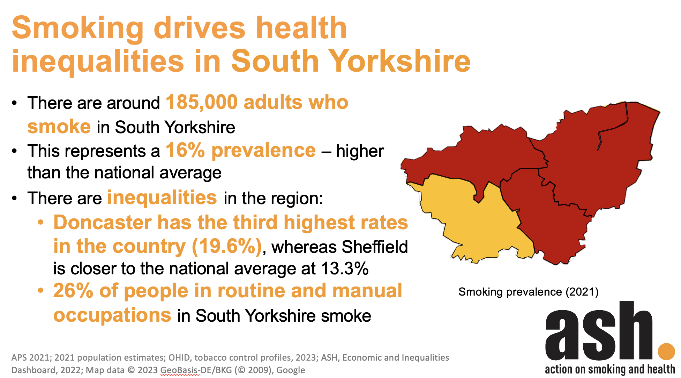
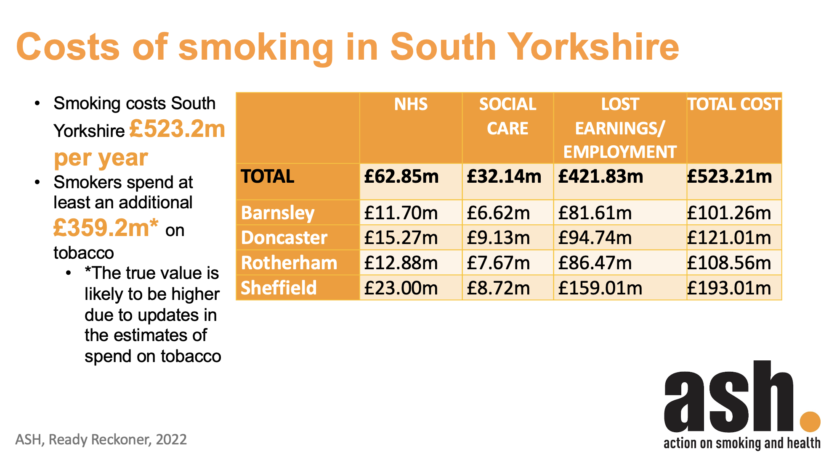
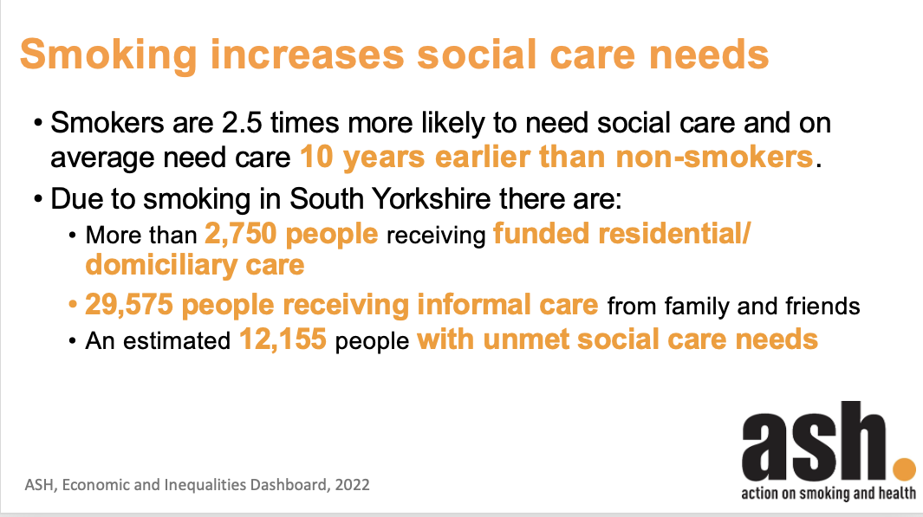
6. Making the case slide set
Presentation designed to be adapted for local use
Intended to engage wider stakeholders
Outlines case for tobacco control in terms of health, inequalities, economics
Gives policy context and progress towards smokefree 2030
Outlines case for regional-level tobacco control and suggests areas for action
Comes with spreadsheet to aid in completing the slides

Slide 12
7. Supporting spreadsheet
Works through the “making the case” slide set slide by slide, giving a source for each statistic to allow the user to complete the presentation
Where ICB/regional level data is not readily available, it will calculate this from local authority data
Statistics needed for the board paper can also be found in this spreadsheet

Slide 13
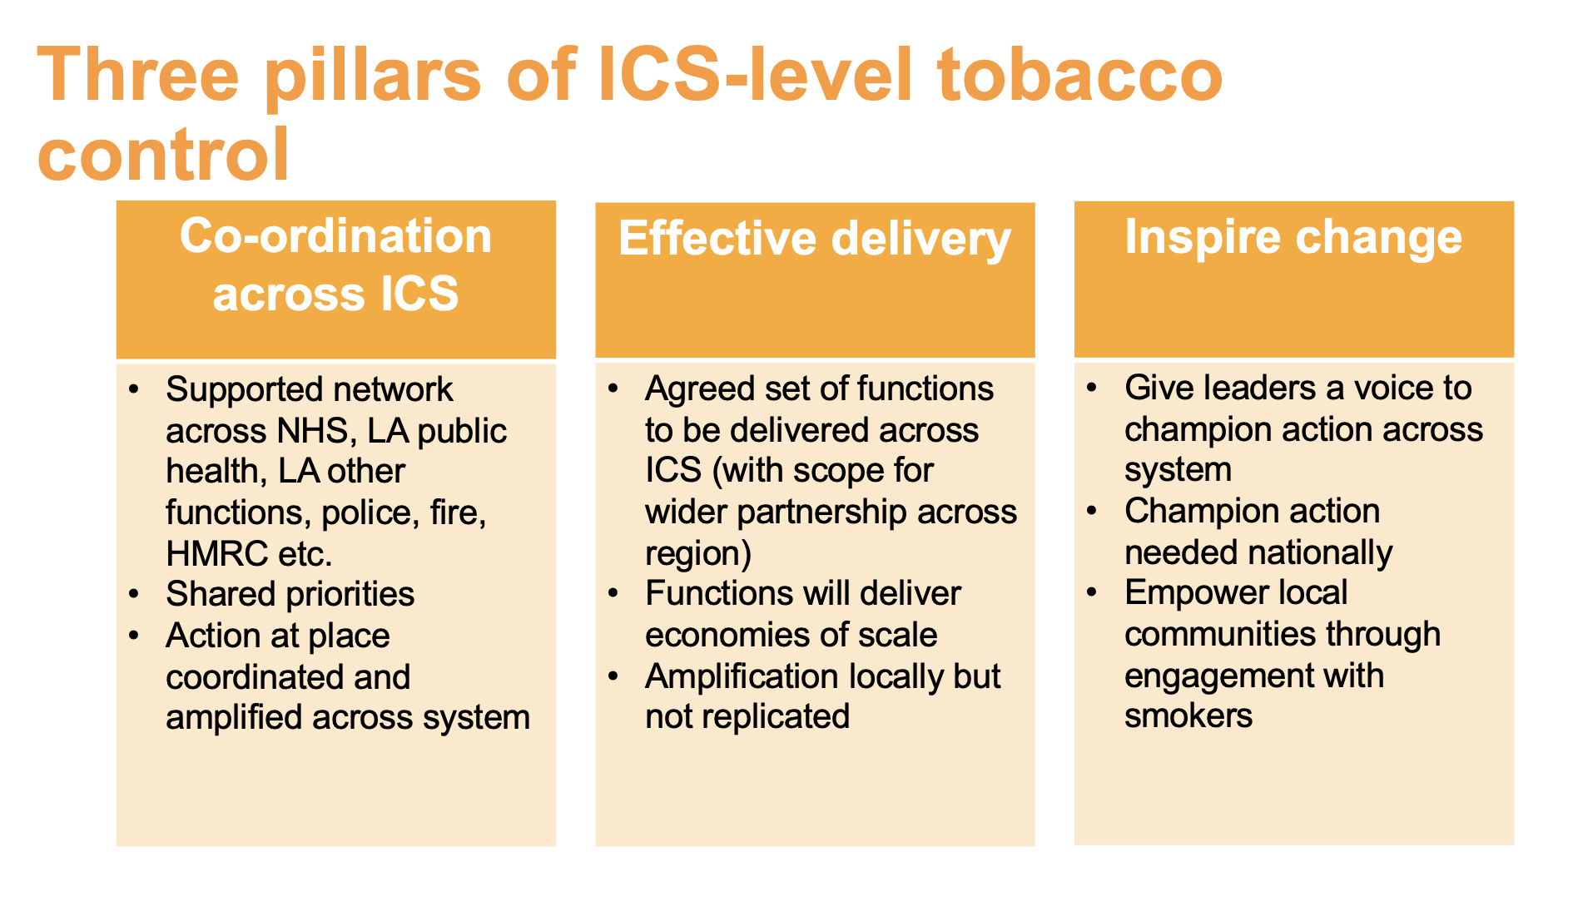
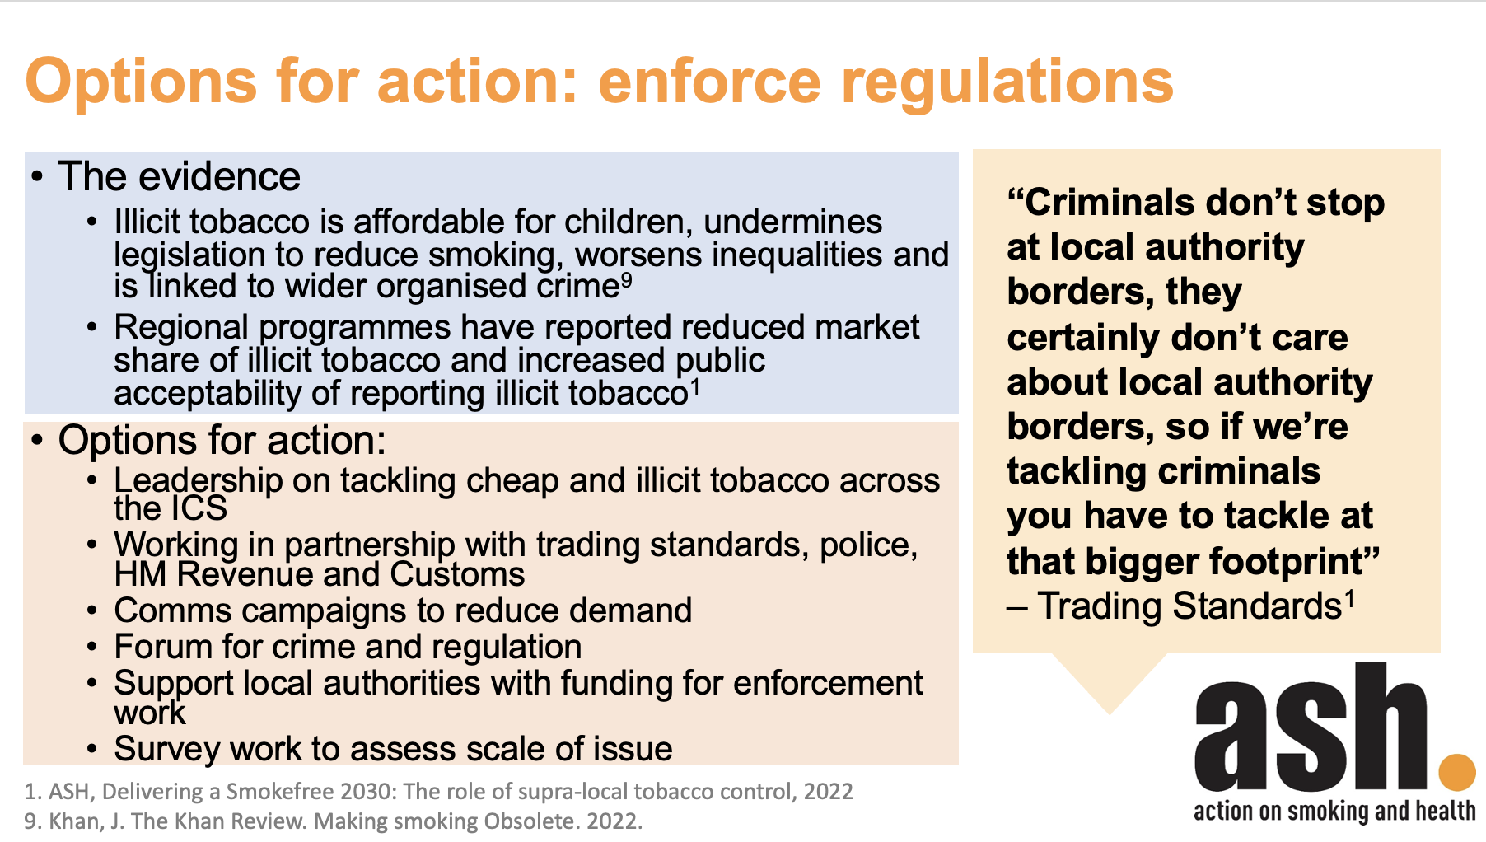
8. Building the strategy slide set
Helps guide strategy development
Provides evidence-based options for action
Covers:
Why ICS level action matters
What should be delivered at ICS level?
How could these work on an ICS footprint
What this looks like in practice
Prioritising funding
Example: Humber and North Yorkshire

Slide 14
9. Fresh strategy slide set
Outlines the strategy for the longest-running gold standard regional programme to help guide strategy development

Slide 15
Thank you

