Slide 1
Addressing the three biggest killers regionally and locally
How can we take a coherent approach to alcohol and unhealthy food and drink, learning from tobacco?

Slide 2
Housekeeping
We encourage all attendees to submit questions and reflections in the meeting chat, to be discussed during the Q&A session
This webinar is being recorded. The recording and slides will be shared online
If you have any issues, please post in the meeting chat

Slide 3
Welcome and introduction

Slide 4
Agenda
Introduction Peter Roderick, Director of Public Health, City of York
Why take a coherent approach? Dr Robyn Burton, University of Stirling
What role do local authorities have? Jilla Burgess-Allen, Director of Public Health, Stockport Metropolitan Borough Council
What role do regions/ICBs have? Dr Nigel Wells, Exec Director of Clinical and Professional, Humber and North Yorkshire ICB
Toolkit for action Caroline Cerny, Deputy Chief Exec and Elaine Londesborough-van Rooyen, Public Health Registrar, ASH
Putting it into practice, case studies for action:
Mobilising communities on childhood obesity in Greater Manchester
Advertising and Sponsorship policy in York
Hot Food Takeaway policy in Hull

Slide 5
Introduction
Peter Roderick, Director of Public Health, City of York

Slide 6
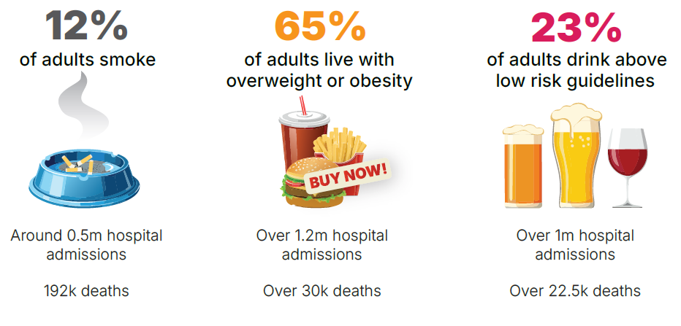
The three biggest killers

Slide 7
Worsening inequalities
Tobacco is responsible for up to half the difference in life expectancy between the highest and lowest sociodemographic groups
Deaths caused by alcohol are twice as high in the most disadvantaged areas
Children from more disadvantaged backgrounds are more likely to be living with overweight and obesity

Slide 8
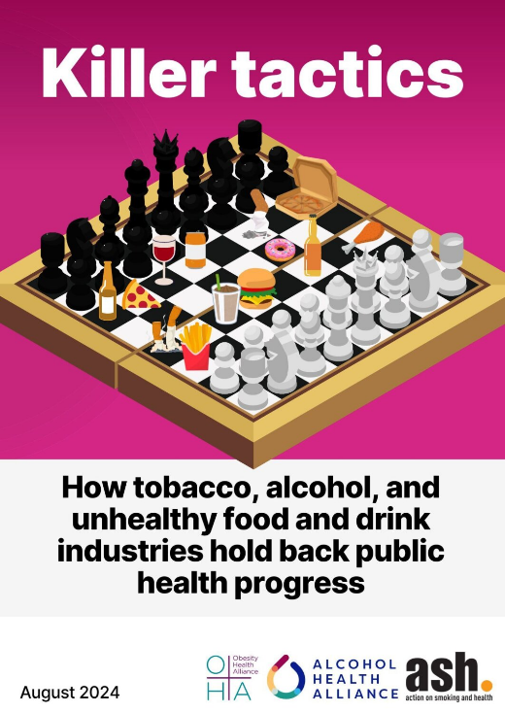
Industries not individuals
Industry ‘playbook’:
Distorting the science and messaging
Discrediting professionals
Legal threats
Positioning as part of the solution
Communicating through proxies
CSR
Industries saturate environments with harmful products and advertising – removing individual choice

Slide 9
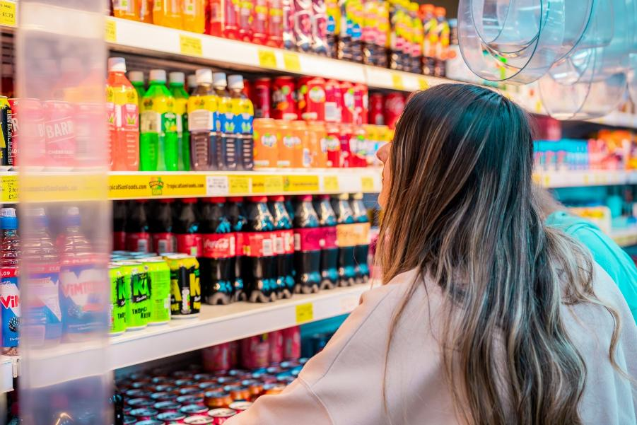
Inequalities in commercial environments
Unhealthy commercial environments, with higher availability of unhealthy food and drink, alcohol and tobacco, cluster in the most disadvantaged areas – compounding inequalities
© 2023. Provided by Impact on Urban Health licensed via a CC BY-NC-ND 4.0 license.

Slide 10
The public are on our side
73% think the government has a role in protecting the public from harmful business practices
74% think that if business and health are in conflict government should prioritise health

Slide 11
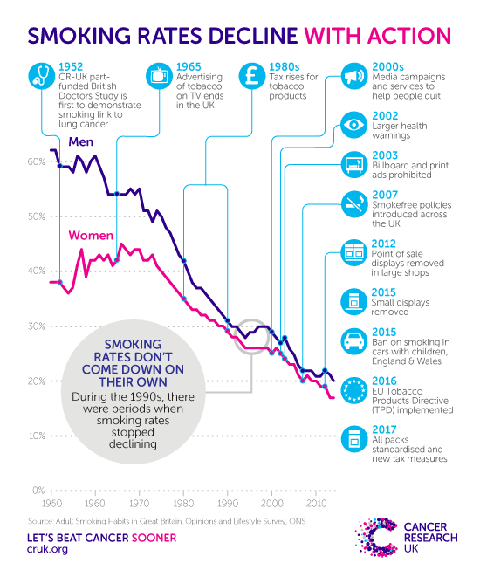
What can we learn from tobacco?
Regulate to reduce:
Affordability
Availability
Promotion

Slide 12
Why take a coherent approach?
Dr Robyn Burton, Senior Research Fellow International Alcohol Policy and Co-Director of the WHO Collaborating Centre on Alcohol Policy and Public Health Research, University of Stirling

Slide 13
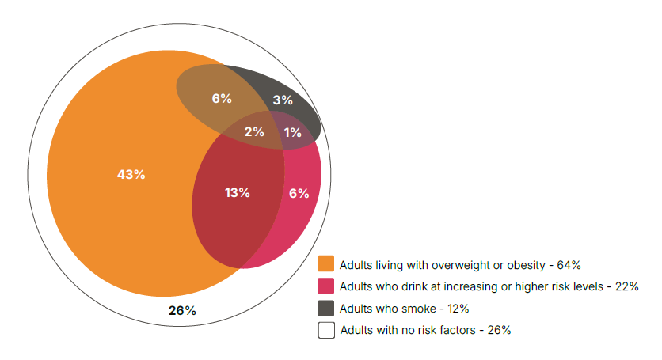
Overlap of risk factors
22% of adults have 1+ risk, eqv. to 10 million adults
5.6m alcohol + excess weight
2.5m excess weight + smoking
0.6m alcohol + smoking
ASH analysis of 2021 Health Survey for England data

Slide 14
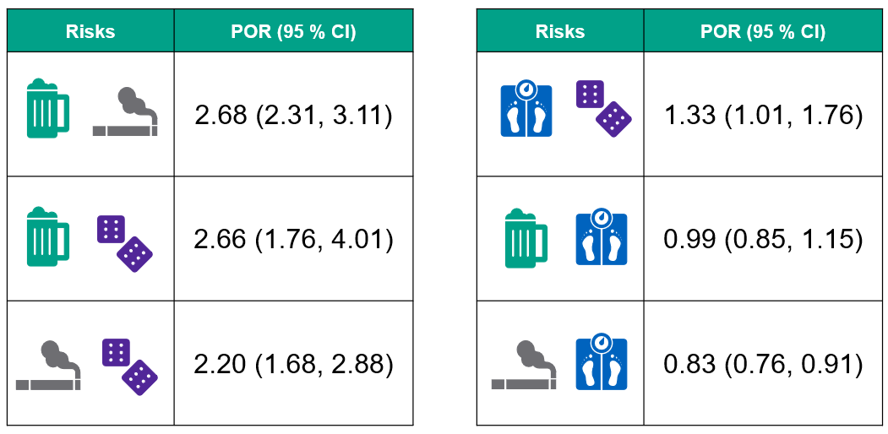
Clustering of multiple risks
Odds of 2+ risks:
Highest among people 45-64 years
Increased with increasing deprivation (IMD quintile, highest level of qualification, unemployment)
Stronger associations in men than women
Age and sex adjusted
Burton et al (2023) The prevalence and clustering of alcohol consumption, gambling, smoking, and excess weight in an English population. Preventive Medicine 175 : 107683

Slide 15
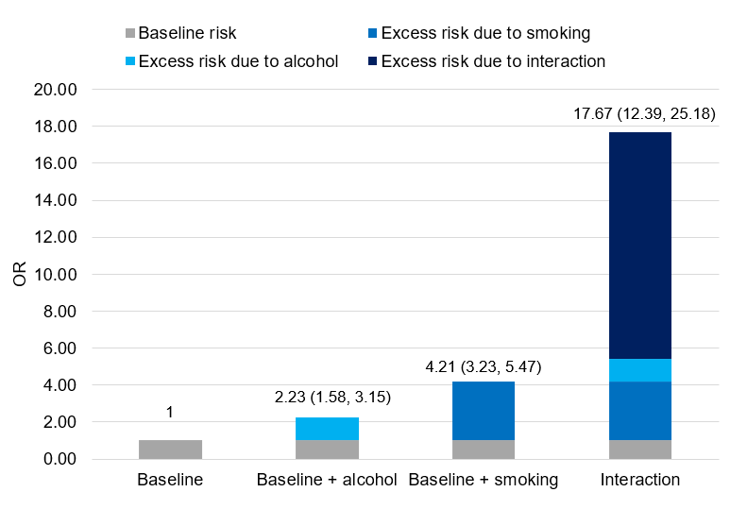
The combined effect of smoking and alcohol on head and neck cancers is 3.8 times greater than the additive effect of each exposure on its own
(n=138,130)
Burton et al (2023) The prevalence and clustering of alcohol consumption, gambling, smoking, and excess weight in an English population. Preventive Medicine 175 : 107683

Slide 16
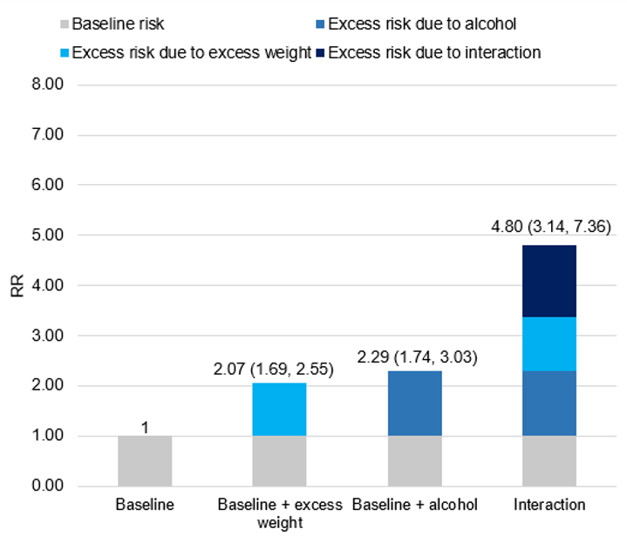
The combined effect of alcohol and excess weight on liver disease was 1.6 times greater than the additive effect of each exposure on its own
(n=2,603,939)
Burton et al (2023) The prevalence and clustering of alcohol consumption, gambling, smoking, and excess weight in an English population. Preventive Medicine 175 : 107683

Slide 17
What is the role of local authorities?
Jilla Burgess-Allen, Director of Public Health, Stockport Metropolitan Borough Council

Slide 18
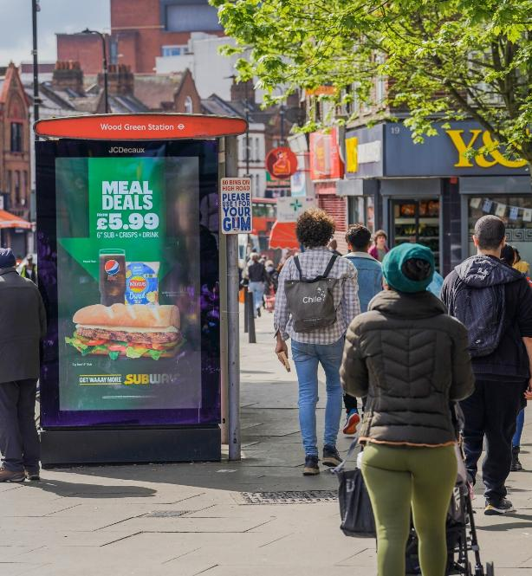
What is the role of local authorities?
Harnessing power of communities and place
Relevant levers such as planning and licensing powers to shape the environment for residents
Connecting in with combined authorities and other regional/supra-local partners
© 2023. Provided by Impact on Urban Health licensed via a CC BY-NC-ND 4.0 license.

Slide 19
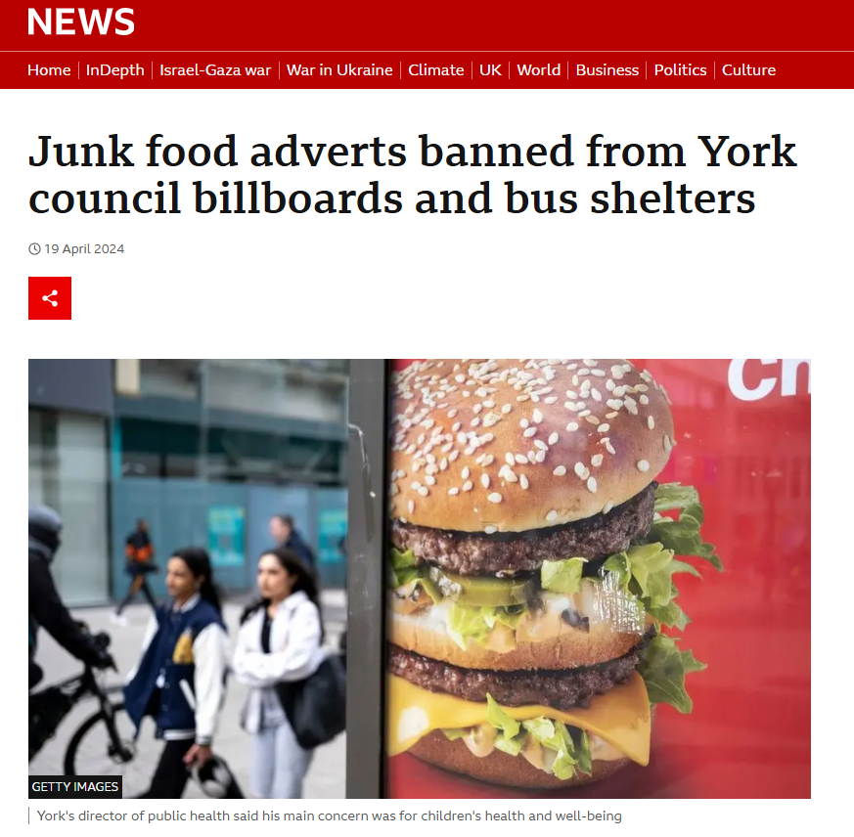
Advocacy and trailblazing
Important trailblazing and advocacy roles
Liverpool going smokefree ahead of national legislation
Advertising bans
Minimum unit pricing advocacy

Slide 20
What is the role of regions/ICBs?
Executive Director of Clinical and Professional, Humber and North Yorkshire ICB

Slide 21
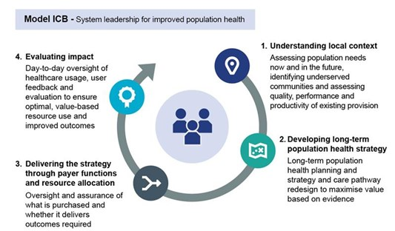
What is the role of regions/ICBs?
From treatment to prevention
Strategic direction and regional coordination
Centre for Excellence model

Slide 22
A Toolkit for Action
Caroline Cerny, Deputy Chief Executive and Elaine Londesborough-van Rooyen, Public Health Registrar, ASH

Slide 23
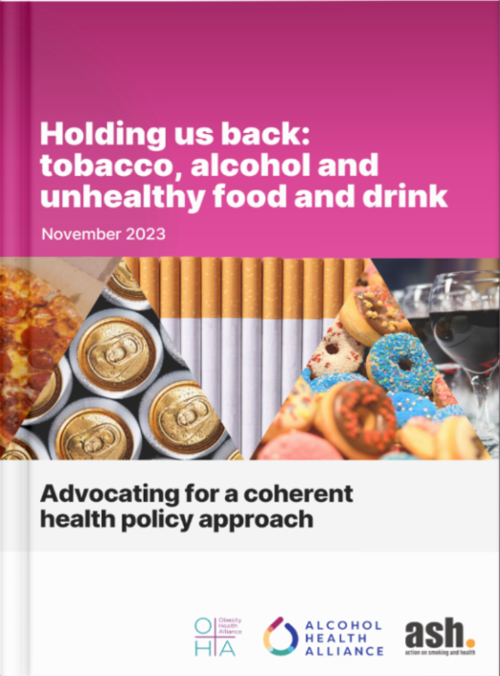
The journey to a toolkit
Holding us Back report (2023)
What would a regional approach look like?
Greater Manchester and Humber and North Yorkshire ICBs commissioned ASH, OHA and AHA to develop a regional approach over the last year
Our new toolkit, produced jointly, gives a practical sense of how regions and local authorities can respond coherently to alcohol and unhealthy food and drink, learning lessons from tobacco

Slide 24
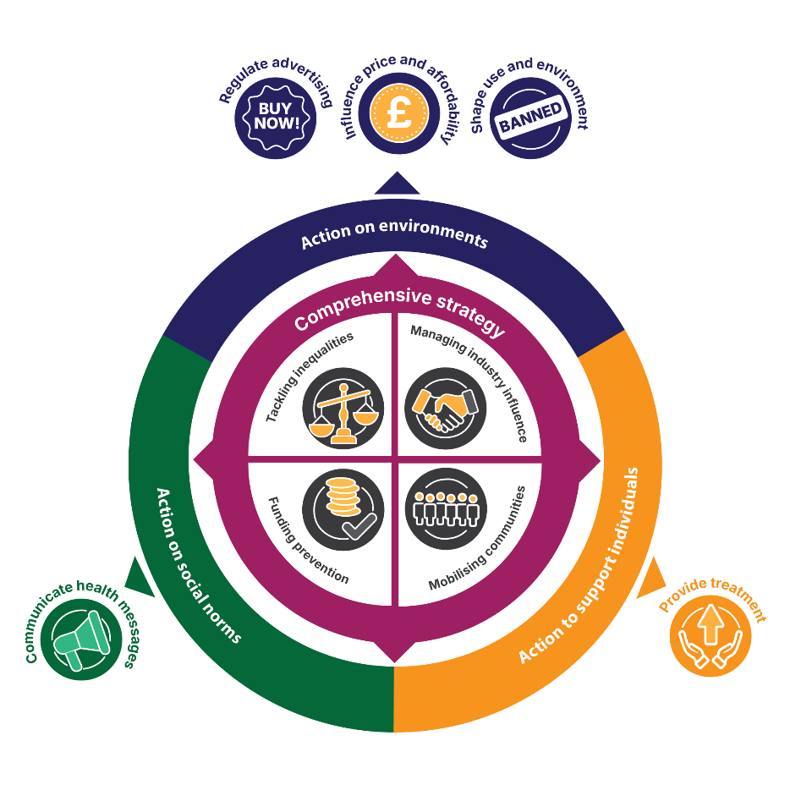
A framework for action

Slide 25
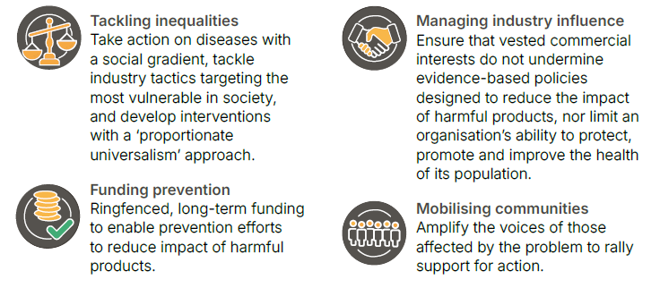
A comprehensive strategy

Slide 26
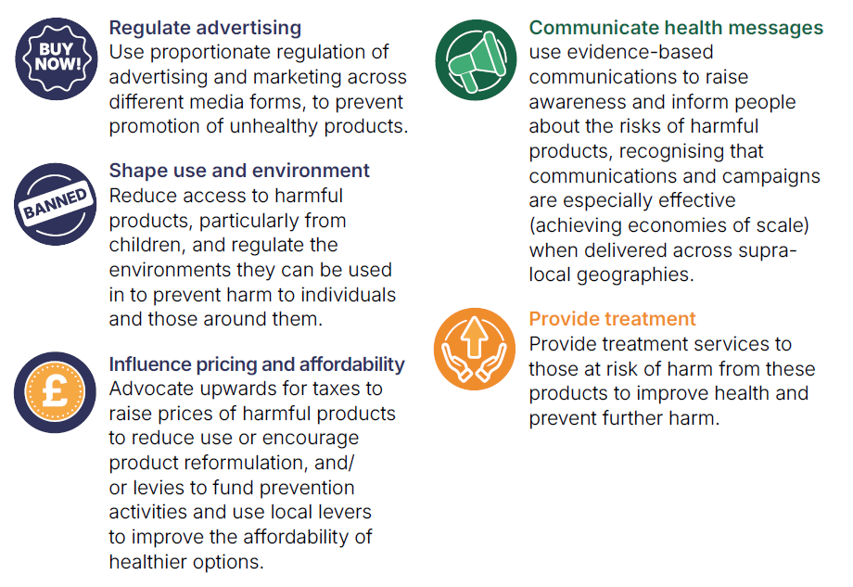
High impact actions

Slide 27
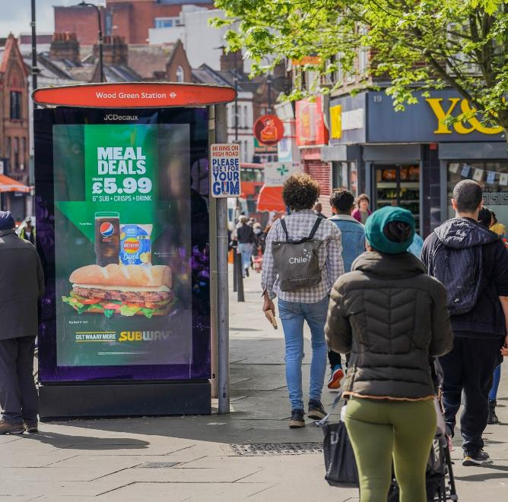
Regulate advertising
Use proportionate regulation of advertising and marketing across different media forms, to prevent promotion of unhealthy products.
Example:
Introduce a healthier advertising policy covering both alcohol and high fat, salt and sugar foods and consider who other harmful products could be included
© 2023. Provided by Impact on Urban Health licensed via a CC BY-NC-ND 4.0 license.

Slide 28
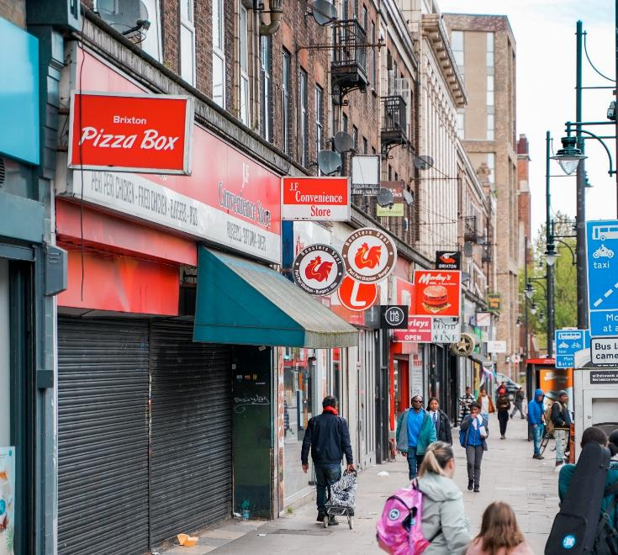
Shape use and environment
Reduce access to harmful products, particularly by children, and regulate the environments they can be used in to prevent harm to individuals and those around them.
Examples:
Use planning powers to restrict hot food takeaways around schools
Use licensing powers to limit opening hours for premises selling alcohol
© 2023. Provided by Impact on Urban Health licensed via a CC BY-NC-ND 4.0 license.

Slide 29
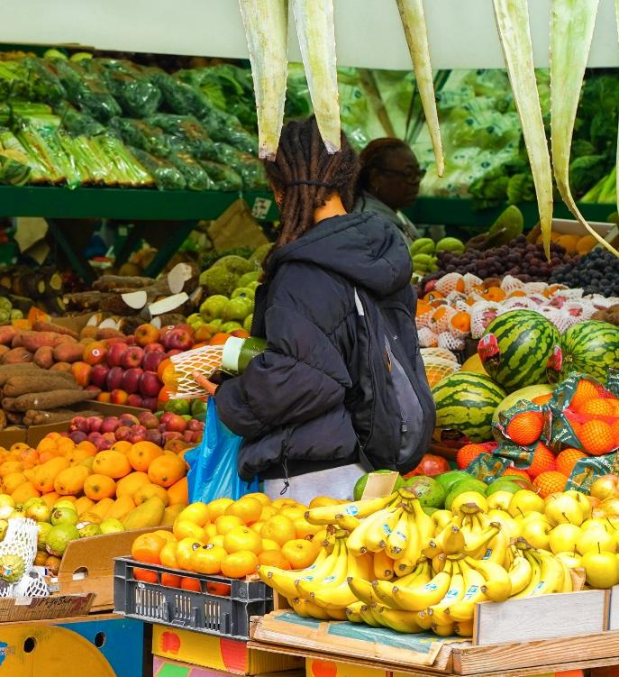
Influence price and affordability
Advocate upwards for taxes and minimum pricing policies to raise prices of harmful products to reduce use or encourage product reformulation, and/or levies to fund prevention activities, and consider actions that reduce the cost of good food for communities.
Examples:
Lobby nationally for minimum unit pricing for alcohol
Introduce auto-enrolment for free school meals
© 2023. Provided by Impact on Urban Health licensed via a CC BY-NC-ND 4.0 license.

Slide 30
Communicate health messages
Use evidence-based communications to raise awareness and inform people about the risks of harmful products, and the benefits of engaging in healthy behaviours.
Example:
Work with communities to spread evidence-based messages about alcohol
Coordinate mass-media campaigns on a regional footprint

Slide 31
Provide treatment
Provide treatment services to those already impacted by harmful products to improve health and prevent further harm.
Example:
Consider how treatment services can provide brief interventions across tobacco and alcohol dependence

Slide 32
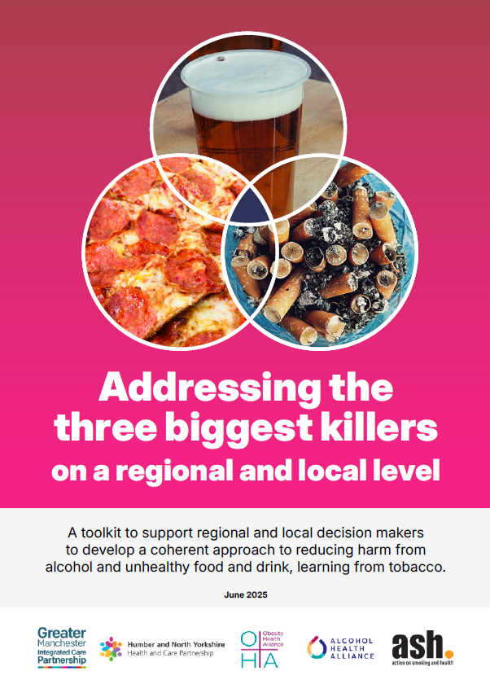
Toolkit contents
Main toolkit document including:
Evidence-based best practice examples
Step-by-step guide to developing your own approach
‘Making the case’ slide deck
Asset and deficit mapping template
Stakeholder mapping template
Case studies from across Greater Manchester and Humber and North Yorkshire

Slide 33
Putting it into practice
Case studies

Slide 34
Putting it into Practice: Community Mobilisation The Real Picture of Childhood Obesity in Greater Manchester
Jessica Holloway, Strategic Lead, Population Health, NHS Greater Manchester

Slide 35
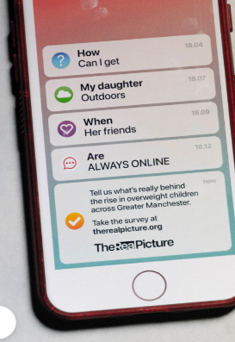
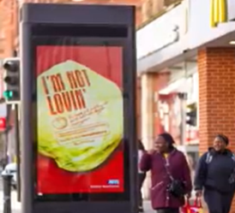
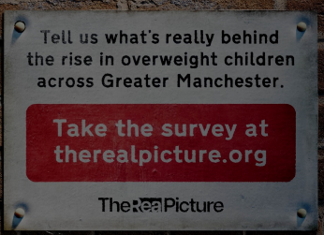
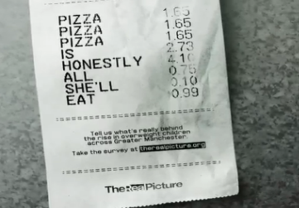
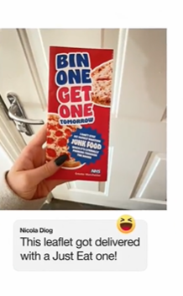
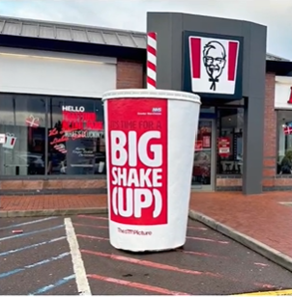
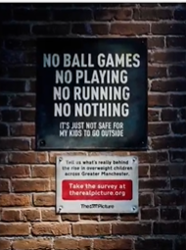
The Real Picture
In response to the rising rates of childhood obesity in Greater Manchester a large public consultation was launched to help explore the real and complex drivers, build public support and work with communities to develop actionable, people-powered solutions.
Through a multi-channel approach—including an online survey, an 8-week digital campaign, grassroots promotion and community driven engagement —we opened a space for honest dialogue with parents, carers, teachers, residents and those with lived experience of childhood obesity.
Public health leads and local councillors amplified the campaign through local media driving strong interest and participation across all 10 boroughs. We also worked with 10GM and VCFSE / community group partners, to bring an offline version of the survey to those who may be digitally excluded.

Slide 36
The Real Picture in Action

Slide 37
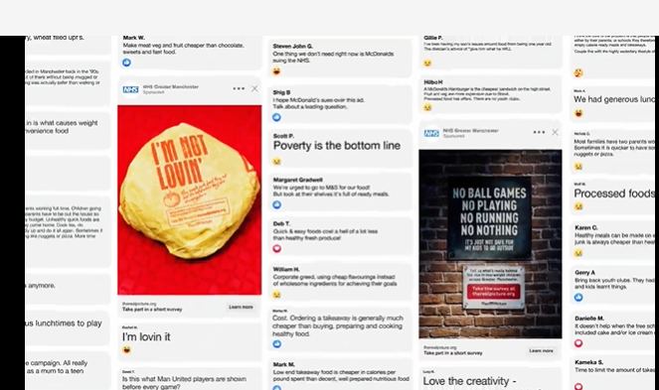
What Did We Find?
10,000 complex, diverse and impassioned perceptions and perspectives.
79% of respondents believed addressing childhood obesity rates should be top or high priority for local authorities and health and care services.
Most are unaware of activity by local authorities and healthcare services being delivered to tackle childhood obesity.
Access to unhealthy food ranked highest contributing factor.
Cheap cost of unhealthy food, digital screentime / sedentary lives, junk food advertising and confusion over the nutritional quality of food ranked top 5 factors behind the rising rates in childhood obesity.

Slide 38
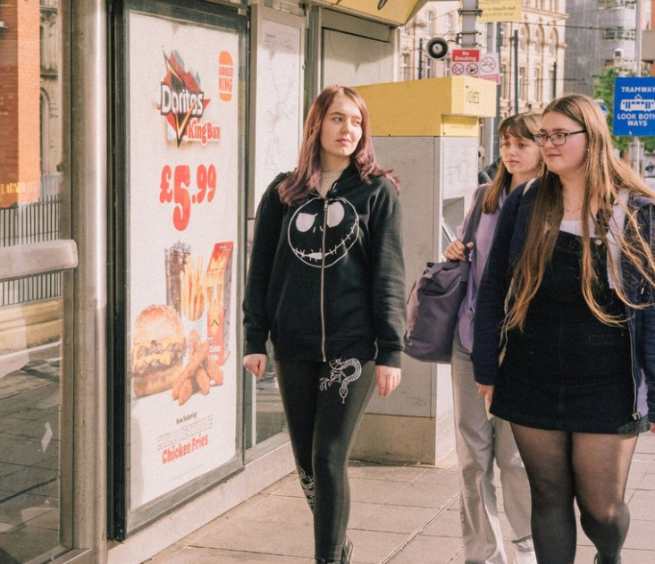
Lessons Learned
1. Get the right people involved from the start
2. Brace yourself for the real talk and the public buzz
3. Timing matters
4. Spotlight your findings where they matter, in ways that count
5. Close the feedback loop

Slide 39
Thank you.

Slide 40
Taking action: the experience of developing and adopting an advertising policy
Phil Truby – Public Health Specialist
E: philip.truby@york.gov.uk
T: 07767 318091

Slide 41
The Headline
In May 2024, City of York Council became the 14th local authority to implement a healthier food advertising policy (and the second in Yorkshire and Humber).
The policy also includes other products within the commercial determinants of health

Slide 42
The Policy
Covers both Advertising and Sponsorship, across the council’s property and public estate.
It details the types of organisations, products and services that are prevented from advertising
It has provision for named organisations and named products and services, although none are detailed at present.
tobacco or tobacco related products
vaping products
nicotine pouches
alcohol
gambling
unhealthy food or drinks defined as high saturate fat, salt and/or sugar (HFSS)
pornography
adult content
cosmetic surgery
loans and speculative financial products
weapons, violence or anti-social behaviour of any description
any product or service which is deemed or perceived to discriminate on the grounds of race, colour, national origin, religion, sexual orientation or disability
https://www.york.gov.uk/AdvertisingAndSponsorshipPolicy

Slide 43
How we got there
A long road, process commenced in 2019, COVID delayed things substantially.
Bus stop advertising contract expiring – provided the impetus
Support from sustain (Fran Bernhardt) – via ADPH Y&H
Building on the experience of those before us, including TfL
Strong leadership from consultant in PH (now our DPH)
Cross-council working – policy, comms and public health
Comms commissioned assessment of advertising potential and policy impact

Slide 44
Challenges
Director level buy-in – “free choice”, “nanny state”, “loss of revenue”
Elected members – especially opposition members
City history – “Chocolate story”
Ongoing – implementation and monitoring

Slide 45
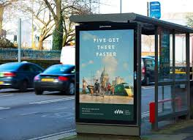
Implementation
York doesn’t have an abundance of billboard or digital screen advertising, bus stops are the main source of revenue.
Contract has moved from JCD to Clear Channel from 1 Jan 2025 – transition underway, including physical bus stops, fully in place by Dec 2025.
This poses a challenge as JCD out of contract, but still selling advertising (and not currently complying with the new policy).
Bus stop contract monitoring (!!) and new contracts.
Continuous review – categories, products, companies.
Evidence base vs. “right thing to do”

Slide 46
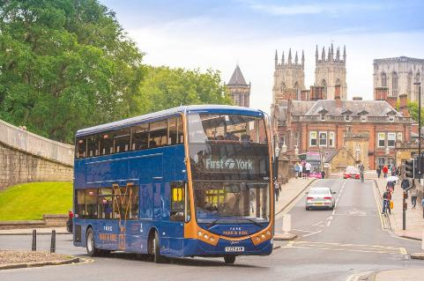
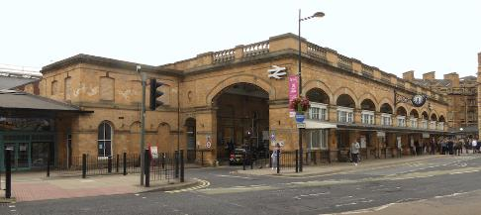
Next Steps
On bus advertising – First Buses main provider
Train station – LNER managed
HE/FE – 1 large college, 2 universities

Slide 47
Hull’s Hot Food Takeaway Policy
Joanne Arro
Public Health, Hull City Council

Slide 48
Hull’s Hot Food Takeaway Policy
The Hull Picture
About 70% adults in Hull are living with excess weight compared to 64% in England.
Children 2023/24
26.4 % of reception children in Hull are living with excess weight compared to 21.3% in England. Almost 1 in 4.
42.2% of year 6 children in Hull are living with excess weight compared to 36.6% in England. 4 in 10.

Slide 49
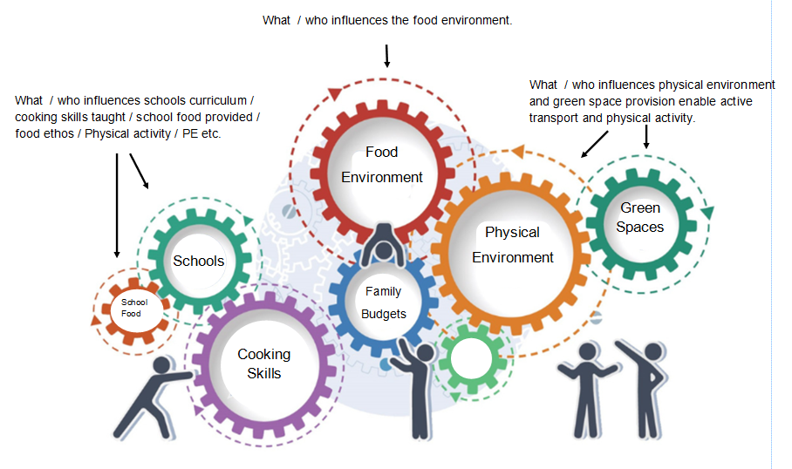
Hull’s Hot Food Takeaway Policy
Whole System Approach – Cogs & Levers

Slide 50
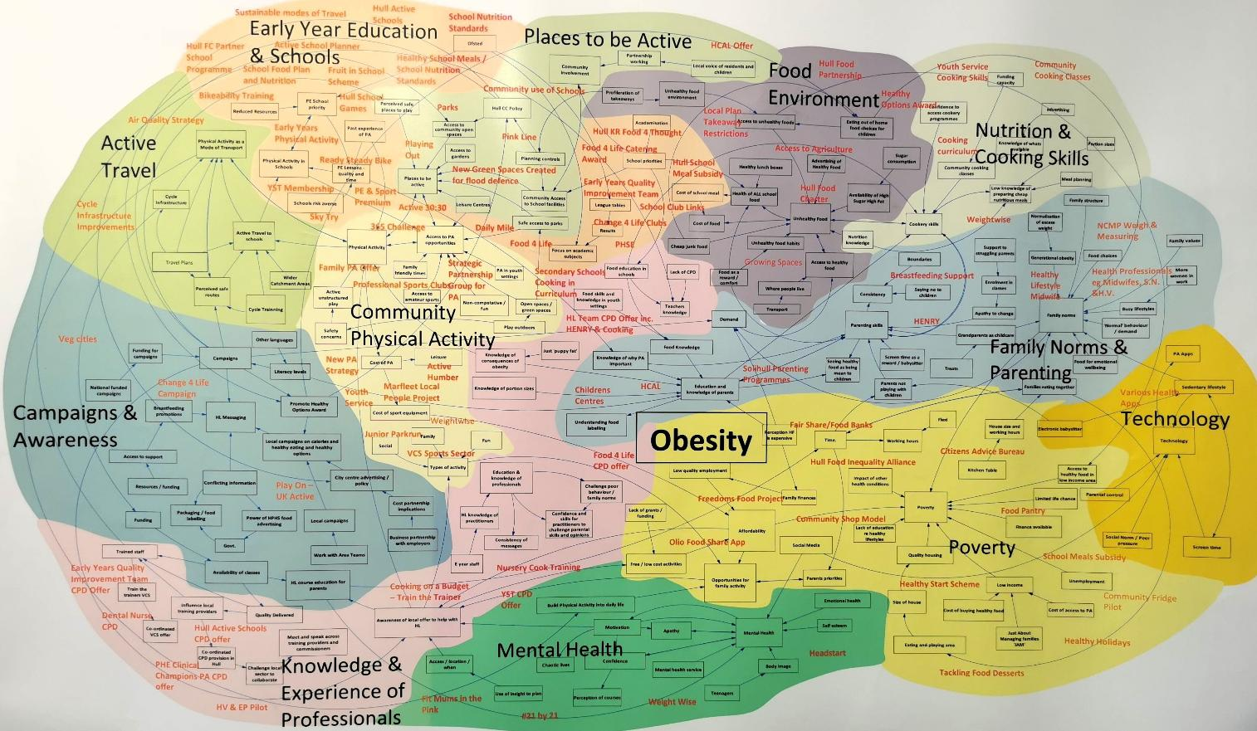
Hull’s Hot Food Takeaway Policy
Hull’s Whole System Healthy Weight Map

Slide 51
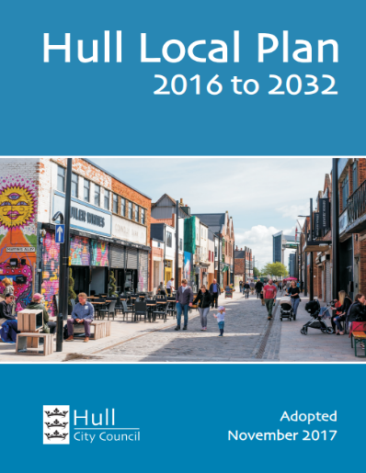
Hot Food Takeaway Policy
As part of our Whole-system Approach to Healthy Weight Hull City Council included the following policies in its Local Plan (2016) to restrict the number of new takeaways: -
Development to accommodate hot food takeaway (A5) use will not be supported in local or neighbourhood centres where a threshold of 20% of all units would be or has already been reached, to prevent over proliferation where this could undermine objectives to promote healthy eating in the city.
Development to accommodate hot food takeaway (A5) use will not normally be supported within 400m of a secondary school or sixth form college or playing fields.
Evaluation results show that in 2016 Hull had 302 HFT in the city and in 2023, 6 years later it had 259 (43 less).

Slide 52
Hull’s Hot Food Takeaway Policy
Challenges and Next Steps
Levers in Planning:
Are all HFT selling High Fat Salt Sugar Food (HFSS)
Other food outlets that aren’t covered
Balancing outlets selling healthier food
Challenges to the Policy
New National Policy Planning Framework (NPPF) Dec 2024
Paragraph 97 says that ‘planning authorities should refuse applications for hot food takeaways and fast food outlets:
a) within walking distance of schools and other places young people meet, unless the location is in a designated town centre: or
b) locations where there is evidence that a concentration of such uses is having an adverse impact on local health, pollution or anti-social behaviour.’

Slide 53
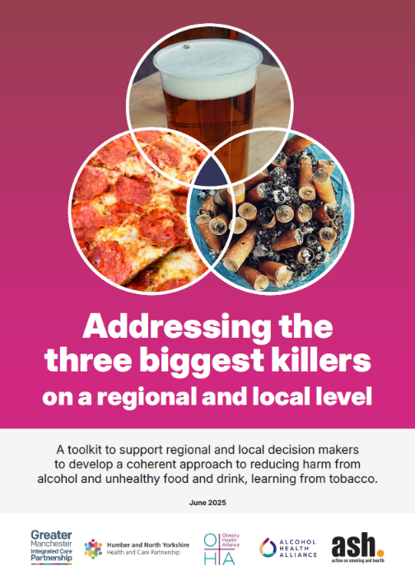
Wrap-up and next steps
Toolkit launches today
Please get in touch if you have case studies to add
Working on how to take it forward in Greater Manchester and Humber and North Yorkshire
We encourage you to do the same!

Slide 54
Q&A

