Slide 1
Swap to Stop Evaluation – selected findings
Policy Research Unit in Addictions
Professor Leonie Brose
October 2028

Slide 2
Background

Slide 3
Vapes (e-cigarettes) for smoking cessation
Vapes
  Work better than NRT
  Are similarly effective as prescription med but used much more often, so help more people stop smoking
NICE guideline NG209
  Ensure vapes accessible to adults who smoke
  Advise vapes among the options more likely to result in success
Jackson et al (2019) https://doi.org/10.1111/add.14656
NHS Digital (2025) https://digital.nhs.uk/data-and-information/publications/statistical/statistics-on-nhs-stop-smoking-services-in-england
Lindson et al (2024) https://doi.org/10.1002/14651858.CD010216.pub8
https://www.nice.org.uk/guidance/ng209

Slide 4
Swap to stop scheme to support smoking cessation
Aim
Reach almost 1 in 5 who smoke in England
Delivery
Choice of vapes or vouchers to local authorities and partnerships
Provided alongside behavioural support
Locally defined priority populations
Timeline
First announced April 2023
Live approximately from January 2024 to April 2026
No national campaign or branding

Slide 5
Findings – Process
How was Swap to Stop implemented?

Slide 6
Methods
Smoking Toolkit Study - adults each month in GB, who smoked or recently stopped, Jan to Dec 2024
Information from applications (Expressions of interest)
Summary of training data from National Centre for Smoking Cessation and Training (NCSCT)
Survey data
International Tobacco Control Policy Evaluation Project Survey (ITC 4CV) - adults in England who smoked or recently stopped, Jun to Oct 2024
From October 2023 to October 2024
Semi-structured interviews with 19 commissioners, 35 staff and 19 service users in a range of settings
Interviews
Training data

Slide 7
How did commissioners and staff experience the set up and implementation of Swap to Stop?
Ambitious national vision and alignment with smoking policy
Existing infrastructure (where available) facilitated implementation
Rapid implementation created challenges
Trusted central procurement platform
Flexible delivery mechanisms
"Like people were left to their own devices and I can understand you want innovation, but at the same time then there didn't seem to be any major guidance like actually if we're spending and investing so much resource.”
“…building the plane on the runway and screwing on the fuselage in midair…”
Sawyer et al, in prep

Slide 8
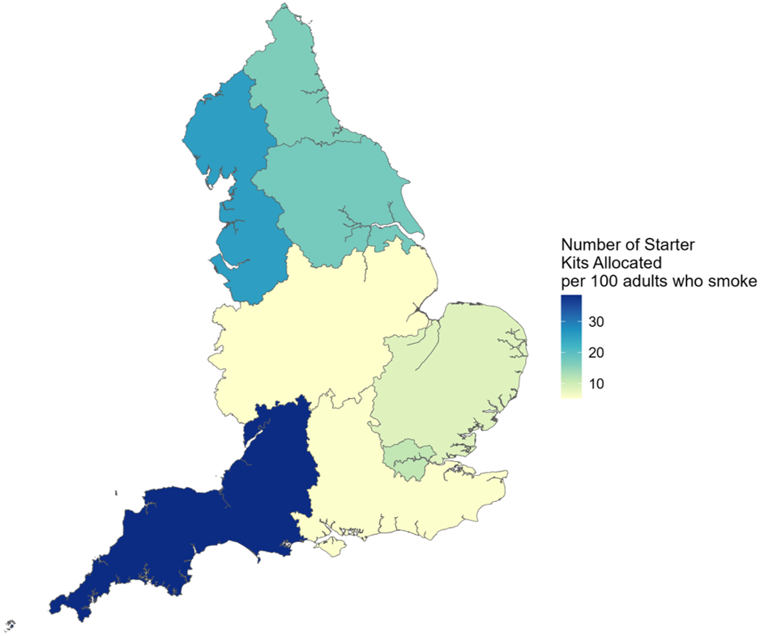
Uptake and proposed delivery
Government support encouraged LAs’ participation, the process was easy, concerns about short-term funding led to rushed applications
Areas often submitted multiple bids, starting small, scaling up, demand sometimes misjudged
Lack of national communications led to some cautious, inconsistent promotion
Sawyer et al, in prep; Moore et al, 2026

Slide 9
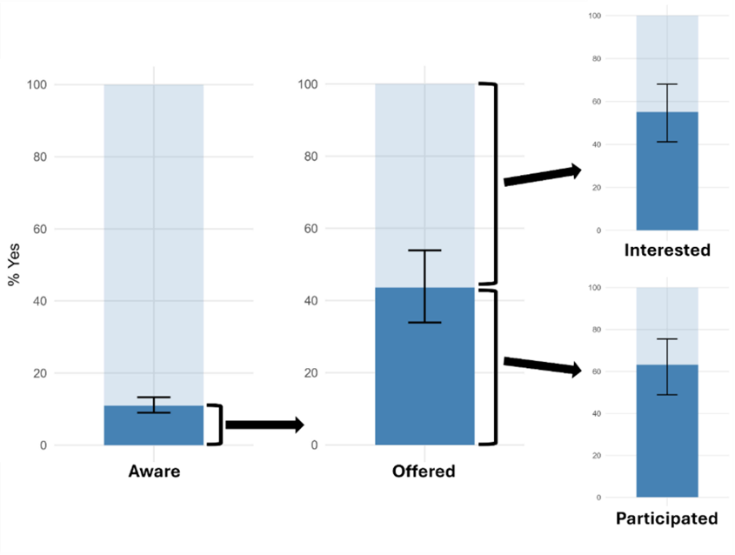
Awareness, participation and interest
Level of awareness reported in surveys not high enough to reach 1 in 5 of all who smoke
Higher awareness among those more dependent on smoking and higher use of vapes for smoking cessation indicate some success in reaching the target population
Household surveys miss many people experiencing disadvantage
Additional efforts needed to increase awareness among priority groups experiencing more disadvantages
Skumlien et al, 2026

Slide 10
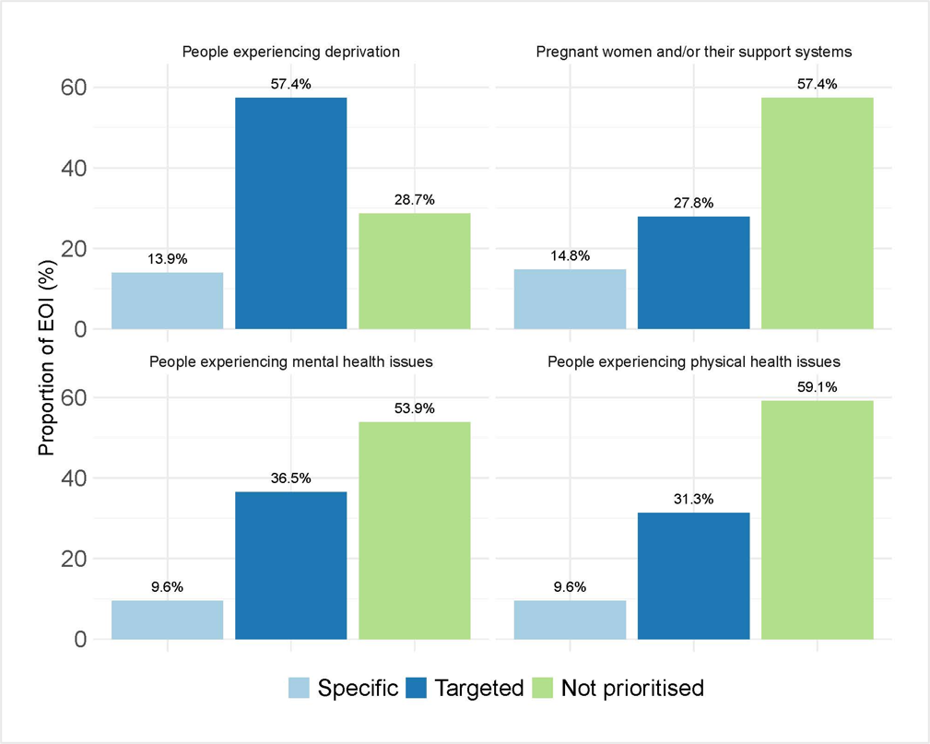
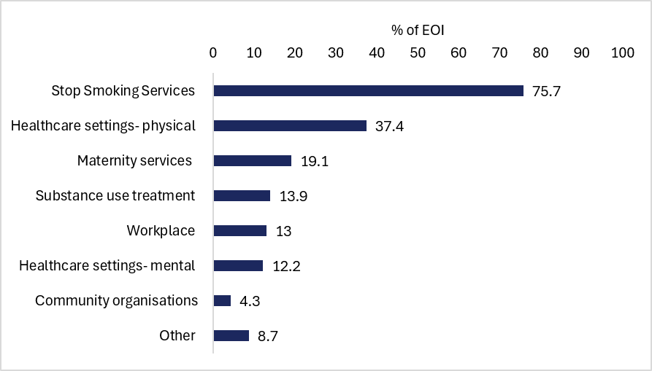
Reaching priority populations
Percentage of 115 applications planning ‘specific’ services (only available to certain populations) or ‘targeted’ services (accessible to all but with stated focus)
Planned delivery routes (early-ish applications)
Moore et al, 2026

Slide 11
Views on type and length of support
Overall, Swap to Stop was delivered as a package combining free vape provision with behavioural support, often for 12 weeks
Well received by service users, with high perceived helpfulness and acceptability of devices.
Flexibility in device choice and delivery supported engagement and transition from smoking.
Views on the optimal duration of support varied, reflecting a balance between resource constraints and the need for sustained, tailored support, particularly for individuals with higher dependence or more complex needs.
Sawyer et al, in prep

Slide 12
Staff training
E-learning module taken up quickly across employer types, job roles, regions and LAs in England
Viewed as helpful and improved staff confidence
LAs often developed additional resources and highlighted need for ongoing training
Training important for addressing vaping misperceptions

Slide 13
Findings – Impact
What difference did Swap to Stop make?

Slide 14
Methods
Survey data
NHS Digital routine monitoring data on stop smoking services
Episode-level data from 23 local authorities

Slide 15
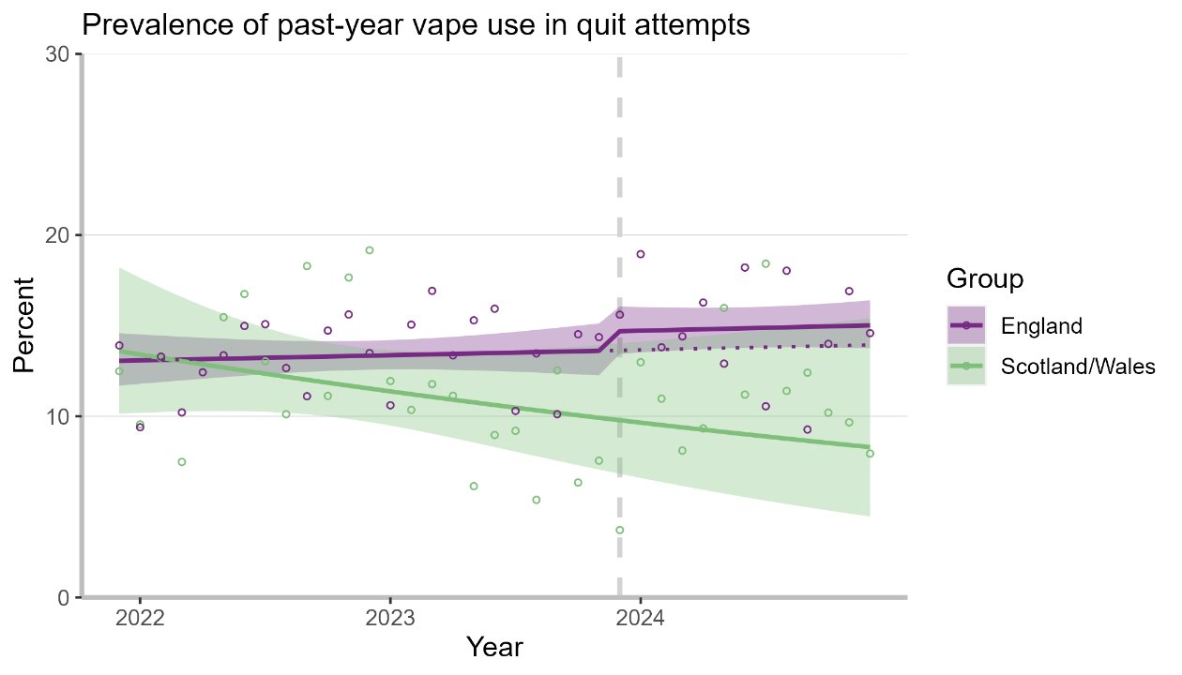
Did the type of support used for smoking cessation change with Swap to Stop?
Smoking Toolkit Study: Monthly survey England Dec 2021-Dec 2024
Introduction of Swap to Stop in December 2023 associated with a 1.5 absolute percentage point increase in the proportion of people in England using vapes in past-year quit attempts that persisted to December 2024
Equates to roughly 125,000 additional quit attempts using vapes which may be attributable to Swap to Stop
Statistical comparison with Scotland/Wales not possible because they were already on a different trajectory
Prevalence of vape use in past-year smoking cessation attempts in adults who smoked in the past year.

Slide 16
Type of support - Service monitoring data
Proportion of episodes using different types of support April 2020 to December 2025; NHS Digital Quarterly Returns.
Substantial and sustained increase in vapes: around 20% in 2023/24 to around 30% in 2024/25.
Proportion of LAs not providing vapes at all declined sharply from over 20% in 2020/21 and 2021/22 to 1-2% in 2024/25 and 2025/26

Slide 17
Has there been a change in the service user population seen by stop smoking services?
While the largest proportion of service users continues to come from routine and manual occupations, this proportion has been declining over time from 28.6% in 2020/21 Q1 to 19.5% in 2025/26 Q3
No indication of a reversal since the start of Swap to Stop.

Slide 18
Did people who used vapes stop smoking?
In routine monitoring data, vapes, NRT and prescription medication have similar rates of short-term smoking cessation success.
Accounting for other factors that predict cessation, each type of support was associated with increased chances of success compared with not using the support

Slide 19
Which swap to stop clients stopped smoking?
Cessation more likely
Older Swap to Stop services users (45-59 or 60+ versus 18-34)
Swap to Stop smoking cessation did not differ by gender or area deprivation or employment in routine and manual occupations
Those smoking less heavily (10 CPD)
Cessation less likely
Those who had never worked or had been unemployed for over a year, were unable to work, or had unknown occupation status than those in managerial/professional or intermediate occupations.
Cessation equally likely
Service users from other/unknown ethnicities compared with white ethnicities
Challenges around the recording of the data
May underestimate smoking cessation rates
Priority populations were engaged settings often outside established reporting systems
Lack of guidance, systems varied considerably, difficulty obtaining follow up data

Slide 20
Recommendations

Slide 21
Recommendations 1-5
Maintain and expand simple, trusted procurement systems with low-cost, approved products.
Continue providing a choice of vape devices and liquids, flexibility in delivery, and ongoing troubleshooting support to maximise acceptability and engagement. Behavioural support should be tailored to individual needs, recognising that the type and duration of support required to achieve smoking cessation may vary between participants.
Continue to embed smoking cessation support within trusted services and priority population settings, particularly those serving people experiencing deprivation, homelessness, mental health conditions, other and multiple health inequalities.
Invest in workforce development by providing regular training and refresher sessions and ensuring that staff across a wide range of services are equipped to support smoking cessation. Training should be flexible and proportionate to staff roles, expertise, and level of involvement in smoking cessation support.
Continue routinely offering vapes alongside behavioural support as part of standard stop smoking support. Support organisational culture change where needed to integrate vaping as an option for smoking cessation.

Slide 22

Recommendations 6 - 10
Improve targeting and equity.
Strengthen awareness and communication to address vaping misperceptions.
Improve monitoring and evaluation.
Consider flexibility in outcome measures.
Ensure long-term sustainability and planning.
Develop vaping cessation pathways. Establish clear guidance and support for vaping cessation as the evidence base develops, while ensuring quitting vaping does not increase relapse to smoking.
Full report: kclpure.kcl.ac.uk/ws/portalfiles/portal/390540538/NIHR_PRU_Swap_to_Stop_Evaluation.pdf
Or scan the QR code at the top

Slide 23
Publications from this evaluation
Out
Brose LS, Buss V, Brown J, McNeill A, Simonavičius E (2026). Awareness of a national initiative to provide free vapes for smoking cessation (Swap to Stop): a survey of adults in England. Nicotine & Tobacco Research, doi.org/10.1093/ntr/ntag077
Buss VH, Beard E, Shahab L, Simonavičius E, Bauld L, Brown J, Brose L (2026). Associations between the national ‘Swap to Stop’ programme offering free vapes for smoking cessation and quit attempts in England: results from a population-based survey. Addiction, 121(6), doi.org/10.1111/add.70332
Moore E, Gillespie D, Simonavičius E, Brose L (2026). Early insights from a national scheme providing vaping devices for smoking cessation. Addiction, doi.org/10.1111/add.70462
Simonavicius E, McNeill A, Gillespie D, Moore E, Brown J, Buss V, Gregory A, Brose L (2025). Mixed methods evaluation of ‘Swap to Stop’, osf.io/bzex2/
Skumlien M, East K, Simonavičius E, Hyland A, Fong GT, Li G, Quah ACK, Boudreau C, McNeill A, Brose L (under review). Awareness and use of a free vapes programme for smoking cessation in England. BMC Public Health (2026). doi.org/10.1186/s12889-026-28769-0
In prep
Brose, L, Soar K. Free vapes for smoking cessation and smoking outcomes: an analysis of routinely collected stop smoking service data.
Sawyer K, Jennings S, Skumlien M, De Oliveira JPW, Simonavičius E, Walsh H, McNeill A, Brose L. Evaluating the ‘Swap to Stop’ initiative to provide free nicotine vapes for smoking cessation: a qualitative analysis of commissioners, staff and service users’ perspectives and experiences
Sawyer K, East K, Skumlien M, D’Mello K, Dhungel B, Yong H, Borland R, Gartner C, Cummings M, Hyland A, Fong G, McNeill A, Brose L. Trends in vaping harm perceptions in Australia, Canada, England and United States: Findings from the ITC4 Country Smoking and Vaping Survey (2016-2024)

