Slide 1
The Three Biggest Killers -
Stakeholder mapping and analysis
A template to support you in developing your own approach

Slide 2
Stakeholder Mapping
Stakeholders can be found across the system at different levels:
Regional level (e.g DHSC region)
Supra-local or system-level (e.g ICB or Combined Authority)
Local or place-level (e.g Local Authority)
The roles of the key stakeholders for this project should be mapped according to these different levels and in the context of their relevance to the topic area (harmful products).

Slide 3
Stakeholder Analysis
To inform how stakeholders are managed for this project, they can be classified in three tiers across the system, as follows:
Tier 1: Key stakeholders within a public health sphere of influence e.g. ICB leads, DPHs, local authority topic leads (or equivalent).
Tier 2: Stakeholders who need to be engaged with the purpose of the project during the development phase, so they can be supportive at launch (likely outside of public health).
Tier 3: Political and senior organisational stakeholders who will need to facilitate eventual action (e.g. budget holders, people with ‘sign-off’ powers).

Slide 4
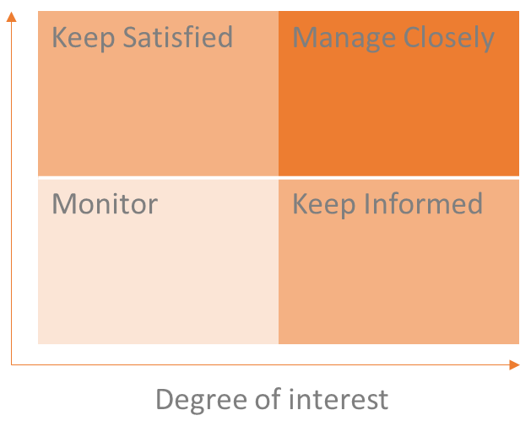
Stakeholder management
Depending on the degree of power and interest a stakeholder has they can be managed in different ways:
Manage closely – aim to get them on side, and keep closely involved throughout.
Keep satisfied – keep closely enough informed and on side such that power can be harnessed if needed.
Keep informed – keep updated on key progress, recognising value of their input.
Monitor (minimum effort) – keep loosely informed.

Slide 5
Regional stakeholder mapping
Below is an example of a map for regional partners. You should undertake your own mapping process to define this for your area.
Programme managers alcohol/obesity
Knowledge and intelligence colleagues
OHID
Other regions (for collaboration and learning)
Regional partners
ADPH
Relevant ADPH network leads for alcohol/obesity/
inequalities
Academics
Businesses/
‘industry’

Slide 6
Regional stakeholder analysis example
Stakeholder Role | Tier | Estimated reaction to project | Management Approach | Justification
OHID Programme Manager(s) | 1 | Positive | Keep informed | High degree of interest in harmful products, likely to have high degree of interest with the project, core public health ideology, expert/referent/informational power.
Leads in other regional programmes | 1 | Positive | Keep informed | High degree of interest in harmful products, specialist public health knowledge and ideology, expert/referent power outside of the region.
Academics (regional) | 2 | Positive | Keep informed | Relevant academics likely to have a high degree of interest and expert power (perhaps informational power too).
Businesses | 2 | Neutral/ Negative | Keep satisfied | High degree of interest in harmful products, but likely to have low interest in the project, will not be driven ideologically by population health, reward/coercive power.
Businesses (with malign motives) | n/a | Negative | System partners to consider | High degree of interest in harmful products, may be interested in the project for malign reasons, driven by corporate motives, reward/coercive power.
Regional ADPH colleagues | 1 | Positive | Keep informed | High degree of interest in harmful products across both regions, core public health ideology, expert/referent/informational power.

Slide 7
Supra-local stakeholder mapping
Below is an example of a map for supra-local partners. You should undertake your own mapping process to define this for your area.
Collaboratives, alliances etc.
Chair/lead
Place-based partnerships
Data leads
Comms
Public health colleagues
Academics
Integrated Care System (ICB/ICP)
Combined authorities
Supra-local partners
ICB/ICP chairs
Workstreams
Clinical leads/
clinicians
Relevant boards
Mayor
Acute Trusts
NHS
Mental Health Providers
Provider collaboratives (chair)
Businesses/
‘industry’
Ambulance Trusts
Board chair and chief exec

Slide 8
Supra-local stakeholder analysis example
Stakeholder Role | Tier | Estimated reaction to project | Management Approach | Justification
Local MPs | 3 | Unknown (should seek to determine) | Keep satisfied | Degree of interest will vary depending on the individual MP, their personal experiences and political ideology. Legitimate/referent power.
Educational colleagues | 2 | Neutral | Monitor | Likely to have a low degree of interest, expert power (lack of direct relevance).
Police | 2 | Neutral | Monitor | Likely to have a low degree of interest, legitimate/coercive power.
Primary care network clinical leads | 3 | Positive/ neutral | Keep satisfied | Likely to have a high degree of interest around the clinical outcomes related to harmful products, unlikely to have a core public health ideology or population health focus, legitimate/referent power.
VCSE colleagues | 1/2 | Positive/ neutral | Monitor | May have interest in harmful products and around the clinical outcomes (depending on the organisation), unlikely to have a core public health ideology or population health focus, expert/referent power.

Slide 9
Local stakeholder mapping
Below is an example of a map for local partners. You should undertake your own mapping process to define this for your area.
Public health team
Topic Leads (or equivalent)
Health and Wellbeing Board (chair)
Councillors (portfolio holders)
Academics
Local MPs
Relevant boards
DPH
Educational settings
Local authority
Comms
Police
Data/
intelligence leads
Anchor institutions
Relevant teams
Clinical leads
‘Place’ partners
Trading standards.
Environmental health.
Planning.
Licensing.
Transport.
Housing.
Early years/education.
Regeneration.
Community safety.
Estates.
VCSE
Community service providers
PCNs
Cultural venues
Local businesses/
employers
Sport and leisure
Lived experience
Citizens Advice
Healthwatch
Community champions
‘Industry’

Slide 10
Supra-local stakeholder analysis example
Stakeholder Role | Tier | Estimated reaction to project | Management Approach | Justification
Mayor (combined authority) | 3 | Positive | Keep satisfied | May have some interest in the topic area (likely more interest in GM due to devolved responsibility around health), ideology around public health will depend on political leanings, legitimate/referent power.
Combined authority colleagues (relevant to public health) | 1/3 | Positive | Keep informed | High degree of interest in harmful products, likely to have high degree of interest with the project, core public health ideology, expert/referent power.
Place-based partnership leads | 1 | Positive | Manage closely | Likely to have a high degree of interest in harmful products and likely to be interested in the project, may have core public health ideology, legitimate/expert/referent power.
Acute trust (senior management colleagues) | 3 | Neutral | Keep satisfied | Likely to have a high degree of interest around the clinical outcomes related to harmful products, unlikely to have a core public health ideology or population health focus, legitimate/referent power.
Clinicians | 2 | Neutral | Monitor | Likely to have a high degree of interest around the clinical outcomes related to harmful products, unlikely to have a core public health ideology or population health focus, expert (clinical) power.

Slide 11
Stakeholder map
Keep Satisfied | Manage Closely
Monitor | Keep Informed
Degree of power
Degree of interest
Notes:
Use this as a template to map stakeholders.

