Slide 1




Smoking cessation incentives
Pilot scheme for priority groups
Ben Arnold: Public Health, Sheffield City Council
Duncan Gillespie, Nick Woodrow, Joe Hullin: Sheffield Centre for Health and Related Research, University of Sheffield

Slide 2
Background
Purpose
To provide additional motivation for our most vulnerable smokers in high prevalence groups (priority groups) to engage with smoking cessation support and successfully quit.
Scheme approval and funding
Approval: discussed at Sheffield City Council’s Strategy and Resources Committee and approved by the Strategic Director of Public Health.
Funding: allocation of £128k from the grant provided by Government for the delivery of stop smoking services and tobacco control interventions. To cover the incentives, administration and evaluation.
2
Sheffield City Council

Slide 3
Background
The priority groups targeted by Smokefree Sheffield are:
Routine and manual workers
People with mental health conditions
People with health conditions caused or made worse by smoking, e.g. lung cancer
People who use drugs or alcohol
People living in the most deprived areas of Sheffield (top 40%)
Social housing tenants
People who are homeless
People from an ethnic minority background
People from the LGBTQ+ community
People with Learning Disabilities
Carers
3
Sheffield City Council

Slide 4
Background
People from priority groups made up 95% of those engaging with the service
Proportion of total quit dates set in 2023/24, by priority group (total quit dates = 3,068)
Selection based on:
Need
Demand
Likely impact
Possible referral routes
Budget constraints
4
Sheffield City Council

Slide 5
Background
Social housing
tenants
100 places
  Strongest predictor of smoking
  Partnership with housing association
  Referrals to Smokefree Sheffield
  Open to staff members
  Decided to open up to self-referrals due to low take-up from chosen housing association
People who use drugs and alcohol
50 places
  Just as likely to want to quit
  May require more support
  Partnership with Likewise
  Referrals to Smokefree Sheffield
  Open to staff members
People with mental health conditions
400 places
  Just as likely to want to quit
  May require more support
  Two routes
  People referred (or who self-refer) to Smokefree Sheffield who have anxiety, depression or SMI - 350 places.
  People supported by SHSC for mental health issues and the staff who work with them. Will be supported by QUIT Team – 50 places.
5
Sheffield City Council

Slide 6
Background
Incentives were high street gift vouchers (EdenRed)
Quit Date Set
4-week quit
8-week quit
£20
£40 (Total £60)
£60 (Total £120)
12-week quit
£80 (Total £200)
Maximum value of £200 per person
Carbon monoxide readings of below 6ppm required
People supported via telephone or online will need to attend face-to-face appointments every four weeks
6
Sheffield City Council

Slide 7
Background
Participants can claim up to £200 in incentives.
Vouchers at 4, 8 and 12 weeks are contingent on a CO reading of below 6ppm.
If a participant leaves the scheme for any reason (e.g. they started smoking again) they can restart (if before the cut-off date) and begin receiving incentives once they reach the stage following the point they left.
Scheme start
Sign-up cut off date
Time
Quit date
Left scheme
Attempt 1
£20
-
Attempt 2
Quit date
4wk quit
Left scheme
£0
£40
-
Quit date
4wk quit
8wk quit
12wk quit
Attempt 3
£0
£0
£60
£80
7
Sheffield City Council

Slide 8
Evaluation
Mixed methods evaluation
Aim: to explore the acceptability, effectiveness and value for money of the incentive scheme
Qualitative data collection
Interviews with service users and staff
Quantitative data collection
Used client level data from the stop smoking service record systems
Findings grouped into themes
Reach, access and adoption
Implementation
Effectiveness
Maintenance, expansion and continued use

Slide 9
Qualitative Insights
Reach, access and adoption
You did have clients coming and saying because they said they didn't suffer with mental health or they didn’t live in social housing that they couldn’t qualify, so they [service users] thought that that was unfair. (Service staff)
Promotion and awareness
The scheme was not advertised beyond the organisations that we were working with
Many service users only learned about it at their initial appointment
There was mixed understanding from service users regarding the eligibility criteria and the service offer – e.g. provision of vapes

Slide 10
Qualitative Insights
Reach, access and adoption
I must have done six or seven face-to-face sessions with their advisors…and I think in total we got five referrals and one quit…it was really frustrating considering how much time and effort we had put in with them, to get basically nothing back…we actually asked the housing 'is there anything more we can do, do you want anything from us?', the managers there just came back and said ‘staff are really busy, it's not a priority for them’. (Service staff)
Challenges in referral pathways
Despite best efforts, low levels of engagement from partner organisations led to few referrals from these agencies
Housing staff suggested that not enough in-person engagement had taken place and that the scheme felt ‘rushed’, resulting in little planning
Differing service priorities and broader systemic challenges (e.g. effectively communicating with ground-level staff in partnering services) remained key barriers

Slide 11
Qualitative Insights
Effectiveness
Just that reward, just that thing in mind to achieve something and get something. You know what I mean, like, yeah gives me that more push to, just to get that reward. (Service user)
Incentives as a motivator
Awareness of the incentive scheme varied, making its effect on initial engagement unclear
Financial incentives were perceived as supporting and enhancing cessation programme adherence
The incentives were typically described as an ‘added bonus’ or valued ‘extra’ reinforcer for engagement and quitting success
Other supportive factors were seen as very important, such as the provision of NRT and vapes
CO checks were also a motivational tool, allowing users to visualise progress
Lately my chest is feeling like when I was 20, 30 years ago, you know when I was 30 years, you know that’s what I wanted more important than vouchers or money or anything, you know that’s my view. (service user)

Slide 12
Qualitative Insights
Implementation
some clients may have been homeless and didn’t obtain a phone so they’d need the voucher code actually physical printing off for them which we didn't have that facility to do that to do that…yeah that were a barrier. (Service staff)
Workload and administrative burden
Digital vouchers were a barrier for people without smartphones, internet access or digital literacy.
Managing the voucher issues increased admin time and “stress” for advisors, which could be a distraction from cessation support.
Preference for physical vouchers, for both practicality and motivation

Slide 13
Qualitative Insights
Maintenance, expansion and continued use
I think I felt like the total of £200 was a little bit too much. And yeah maybe if it was a little bit lower and then spread out to different groups...offer it to other people or other groups as well….Because I think everyone is trying to quit smoking and everyone's the same, they're going through the same struggle, so why just limit it to mental health and social housing (Service staff)
Incentive structure and processes
Views on the £200 incentive were mixed: many found it proportionate and valued, some suggested lower-value amount could increase reach without reducing motivation
Milestone-based payments were valued and widely supported
While targeting priority or high-risk groups was viewed as pragmatic, restricting eligibility to specific cohorts resulted in some perceptions of unfairness and exclusion

Slide 14
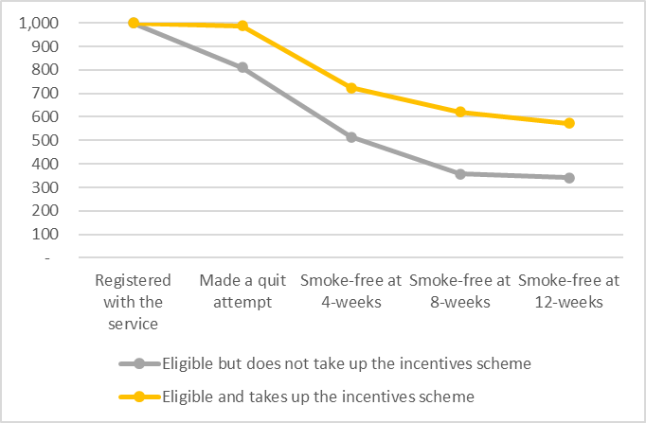
Quantitative Insights
Key findings
The incentive scheme was found to be effective in terms of encouraging quit attempts and quit success at 4, 8 and 12 weeks (higher rates of quit attempts and quit success for those who had vs those without incentives).
This effect was seen across priority groups, including people in routine and manual occupations, social housing and with mental health conditions.
Data from October 2024 to March 2025

Slide 15
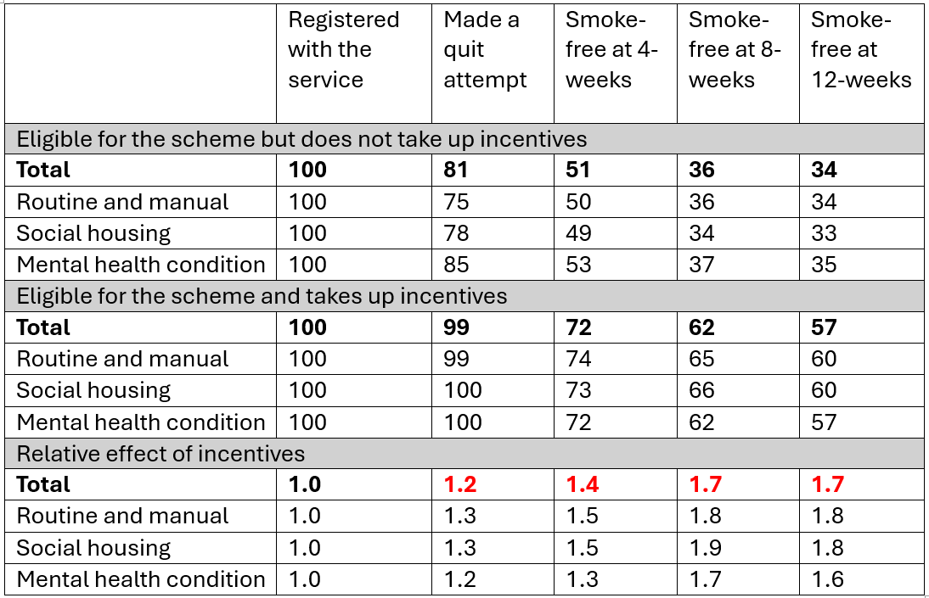
Quantitative Insights
Quit attempts and success at 4, 8 and 12 weeks

Slide 16
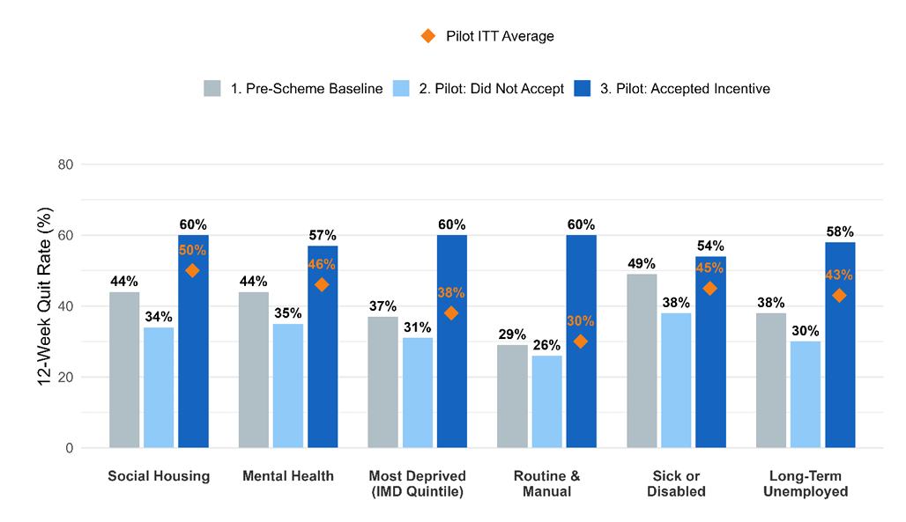
Quantitative Insights
12-week quit rates
There is a large effect of the incentives on programme adherence across every priority demographic.
Individuals who accepted the incentive achieved higher 12-week quit rates than those who did not.
The intention to treat (ITT) analysis removes the potential for bias among highly motivated acceptors – this reduces the impact of the scheme, but still shows positive results across a number of priority groups.
12-week quit success of people who registered with the stop smoking service by priority
group: participant engagement vs. population impact. This chart compares 12-week quit rates for individuals who accepted the incentive (dark blue) against those who did not (light blue) and a historical pre-scheme baseline (grey). The gold diamond represents the overall “Intention-to-Treat” average for the entire eligible population during the pilot period, regardless of whether an incentive was received.

Slide 17
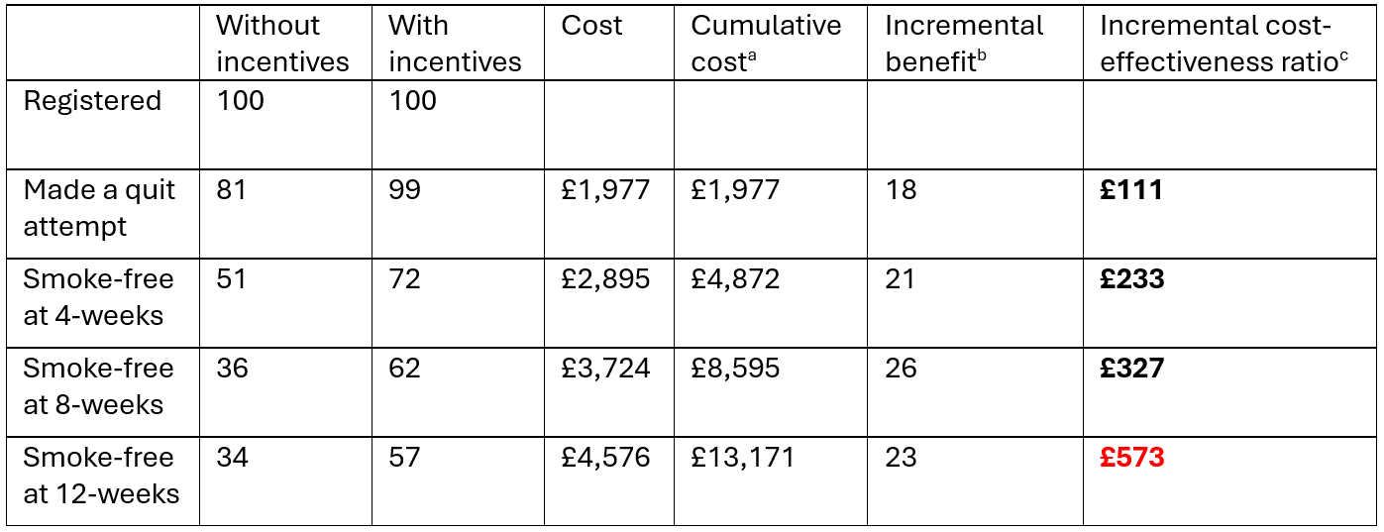
Quantitative Insights
Cost-effectiveness
Cost-effectiveness calculation, assuming that people lost to follow-up did not quit. Illustrative calculation assuming an initial cohort size of 100 registered clients.
ª The cumulative cost of quit attempts (£20), 4-week quits (£40), 8-week quits (£60) and 12-week quits (£80).
^{b} The difference in quit attempts and quits with and without incentives.
^{c} The cost per additional quit attempt or 4-week quit.

Slide 18
Conclusions
Overall findings
The smoking cessation incentive scheme was well-received and acceptable to both service users and staff.
Incentives were seen as providing an additional source of motivation to engage with the service and continue with quit attempts, rather than as replacement for existing support.
Assuming that clients lost to follow-up did not quit, the estimated cost-effectiveness ratios are £233, £327, and £573 per additional 4, 8 and 12 week quit.
Financial incentives have considerable potential to act as a valued, acceptable and effective part of smoking cessation support/provision. BUT there are important caveats relating to communication challenges around the incentive offer, partnership and referral difficulties, overcoming digital barriers to accessing vouchers, and data monitoring issues.

Slide 19
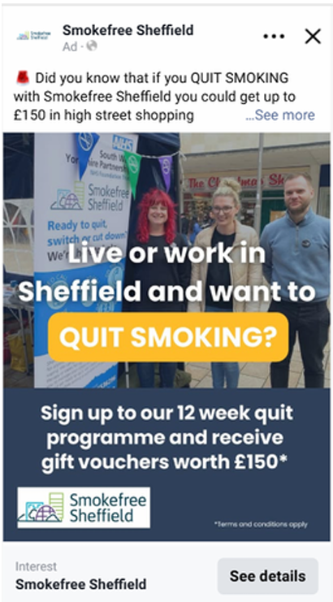
Conclusions
Lessons learned for future schemes
Implemented a universal scheme that we were able to promote, including details of our comprehensive service offer.
Included investing in in paid ads on Facebook, which resulted in approximately 1,000 referrals and 1,700 new followers.
Offering both physical and digital vouchers, depending on preference.
Reduced maximum incentive to £150 to allow the scheme to reach more people.
Future targeted schemes will need greater planning and more time to ensure adequate engagement from partners.

Slide 20
Download the report:
Evaluating Sheffield City Council's smoking cessation incentive scheme for priority groups - Sheffield Addictions Research Group
Get in touch:
ben.arnold@sheffield.gov.uk
duncan.gillespie@sheffield.ac.uk
20

