Slide 1

Economics of the tobacco industry, profitability, and pricing tactics
Dr Rob Branston
University of Bath

Slide 2
CONFLICT OF INTEREST DECLARATION
I have no financial COI
TCRG does not accept funding from tobacco companies or other commercial organisations whose interests are not aligned with improved public health and ensures each research contract gives us freedom to publish.
TCRG / I receives funding from: Bloomberg Philanthropies via the Bloomberg Initiative to Reduce Tobacco Use (www.bloomberg.org)’; and Action on Smoking and Health (ASH UK)
The views expressed herein are those of the author.
I received the gift of 10 shares in Imperial Brands for research purposes. Any money received is/will be donated to health-related charities.
Funding policy
https://www.bath.ac.uk/corporate-information/centre-for-21st-century-public-health-statement-on-funding-sources/
List of projects and funders
www.bath.ac.uk/corporate-information/tobacco-control-research-group-research-projects/

Slide 3
FOR PROFIT
Tobacco products, like cigarettes, are legal products and are relatively freely available despite global tobacco control efforts
Tobacco products are provided by profit seeking manufacturing companies using global supply chains
  In most markets that means a combination of a small number of large transnational tobacco companies, aka ‘Big Tobacco’
  A small number of state-owned enterprises
The profit motive means it is in the interests of tobacco manufacturers to sell, and to keep selling, their tobacco products
  Tobacco profits are as addictive as tobacco products

Slide 4
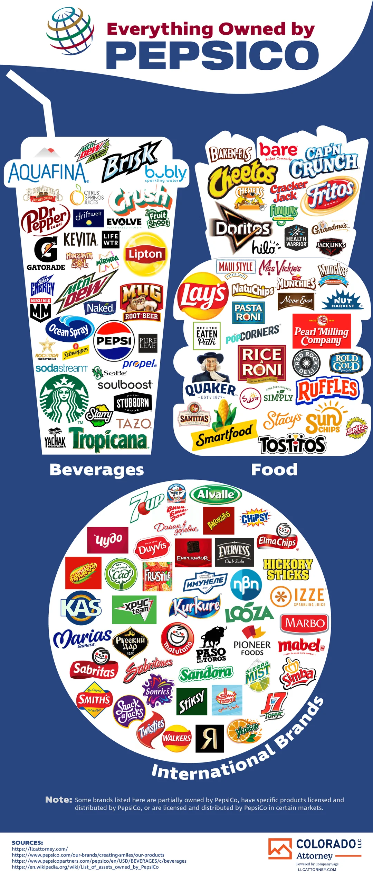




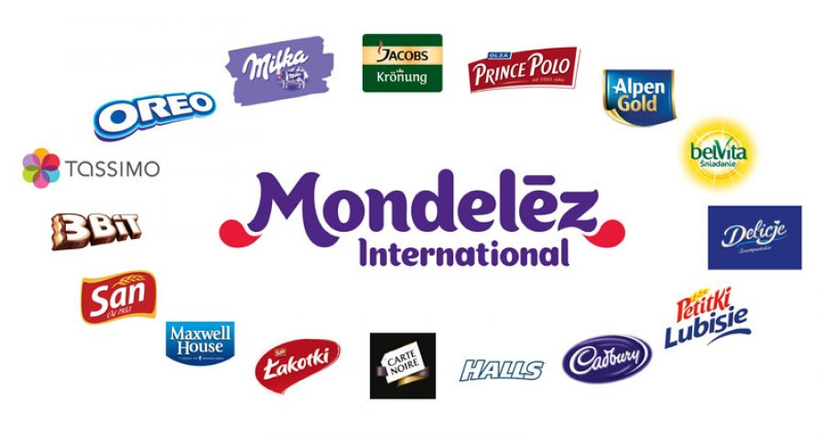
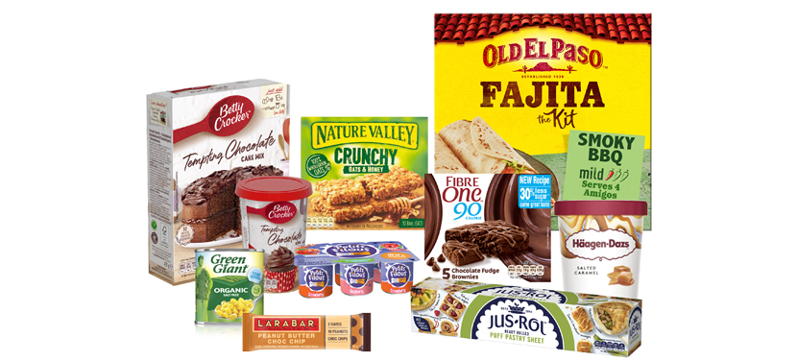
INORDINATE PROFITS
  Manufacturing tobacco products is tremendously profitable
  In 2025 the world's 6 largest tobacco manufacturers made an estimated profit before tax of just over US$100 billion
  Those profits are still increasing
  That is more than: Coca-Cola, Pepsico, Nestle, Mondelez, General Mills, Unilever, Reckitt, Heineken, and Carlsberg combined (US$53bn and 9 companies)

Slide 5
INORDINATE PROFITS
  Manufacturing tobacco products is tremendously profitable
  In 2025 the world's 6 largest tobacco manufacturers made an estimated profit before tax of just over US$100 billion
  Those profits are still increasing
  That is more than: Coca-Cola, Pepsico, Nestle, Mondelez, General Mills, Unilever, Reckitt, Heineken, and Carlsberg combined (US$53bn, and note 9 companies)

Slide 6
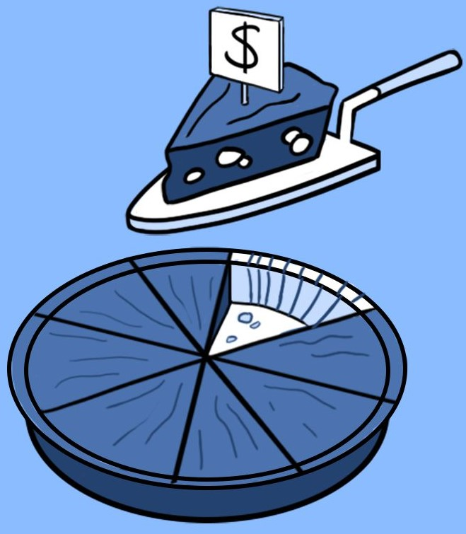
INCREDIBLE
PROFIT MARGINS
Profit margins are the size of profits relative to a firm’s revenue
With tobacco such margins are so much bigger than other industries!
  BAT adjusted global operating margin was 45.2% in 2025
  Altria made operating profit margins of 63.0% in 2025
  Imperial Brands made operating profit margin of 62.1% in the UK in 2025
The comparator companies had operating profit margins of around 16% in 2025, ranging from a low of 4.8% (General Mills) and a high of 29.7% (Reckitt)
Such profits give these firms significant resources and a huge incentive to maintain the status quo

Slide 7
CIGARETTES STILL RULE
Companies like PMI and BAT want us to believe that they are moving away from combustible tobacco
  ‘Unsmoke’ for a Smoke-free future and ‘A Better Tomorrow’
BUT as of 2025 combustibles still account for the majority of profits and net revenue for the biggest Six Tobacco companies
  Yet they don’t itemise where their profits come from
PMI
  Global net revenue $23.8bn combustible vs $16.9bn smoke-free (although said to be bigger in 27 markets)
  Cigarettes 607.4bn units vs 786.5bn units overall
BAT
  Global net revenue £25.6bn but just £3.6bn from ‘new categories’; Global profit from operations £10.0bn but new categories just £0.4bn
Imperial
  From a self-reported UK market share of 37%, made at least £331m in operating profits in 2025 but NGP made a loss of £0.3m

Slide 8
PAYING THEIR WAY?
While many countries do levy tobacco excise duty, this is passed on to smokers via higher prices
Firms use many common tax avoidance strategies to reduce their profit based taxation on these huge profits
  BAT is UK based but paid £11m in corporation tax in the 6 years up to 2016 while earning £10s billion in profit.
  In 2025 they paid only £17m having made profits from operations of £9,997m (but did pay £2.1bn in overseas tax).
  The on paper sale of all BAT cigarettes produced by BAT Korea Manufacturing Ltd. (South Korea) to Rothmans Far East BV in the Netherlands. They are immediately re-sold to another South-Korean company, BAT Korea Ltd, at a much higher price. This way, on average each year €98 million in Korean profits are shifted to the Netherlands.
We need to stop letting the industry profit at the wider expense of society
https://doi.org/10.1093/pubmed/fdz004

Slide 9
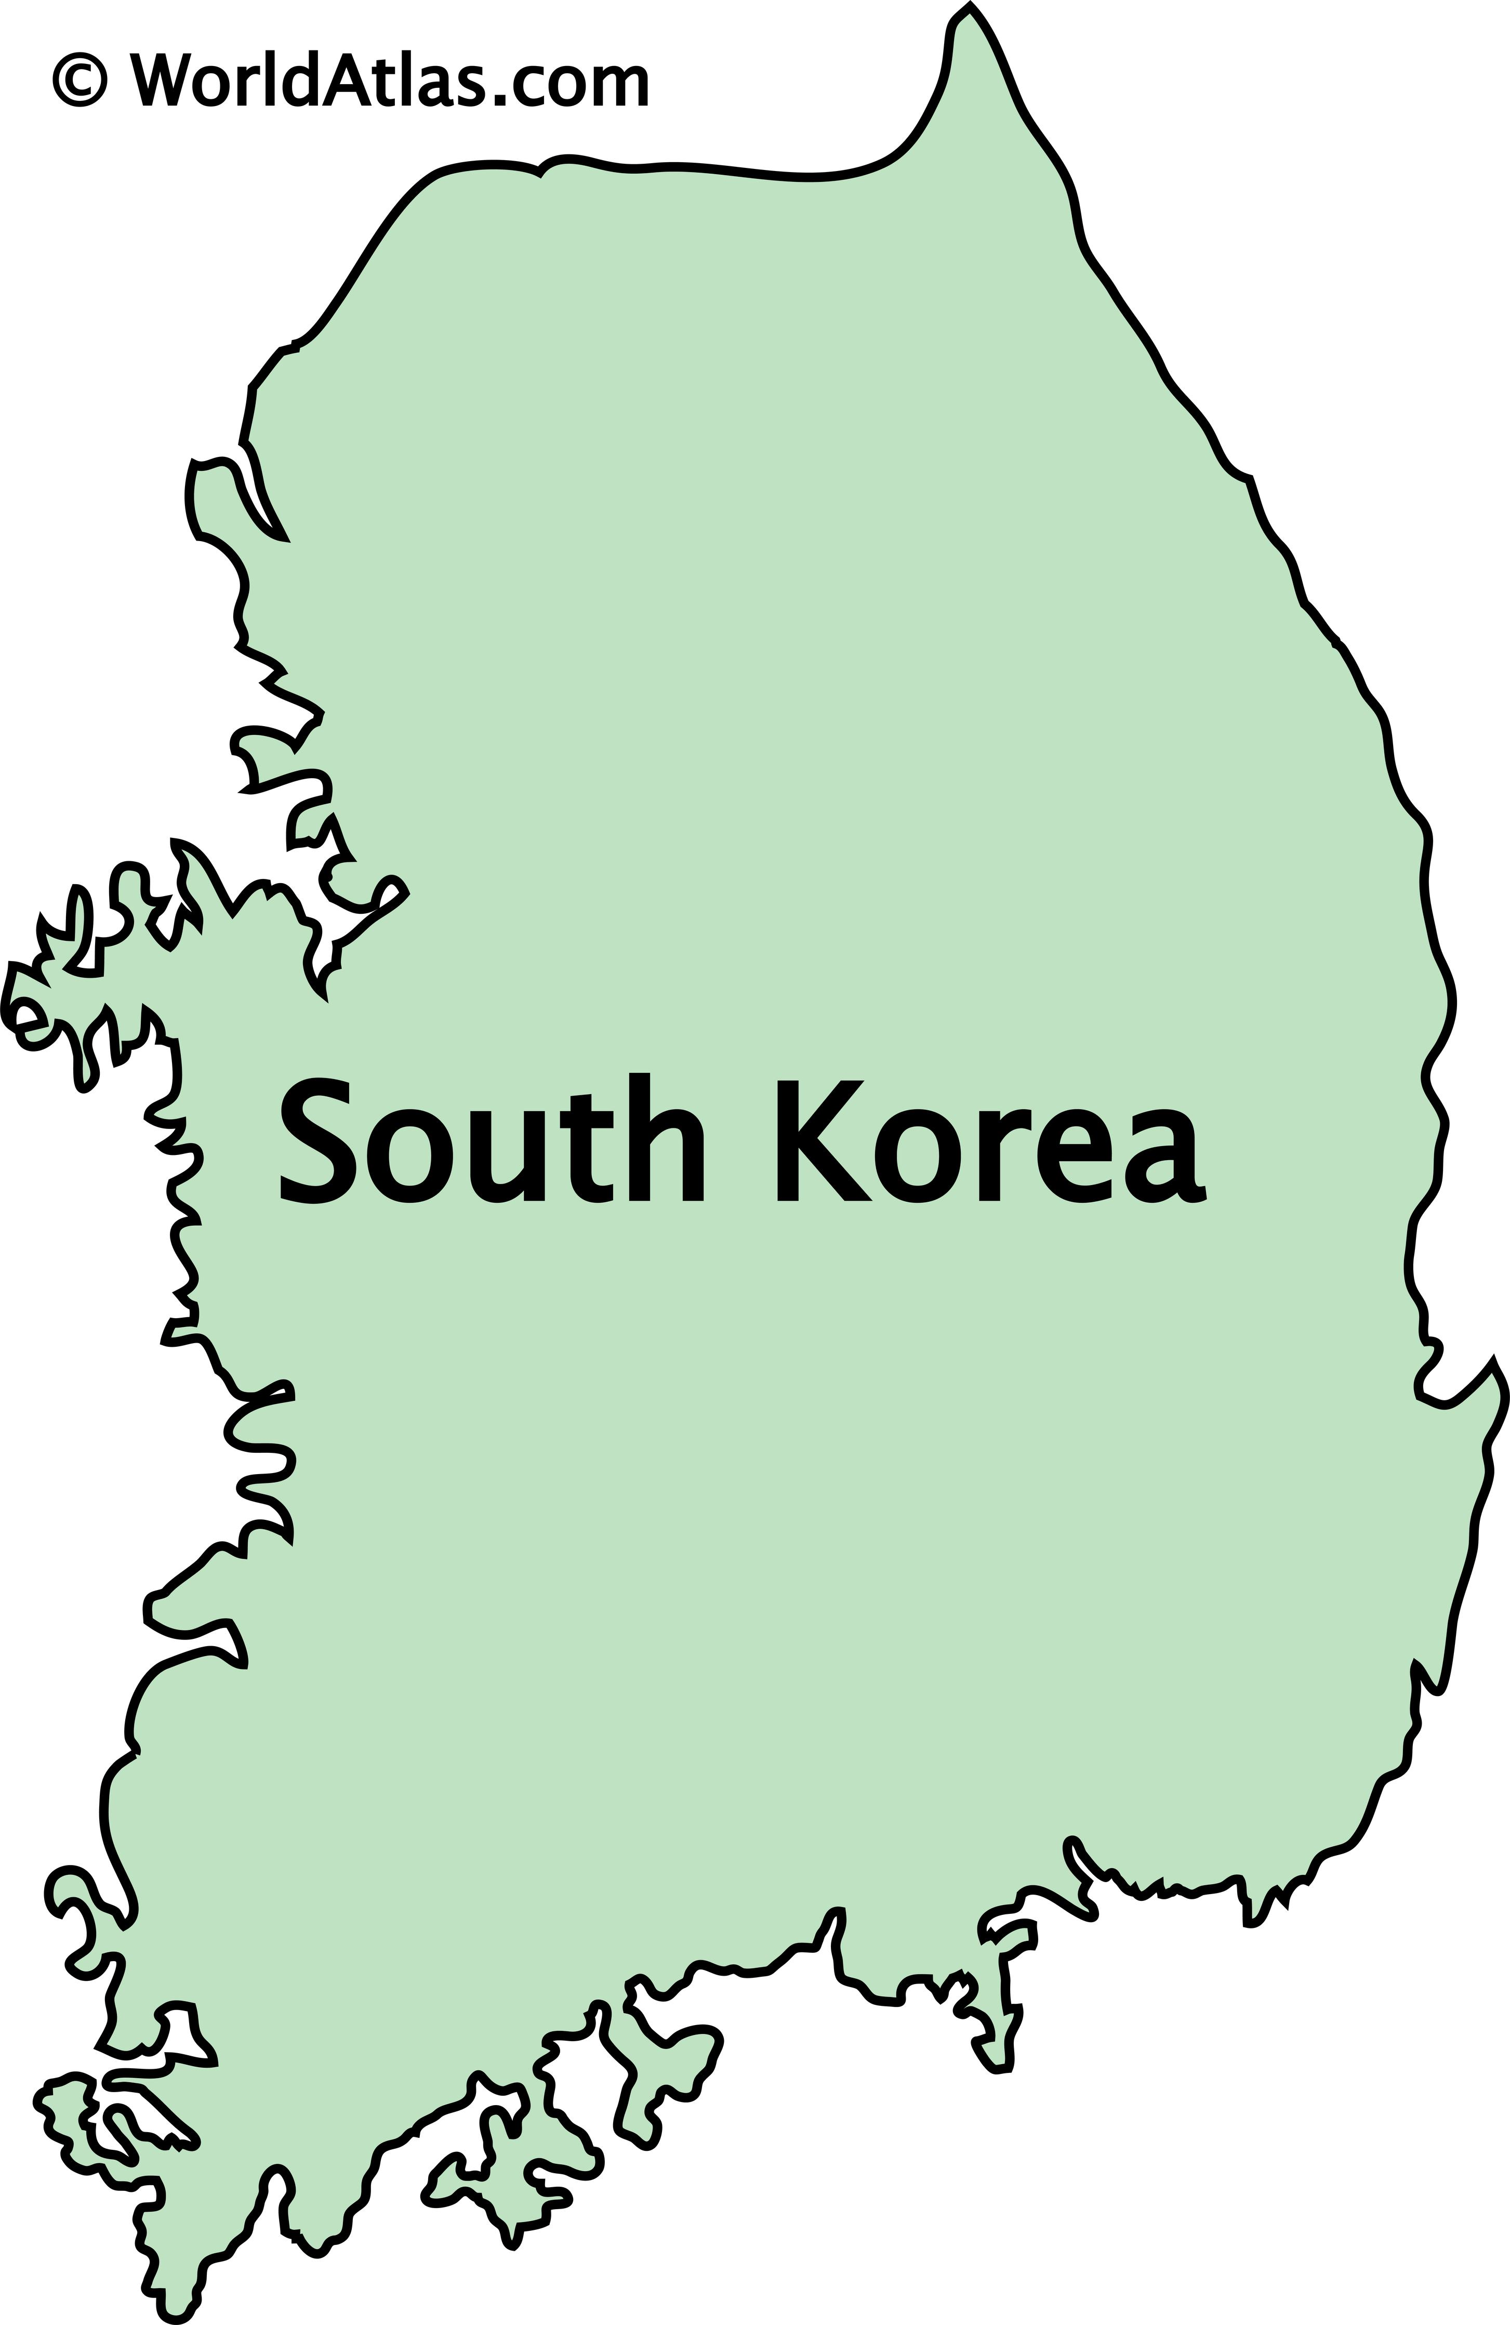
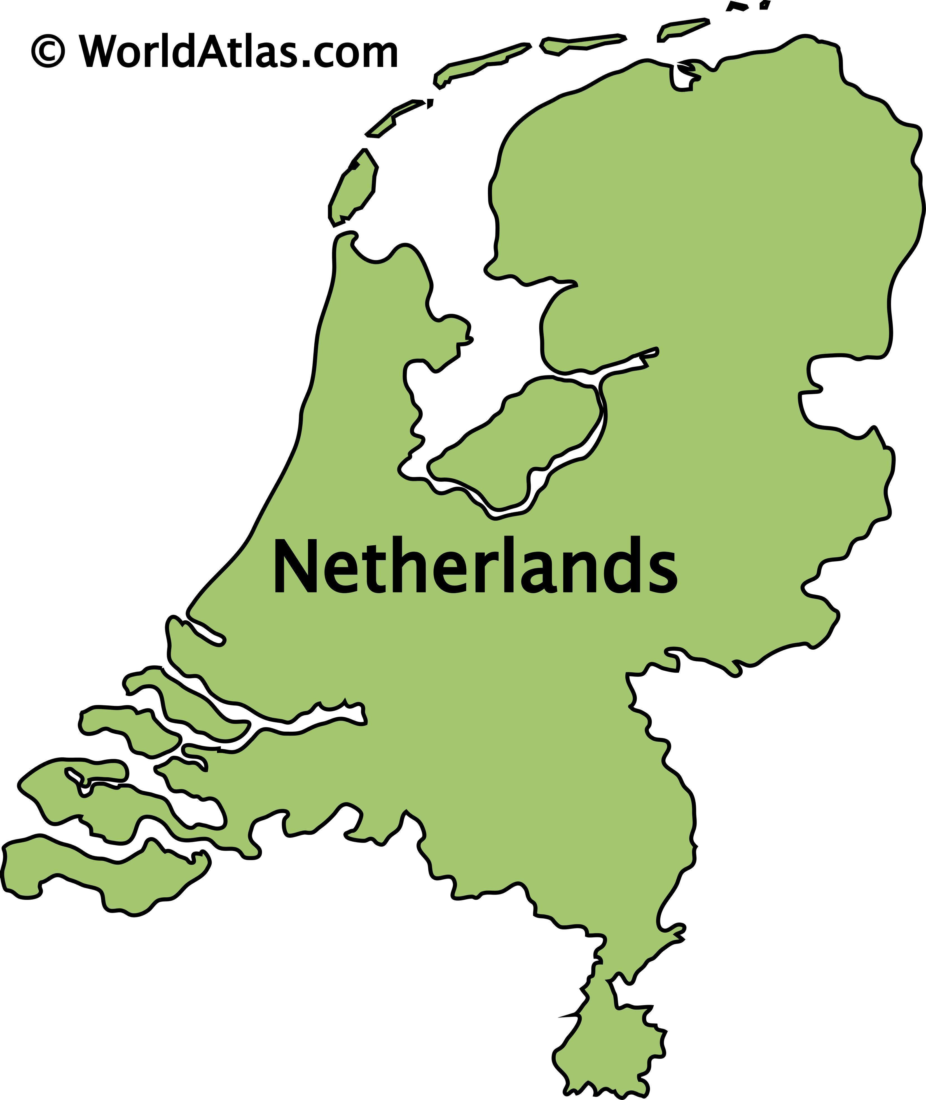
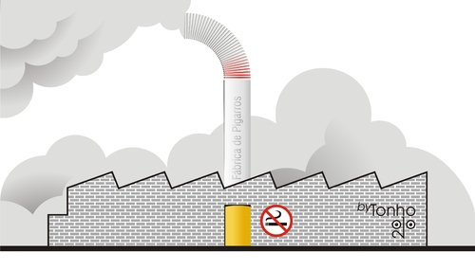


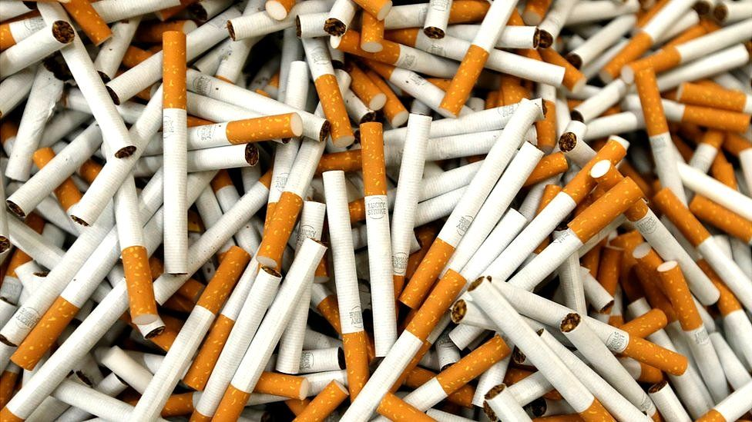
Low price
Subsidiary 2
Subsidiary 3
High price
€98 million in Korean profits per year
https://www.bath.ac.uk/publications/big-tobacco-big-avoidance/

Slide 10
PAYING THEIR WAY?
While many countries do levy tobacco excise duty, this is passed on to smokers via higher prices
Firms use many common tax avoidance strategies to reduce their profit based taxation on these huge profits
  BAT is UK based but paid £11m in corporation tax in the 6 years up to 2016 while earning £10s billion in profit.
  In 2025 they paid only £17m having made profits from operations of £9,997m (but did pay £2.1bn in overseas tax).
  The on paper sale of all BAT cigarettes produced by BAT Korea Manufacturing Ltd. (South Korea) to Rothmans Far East BV in the Netherlands. They are immediately re-sold to another South-Korean company, BAT Korea Ltd, at a much higher price. This way, on average each year €98 million in Korean profits are shifted to the Netherlands.
We need to stop letting the industry profit at the wider expense of society
https://doi.org/10.1093/pubmed/fdz004

Slide 11
INDUSTRY PRICING STRATEGIES
Tobacco products are increasingly expensive thanks to Tobacco Taxes
  Currently £13.00 to £19.90 for a packet of 20
Identified Six pricing strategies of the tobacco industry in response to increase in taxation
Overall price goes up more than sales go down
Differential shifting of tax
Price smoothing
Changing product attributes
Taxation on tobacco products
Price discrimination and promotions
Shrinkflation
http://dx.doi.org/10.1136/tobaccocontrol-2021-056630
Introducing new brands/segments/products
https://exposetobacco.org/wp-content/uploads/Price_We_Pay.pdf

Slide 12
OTHER STRATEGIES
The industry tries to avoid tax increases in the first place using a variety of strategies
The Industry (false) tactic of promoting concerns around illicit tobacco are a common example
  Industry often increases their prices beyond tax increases
  Country examples of illicit going down as tax rates go up (e.g. Ireland, UK, Belgium)
  Primarily a law enforcement issue
Raise concerns around / threaten ‘economic costs’ to the economy
Will argue lower taxes / tax increases will be revenue maximising (the laffer curve)
If it can’t avoid taxes, it lobbies for smaller and predictable tax increases that it can plan for, undermine, and even take advantage of
Lobby for weakness in the tax codes that it can exploit (e.g. RYO / HTP)

Slide 13

THANK YOU

