Slide 1
Experience of going smoke free Regency Ward

Slide 2
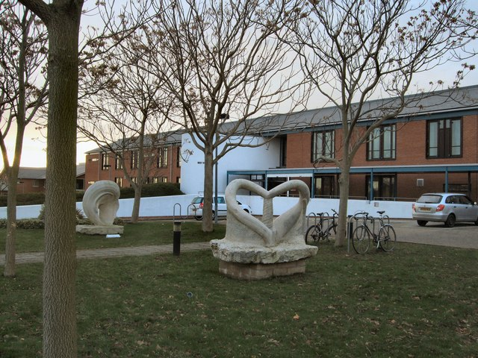
Regency Ward overview
1 of 5 Wards at Millview Hospital
Ward size
Admission criteria
Length of stay
Environment
This Photo by Unknown Author is licensed under CC BY-SA

Slide 3
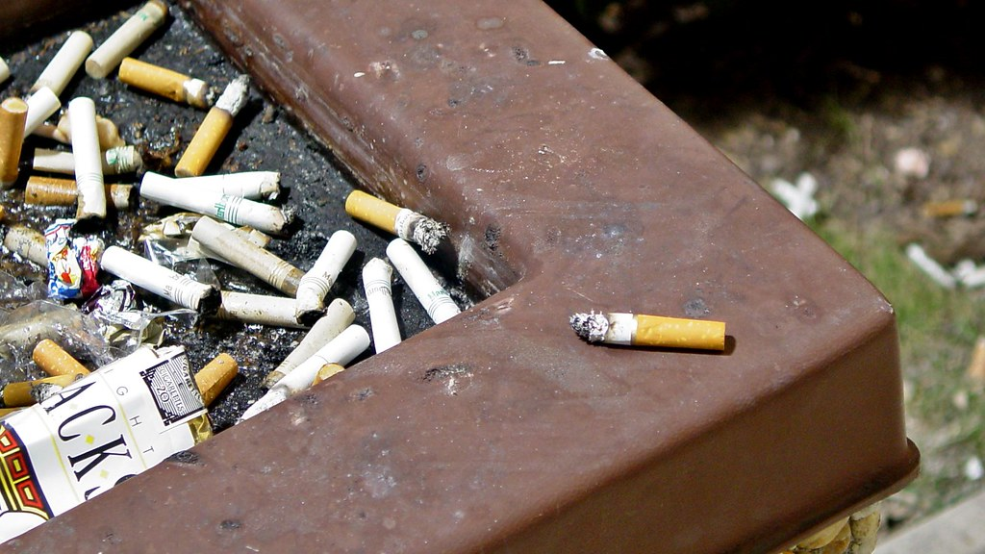
Regency Ward history
The wards Smoking culture
This Photo by Unknown Author is licensed under CC BY-SA

Slide 4
Regency Ward plan
Date set
Patient information
Staff information
Preparations
This Photo by Unknown Author is licensed under CC BY-SA
This Photo by Unknown Author is licensed under CC BY-SA

Slide 5
Regency Ward Implementation
Tobacco and lighter collection and storage
NRT
Brief Interventions
Person centered approaches
Leave procedures
Responding to breeches
This Photo by Unknown Author is licensed under CC BY-SA
This Photo by Unknown Author is licensed under CC BY-SA

Slide 6
Regency Ward reaction and impact
Working together groups-patient feedback
Staff feedback
Incidents
This Photo by Unknown Author is licensed under CC BY-SA
This Photo by Unknown Author is licensed under CC BY-SA

