Slide 1
Staff Tobacco Dependency Offer
North East and North Cumbria
Supporting Staff to Quit with e-cigarettes
Ruth Sharrock – Clinical lead for Tobacco, Respiratory Consultant
Caitlin Barry – STDO Project manager
Rachel McIvenna – Regional Smokefree Strategic Manager

Slide 2
Overview STDO
Personal experience of supporting staff to quit, motivated by the visible impact of smoking on colleagues ill health, success of peer to peer advice.
Behaviour change models – awareness, capability, opportunity, motivation
‘Easy, attractive, social, friendly’
How can we remove barriers to making a quit attempt to reduce risk of widening HI
What is the role of e-cigarettes in supporting colleagues to quit
PHASE 1
Available to NHS staff working within 11 Foundation Trusts in the region
Free NRT/E-Cigarette with or without behavioural support
Ease of sign-up – varied routes, non judgemental support – congratulated on every step
Out of hours access
Postage of products
Premium access to Smokefree app available to all
Hosted by Gateshead Health NHS FT on behalf of NENC ICS (immediate mobilisation)
FT engagement at challenging time; considered narrative, time pressured, opportunity to showcase work, competitive feedback to trusts
PHASE 2
Need to future proof this offer and keep existing services engaged
Uplift existing LA services to deliver support and products to staff (ecig provision, mitigate voucher costs)
Uplift to existing data management systems to collect staff status
Extension of offer to all NHS staff within the region (covering 13 LAs)
Hosted by County Durham and Darlington FT on behalf of NENC ICS

Slide 3
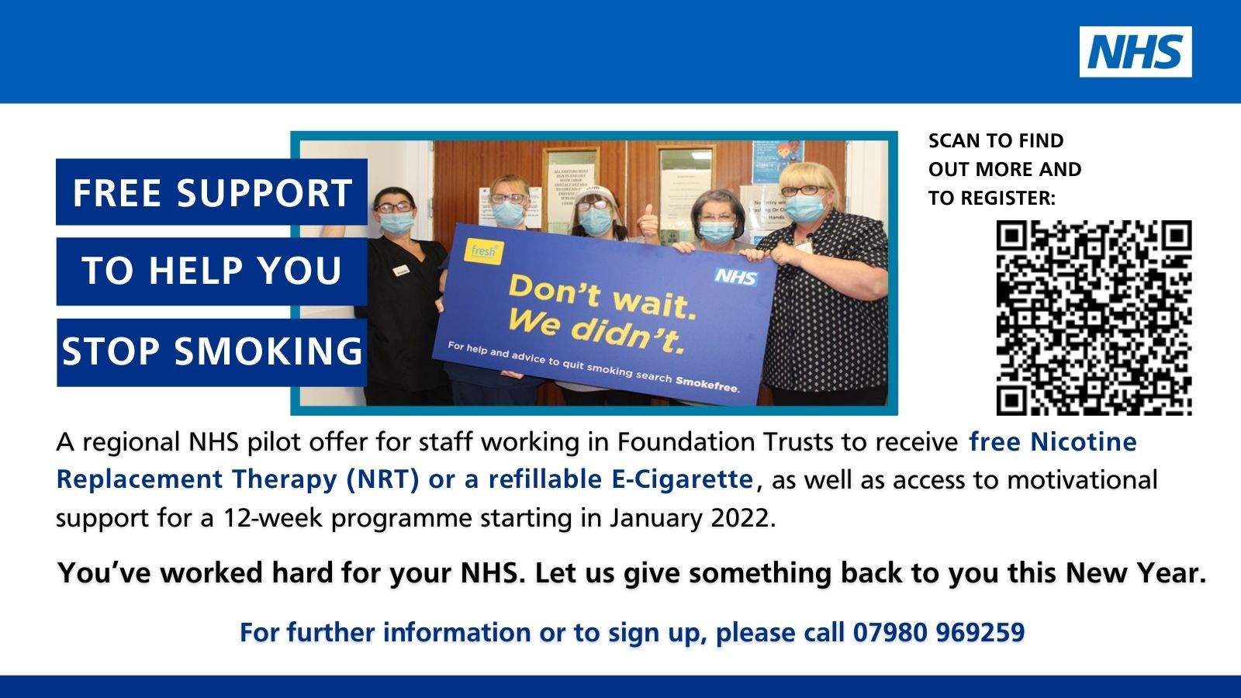
Registration

Slide 4
Early data and outcomes
>1200 staff have registered
Data reported on first 927
757 requested ecigarettes (81%)
170 requested NRT
Of 757 who initially requested e-cigarettes 26 (3.4%) have either switched to NRT or had patch added.
E-cigarette group – where data has been pulled
None withdrawn from support
48% abstinent from cigarettes at 4 weeks (self report)
23% significantly cut down, but not fully quit – keen for ongoing/additional support
23% either not attempted to quit or have relapsed, all requested ongoing support
3.4% requested change to or supplement with NRT
Small number of those who registered are uncontactable, but none have requested discontinuation of support
NRT Group
30 are past 12 week mark and reported successful quit
30 have dropped out citing circumstance change
110 ongoing support

Slide 5
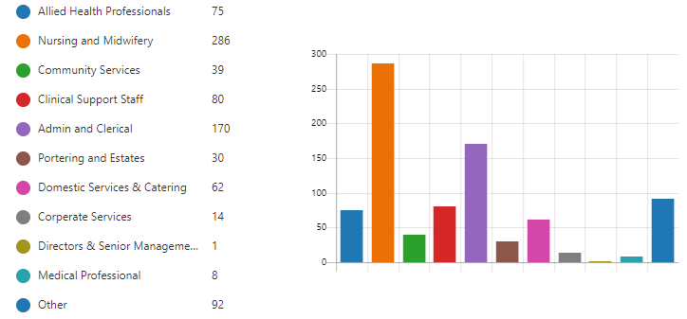
Current Uptake Per Staff Group
Data correct as of 6th Feb 2022
Uptake without comms – ‘Word of Mouth’, nearly all request e-cigarette, >50% R+M

Slide 6
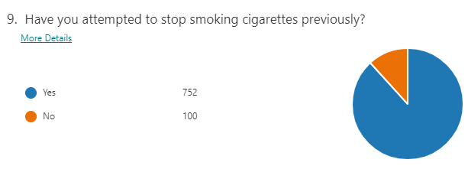
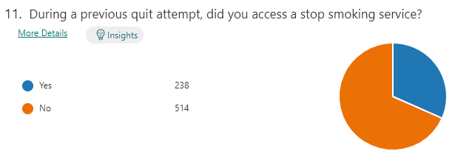
Previous Quit Attempts
Data correct as of 6th Feb 2022

Slide 7
Staff Feedback…
“I’ve been looking to stop smoking for a while but didn’t know where to start.
To know this opportunity and support is available to me through my workplace is fantastic and I can’t wait to get started. It’s exactly what I need. Thank you so much!”
“If I can give this a go anyone can, so easy to sign up …. Feeling more determined than ever”
“They’re so pleased, I’m embarrassed to admit I hadn’t realised just how passionate they felt about me stopping until I had.”
(NHS Staff Member talking about their children’s response to quitting smoking)
‘As if stopping smoking wasn’t hard enough you had the stress of spending all your spare time trying to sort out how and where you were going to get the tablets from. It was easier to walk to the corner shop and buy cigarettes.’ (NHS Staff Member talking about a previous quit attempt)

Slide 8
Challenges
Who benefits from NRT plus vape?
Who should aim for graduated quit versus swapping over, risks of relapse?
Benefits of lead in time/risks of co-use? Especially shift workers
What is the additional benefit of a prolonged support period? (There is a difference between ecigs and vapes with people staying engaged but struggling to quit) Does more time lead to more quits eventually?
Variety of products/ changing market makes it harder to advise and train
Sustainability of the offer –does physical provision of device provide wider reach than self order process?

Slide 9
E-cigarettes to support quit attempts in Staff
Appeal to harder to reach groups, those who don’t contact SSS, R+M, ‘word- of mouth’ referrals
Achieve success without necessarily needing complex support – extremely cost effective
£50 versus £281 in our model, products alone
Particular benefit to health care staff - cost benefit to users on low income - £50 versus £1000 for 12 weeks (20cpd) – cost of living situation, can be used at work
Difficult to measure benefits
Significance of the gesture
Prompts more quit attempts in peers because of visible usage in smoking areas
Powerful enabler of conversations with patients when staff are able to draw on their own experiences

Slide 10
Any Questions?
ruthsharrock@nhs.net
Caitlin.barry1@nhs.net

