Slide 1


Progress towards smokefree mental health services
March 2022
Hazel Cheeseman, Deputy Chief Executive, Action on Smoking and Health (ASH)

Slide 2
Why smokfree context matters
The NHS Long Term Plan commits to introduce a new tobacco dependency treatment pathway in mental health inpatient settings by 2023/24
Government set a target of smokefree mental health settings by 2018 in the 2017 TC Plan
We assessed smokefree to mean implementation of NICE PH48, this was updated in November 2021
Full implementation of this guidance including smokefree policies necessary to maximise the impact of the LTP pathway

Slide 3
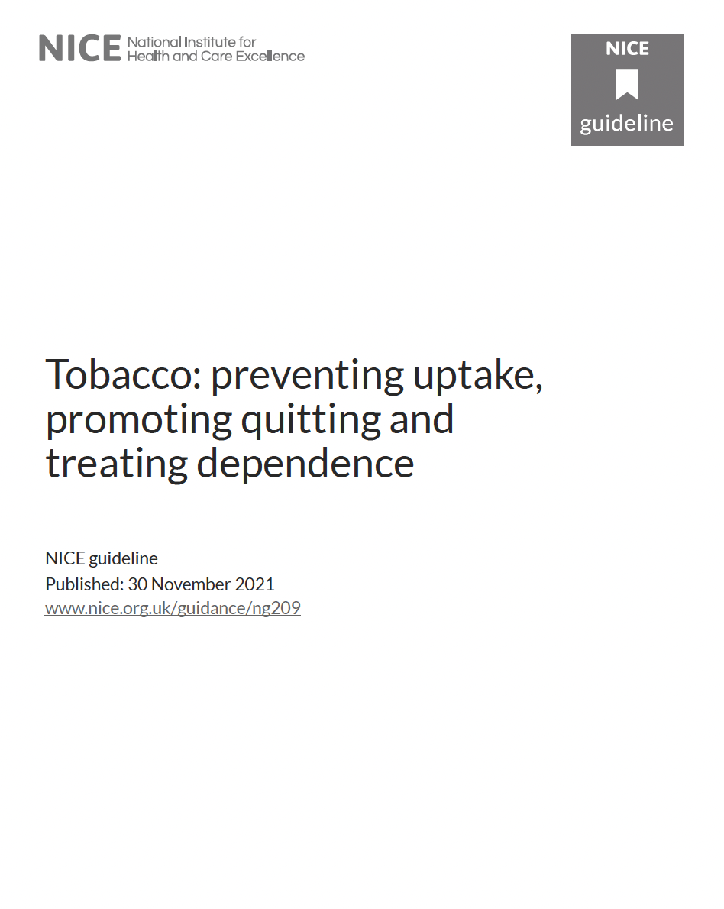
Tobacco: preventing uptake, promoting quitting and treating dependence [NG209]
Recommendations for:
Preventing uptake
Promoting quitting
Treating tobacco dependence
Pregnant woman
Policy, commissioning, and training

Slide 4
Key points…
Main guidance remains common with past….
Combination of behavioural support & stop smoking medication or nicotine containing product (NRT or vapes)
Stopping smoking in one go is the best approach
Training standards for those delivering stop smoking support
NCSCT Certification for stop smoking advisors (or the equivalent)
Specialist training for those working with pregnant woman and persons with mental health illness

Slide 5
NICE Recommendations
What is new…..
Tailor quit plan to the needs of smokers
Promoting greater flexibility in use of NRT
Nicotine containing vapes (e-cigarettes) as a first line quit aid
Clearer guidance on NRT in pregnancy and incentives
A role for harm reduction
Partnership, outreach, promoting quitting

Slide 6
NICE smokefree policies
Ensure smokefree implementation plans include:
support for staff and people to stop smoking completely or temporarily
training for staff
removing shelters or other designated outdoor smoking areas
no staff smoking during work hours

Slide 7
NICE recommendations specific to mental health settings
delivery by a specialist adviser with mental health expertise
support that is tailored in duration and intensity to the person's needs.
Closed institutions and smokefree policies including supporting staff and patients through harm reduction approaches

Slide 8
Implementation of NICE guidance
Survey of MH Trusts conducted in Spring 2019 by ASH and commissioned by Public Health England
Online survey of mental health trusts in England with an 83% response rate (45 out of 54 trusts responded in full)
Also report findings from 2019 survey of staff skills and 2021 survey of local authority delivery

Slide 9
Smokefree policy implementation
82% of surveyed trusts had a comprehensive smokefree policy in operation prohibiting smoking on wards and hospital grounds
18% of surveyed trusts still permitted smoking in ward courtyards or in designated areas on the hospital grounds.
Enablers: leadership, staff support, e-cigarettes and training
Barriers: staff resistance, patient resistance, lack of senior management leadership and insufficient resources

Slide 10
Smokefree sites in practice
Noncompliance with smokefree policy was universal: all surveyed trusts reported smoking on site though this was much less frequent in some trusts than in others.
In surveyed trusts:
  48% found patients smoking in bed/bathrooms at least once a week
  22% found patients smoking in ward courtyards every day
  86% used Section 17 leave to facilitate smoking breaks
Problems at trust boundaries:
  Cigarette litter
  Conflicts with practice in neighboring or host trusts

Slide 11
Implementation challenge: variable smokefree policies
How often staff accompany patients on smoking breaks on average adult mental health wards (all surveyed trusts)
ASH, Progress Towards Smokefree Mental Health Settings, 2019 https://ash.org.uk/wp-content/uploads/2019/10/PHE-mental-health-trust-2019-survey-full-report_v12.pdf

Slide 12
Treatment for tobacco dependence
Most but not all of the surveyed trusts (93%) provided on-site support for tobacco dependence BUT only 29% of trusts had a dedicated smoking cessation service
Only 47% offered the choice of combination NRT or varenicline in line with NICE best practice.
55% of trusts did not always ask patients their smoking status on admission.
Local authority funded community support was not available for people with mental health conditions on discharge in half of trusts
62% of trusts had made some investment of their own in community stop smoking support

Slide 13
Local authority engagement
77% of LA’s tell us they are specially engaging MH population
41% tailored mainstream service (e.g. referral pathway or flexible delivery model)
34% ongoing programme of support (e.g. training, support with smokefree implementation)
11% specific in reach support to mental health settings
39% developing activity including roll out of the Long Term Plan
“we have delivered training to all mental health team and before covid ran clinics in the three units, IAPT, XXXX hospital and XXXX these are due to restart for stoptober we have a network with mental health teams and the 5 boroughs that have residents in XXXX, NRT is on the ward and we can prescribe this via our sessions and patients can collect from the ward, the hospital have also introduced providing vapes for patients.”
“People with mental health conditions is a target group for stop smoking / lifestyle provision. People with MH conditions are offered a more flexible "harm reduction / cut down to quit" service rather than a "12 week quit" programme”.
“NHS Mental Health Services need to do more and to engage with us too ideally”

Slide 14
Primary care engagement

Slide 15

Implementation challenge: Training
ASH, Smokefree Skills: training needs of mental health nurses and psychiatrists, 2020
https://ash.org.uk/information-and-resources/reports-submissions/reports/smokefreeskills/

Slide 16
Smokefree Skills report
Large proportions of mental health nurses and psychiatrists reported having not received training, or could not recall if they had received training, on key aspects of the NICE guidance
Staff do not appear to fully understand how to deliver basic interventions such as Very Brief Advice (VBA) even though this is something they say they do regularly
Misperceptions about smoking, quitting and mental health were common among nurses and psychiatrists
Organisational structures and norms were inhibiting uptake and implementation of training

Slide 17
E-cigarettes
91% of trusts permitted some or all inpatients to use e-cigarettes:
  47% of surveyed trusts allowed all types of e-cigarettes to be used
  31% of surveyed trusts only allowed the use of non-rechargeable, disposable devices
All but one trust restricted where e-cigarettes could be used:
  44% of surveyed trusts allowed the use of e-cigarettes indoors
  76% allowed the use of e-cigarettes in ward courtyards
42% provided e-cigarettes free to their patients.

Slide 18
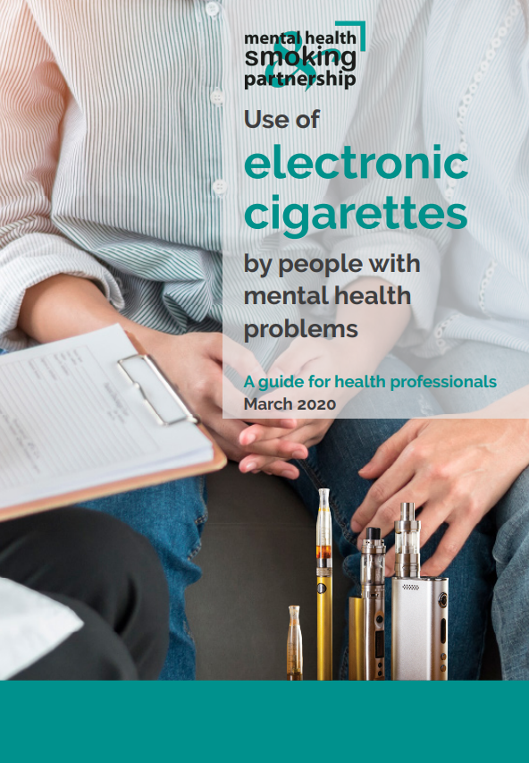
2018 Science and Technology Select Committee
“NHS England should set a clear central NHS policy on e-cigarettes in mental health facilities which establishes a default of allowing e-cigarette use by patients unless an NHS trust can show reasons for not doing so which are demonstrably evidence-based. NHS England should issue e-cigarette guidance to all NHS mental health trusts to ensure that they understand the physical and mental health benefits for their patients.”
https://publications.parliament.uk/pa/cm201719/cmselect/cmsctech/505/50508.htm
https://smokefreeaction.org.uk/wp-content/uploads/2020/03/MHSP-ecig-briefing-2020-v2.pdf

Slide 19
Implementation challenge: impact of COVID-19
There have been reports that policy implementation has been disrupted in some areas, particularly for smokefree policies
Evidence indicates that some smokers with a mental health condition have quit smoking with greater success during the pandemic BUT others are increasing their consumption of tobacco, relapsing, or taking up smoking for the first time. Consequently, the pandemic may be exacerbating the significant inequalities this group already face
The disruption of pandemic means the LTP is behind schedule and risks being deprioritised in the face of current pressures

Slide 20
Implications for Tobacco Dependency Treatment services
Implementing NICE guidance is an enabler
Shapes the culture and environment of services
Need all the tools in the toolbox including e-cigarettes and smokefree grounds (see full reports and guidance for further support)
Whole system not just the inpatient environment – important relationships with community and primary care provision

