Slide 1
QUIT
Pharmacotherapy
Approaches
Sharon Hughes, Healthy Hospital Programme Lead
April 2022

Slide 2
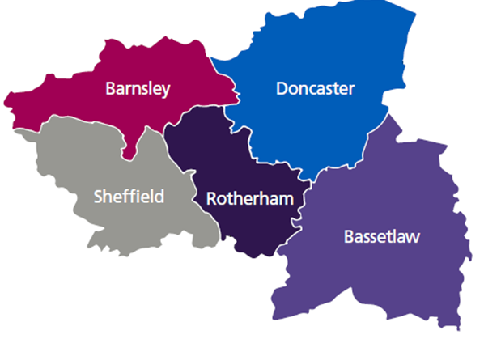
SYB ICS
Whole ICS Approach
1.5 Million population
5 CCGs
4 Acute Trusts
3 Mental Health Trusts
1 Children's Trust
5 LAs
5 CSSSs (3 providers) plus 2 for
children only
350 Community pharmacies
Smoking rates above national average 3 places
196,000 SYB Adults Smoke

Slide 3
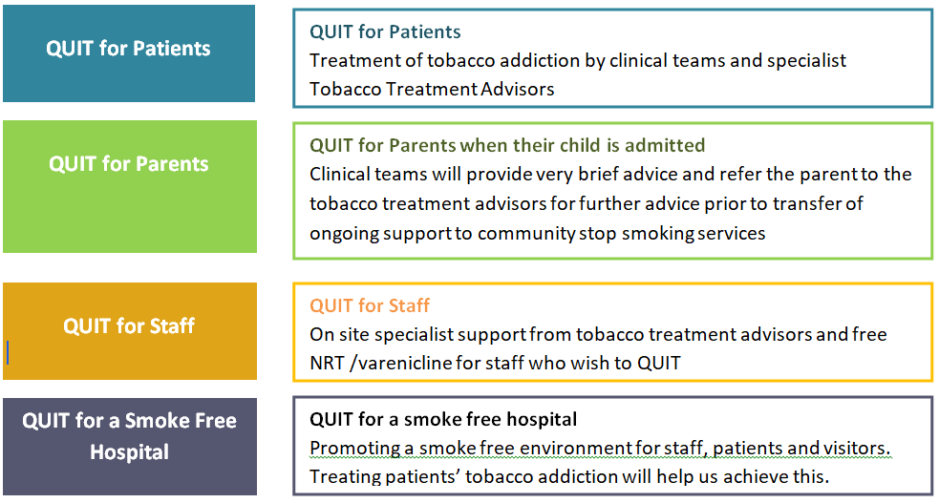
Four strands
Smoking in pregnancy – covered in Maternity Services, but pregnant women who are admitted for non obstetric reasons are included in QUIT
Notes:
Sharon
Quit for pts –
Quit for parents - Clinical teams providing very brief advice and referring to tobacco treatment advisors parents who smoke of children who have been admitted
Quit for staff On site specialist support from tobacco treatment advisors and free NRT for staff who wish to QUIT
QUIT for a smoke free hospital - Promoting a smoke free environment for staff, patients and visitors.
Treating patients’ tobacco addiction will help us achieve this.

Slide 4
QUIT for Patients
QUIT for Patients
Acute Trust and Mental Health: Inpatients
Clinical teams will systematically identify smokers on admission to hospital and offer very brief advice and nicotine replacement therapy to those ages 12 and over (or e-cigarettes where offered by mental health trusts) on an opt out basis.
Specialist Trust based Tobacco Treatment Advisors will be notified of and see all smokers while in hospital on an opt out basis.
Smokers will have ongoing specialist support and medications once they leave hospital.
Mental health trusts - harm reduction as well.
Acute Trust pts - 1 post discharge FU and then transfer pts to local community stop smoking service. (SYB pts)
Mental Health Trust pts – Trust TobTAs provide all of pts going support. (SYB pts)
Acute Trust and Mental Health: Inpatients
Acute Trust : A&E, Outpt and day cases
Secondary Care Community Mental Health Services
Notes:
It is important that treatment and support is offered to all smokers on an ‘opt out’ rather than ‘opt in’ basis – just like we would offer treatment for any other medical condition such as asthma or diabetes.
This will enable the most people to benefit from the effective treatment and support available and give us the best outcomes.
This ‘opt out’ approach has been successfully implemented in maternity services for a number of years.

Slide 5
QUIT for Patients
QUIT for Patients
Acute Trust and Mental Health: Inpatients
Clinical teams will systematically identify smokers on admission to hospital and offer very brief advice and nicotine replacement therapy to those ages 12 and over (or e-cigarettes where offered by mental health trusts) on an opt out basis.
Specialist Trust based Tobacco Treatment Advisors will be notified of and see all smokers while in hospital on an opt out basis.
Smokers will have ongoing specialist support and medications once they leave hospital.
Mental health trusts - harm reduction as well.
Acute Trust pts - 1 post discharge FU and then transfer pts to local community stop smoking service. (SYB pts)
Mental Health Trust pts – Trust TobTAs provide all of pts going support. (SYB pts)
Acute Trust and Mental Health: Inpatients
Acute Trust : A&E, Outpt and day cases
Secondary Care Community Mental Health Services
Notes:
It is important that treatment and support is offered to all smokers on an ‘opt out’ rather than ‘opt in’ basis – just like we would offer treatment for any other medical condition such as asthma or diabetes.
This will enable the most people to benefit from the effective treatment and support available and give us the best outcomes.
This ‘opt out’ approach has been successfully implemented in maternity services for a number of years.

Slide 6
QUIT for Patients
QUIT for Patients
Acute Trust and Mental Health: Inpatients
Acute Trust: A&E, Outpatients and Day Cases
Clinical teams will give very brief advice and signpost patients to their local Community Stop Smoking Services
Provision of specialist Tobacco Treatment Advisor support for people on selected priority outpatient pathways (SYB CCG pts). In some cases this may include all of their ongoing treatment rather than referral to a community stop smoking service.
Acute Trust : A&E, Outpt and day cases
Secondary Care Community Mental Health Services

Slide 7
QUIT for Patients
QUIT for Patients
Acute Trust and Mental Health: Inpatients
Secondary Care Community Mental Health Services
Clinical teams will provide very brief advice and refer service users to the Mental Health Trust Tobacco Treatment Advisors for specialist treatment and support.
Trust TobTA will provide all of the pts ongoing tobacco addiction treatment (SYB CCG pts).
Service users attending primary care MH service eg IAPT, will be referred by clinicians to their local community stop smoking service.
Acute Trust : A&E, Outpt and day cases
Secondary Care Community Mental Health Services

Slide 8
Pharmacotherapy
Our system
Our system
Our system
Unable to agree a common Trust protocol or formulary
E-cigarettes – Mental Health Trust, Commonest requested form of nicotine replacement ( 90%)
Still hesitancy amongst pharmacists re MH pts and varenicline
Nurse initiation of NRT
Over counter drug – does not need PGD - Use homely remedy
BUT think carefully how documented that pt is on NRT
Take Home Medication
Two weeks
Significant problem with pts going home without TTA
Funding:
Inpt and two week TTA – Trusts
Post discharge – Community SSSs / LAs – with CCGs funding additional costs above a baseline equivalent to pre QUIT 100% commissioned activity levels
E-voucher license – ICS
E-Voucher supply and prescribing costs – CCGs – unless staff supply or pts who not had a TTA - Trust

Slide 9
Why need an E-voucher Scheme
Number of different scenarios where patients in the community, who are being supported by Trust TobTAs, will need to be supplied with pharmacotherapy.
Modules developed within PharmOutcomes (software used by Community Pharmacies and NHSE) that enable Trust based Tobacco Addiction Advisors to issue an e-referral to community pharmacies requesting them to supply NRT and / or varenicline.
Mental Health Trust patients – Repeat e-vouchers as TobTAs providing all of their ongoing support
Acute Trust patients – Mainly one off vouchers until care picked up by Community Stop Smoking Services eg if no TTA, if drug change at 3 day FU call
Staff who being supported to QUIT – some Trusts

Slide 10
E-voucher cont.
The QUIT E-voucher only be used when the patient is under the care of the Trust based TobTAs.
Once the patient’s care has been transferred to the Community SSS, the Community SSS will use their existing supply routes / voucher schemes.
Some Com SSS / SIP now using the PharmOutcomes module for their schemes. As can only have one drop down list of accredited pharmacies, need to access through a separate ‘portal’ on your PharmOutcomes menu and commissioned separately.
Patient Group Direction
Each CCG has an identical PGD for varenicline for the QUIT E-voucher, approved by their own governance process.
The PGD eligibility criteria covers all SYB CCG patients. (MOU covers this).
Varenicline off the market so currently not being utilised.

Slide 11
Contracting – e-voucher
Service specification developed in association with LPCs
Service for supply of NRT and Varenicline via PhamOutcomes based referral
Not provision of behavioural support. Behavioural support is via Trust TobTAs or Com SSSs
5 SYB CCGs commissioning collaboratively to ensure a single QUIT service for all SYB pts
‘Contracting’ letter & service specification allows Community Pharmacy to supply pharmacotherapy to pts from any of the 5 SYB CCGs who are on QUIT Programme pathways
Each CCG will process and pay the invoices for patients registered with GPs in their CCG, and residents who live in their catchment area who are not registered with a GP.
PharmOutcomes will automatically invoice the correct CCG based upon the patient’s GP, monthly.

Slide 12
Fees and Drug cost reimbursement
Pharmacies who have signed up set time received a non-recurrent payment of £100 from the CCG on receipt of the signed declaration of competence and attendance at awareness session of 1 pharmacist and 1 support worker.
Drug costs | Reimbursement of drug cost to pharmacy in line with NHS Business Authority’s Dictionary of medicines and devices. VAT applied at low rate to NRT. | Reimbursement of drug cost to pharmacy in line with NHS Business Authority’s Dictionary of medicines and devices. VAT applied at low rate to NRT.
NRT | First supply | £2.50 for single NRT, total of £3.50 if on dual NRT
 | Subsequent supply | £2.50 for single NRT, total of £3.50 if on dual NRT
Varenicline | First supply by the pharmacy | £25
 | Subsequent supply | £5
PharmOutcomes – License – about £10k per year for total of 200 pharmacies – (separate license needed for NRT and varenicline modules) Plus set up fees about £3k

Slide 13
Advance service
Our system
Our system
Our system
NHSE Integrated Pharmacy – Advance Service
Behavioural support and medication
Consideration of capacity and uptake
Aligning pathways to offer pt choice, but first consideration QUIT offer
Pharmacist delivered only
Trusts to sort out referral routes
Reporting back through Trusts
Need to increase geographical coverage across both schemes to improve accessibility.
The South Yorkshire and Bassetlaw Integrated Care System formally launched as an ‘ICS’ in October 2018.
We have been working as a partnership for more than three years, first as a Sustainability and Transformation Partnership, then as a first wave Accountable Care System and now, as one of the leading ICS’ in the country.
We are one NHS, working as a System. We work with other partners, such as Local Authorities and the voluntary sector, in Neighbourhoods, Place and across the System when we have a common purpose and where it makes a positive difference to people’s lives. Our aim is to break down organisational barriers so that we can wrap support, care and services around people as individuals.
We shared responsibility (in ways that are consistent with individual legal obligations) for how we can use our collective resources to improve quality of care and health outcomes to the benefit of the population that we serve.

Slide 14
Lessons Learnt
Our system
Our system
Our system
Time delays between set up and use
Communications
Locum awareness
Robust reporting
Relationship building
Fees
The South Yorkshire and Bassetlaw Integrated Care System formally launched as an ‘ICS’ in October 2018.
We have been working as a partnership for more than three years, first as a Sustainability and Transformation Partnership, then as a first wave Accountable Care System and now, as one of the leading ICS’ in the country.
We are one NHS, working as a System. We work with other partners, such as Local Authorities and the voluntary sector, in Neighbourhoods, Place and across the System when we have a common purpose and where it makes a positive difference to people’s lives. Our aim is to break down organisational barriers so that we can wrap support, care and services around people as individuals.
We shared responsibility (in ways that are consistent with individual legal obligations) for how we can use our collective resources to improve quality of care and health outcomes to the benefit of the population that we serve.

