Slide 1
Making the case
Building support and optimizing the value of the NHS Smokefree Pledge
Martin Lever, Tobacco Reduction Programme Manager

Slide 2
Local data shifts perceptions
(Source: ASH/OHID Fingertips/Somerset Public Health Intelligence)
14.6% of the adult population of Somerset currently (APS 2020) smokes which equates to around 38,000 smokers
Annually, smoking causes 5266 hospital admissions and 2110 premature deaths per 100,000 in Somerset.
Annually 702 smoking-related deaths: 296 COPD deaths; 314 cancer deaths; 92 from cardiovascular disease.
13 smoking-related deaths every week
Smoking prevalence is higher in so-called "routine and manual" workers (at 23.8% in 2020); 10% of women in early pregnancy smoke (2020/21)and in people with mental health problems (40-65%) depending on the severity of illness.
Smoking in Somerset is estimated to add around £24 million to costs incurred by the NHS and Somerset County Council for care services.
Smoking-related hospital admissions in Somerset cost around £9.4 million, or £26.50 per head of population.
Martin Lever

Slide 3
Why bother?
Culture change
Commitment
Supporting the TTD work
Integrating tobacco treatment into routine care
Increasing health equity
Reducing health inequalities
Core20PLUS5 health inequalities
System wide savings and health benefits

Slide 4
Percentage of admission costs attributable to smoking T1: Extracted from: Boyle S & Sandford A ‘Estimating the cost of smoking to the NHS in England and the impact of declining prevalence’ Health Economics Policy and Law · (October 2011) T2: Statistics on Smoking 2020: Data tables - NHS Digital
Martin Lever

Slide 5
Treatment costs by stage per individual excluding the costs of recurrence
Maeda R & Warwick C. MedTech Navigator Report (6.2.2020) Counting the cost of respiratory disease (medtechnavigator.co.uk)
Martin Lever

Slide 6
COPD
Amongst those with Chronic Obstructive Pulmonary Disease (COPD), stopping smoking is associated with a 43% decreased risk of hospitalisation.
The British Thoracic Society found that, within a population Of 411 COPD patients, spending just £500 helped two patients quit smoking and saved four hospital admissions costing a total of £9,408*
* British Thoracic Society ‘The Case for Change: Why dedicated, comprehensive and sustainable stop smoking services are necessary for hospitals’ BTS Reports Vol. 5 Issue 2 2013 smoking-cessation_bts-case-for-change_.pdf (brit-thoracic.org.uk)
Martin Lever

Slide 7
Emergency admission costs
Source: NHS Pricing data
Trip to A&E that doesn't require any additional treatment, costs ~£419 per person
Cost of overnight stay ~£722 per person
Surgery costs from £2800 - £9000 depending on severity/complexity
Excludes pharmacy costs
Martin Lever

Slide 8
Costs and benefits (based on CURE via Future NHS)
Estimated number of acute adult admissions per year (based on 21/22 data) 60,000 emergency, maternity (excludes elective) from YDH/MPH
Estimated number of smokers admitted per year 6,000 Based on OHID Fingertips data plus maternity smokers
Martin Lever

Slide 9
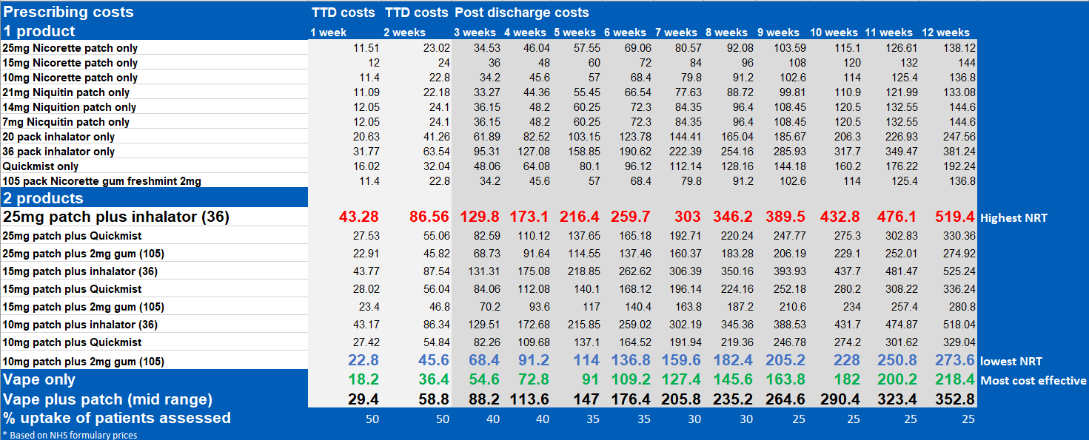
Ongoing work (peri-op/health optimization)
Cost per smoking-related admission
Cost of pharma per patient v cost of vaping per patient
Cost of pharma per quit
Average smoking-related admission hospital stay (length)
Take-up of TTD / Quits at 28 days
QI driving value and efficiency (protocols etc)
Reduction in smokers’ admissions/ readmissions
Martin Lever

Slide 10
Optimizing the system
Benefits the patient – stopping/slowing progression of disease, prevention = more QALYs
It makes economic sense – savings to the system
Peri-op/health optimization – huge opportunity
Core20PLUS5
Reduces smoking-related admissions and readmissions – more beds!
Creating space for elective care – reducing waiting times
Part of routine care
Invest now £, payback later ££££ - savings across the system, reduced primary and secondary care costs
The sooner someone quits, health benefits ++ for individual and financial savings ++ for the system
Admissions
Reductions in readmissions
Treatment
Reduced primary care appointments
Harm reduction
WIN WIN for the health system
Quits
health optimization
Martin Lever

Slide 11
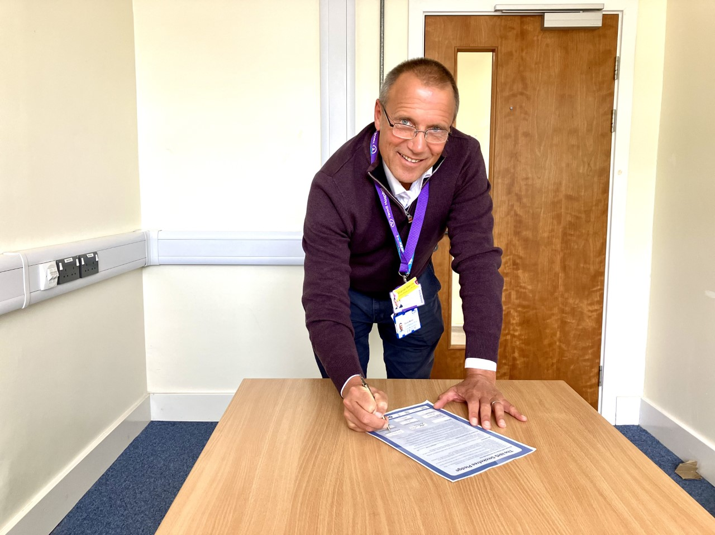
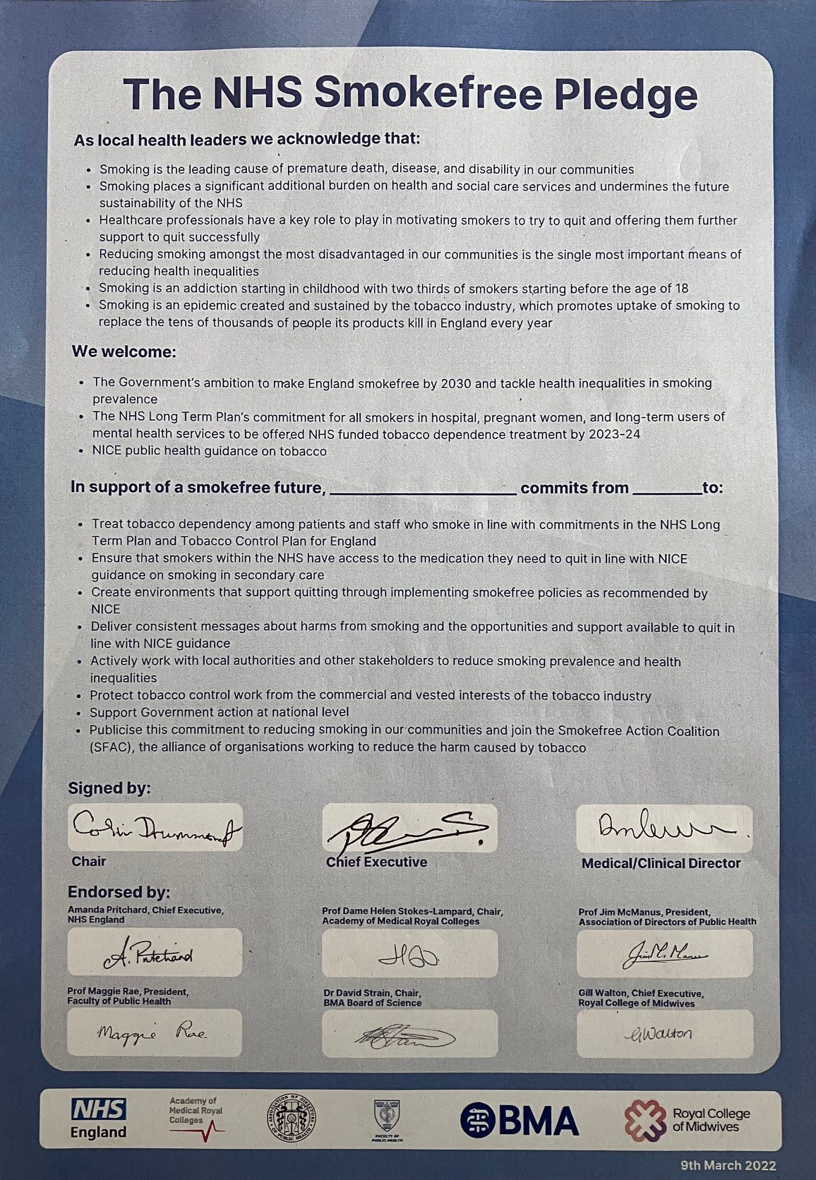
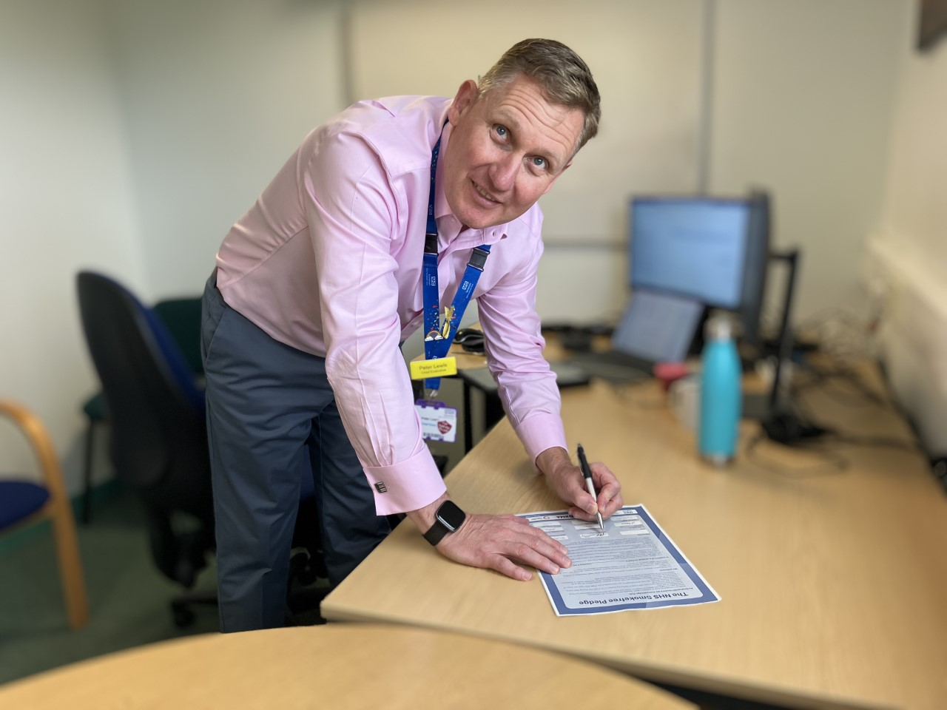
CMO – Dan Merron
Chief Exec –
Peter Lewis
Chair –
Peter Lewis
Thank you
martin.lever@somersetft.nhs.uk
Chair - Colin Drummond
Chief Executive - Peter Lewis

