Slide 1
The Three Biggest Killers
How can we learn from tobacco to tackle harms from alcohol and unhealthy food and drink regionally and locally?

Slide 2
Contents
You will find the below sections in this slide deck – use what you need in different contexts. Highlighted text throughout could be updated with local information/data.
Making the case for a coherent approach to the three biggest killers
Our vision
Phases and timelines
A coherent regional framework
Detailed description of the framework
Needs assessment
Stakeholder map
Local assets and deficits

Slide 3
Tobacco, alcohol and unhealthy food and drink are the leading causes of early death in the UK, contributing to a wide range of chronic diseases, including cancers, type 2 diabetes, cardiovascular disease, and dementia, plus significant mental health impacts
12% adults smoke
~ 0.5m hospital admissions
192k deaths
23% adults drink above low risk guidelines
> 1m hospital admissions
Over 22.5k deaths
65% adults live with overweight or obesity
> 1.2m hospital admissions
Over 30k deaths
Notes:
Amend this slide to cover relevant local data on tobacco, alcohol and obesity.
England data sources: all from DHSC Fingertips except hospital admissions for obesity (NHS Digital) and deaths for obesity (2021 Global Burden of Disease Study).

Slide 4
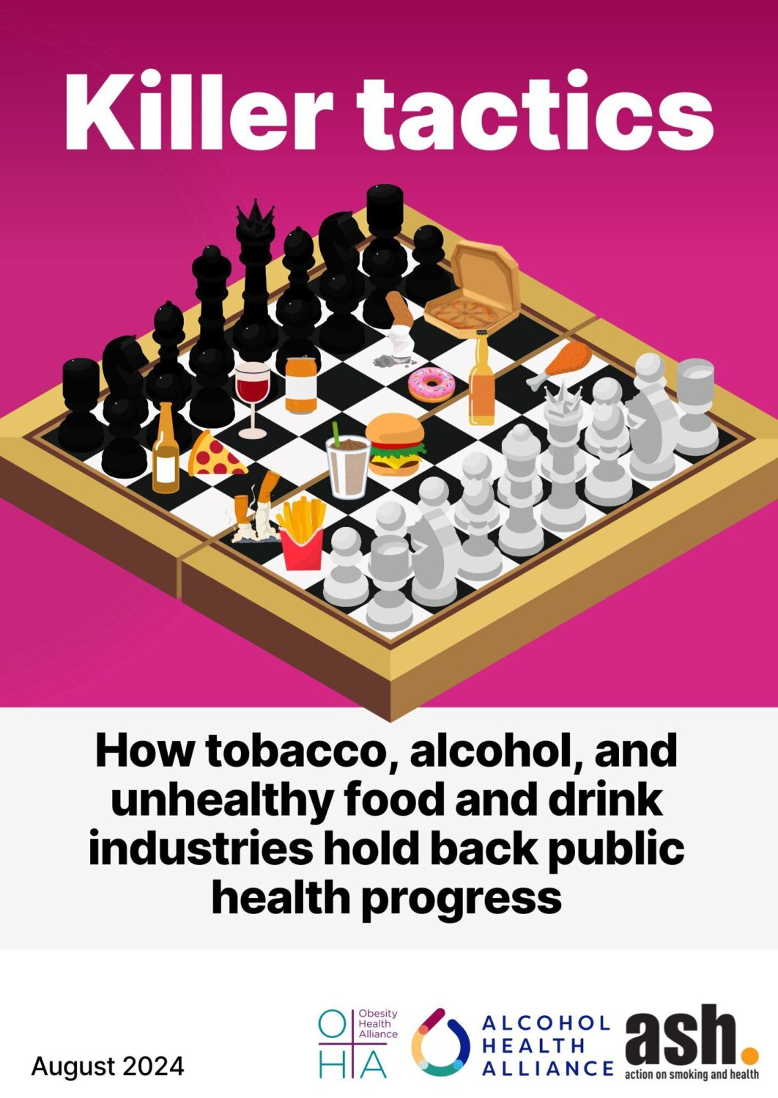
Industries not individuals
Industry ‘playbook’:
Distorting the science and messaging
Discrediting professionals
Legal threats
Positioning as part of the solution
Communicating through proxies
Corporate Social Responsibility
Industries saturate environments with harmful products and advertising – removing individual choice
Notes:
Industry uses a common playbook: around risks and harms; discrediting professionals; using legal threats; positioning themselves as part of the solution; using proxies to communicate their messages; using Corporate Social Responsibility, and giving incentives to politicians
Health harming industries saturate our environments with unhealthy products, targeting people in their homes, workplaces, neighbourhoods, schools and at social events.

Slide 5
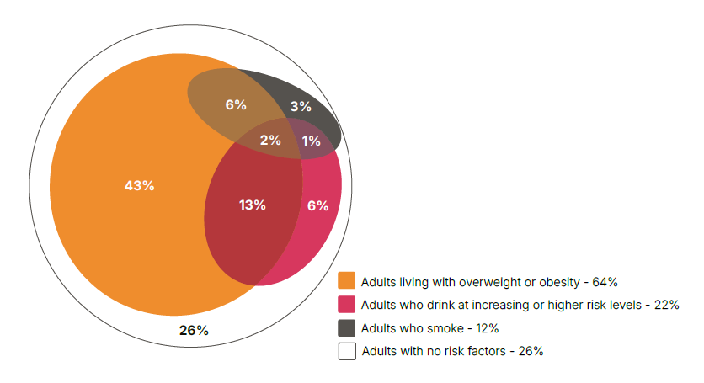
Overlap of risk factors
Harms overlap - 22% of adults have more than one risk factor
ASH analysis of 2021 Health Survey for England data
Notes:
Recent analysis of 2021 by ASH has shown that there is a significant overlap of harms with 22% of adults having more than one risk factor.
13% for overweight/obesity and increasing/higher risk drinking (equivalent to 5.6 million adults)
• 6% for overweight/obesity and smoking, (equivalent to 2.5 million adults)
• 1% for increasing or higher risk drinking and smoking, (equivalent to 0.6 million adults)
• 2% for all three risk factors (equivalent to 1.0 million adults)
This suggests that there is a strong argument for thinking holistically about risk factors and understanding better the interactions between them in our response.

Slide 6
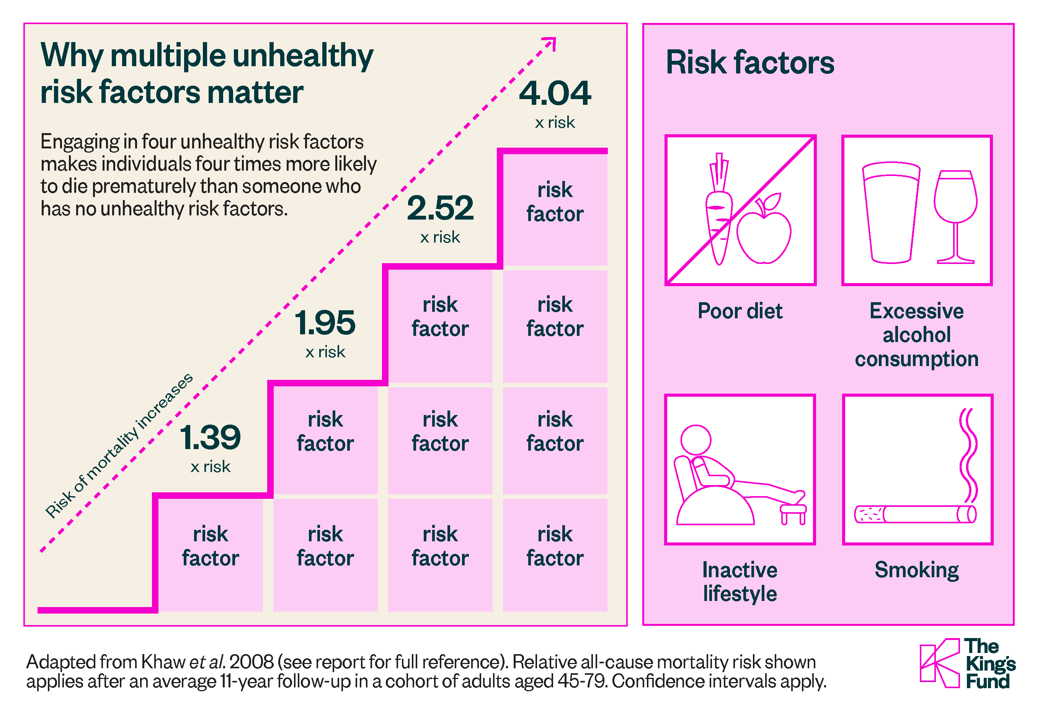
Harms are multiplicative
People with all four risk factors are 4 times as likely to die prematurely compared with people with none
Notes:
Harms are multiplicative – analysis by the Kings Fund found that people with 4 risk factors – poor diet, excessive alcohol consumption, smoking and inactivity, were 4 times more likely to die prematurely compared with people with none of those risk factors.
Source for figure: https://assets.kingsfund.org.uk/f/256914/x/8c21cf4377/tackling_multiple_unhealthy_risk_factors_2018.pdf

Slide 7
Worsening inequalities
Tobacco is responsible for up to half the difference in life expectancy between the highest and lowest sociodemographic groups
Deaths caused by alcohol are twice as high in the most disadvantaged areas
Children from more disadvantaged backgrounds are more likely to be living with overweight and obesity
Notes:
The 3 biggest killers disproportionately impact the most disadvantages communities.
You might have local data you could draw to demonstrate local inequalities.
Tobacco ref: Institute of Health Equity [Internet]. [cited 2025 Mar 24]. Fair Society Healthy Lives (The Marmot Review). Available from: https://www.instituteofhealthequity.org/resources-reports/fair-society-healthy-lives-the-marmot-review
Alcohol ref: Alcohol Profile - Data | Fingertips | Department of Health and Social Care [Internet]. [cited 2025 Mar 24]. Available from: https://fingertips.phe.org.uk/profile/local-alcohol-profiles/data#page/1
Obesity ref: Obesity Profile - Data | Fingertips | Department of Health and Social Care [Internet]. [cited 2025 Mar 24]. Available from: https://fingertips.phe.org.uk/profile/national-child-measurement-programme/data#page/7/gid/8000011/pat/159/par/K02000001/

Slide 8
Inequalities in commercial environments
Unhealthy commercial environments, with higher availability of unhealthy food and drink, alcohol and tobacco, cluster in the most disadvantaged areas – compounding inequalities
Include local data on commercial environments here if you have it
© 2023. Provided by Impact on Urban Health licensed via a CC BY-NC-ND 4.0 license.
Notes:
Add local photos and data if you have them

Slide 9
Public opinion
73% think the government has a role in protecting the public from harmful business practices
74% think that if business and health are in conflict government should prioritise health
Notes:
This isn’t just a public health priority, the public are on our side too.
Ref: https://ash.org.uk/media-centre/news/blog/profit-over-people-the-public-doesnt-trust-big-business-with-their-health-and-want-tough-action-on-the-three-big-killers

Slide 10
What can we learn from tobacco policy?
Smoking prevalence has been driven down over time through successful efforts to regulate the tobacco industry.
The alcohol and unhealthy food and drink industries use the same playbook as the tobacco industry.
Strategies to reduce harm from alcohol and unhealthy food and drink focus on many of the same approaches as tobacco policy including tackling:
Affordability
Availability
Promotion

Slide 11
Our Vision
Aim: to develop and implement a coherent prevention framework for tackling alcohol and unhealthy food and drink at system-level, building on the existing model for tobacco.
Outcome: a clear strategic framework in place with stakeholder support that will drive action to reduce preventable disease and deaths from tobacco, alcohol and unhealthy food and drink.
Audience: taking a regional lens: professionals and policy-makers in local government, NHS, ICBs, politicians, academics, the public.
Notes:
Amend this slide to set out what you hope to achieve locally with the development of the framework

Slide 12
Discovery phase (include months): project initiation, stakeholder mapping and analysis, needs assessment, asset and deficit mapping (what is and isn’t already happening), identify data sources/indicators
Construction phase (include months): develop and test framing, secure stakeholder buy-in for principles and framing etc, set out plan and strategic objectives.
Launch phase (include months): launch the new framework, begin monitoring period, embed in reporting structures
Phases and Timelines
Notes:
Amend this slide to explain to your audience how the process of developing your regional/local approach will work

Slide 13
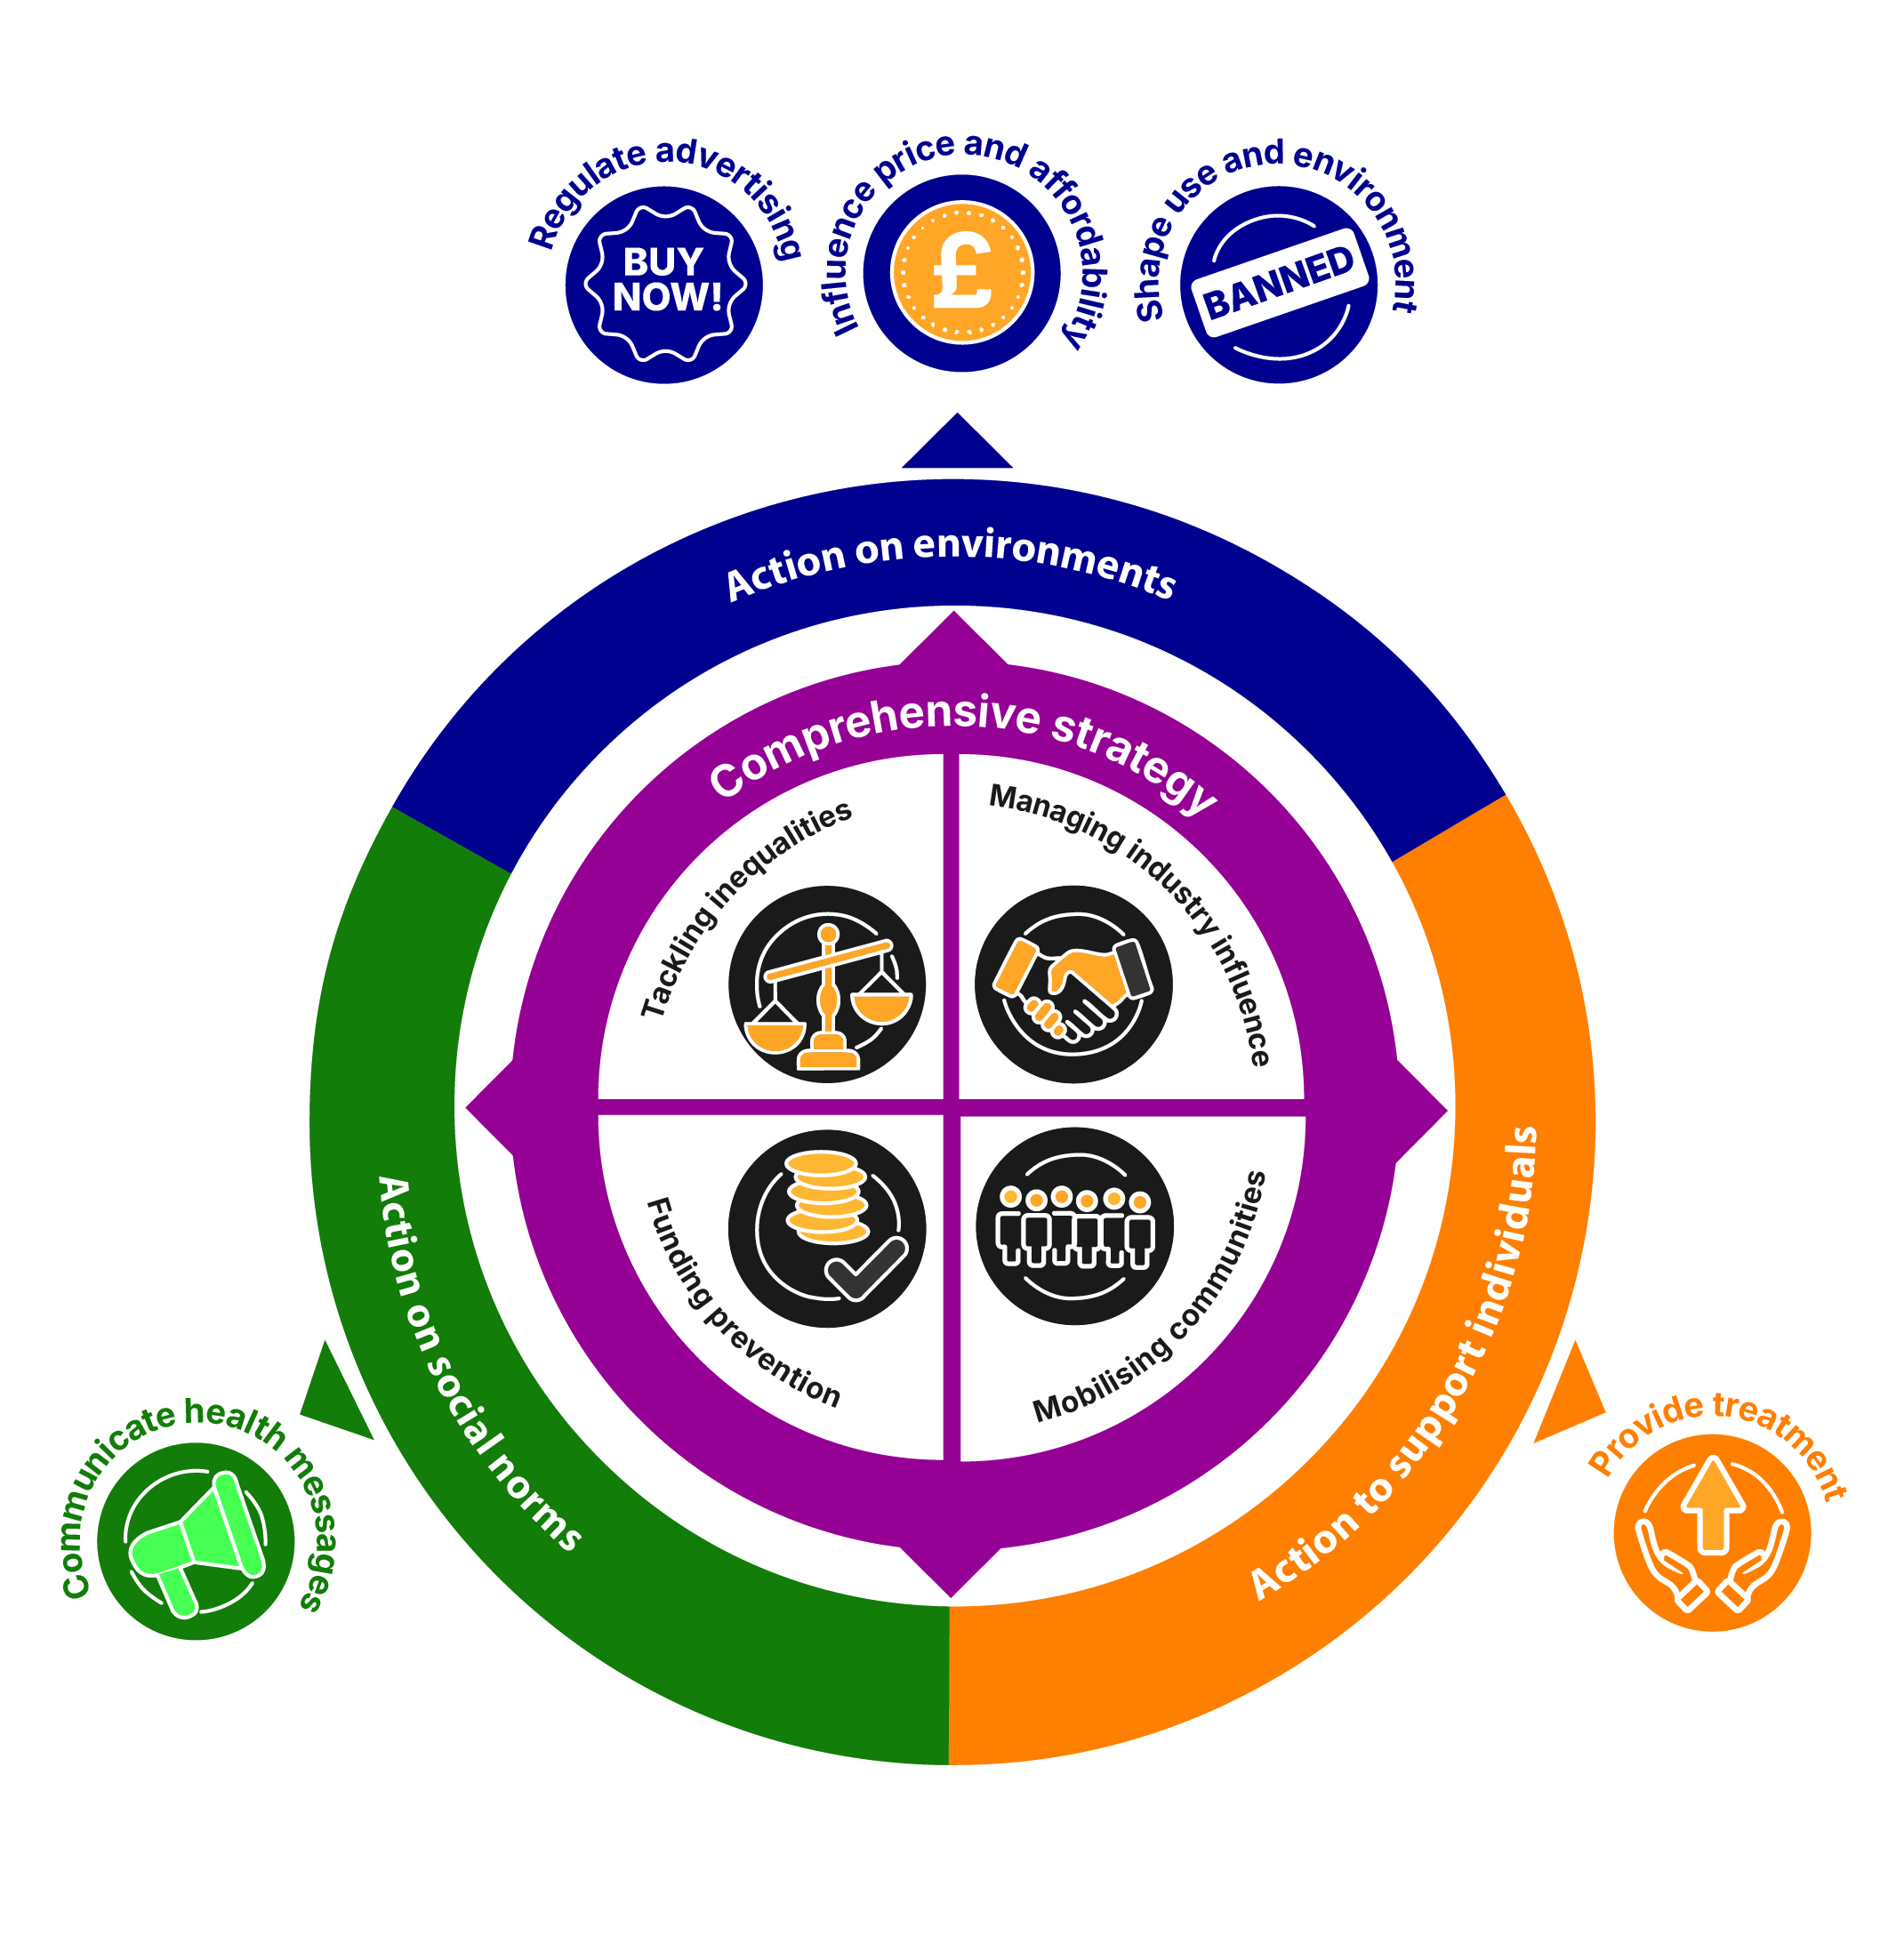
A framework for action
Notes:
A framework for action on the 3 biggest killers based on the ‘Holding us Back’ framework but adapted for use regionally and locally

Slide 14
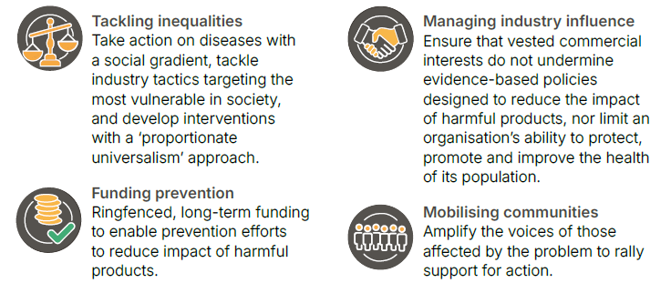
A comprehensive strategy
Notes:
The framework is underpinned by a strategic approach with 4 key enablers:
Tackling inequalities: take action on diseases with a social gradient, tackle industry tactics targeting the most vulnerable in society, and develop interventions with a ‘proportionate universalism’ approach.
Funding prevention: ringfenced, long-term funding to enable prevention efforts to reduce impact of harmful products.
Manging industry influence: ensure that vested commercial interests do not undermine evidence-based policies designed to reduce the impact of harmful products, nor limit an organisation’s ability to protect, promote and improve the health of its population.
Mobilising communities: amplify the voices of those affected by the problem to rally support for action.

Slide 15
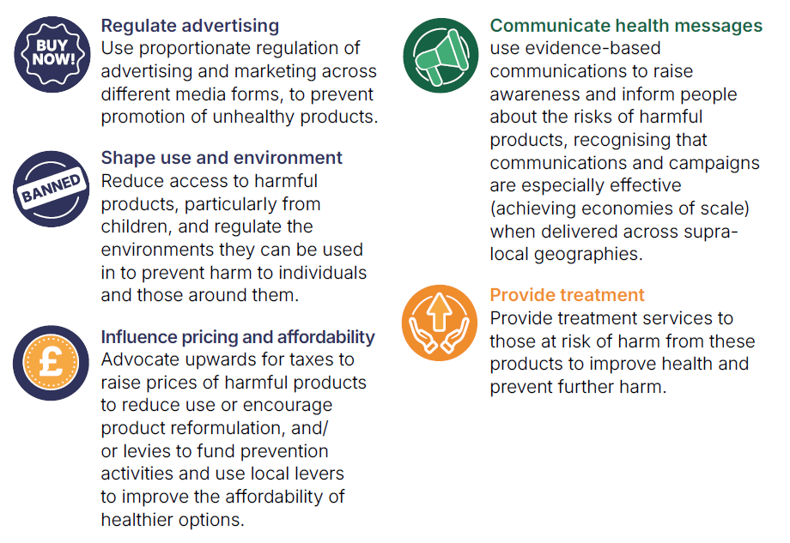
High impact actions
Notes:
These high impact actions have been inspired by what we know works in tobacco policy – but adapted and applied to alcohol and unhealth food and drink on a regional and local level.

Slide 16
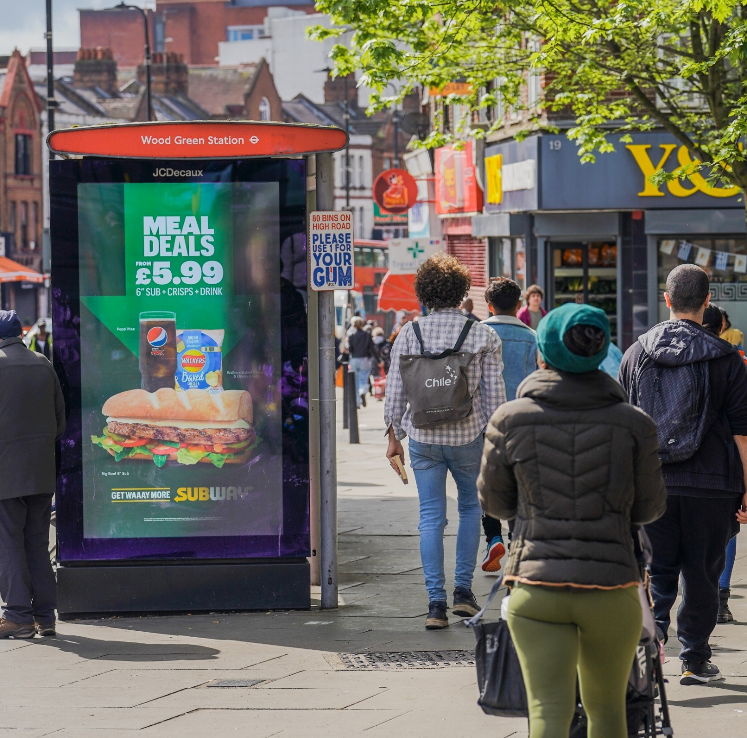
Regulate advertising
Use proportionate regulation of advertising and marketing across different media forms, to prevent promotion of unhealthy products.
Example:
Introduce a healthier advertising policy covering both alcohol and high fat, salt and sugar foods and consider who other harmful products could be included
© 2023. Provided by Impact on Urban Health licensed via a CC BY-NC-ND 4.0 license.

Slide 17
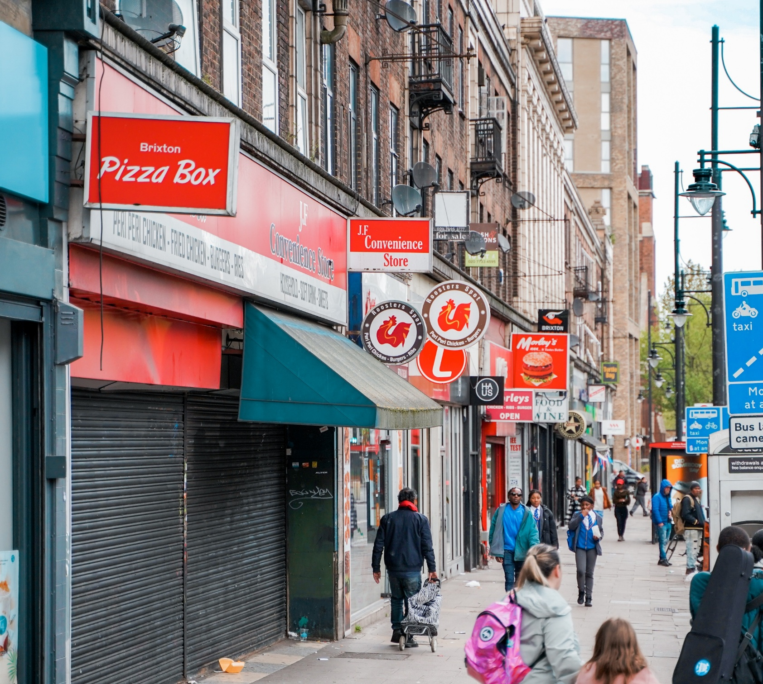
Shape use and environment
Reduce access to harmful products, particularly by children, and regulate the environments they can be used in to prevent harm to individuals and those around them.
Examples:
Use planning powers to restrict hot food takeaways around schools
Use licensing powers to limit opening hours for premises selling alcohol
© 2023. Provided by Impact on Urban Health licensed via a CC BY-NC-ND 4.0 license.

Slide 18
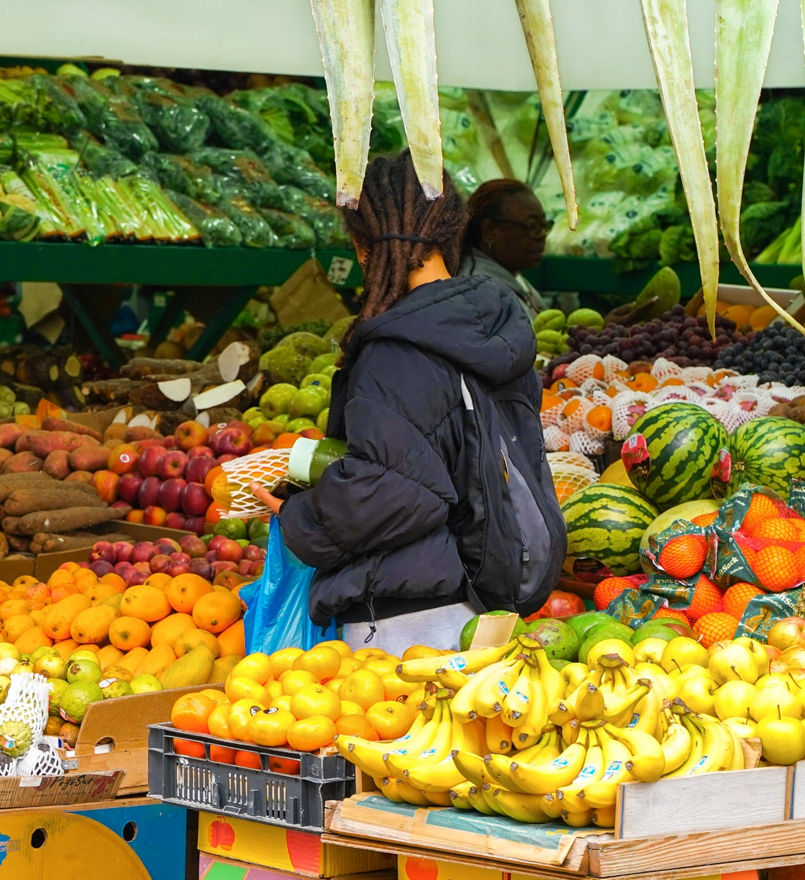
Influence price and affordability
Advocate upwards for taxes and minimum pricing policies to raise prices of harmful products to reduce use or encourage product reformulation, and/or levies to fund prevention activities, and consider actions that reduce the cost of good food for communities.
Examples:
Lobby nationally for minimum unit pricing for alcohol
Introduce auto-enrolment for free school meals
© 2023. Provided by Impact on Urban Health licensed via a CC BY-NC-ND 4.0 license.

Slide 19
Communicate health messages
Use evidence-based communications to raise awareness and inform people about the risks of harmful products, and the benefits of engaging in healthy behaviours.
Example:
Work with communities to spread evidence-based messages about alcohol
Coordinate mass-media campaigns on a regional footprint

Slide 20
Provide treatment
Provide treatment services to those already impacted by harmful products to improve health and prevent further harm.
Example:
Consider how treatment services can provide brief interventions across tobacco and alcohol dependence

Slide 21
Needs assessment
Use this slide to feedback key findings of your local needs assessment, focussing on the data you think will be most influential for the audience you are talking to

Slide 22
Stakeholder map
Use this slide to feedback your stakeholder mapping

Slide 23
Stakeholder analysis
Keep Satisfied | Manage Closely
Monitor | Keep Informed
Degree of power
Degree of interest
Notes:
Use this slide to feedback your stakeholder analysis if needed

Slide 24
Assets and deficits
Use this slide to feedback key findings of your asset and deficit mapping
Notes:
Amend this slide feedback from your asset and deficit mapping process

