Slide 1
Notes:
Thank you. Acknowledge funders. No financial or other COIs. Pre-recorded – here for questions.

Slide 2
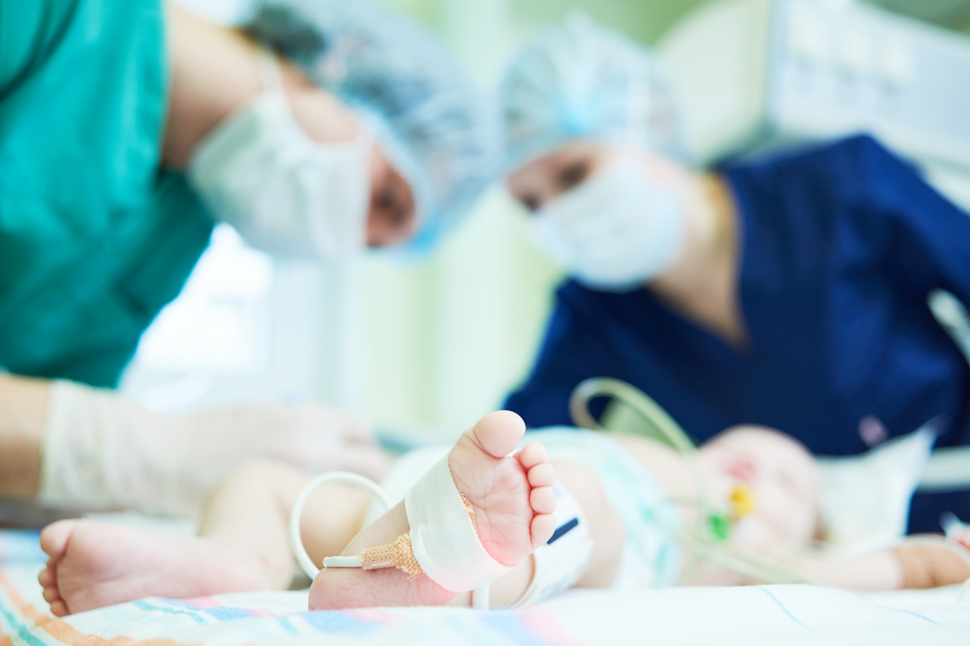
A smoke-free home intervention for families of babies admitted to neonatal intensive care
Notes:
LML is… Under development. Hope to launch later this year. Welcome feedback.

Slide 3
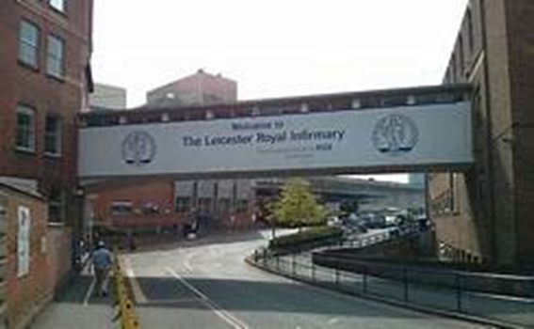
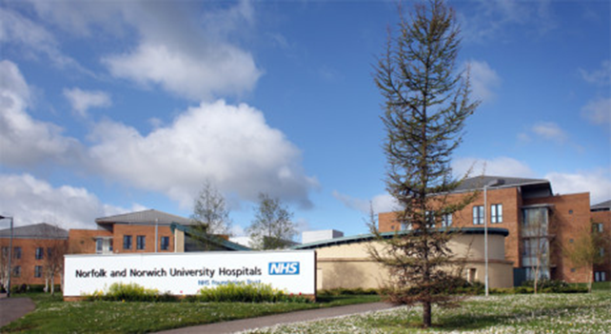
LOVE MY LUNGS – TEAM
Professor Caitlin Notley (Study Lead)
Dr Emma Ward (Researcher)
Louise Ross (Independent Smoking Cessation Training Consultant)
Amy Nicholls (NNUH NICU Research Nurse)
Kieran Reynolds (Web Developer)
Thanks to…
Immersive Medical – Dr Jordan Tsigarides
Hide and Seek Media
Notes:
Core team. Special mention Amy. From start. Fantastic asset.
LML born from development study NESCi Leicester and Norwich. Wider nesci team.

Slide 4
‘Love my Lungs’ is a whole unit approach – a smokefree NICU
The package has three parts according to parents’ situations:
Advice, guidance and support to create a smoke-free home environment
Supporting parents to stop smoking
Supporting parents to stay stopped from smoking (‘relapse prevention’)
The package includes training for NICU staff to offer this support

Slide 5
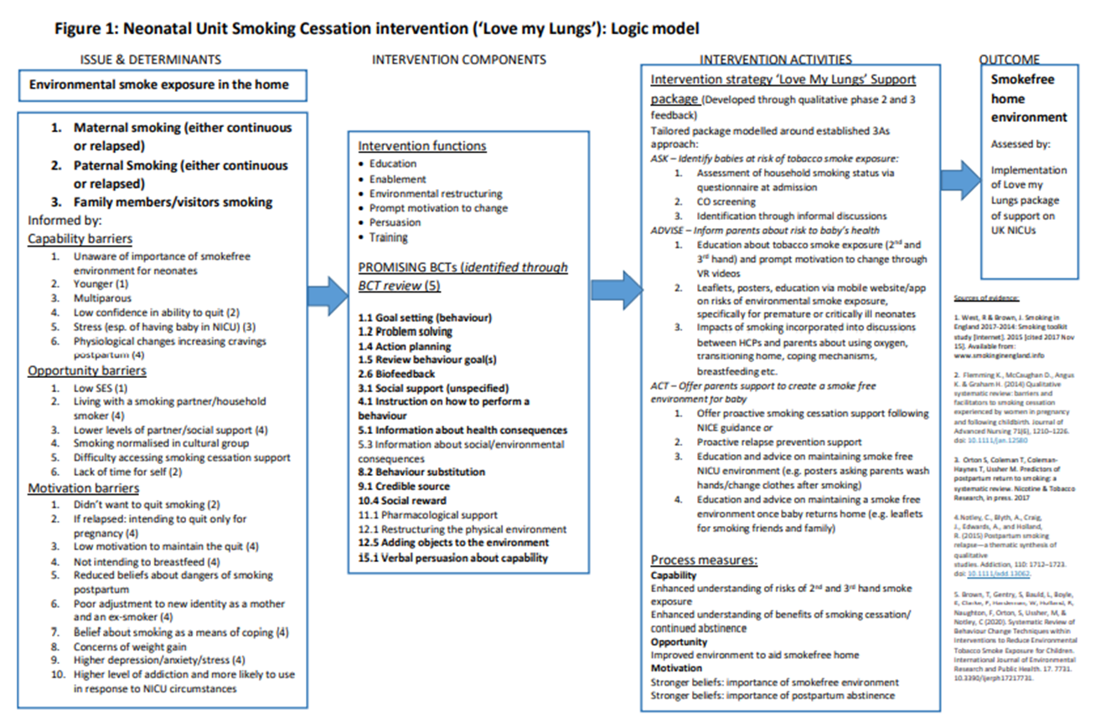
LOGIC MODEL
Notes:
NESCI findings develop intervention based on behaviour change theory.

Slide 6
Support from NICU staff: VERY BRIEF ADVICE
ASK
Identify babies at risk of tobacco smoke
ADVISE
Inform parents about the risks to babies’ health, and what is the best way to maintain a smoke free environment
ACT
Offer parents support to maintain a smoke free environment for baby
Notes:
Talk about VBA. You may already have heard about this approach, used widely by GPs and other HCP. But we are making it specific to NICU context…. Talk about each in turn with ideas about how you can implement this.

Slide 7
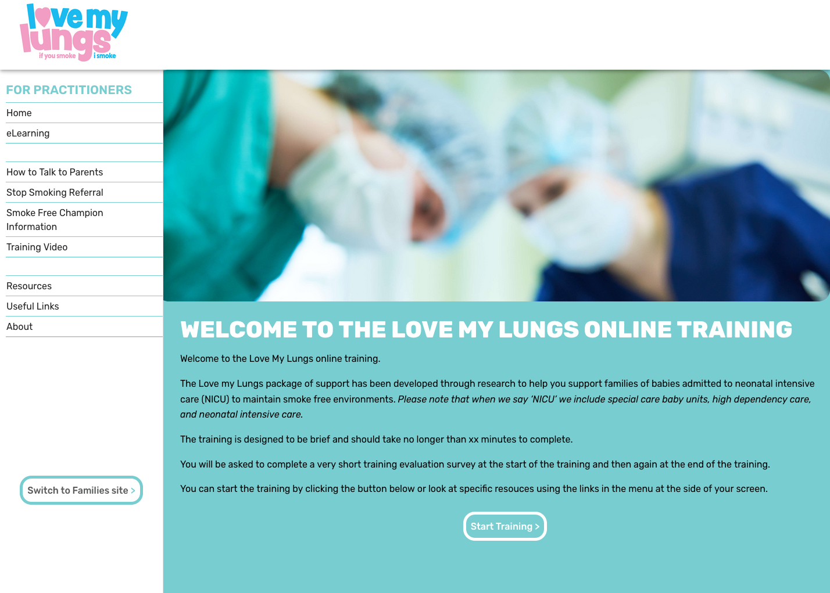
Support from NICU staff : Practitioner Training
Notes:
E learning module

Slide 8
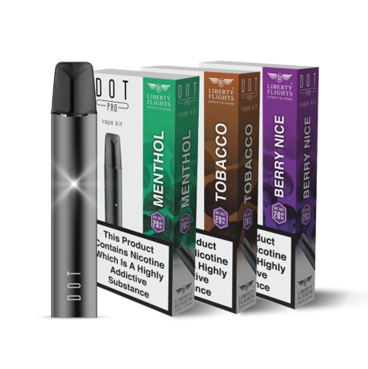
Support to stop smoking: NRT or an e cigarette
Notes:
Act part of intervention – offer support and NRT

Slide 9
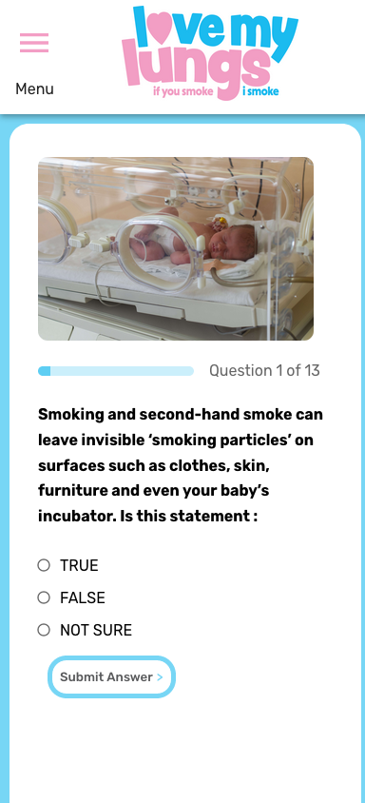
SUPPORT TO STAY SMOKEFREE: LOVE MY LUNGS WEBSITE
LOGIC MODEL
Notes:
‘responsive’ app based website for parents. NICU staff can show them this as part of the ‘ACT’ to offer support:
Virtual reality videos for parents
Quiz for parents
Resources (e.g. downloadable posters & leaflets, links to support and further information)

Slide 10
TIMELINE OF LML IMPLEMENTATION
Jun
Jul
Aug
Sep
Oct
Nov
Dec
Stage 2 research app
ASH webinar 22/06
Ongoing PPI
Intervention finalisation:
web development, video editing, user testing
Recruitment of NICUs for evaluation
Full evaluation *funding dependent
Notes:
Timeline now to submit grant app. Want to work with NICUs and more PPI

Slide 11
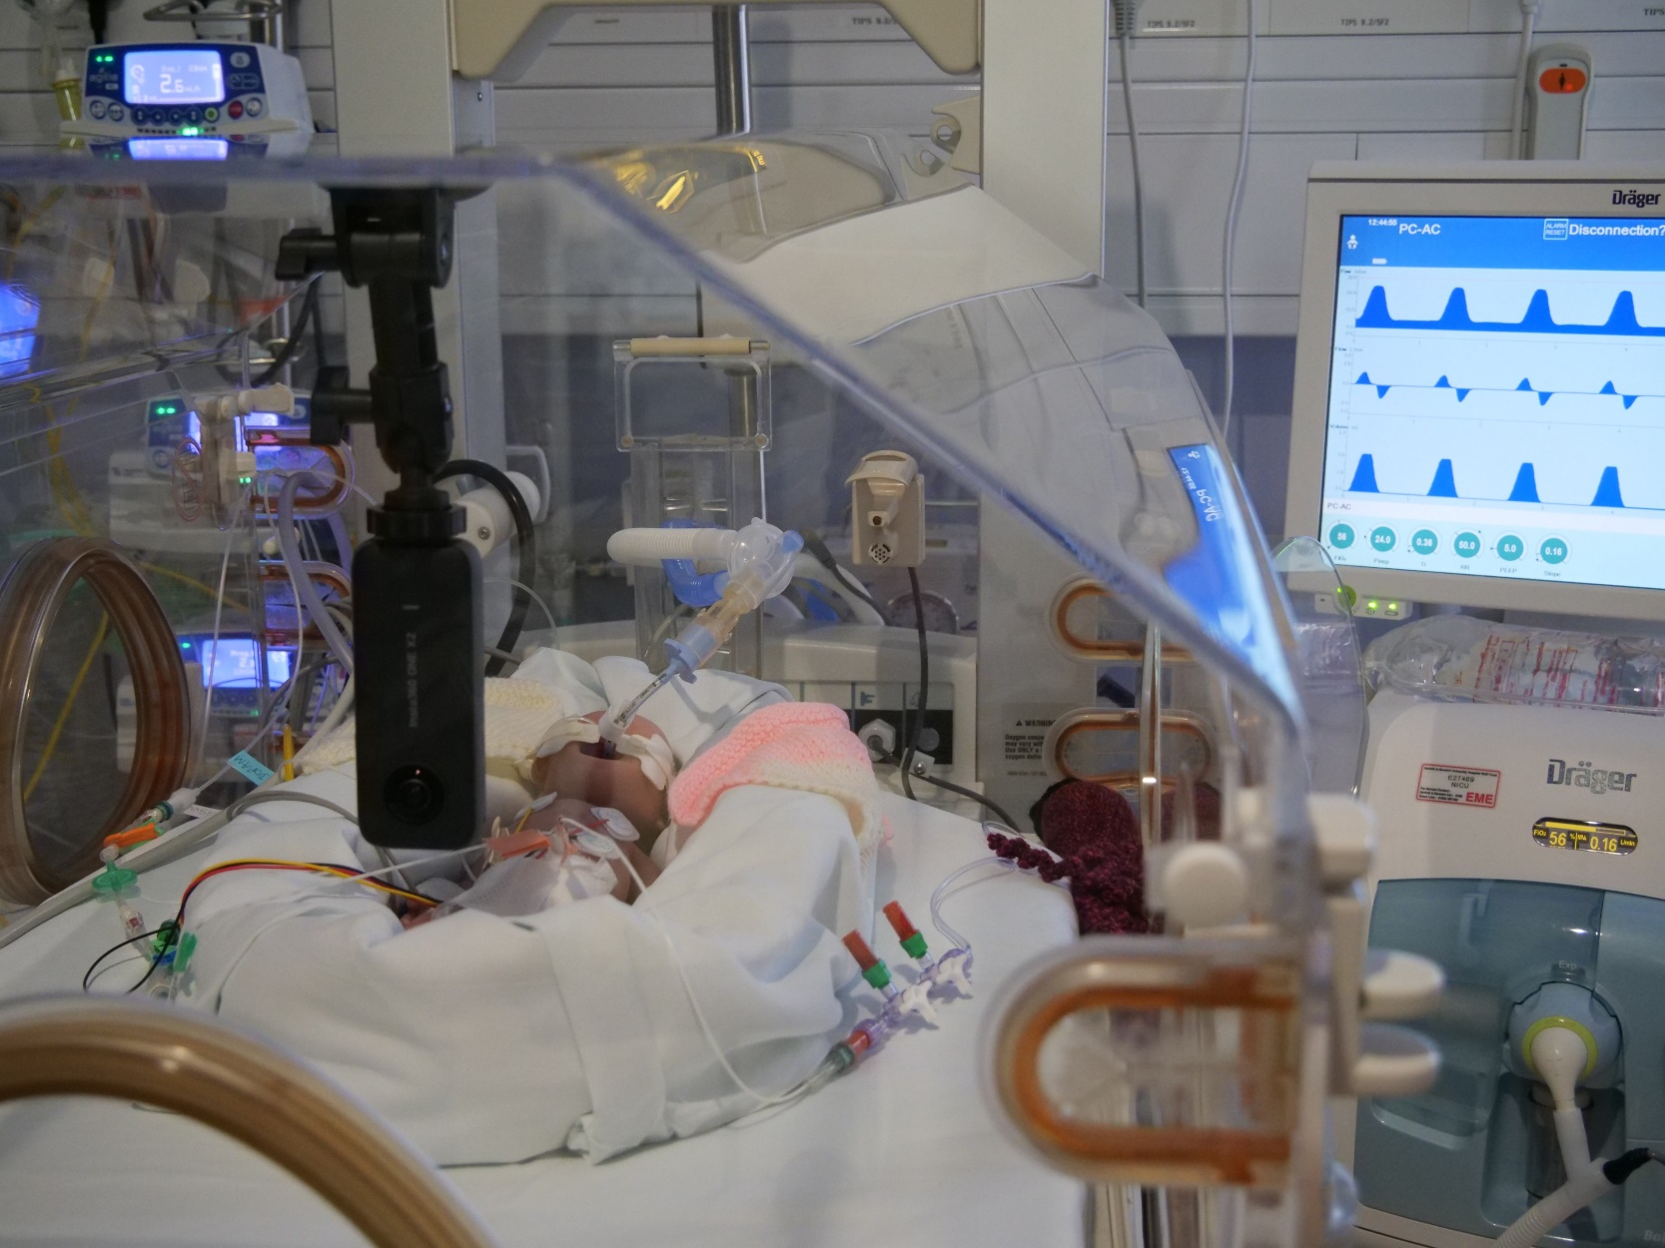
A smoke-free home intervention for families of babies admitted to neonatal intensive care
c.notley@uea.ac.uk
Notes:
Thank you for listening. I’m happy to answer any question. Questions in chat we can’t get to we can answer afterwards

