Slide 1
A TOBACCO CONTROL PLAN TO DELIVER A SMOKEFREE 2030
APPG on Smoking and Health Roundtable, 9th June 2021

Slide 2
ABOUT SPECTRUM
Consortium funded by the UK Prevention Partnership involving 10 Universities and partner organisations and alliances, including the main public health agencies in the UK and the Smokefree Action Coalition
Examines policy interventions operating at the population level to understand their system-level impacts on markets, producers, social practices and institutions.
Researches how unhealthy commodity producers influence the implementation (or not) or effective public health policies.
Provided evidence for the APPG on Smoking and Health report and recommendations for the forthcoming Tobacco Control Plan

Slide 3
OUTLINE
Progress to date: adults, children and smoking in pregnancy
APPG recommendations for a Smokefree 2030 – evidence and impact
Notes:
Assumption is made that the recommendations would be included in the Tobacco Control Plan for England to be published this year and that they would be implemented by the financial year 2022/3.

Slide 4
ADULT SMOKING PREVALENCE
Source: Office for National Statistics Adult Population Survey 2019
Notes:
At current rates of decline we will miss the target by seven years, and double that for the poorest in society. There are still nearly 6 million smokers in England, one in seven of the adult population. We will only achieve a Smokefree 2030 by motivating more smokers to make a quit attempt using the most effective quitting aids, while reducing the number of children and young adults who start smoking each year Cancer Intelligence Team, Cancer Research UK. Smoking prevalence projections for England, Scotland, Wales, and Northern Ireland, based on data to 2018/19. Published February 2020.
Cancer Intelligence Team, Cancer Research UK. Smoking prevalence projections for England, Scotland, Wales, and Northern Ireland, based on data to 2018/19. Published February 2020.

Slide 5
PERSISTENT INEQUALITIES NEED TO BE ADDRESSED IN THE NEW PLAN
Source: Office for National Statistics Adult Population Survey 2019

Slide 6
SMOKING IN PREGNANCY
Projected rate of decline
Decline needed to meet 6% target by 2022

Slide 7
Notes:
Smoking rates have gone down during a time when there has been substantial ratcheting up of tobacco control interventions. The impact of interventions like Smokefree public places legislation, the point of sale display ban, a ban on smoking in cars carrying children, and plain packaging and larger health warnings have now been banked and we can’t assume that smoking rates will continue to decline even at current rates without further ratcheting up.

Slide 8
APPG RECOMMENDED POLICY INTERVENTIONS
Smokefree 2030 Fund demonstrating global leadership
Set interim targets, measure progress and update as necessary
Targeted investment to level up and reduce inequalities
Low cost policy interventions to denormalise smoking

Slide 9
TARGETED INVESTMENT TO LEVEL UP AND REDUCE INEQUALITIES:
Deliver anti-smoking behaviour change campaigns targeted at routine and manual and unemployed smokers (C2DE).
Ensure all smokers are advised to quit at least annually and given opt-out referral to Stop Smoking Services.
Target support to give additional help to those living in social housing or with mental health conditions, who have high rates of smoking.
Ensure all pregnant smokers are given financial incentives to quit in addition to smoking cessation support
Fund regional programmes to reduce the use of illicit tobacco in deprived communities.

Slide 10
BEHAVIOUR CHANGE CAMPAIGNS TARGETED AT C2DE SMOKERS
Multi-media campaigns motivate quitting, discourage uptake + encourage smokers to use most effective means to quit
Effective and cost effective BUT funding cut from £23.3M in 2008/9 to £2.16M in 2018/19
Annual quit attempts fell by a quarter from 40% of adult smokers in 2008 to 30% in 2018
UCL estimates sustained campaigns with uplift for north and Midlands could deliver 164K extra quit attempts and nearly 7K long-term ex-smokers in first year among C2DE smokers
Highly cost-effect = £170 per quit attempt; £4K per long-term ex-smoker
In US sustained campaigns funded by tobacco manufacturers – why not here?
Quarterly spend by the Central Office of Information on tobacco campaigns correlates with the number of calls
to NHS helpline: R=0.70, p=0.002 adjusting for quarter, yearly increase and Smoke-Free

Slide 11
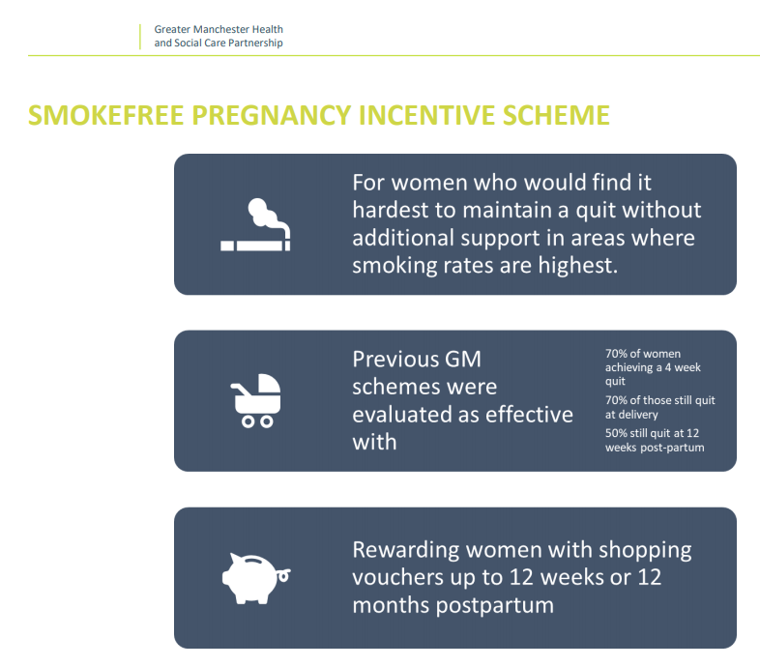
FINANCIAL INCENTIVES NEEDED TO MEET SMOKING IN PREGNANCY TARGETS
Systems approach + incentives
Smoking at time of delivery stagnated in recent years at around 10% = not on track to hit target of 6% or less by the end of 2022.
Significant declines only been delivered where pregnant smokers given financial incentives as well as smoking cessation advice
Highly cost-effective = cost per QALY of £482; return on investment of £4 for every £1 invested
UCL estimates that if delivered to all pregnant smokers smoking prevalence would be reduced by an additional 27% by 2030 to 3.2% on track to delivering a Smokefree generations.
Notes:
Information backing up what’s on slide in report

Slide 12
LOW COST POLICY INTERVENTIONS TO DENORMALISE SMOKING
Closing loopholes in existing regulations including by enhancing quit messaging on individual cigarettes and in packs
Regulating e-cigarettes and other nicotine products to protect young people while helping adult smokers to quit
Consider raising the age of sale for tobacco products from 18 to 21
Notes:
Full details and evidence set out in the report

Slide 13
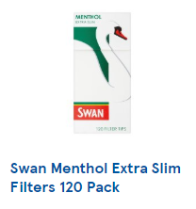
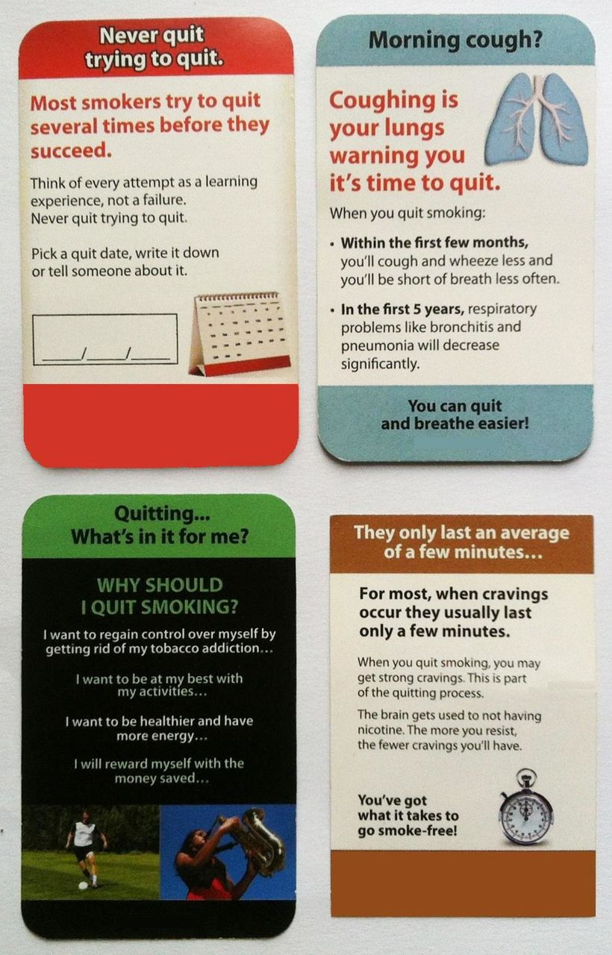
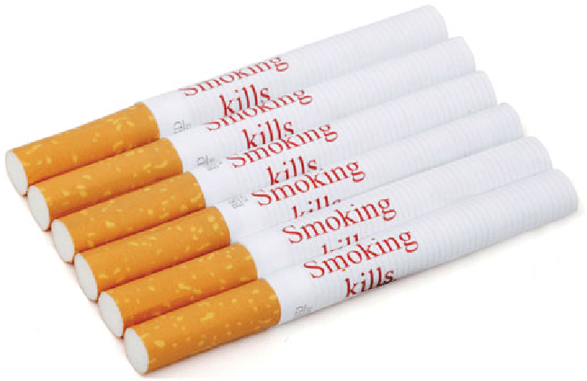
LOW COST POLICY INTERVENTIONS
APPG recommendations include:
Health warnings on cigarette sticks and rolling papers
Pack inserts promoting quitting
Closing loopholes in flavour ban
Notes:
SPECTRUM researchers in collaboration with ASH have identified loopholes in the existing legislation particularly on the ban on flavours which needs to be strengthened to be any flavours, not just so-called ‘characterising’ flavours, and to cover all tobacco products and accessories. Easier to do now we’re out of the EU.

Slide 14
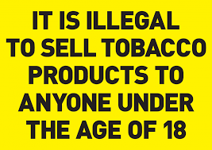
CONSULT ON RAISING AGE OF SALE TO 21
Strong evidence raising the age of sale would have significant impact
Almost all smokers (95%) begin smoking before they turn 21
Raising age of sale to 21 would reduce smoking rates in 18-20 yr olds by ~30%
= 95,000 fewer smokers 18-20 in year one (2022)
= 77.000 fewer 18-20 year olds taking up smoking between 2022 and 2030
= smoking prevalence of 2% in 18-20 yr olds by 2030
Notes:
Raising age of sale should be subject to consultation, and it’s important to consult children and young adults in particular as they will be most affected – this is the sort of policy which will only work if it is understood and supported like Smokefree places laws were which had over 95% compliance from day one.
However, this is a measure for which there is good evidence from what happened when age of sale rose from 16-18 in England and from 18 to 21 in US states – researchers at UCL have estimated that:
Smoking prevalence in 18-20 year olds would fall by around 30%
Resulting in 95 thousand fewer smokers in 2022 and an additional 77 thousand fewer 18-20 year olds taking up smoking long-term up until 2030. This would reduce smoking prevalence to 2% in 2030.

Slide 15
IN 2025 UPDATE PLAN IN LIGHT OF PROGRESS
APPG report and recommendations sets out a clear and impressive plan of action. And:
Sets out interim targets for 2025
Recommends improvements in data collection and analysis to inform progress
Also recommends review progress take further action if not on track by 2025
Notes:
Policy interventions the APPG recommends that the Government include in the forthcoming Tobacco Control Plan are supported by the evidence. They will work together synergistically to increase the rate of decline in smoking prevalence significantly, and even more importantly to reduce the high level of smoking-related inequalities across society.
However, as the Government itself acknowledged when it announced the Smokefree 2030 target, it is “extremely challenging”.
Therefore it is essential that interim targets are set for 2025, progress is carefully monitored and that the Tobacco Control Plan is reviewed and further action is taken if we are not on track by then for a Smokefree 2030.

Slide 16
Thank you – Linda.Bauld@ed.ac.uk @LindaBauld
This work is supported by the UK Prevention Research Partnership (MR/S037519/1), which is funded by the British Heart Foundation, Cancer Research UK, Chief Scientist Office of the Scottish Government Health and Social Care Directorates, Engineering and Physical Sciences Research Council, Economic and Social Research Council, Health and Social Care Research and Development Division (Welsh Government), Medical Research Council, National Institute for Health Research, Natural Environment Research Council, Public Health Agency (Northern Ireland), The Health Foundation and the Wellcome Trust.

