Slide 1




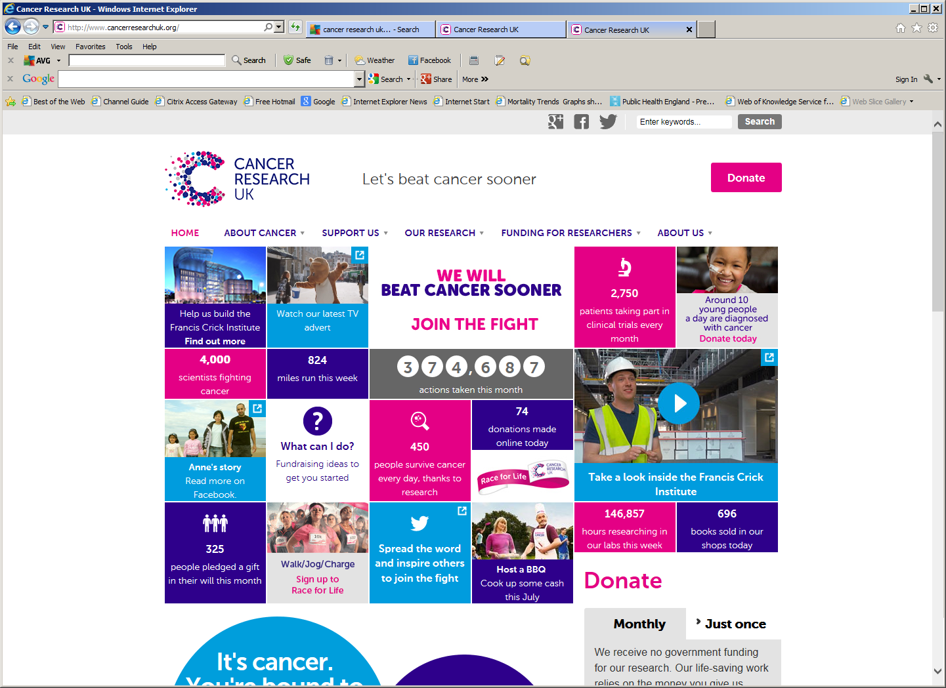

Use of Nicotine in Pregnancy
@LindaBauld

Slide 2
Outline
Smoking in pregnancy
Nicotine Replacement Therapy in pregnancy
Nicotine and tobacco harm reduction
Cochrane review
SNAP Trial
Evidence from non randomised studies
Ongoing research

Slide 3
Smoking in pregnancy in England
Latest national Tobacco Control Plan set a 2022 target of 6% - to reach it will require a near doubling of the current rate of decline nationally

Slide 4
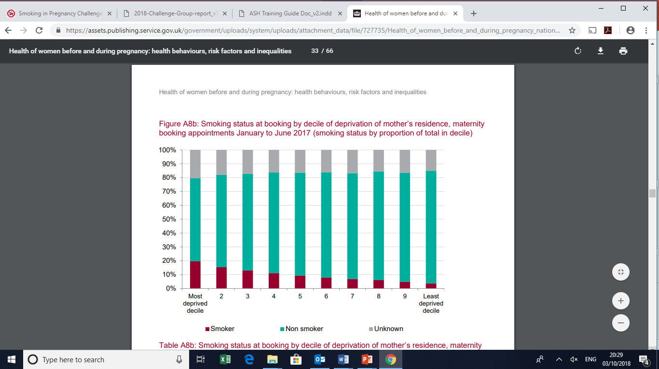
Steep social gradient in smoking in pregnancy

Slide 5
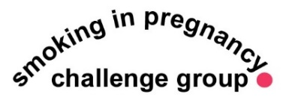
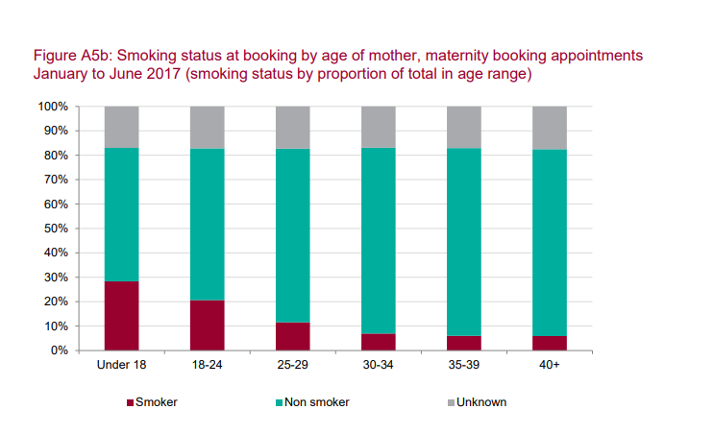
Gradient by Age

Slide 6
Impact of smoking in pregnancy
 | Maternal smoking | Passive smoking
Low birth weight | Average 250g lighter | Average 30-40g lighter
Stillbirth | Double the likelihood | Increased risk
Miscarriage | 24%-32% more likely | Possible increase
Preterm birth | 27% more likely | Increased risk
Heart defects | 50% more likely | Increased risk
Sudden Infant Death | 3 times more likely | 45% more likely
Source: www.smokefreeaction.org.uk/smokefree-nhs/smoking-in-pregnancy-challenge-group/ - draws on systematic
reviews initially reported in the Royal College of Physicians report on passive smoking & children (2014), updated
Reviews 2018.

Slide 7
Nicotine Replacement Therapy in Pregnancy
Licensing changed in 2005 to allow prescriptions for pregnant women and other priority groups (i.e. patients with CVD, children over the age of 12)
Widely prescribed including to women accessing stop smoking services across the UK
Endorsed in 2010 NICE guidance, although health professionals to use clinical judgement and discuss risks and benefits with women
No evidence of effectiveness for smoking cessation in pregnancy (see later in the presentation)
  increased metabolism a likely explanation, along with limited adherence

Slide 8
Some basics: where does nicotine come from?
Nicotine is present is several types of plants in the nightshade family. This includes potatoes, aubergine, tomatoes and red peppers
It also includes the tobacco plant
Nicotine can be produced synthetically, but this is expensive and not commercially viable
Nicotine in cigarettes, other tobacco products (including oral tobacco ) and Nicotine Replacement Therapy comes from the tobacco leaf
It is both a sedative and a stimulant and affects the heart rate, breathing activity and blood pressure. It may improve memory and concentration
Nicotine can be addictive but it depends on the mode of delivery

Slide 9
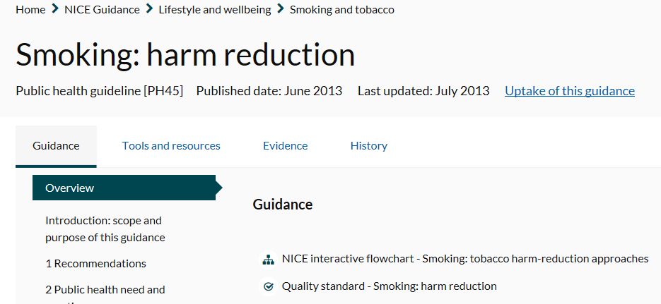
Guidance on Nicotine
The UK has formal guidance on tobacco harm reduction and this guidance has, as its basis, evidence reviews on nicotine primarily in the form of Nicotine Replacement Therapy
The reviews conducted for the guidance did not cover pregnancy, but make it clear that there are no circumstances under which it is safer to smoke than to use NRT
The guidance endorses the use of NRT for: temporary abstinence, cutting down, smoking cessation and long term use (relapse prevention)

Slide 10
Pregnant smokers are worried about nicotine
Qualitative studies with pregnant smokers illustrate real concerns about nicotine separate from smoking
These relate to safety, addictiveness, and whether using NRT increases the risk of relapse to smoking
UK studies also suggest that advice and support from health professionals regarding nicotine + NRT is inconsistent
I can remember the conversation we had about it and [the smoking cessation advisor] was letting me know where I can put [the patches] and what not, but to myself I just thought no, that’s just a bit too – you know you sit there thinking about it. I don’t know, it’s weird, I just think it’s too close to the baby to be having all that nicotine going in
My main concern was obviously ‘smoking passes on horrible chemicals to the child, does this [NRT] still do that’
Source: Bowker, K et al (2015) Understanding pregnant smokers’ adherence to
nicotine replacement therapy during a quit attempt: a qualitative study.
Nicotine & Tobacco Research, 18(5), 906-912.

Slide 11
Cochrane Review: NRT in pregnancy
Most recent review of RCTs examined the efficacy and safety of smoking cessation pharmacotherapies in pregnancy.
9 trials of NRT and one of bupropion identified up to July 2015
Overall finding: There were no differences between NRT and control groups in rates of miscarriage, stillbirth, premature birth, birthweight, low birthweight, admissions to neonatal intensive care, caesarean section, congenital abnormalities or neonatal death.
Non‐serious side effects observed with NRT included headache, nausea and local reactions (e.g. skin irritation from patches or foul taste from gum), but these data could not be pooled.
Source: Coleman T, Chamberlain C, Davey MA, Cooper SE, Leonardi‐Bee J (2015) Pharmacological interventions for promoting smoking cessation
during pregnancy. Cochrane Database of Systematic Reviews. https://www.cochranelibrary.com/cdsr/doi/10.1002/14651858.CD010078/full

Slide 12
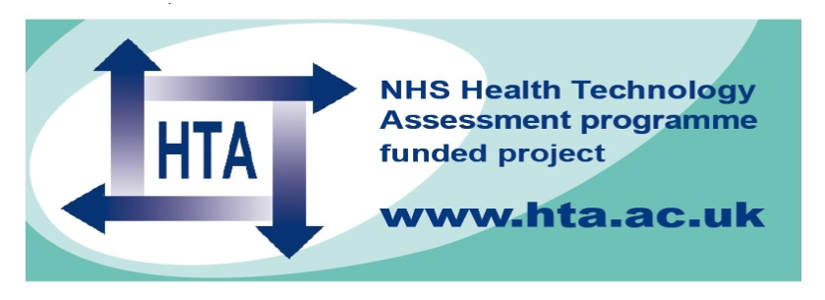
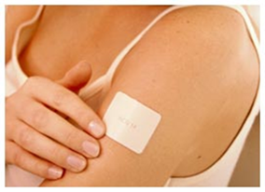
SNAP Trial
1050 Participants
12-24 weeks
>5 cigs/day (>10 pre-pregnancy)
CO>8ppm
Behavioural support
& up to 8 weeks 15mg/16hr nicotine patch offered
Behavioural support
& up to 8 weeks placebo patch offered
Followed up: 1 month & delivery
By questionnaire until infants 2 years old
Led by Prof Tim Coleman, University of Nottingham. 15mg/16hr patch used.
Mean gestational age at recruitment 16 wks

Slide 13
SNAP Findings
% validated cessation
Non significant
1.26 (0.82 -1.96)
Source: Coleman, T., Cooper, S., Thornton, J. G., Grainge, M. J., Watts, K., Britton, J., & Lewis, S. (2012).
A randomized trial of nicotine-replacement therapy patches in pregnancy. New England Journal of Medicine, 366(9), 808-818.
Notes:
13

Slide 14
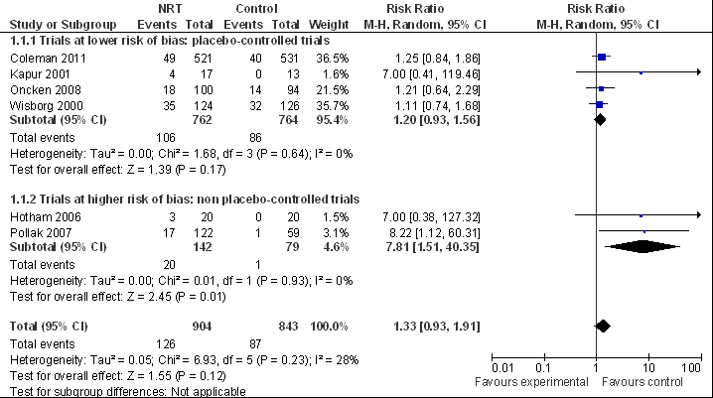
Effectiveness of single product NRT for smoking cessation in Pregnancy
NRT

Slide 15

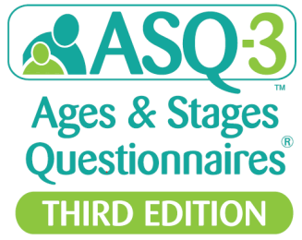
SNAP Follow up objectives
To compare at 2 years after delivery, the impact of NRT & placebo on:
Infant survival without impairment: no disability or problems with development
  ASQ-3: screening instrument, high sensitivity & specificity. 5 domains: communication, fine and gross motor, problem solving, personal-social. All needed to be normal.
Infant respiratory symptoms
Maternal prolonged smoking abstinence
Source: Cooper, S., Taggar, J., Lewis, S. et al(2014). Effect of nicotine patches in pregnancy on infant and maternal outcomes at 2 years: follow-up
from the randomised, double-blind, placebo-controlled SNAP trial. The Lancet Respiratory Medicine, 2(9), 728-737.

Slide 16
Responses to parental and health professional questionnaires at 2 years
1,050 randomised
NRT 521
Placebo 529
302 (58%)
PQ2
304 (57%)
146 (28%)
HPQ
148 (28%)
Total returned: 448 (86%)
Outcome data
Total returned: 452 (85%)
Live singleton births: 503
Total returned: 445 (88.5%)
Live singleton births: 507
Total returned: 446 (88.0%)

Slide 17
Infant outcomes at 2 years
Multiple imputation ITT analysis [singleton live births n=1010] | Outcomes allocated from PQ2 or HPQ |  | OR (95% CI)
 | NRT | Placebo
Survival with no impairment (primary outcome) | 323/445 (73%) | 290/443 (65%) | 1.40 (1.05-1.86) (p=0.023)
Respiratory problems | 132/444 (30%) | 111/444 (25%) | 1.30 (0.96-1.77)
Similar findings for complete case analyses (i.e. just those with returned questionnaires), including those adjusted for clustering by twin births, and in PQ2 only analyses

Slide 18
SNAP Follow up: implications
1st trial of smoking cessation intervention in pregnancy to assess infant outcomes at 2 years
First time a smoking cessation intervention seen to have beneficial effect on pregnant smokers’ children
Better developmental outcomes of infants in the NRT group due to reduced smoking?

Slide 19
Evidence on Safety from non-RCT studies
In addition to the Cochrane review and the SNAP trial there is some evidence on safety from non-randomised controlled trials
These studies look at key pregnancy and birth outcomes including:
  Preterm birth
  Birth weight
  Small for gestational age
  Still birth
  Congenital abnormalities
  & other outcomes

Slide 20
Evidence on Safety from non-RCT studies
Findings from non-RCT studies are consistent with those from the Cochrane review and provide additional detail. They primarily examine women who smoke or use NRT (or both) in pregnancy
Overall, for the outcomes mentioned in the last slide, there is a lower rate of negative pregnancy-related health outcomes when NRT is used in pregnancy compared to smoking.
In addition, NRT used by smokers is not associated with poor outcomes but smoking alone is, suggesting NRT may have a protective effect
One outcome that may be worse in NRT users (with or without smoking) is infant colic. But an improvement in other pregnancy outcomes when NRT is used as an alternative to smoking probably outweigh any risk of colic.

Slide 21
Ongoing research: N-Ready Programme
NIHR HTA funded programme led by Professor Tim Coleman at the University of Nottingham
Contains a series of work streams including several systematic reviews, one is on the safety of NRT in pregnancy
Future trial of higher dose (combination therapy) NRT planned
Should provide valuable new evidence on the effectiveness of NRT in pregnancy and inform future updated NICE guidelines

Slide 22
Summary
Smoking in pregnancy remains a significant public health challenge that results in adverse outcomes for mothers and children
NRT is widely prescribed for smoking cessation in pregnancy in the UK
A high quality UK trial adds to international evidence suggesting single product NRT isn’t effective for cessation but does not result in harm to infants
Non randomised studies also suggest that using NRT in pregnancy is far safer than smoking
Ongoing research is underway, but for now the priority remains to support women to stop smoking in pregnancy, including by continuing to use nicotine in less harmful forms than in cigarettes.

Slide 23
Thank You
Linda.Bauld@ed.ac.uk
@LindaBauld

