Slide 1

Rapid Evidence Update
Professor Linda Bauld
ASH & Smoking in Pregnancy Challenge Group Webinar May 14th 2021
@LindaBauld @SPECTRUMRes

Slide 2

Outline
Context
Nicotine use in pregnancy – NRT and E-cigarettes
Financial incentives
Relapse prevention

Slide 3
Context

Slide 4
Covid-19 and smoking in pregnancy research
Most existing studies involving pregnant women in the UK (on many topics/areas of research) were paused from March 2020 until recently, in terms of face to face data collection and investigations
Studies that had follow up by phone or online continued, or those that involved sending a saliva sample (for biochemical validation of smoking abstinence) by post
New studies that were due to commence in 2020/early 2021 did not start – and are now aiming to begin now/in the coming months
So we’ve lost around a year of smoking in pregnancy research, but things are getting back on track

Slide 5
Nicotine use in pregnancy

Slide 6
Nicotine – background
Nicotine is a naturally occurring substance present is several types of plants in the nightshade family. This includes potatoes, aubergine, tomatoes and red peppers
It also includes the tobacco plant (Nicotiana tabacum)
Nicotine can be produced synthetically, but this is expensive and not commercially viable
Nicotine in cigarettes, other tobacco products (including oral tobacco ) and Nicotine Replacement Therapy comes from the tobacco leaf
It is both a sedative and a stimulant and affects the heart rate, breathing activity and blood pressure. It may improve memory and concentration
Nicotine can be addictive but it depends on the mode of delivery

Slide 7
Nicotine Replacement Therapy in pregnancy
Licensing changed in 2005 to allow prescriptions for pregnant women and other priority groups (i.e. patients with CVD, children over the age of 12)
Widely prescribed including to women accessing stop smoking services across the UK
Endorsed in NICE guidance, although health professionals to use clinical judgement and discuss risks and benefits with women
Limited evidence of effectiveness for smoking cessation in pregnancy (see next slide)
  increased metabolism a likely explanation, along with limited adherence

Slide 8
Cochrane review – NRT and buproprion in pregnancy
Most recent review of RCTs (2020) examined the efficacy and safety of smoking cessation pharmacotherapies in pregnancy.
Nine trials of NRT and two of bupropion identified
Overall findings: NRT used for smoking cessation in pregnancy may increase smoking cessation rates in late pregnancy. However, this evidence is of low certainty, as the effect was not evident when potentially biased, nonplacebocontrolled RCTs were excluded from the analysis. Future studies may change this conclusion. Review found no evidence that NRT has either positive or negative impacts on birth outcomes; however, the evidence for some of these outcomes was also judged to be of low certainty due to imprecision and inconsistency. Review found no evidence that bupropion may be an effective aid for smoking cessation during pregnancy, and there was little evidence evaluating its safety in this population.
Safety: There was no evidence of a difference between NRT and control groups in rates of miscarriage, stillbirth, premature birth, birthweight, low birthweight, admissions to neonatal intensive care, caesarean section, congenital abnormalities, or neonatal death.
Source: Claire, R, Chamberlain C, Davey MA, Cooper SE, Berlin, I, Leonardi‐Bee, Coleman, T (2020) Pharmacological interventions for promoting smoking
cessation during pregnancy. Cochrane Database of Systematic Reviews. https://www.cochranelibrary.com/cdsr/doi/10.1002/14651858.CD010078.pub3/full

Slide 9

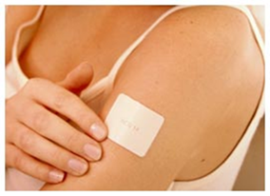
SNAP Trial
1050 Participants
12-24 weeks
>5 cigs/day (>10 pre-pregnancy)
CO>8ppm
Behavioural support
& up to 8 weeks 15mg/16hr nicotine patch offered
Behavioural support
& up to 8 weeks placebo patch offered
Followed up: 1 month & delivery
By questionnaire until infants 2 years old
Led by Prof Tim Coleman, University of Nottingham. 15mg/16hr patch used.
Mean gestational age at recruitment 16 wks

Slide 10
SNAP Follow-up objectives
To compare at 2 years after delivery, the impact of NRT & placebo on:
Infant survival without impairment: no disability or problems with development
  ASQ-3: screening instrument, high sensitivity & specificity. 5 domains: communication, fine and gross motor, problem solving, personal-social. All needed to be normal.
Infant respiratory symptoms
Maternal prolonged smoking abstinence
Source: Cooper, S., Taggar, J., Lewis, S. et al(2014). Effect of nicotine patches in pregnancy on infant and maternal outcomes at 2 years: follow-up
from the randomised, double-blind, placebo-controlled SNAP trial. The Lancet Respiratory Medicine, 2(9), 728-737.

Slide 11
Infant outcomes at 2 years
Multiple imputation ITT analysis [singleton live births n=1010] | Outcomes allocated from PQ2 or HPQ |  | OR (95% CI)
 | NRT | Placebo
Survival with no impairment (primary outcome) | 323/445 (73%) | 290/443 (65%) | 1.40 (1.05-1.86) (p=0.023)
Respiratory problems | 132/444 (30%) | 111/444 (25%) | 1.30 (0.96-1.77)
Similar findings for complete case analyses (i.e. just those with returned questionnaires), including those adjusted for clustering by twin births, and in PQ2 only analyses

Slide 12
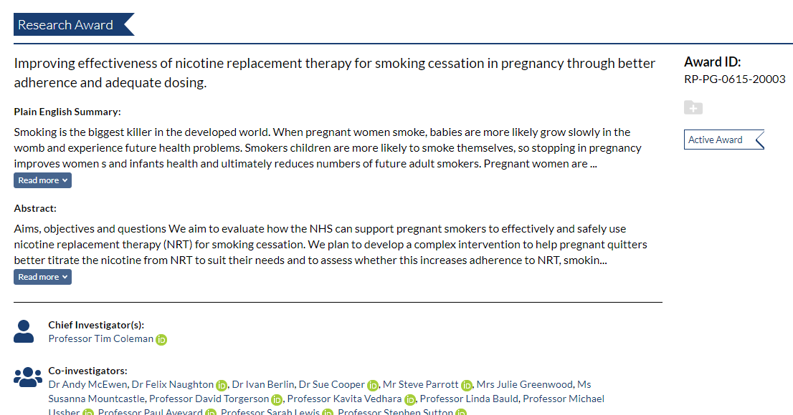
Ongoing Research

Slide 13
E-cigarettes in pregnancy
Still limited research. Systematic review recently completed for 2019 PHE E-cigarette report – 27 studies identified, nothing on safety
UK studies – limited to a national survey and qualitative research
Large UK trial completed recruitment and follow up, due to report later this year
Challenge Group resources (see next slide) still current and relevant
Pregnant women who smoke and who choose to vape should be supported to do so if the alternative is continued smoking or relapse to smoking

Slide 14
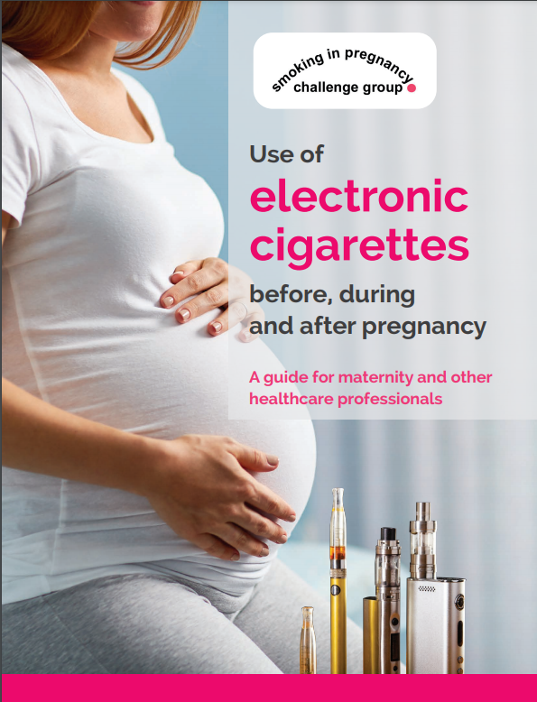
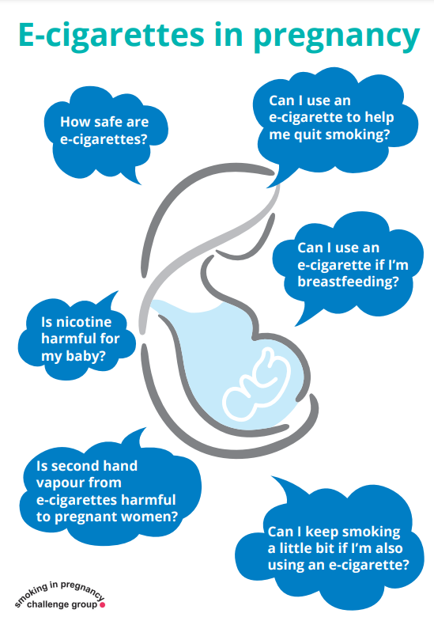
E-cigarettes in pregnancy

Slide 15
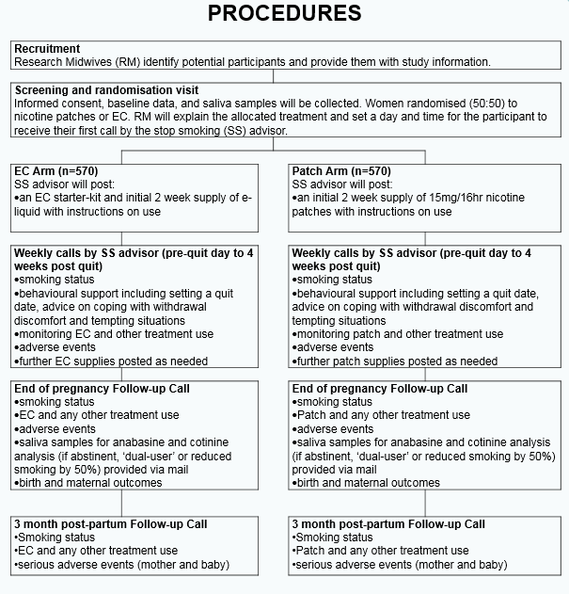
Trial of e-cigarette use
Recently completed in Scotland & England
Led by Professor Peter Hajek at Queen
Mary University of London
Funded by NIHR HTA, the ‘PREP’ trial
Data analysis now underway, results
before the end of 2021

Slide 16
Financial incentives

Slide 17
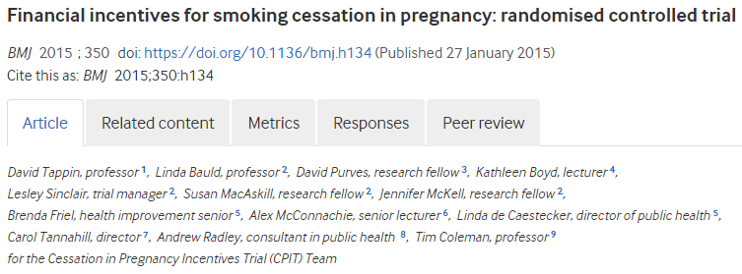
Previous Research and soon to report study
Phase II RCT published in 2015 of financial incentives for smoking cessation in pregnancy – conducted in Glasgow involving 612 women
Found that women who received incentives (up to £400 in stages) were twice as likely to be abstinent from smoking than the control group – 22.5% vs 8.6%.
Mean birth weight was slightly higher (3140g) among babies born to women in the intervention arm (3140g) than the control arm (3120g).
No harms from financial incentives were identified and there was no evidence that women ‘gamed’ the system
We have continued our research and have now completed a Phase III multi-centre trial, the CPIT III trial
Analysis of results is now underway
We expect to report results towards the end of this year

Slide 18
Financial Incentives for Preventing Postpartum return to Smoking (FIPPS): a three-arm randomised controlled trial (in Manchester)
Aim: To assess effectiveness and cost effectiveness of offering financial incentives to help 900 women who are abstinent from smoking at end of pregnancy to avoid return to smoking up to 12 months postpartum.
Interventions We will randomise participants to one of three groups:
(i) no financial incentives to remain abstinent
(ii) incentives (shopping vouchers) up to 3 months postpartum,
(iii) incentives up to 12 months postpartum
Chief Investigator: Professor Michael Ussher
Funder: Greater Manchester Combined Authority
Recruiting finishing August 2021
Final follow-up September 2022

Slide 19
FIPPS Flow diagram
All women entering GM Smokefree Pregnancy programme
informed about trial
At 32 weeks gestation eligible women given a
‘generic’ participant information sheet (PIS)
Consent obtained at 34 weeks gestation to 2 weeks postpartum
Randomisation and
‘group-specific’ PIS
No financial incentives
Financial incentives of up £120 up to 3 months postpartum
Financial incentives of up to £300 up to 12 months postpartum
Assessment of smoking status at 3 & 12 months postpartum
Following 12 months assessment:
Interviews with 10 women from each trial arm
Focus group with stop smoking service advisors/managers delivering intervention

Slide 20
Relapse prevention

Slide 21



Defining the Problem: Postpartum smoking relapse
22% OF WOMEN REPORT SMOKING IN THE 12 MONTHS BEFORE PREGNANCY
MANY QUIT DURING PREGENANCY
POSTPARTUM RELAPSE
IS COMMON
NO ROUTINE SUPPORT FOR SUSTAINING SMOKING ABSTINENCE
POLICY FOCUS ON PREVENTION AND PARTICULARLY SMOKING CESSATION IN PREGNANCY AND POSTPARTUM
CANCER PREVENTION FOR MOTHERS
SECOND HAND SMOKE EXPOSURE REDUCTION FOR FMAILIES
INTERRUPTING GENERATIONAL TRANSMISSION OF CANCER RISK BEHAVIOURS

Slide 22



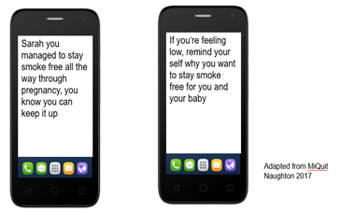
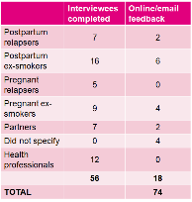
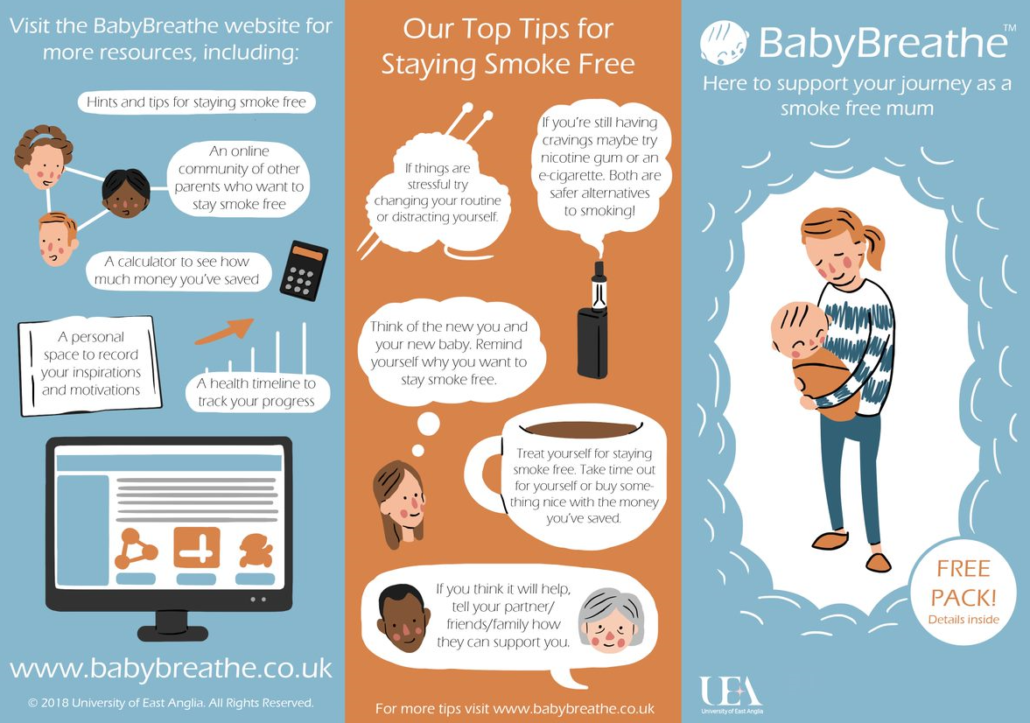



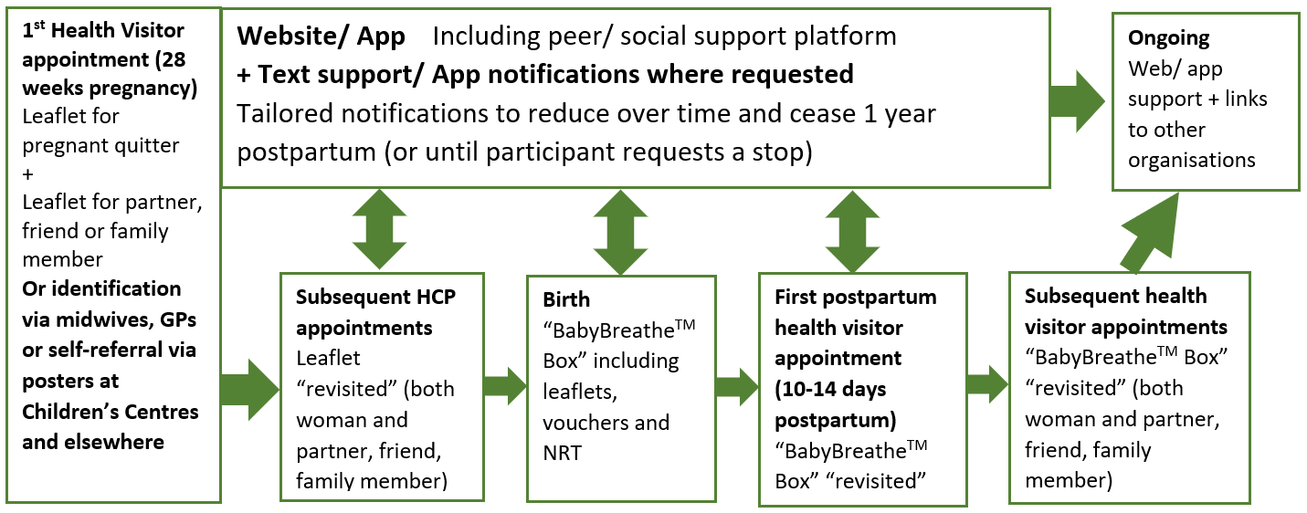
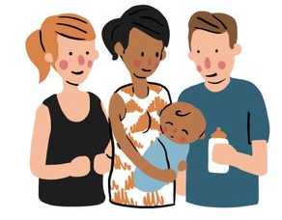
PREVENTING RETURN TO SMOKING POSTPARTUM (PReS STUDY)
AN EVIDENCE BASED COMPLEX INTERVENTION FOR RELAPSE PREVENTION
Brown, T, Holland, R, Ussher, M, Bauld, L, Orton, S, Naughton, F, & Hardeman, W
Risk of postpartum smoking relapse is high (1, 2)
No routine support for relapse prevention (3)
Cost of returning to smoking after pregnancy is high (3)
No recommended interventions for preventing postpartum smoking relapse (4)
There is no routine provision of support
Phase 1: Review of systematic reviews of smoking cessation in pregnancy and relapse prevention interventions to identify potentially effective behaviour change techniques (BCTs) as promising intervention components.
Phase 2: Qualitative intervention development with pregnant and post-partum women, partners and health professionals via focus groups and interviews.
Phase 3: The prototype intervention was refined and developed with individual postpartum women using a person-based approach.
RESULTS
PHASE 1
BCT REVIEW:
32 RCTs were included in the review.
45 BCTs were coded. Analysis of frequency and saliency resulted in a list of 6 most promising
BCTs associated with long-
term effectiveness
BCTS were problem solving,
Social support, information
about health and social
consequences, how to
perform the behaviour and
reducing negative emotions.
PHASE 2
FOCUS GROUPS AND INTERVIEWS:
Midwives were suggested as credible sources for introducing the intervention. A tailored approach to information giving throughout pregnancy and into the postpartum period, including partner support, was important. Objective evidence-based advice on medication for relapse prevention, including the use of e-cigarettes is needed.
PHASE 3
PERSON CENTRED INTERVENTION DEVELOPMENT:
Detailed feedback supporting the use of a tailored text message support system postpartum, linked to a website or
app with health information that
could be tailored to individual
needs and provided access to
social support.
Support for partners, reiterated
by health visitors.
“She was kind of crying and not sleeping and, you know, not being bad at all, just being a baby and I thought “this is sh#t”, you know. Whereas every other time with the sleep deprivation it’s… and just because both of her grannies smoked. So my mother smokes and my husband’s mother smokes and my husband’s mother lives here…”
“it’s informing the mum of, you know, all the benefits for you and the baby. The same that the dad or partner or whoever would… they need that understanding as well but I think coming from a different angle. Because this is more of a nurturing angle which I think you need becoming a new mum”
“I think that’s another thing for a lot of mums, is when they don’t feel like they have time to themselves, even if it’s just to have a bath or paint their nails. Because you just feel really ropey.”
CONCLUSIONS
“Loved my health visitor. I still talk to her now, I saw her yesterday.”

Slide 23
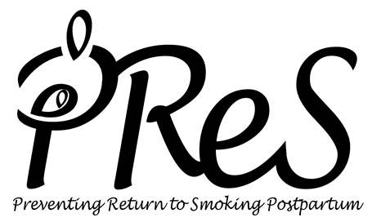
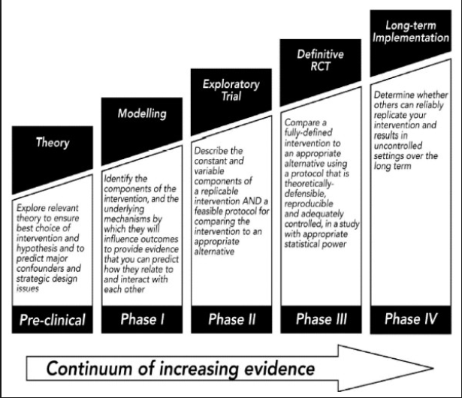



PReS Study – Aims and Methods
Map literature to identify determinants and specify promising behavioural change techniques
Refine a prototype intervention through focus groups and interviews with women, partners and health professionals
Model the prototype intervention with postpartum ex-smokers
Define an intervention suitable for testing in a phase II randomised feasibility trial

Slide 24
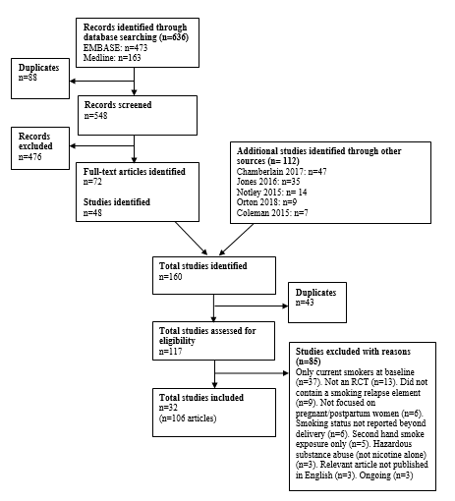
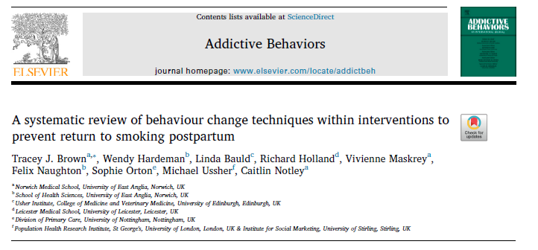
PReS Study – BCT review findings
32 included studies
6 deemed to be long-term effective.
These six studies used self-help, mainly in conjunction with counselling, and were largely delivered remotely.
6 ‘promising’ BCTs i.e. both frequently occurring and present in trials which demonstrated long-term effectiveness:
‘problem solving’, ‘information about health consequences’, ‘information about social and environmental consequences’, ‘social support’, ‘reduce negative emotions’ and ‘instruction on how to perform a behaviour’.

Slide 25
Protocol for a randomised controlled trial of a complex intervention to prevent return to smoking postpartum
Professor Caitlin Notley
c.notley@uea.ac.uk
@AddictionUEA
Bauld, L, Ussher, M, Harris, T, Gilroy, V, Duneclift, S, Holland, R, Naughton, F, Hardeman, W, Smith, D, Clarke, A, Turner, D, Brown T & Howard, G.

Slide 26
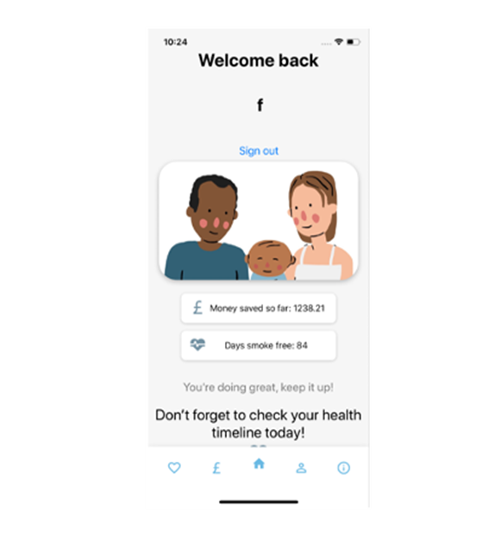
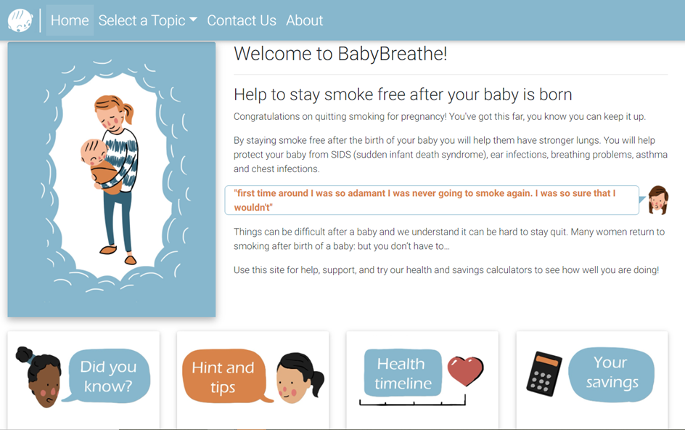
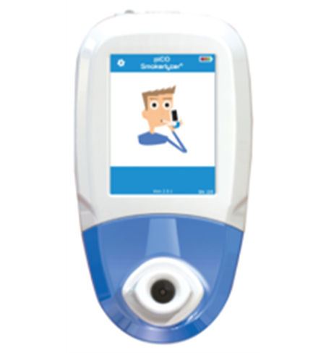
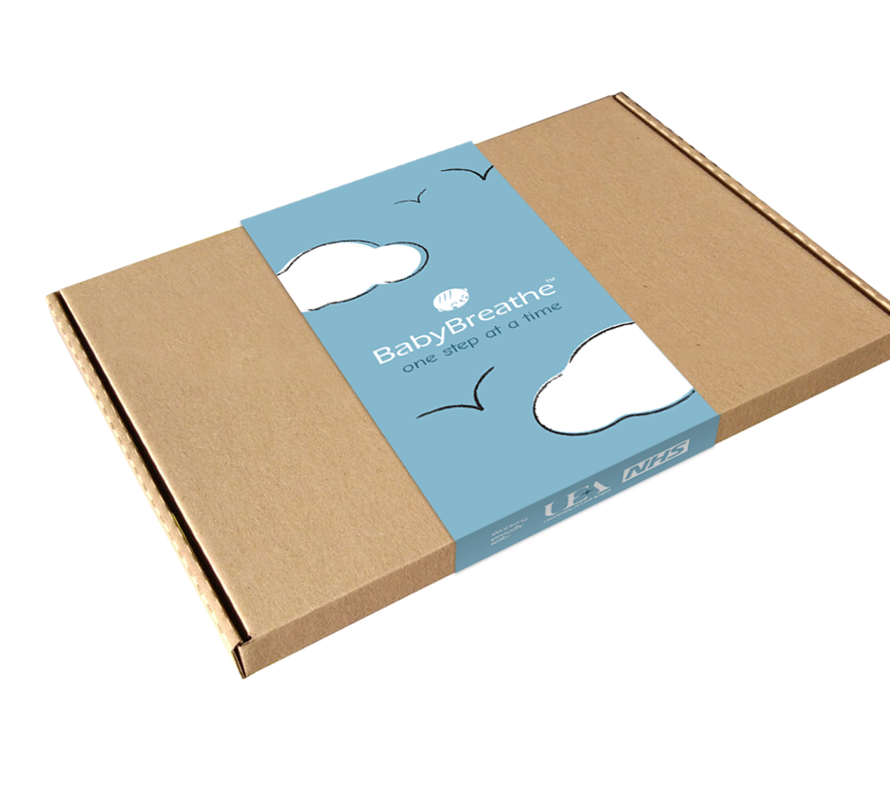
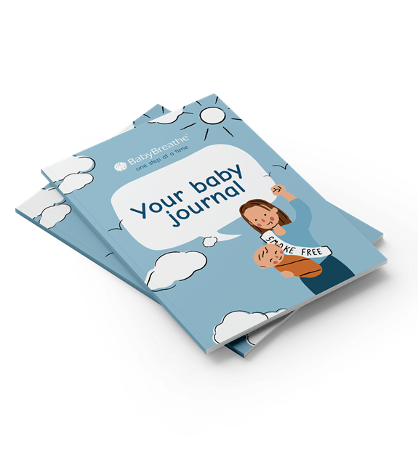
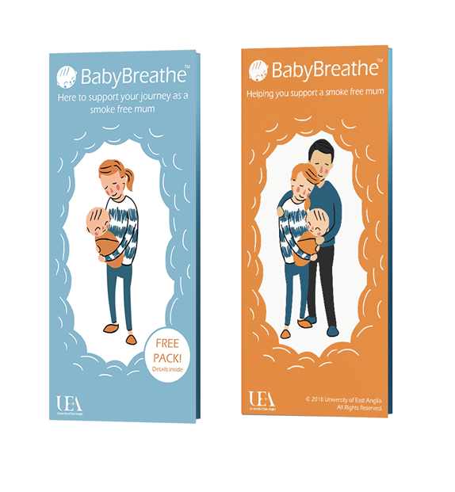

Intervention pathway
1st Health Visitor Appointment (28 weeks pregnancy)
Leaflet for pregnant quitter + Leaflet for partner / friend / family member
Or identification via midwives, GPs or self-referral via posters at Children’s Centres and
Website / App Including peer / social support platform
+ Text support / App notification where requested
Tailored notifications to reduce over time
and cease 1 year postpartum
Ongoing
Web / App support + links to other organisations
Subsequent HCP appointments
Leaflet “revisited” (both woman and partner / friend / family member)
Birth
“BabyBreatheTM Box” including leaflets, vouchers and NRT
First postpartum health visitor appointment (10-14 days postpartum)
“BabyBreatheTM Box” “Revisited”
Subsequent health
visitor appointments
“BabyBreatheTM Box” “Revisited” (both woman and partner / friend / family member

Slide 27
Looking ahead

Slide 28
Next Steps
As we move into a post-pandemic recovery phase, we need to align communicable and non communicable disease responses
Smoking in pregnancy remains a priority public and maternal/child health issue
Research has been affected, as have support services for women who smoke
But things are getting back on track
In terms of research, we have a number of studies due to report soon that will provide evidence to inform practice, and more in the pipeline.
Keep an eye on the Smoking in Pregnancy Challenge Group webpages for further updates.

Slide 29






















Acknowledgements: Professors
Michael Ussher, Tim Coleman
& Caitlin Notley
Thank you – Linda.Bauld@ed.ac.uk
@LindaBauld
SPECTRUM is supported by the UK Prevention Research Partnership (MR/S037519/1), which is funded by the British Heart Foundation, Cancer Research UK, Chief Scientist Office of the Scottish Government Health and Social Care Directorates, Engineering and Physical Sciences Research Council, Economic and Social Research Council, Health and Social Care Research and Development Division (Welsh Government), Medical Research Council, National Institute for Health Research, Natural Environment Research Council, Public Health Agency (Northern Ireland), The Health Foundation and the Wellcome Trust.

