Slide 1
Jane Coyne
Treating Tobacco Dependency Lead – GM
Insights from delivering a Smokefree Pregnancy Programme across
Greater Manchester
Jane Coyne
05.09.22

Slide 2
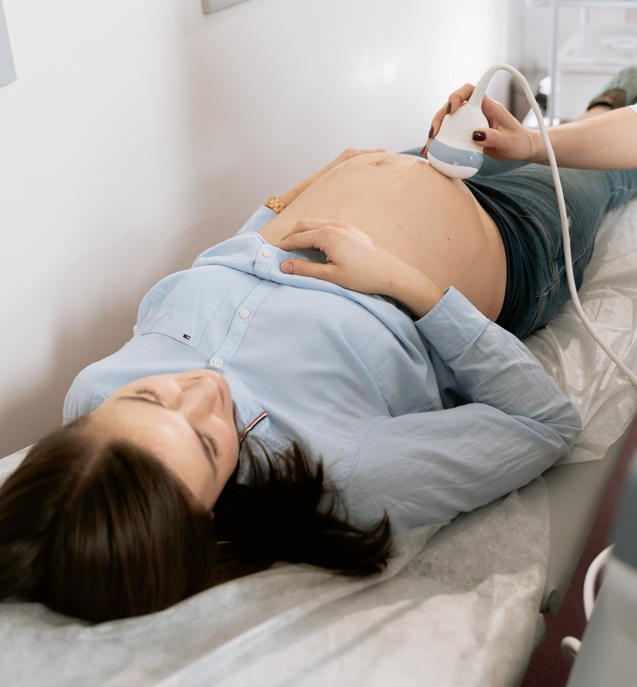
Project background
Smoking in pregnancy is a major preventable risk factor for complications in pregnancy and birth. Tackling it is a key part of the NHS England initiative Saving Babies’ Lives.
In 2018, the Greater Manchester Health and Social Care Partnership launched its innovative Smokefree Pregnancy programme in response to a static Smoking at the Time of delivery rates and has since supported more than 3,500 pregnant women and partners to quit smoking.
Offering expert training to deliver Very Brief Advice, Incentives and additional interventions to support quitting during pregnancy

Slide 3
Supporting a Smokefree pregnancy
Notes:
This has led to a dramatic reduction in Smoking At Time Of Delivery rates. Prior to the programme being launched, 1 in 8 women across Greater Manchester were smokers at the time of giving birth. This has reduced to 1 in 10 in just three years
Robust training for all staff groups to have really good VBA conversations – ensures referals, equity -

Slide 4
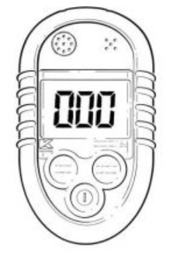





GM maternity-led treating tobacco dependency system
Supporting a Smokefree Pregnancy
Ockenden (2020) A thorough risk assessment must take place at the booking appointment and at every antenatal appointment to ensure that the plan of care remains appropriate.
Referral
CO Monitoring
Specialist Maternity SSS
Incentives
Risk Perception
Data Analysis
This was possible due to the links with the LMS/HOM – senior level buy-in that transferred down to frontline staff.
Mandatory F2F annually
NICE – every contact (2021)
CNST/SBL requirement
E-Learning accessible to all maternity staff
Phone referral at booking appt – some units remain virtual.
Referral from all antenatal appt.
Appointment made there and then
Back up with an email/paper referral
All specialist service offering both F2F and virtual appointments
Continued use of individual CO monitors to support flexible and virtual appointments
Have doubled number of people accessing the service
All FTs now have the RPI embedded with specialist RPI midwives identified within each unit
All HoMs have committed to embedding RPI
More than doubled the number of women recruited onto the scheme
75% quit rate
Issuing electronic vouchers which is quicker, cheaper and easier
Digital Platform now embedded within all teams.
Very effective system which is demonstrating ease of access, reduces admin time.
The platform is extremely effective for the services to see real time outputs and can identify success and barriers immediately.
Currently working on an effective solution for integrating the data into a Smokefree Pregnancy Dashboard.
DP is currently up for two awards-HSJ and RCM
Additional to LTP but ICS/LMS can work towards (NICE 2021)
Expanding programme into Health Visiting and Neonatal units ‘Love Your Lungs’ to take a whole system approach
Notes:
Whole system approach – applied the evidence – reduces stigmatising
CO testing before asking the ‘smoking question’ – promotes trust not seen as a lie detector
reinforcing that this is owned and delivered by maternity in the region and system
Standard pathway – learning best engagement – mw’s ringing direct to service + Direct phone call referral Collaborative working with Community staff/Specialist team – 13 MSW’s into the system
Learning – maternity model saw increased engagement – moved to system level may 2020 – informed LTP
Need

Slide 5
The Cohort
Smoking during pregnancy is strongly correlated with adverse pregnancy and birth outcomes. Women from lower socioeconomic groups are more likely to smoke during pregnancy, reinforcing health inequalities.
‘Smoking during pregnancy is a particularly demonised and stigmatised activity. This stigma is not always related to the level of risk to the foetus, and instead can be seen as a moral judgement about women. We urgently need to move from individualised neo-liberal discourses about the failure of individual smokers, to a more socio-ecological view which avoids victim blaming’.Ref*
*’Smoking during pregnancy, stigma and secrets: Visual methods exploration in the UK - Grant A, Morgan M, Gallagher D. Pub Women and Birth (2020) 70-76
Notes:
Women who smoked during pregnancy associated smoking with their identity, addiction and challenging life circumstances. For pregnant women, moral identity is closely entwined with smoking status.
Negative reactions are directed towards pregnant women who smoked in public, resulting in maternal smoking being undertaken in private. Participants also reported awkward relationships with midwives and other health professionals, including receipt of public health advice in a judgemental tone.
This highlights the importance of stigma, social networks and surveillance in low income pregnant women’s decision to hide smoking.

Slide 6
The GM programme was implemented through a phased approach and has been operational fully operational since June 2019. Final locality joined January 2021.
During this time we have continually compared our maternity-led stop smoking teams to that of Local stop smoking services. The quit rates were dramatically different.
GM also reviews and compares the 4WQ rate against the number of women smoking at time of booking.
The difference that made the difference was….
‘continuity of the maternity support worker’
Notes:
mw’s ringing direct to service, women feel the impact of the intervention which increases engagement – midwives having good honest conversations
Direct phone call referral Collaborative working with Community staff/Specialist team – 13 MSW’s into the system

Slide 7
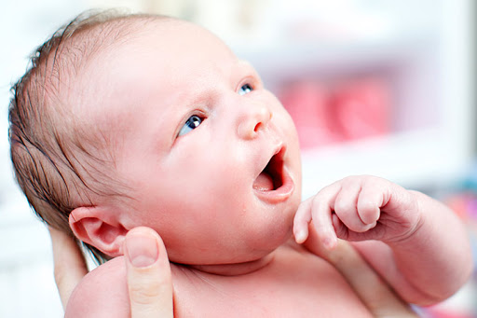
What the GM Pathway has Achieved
Achievements
Consistent standardised approach across the city region
Confidence in maternity services in delivering Very Brief Advice interventions
Digitisation of the maternity pathway
Identifies women contaminated by CO from environment and home sources
Increased engagement with the introduction of bespoke maternity stop smoking services
Reduces the cost of increased complicated births
Increases the average weight and health of new-borns
Reduces the number of babies requiring neonatal care
Continuation of the programmes into the post birth period to prevent relapse
Engaging with house smoking
To name just a few….
Notes:
Impact audit 74% women don’t access antenatal care
5 x as many preterm birth to women smoking at the time of delivery
63% of babies who required care where from smokers
69% of smokers live with another smoker
Modelling in GM – approx. annual spend on 4 price points was over £15m

Slide 8

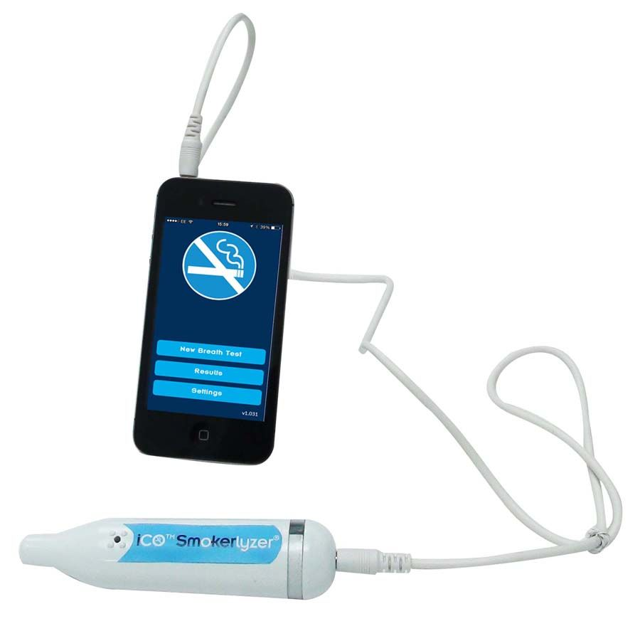
Adapting the stop smoking support to pregnant women during the pandemic
Provision of iCO’s - insights have shown they are positively received by women,
‘it proved my quit’
‘held me to account’
‘It flashes green- it a nice feeling to know you are doing best for you and baby’
Script was developed for midwives, supporting them undertake impactful brief interventions
“spurs you on and gave me the push to carry on “
Specialist maternity treating tobacco advisor is the life-line to everything!
Incentives support daily living!
Notes:
CO testing saw a third less SATOB’s – over 1000 women in the last year, fuel poverty – risk not picking up CO poisoning/second hand smoke
Virtual appointments – supported women at a time when they felt maternity services
The relationship with the MSW was invaluable – holistic care building around their own needs,
iCO increased capacity- allowing for contact with more women, gave women control and ownership through preforming their own monitoring

Slide 9

Lessons learnt
Senior leadership and professional vision at regional level is essential to help providers to push through the discomfort of change
Whole system approach – reducing inequalities
Robust training is essential to increase midwifery confidence in challenging conversations
Opt-out, timely referral is key
Responsive stop smoking support
Tackling household smoking prevents relapse
Shared learning with the system and other regions

Slide 10

People powered CHANGE…..
Jane.coyne@nhs.net
07973655917

