Slide 1
Cochrane review of e-cigarettes for smoking cessation: update on the latest evidence
Jamie Hartmann-Boyce*, Hayden McRobbie, Nicola Lindson, Chris Bullen, Rachna Begh, Annika Theodoulou, Caitlin Notley, Nancy A Rigotti, Tari Turner, Ailsa Butler, Thomas Fanshawe, Peter Hajek
*Centre for Evidence-Based Medicine and Cochrane Tobacco Addiction Group, Nuffield Department of Primary Care Health Sciences, University of Oxford. Jamie.hartmann-boyce@phc.ox.ac.uk
April 2022

Slide 2
Acknowledgements and funding
The work presented today has been supported by Cancer Research UK, the University of Oxford, and the National Institute for Health Research (NIHR).
Within the past 3 years, I have received funding from Cancer Research UK, the NIHR, the British Heart Foundation, Cochrane, and the University of Oxford.
The views and opinions expressed therein are those of myself (and for the paper results, my co-authors) and do not necessarily reflect those of the Systematic Reviews Programme, NIHR, National Health Service (NHS) or the Department of Health.
I have never received industry funding and have no conflicts of interest to declare.

Slide 3
Our author team

Slide 4
About Cochrane
WHAT?
Gathers and combines the best evidence from research to determine the benefits and risks of treatments/interventions
HOW?
By systematically reviewing the available evidence, with strong emphasis on quality assessment
Cochrane methods considered gold-standard
WHY?
To help healthcare providers, patients, carers, researchers, funders, policy makers, guideline developers improve their knowledge and make decisions

Slide 5
Living systematic review (LSR)
Search for new evidence monthly
Publish links to new evidence monthly
Update full review when new data emerges that changes, strengthens, or weakens existing conclusions, or relates to new comparisons or outcomes

Slide 6
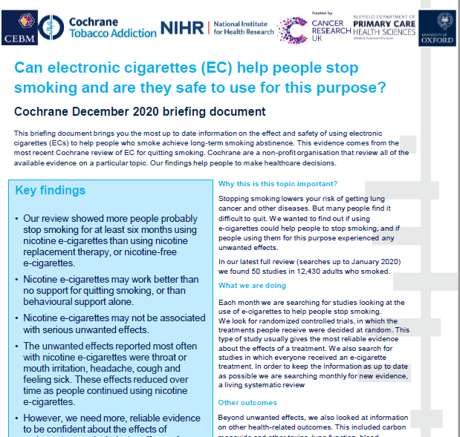
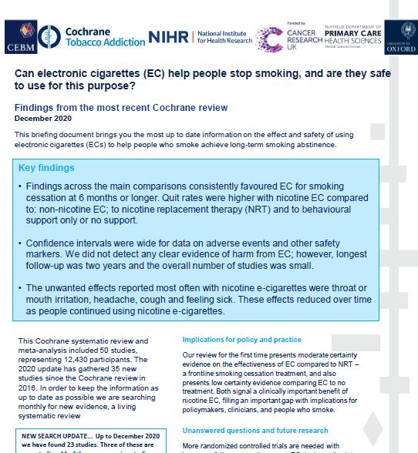
Also as part of the living systematic review project…
Review update published Sept 2021
Studies identified since last search will be included in subsequent update; so far they are not judged to change main conclusions of review

Slide 7
Inclusion criteria
Randomized controlled trials
Uncontrolled intervention studies
All people who smoke in study offered EC
People who smoke randomized to EC or control
Sept update:
61 studies
(34 RCTs)
16,759 participants
Measures of harm
(1 week+)
Smoking cessation (6m +)

Slide 8
Primary comparisons
Nicotine e-cigarette versus NRT
Nicotine e-cigarette versus behavioural support only/no-support
Nicotine e-cigarette versus non-nicotine e-cigarette

Slide 9
Outcomes
new outcome
Cessation*
Adverse events (AE)*
Serious adverse events (SAE)*
Changes in relevant biomarkers
6 months+
Intention to treat
Strictest definition of abstinence
Biochemically verified where available
One week or longer of EC use
One week or longer of EC use
One week or longer of EC use
Known carcinogens and toxicants
Exhaled carbon monoxide
Airway and lung function
Blood oxygen levels
Any AE where the patient outcome is death; life-threatening; hospitalization; disability; birth defect; or requires intervention to prevent any of the above
Defined as any undesirable experience associated with the use of a medical product in a patient
(as per standard Cochrane methods)
Product use
6 months or longer
Proportion of participants still using assigned study product (EC or medication) at longest follow-up
Added as part of LSR process at request from multiple policymakers
*primary outcome

Slide 10
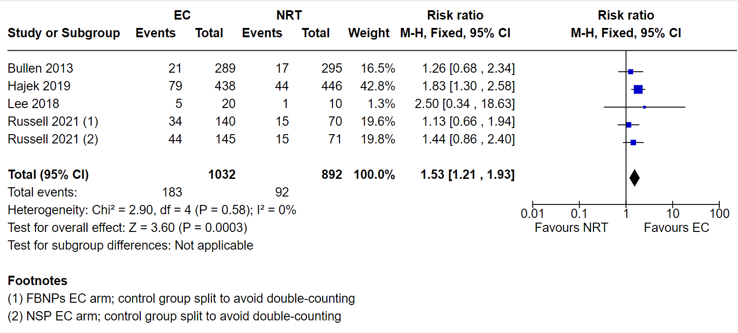
Nicotine e-cigarette versus NRT: Quitting at 6+ months
GRADE certainty of evidence: MODERATE (downgraded one level due to imprecision)

Slide 11
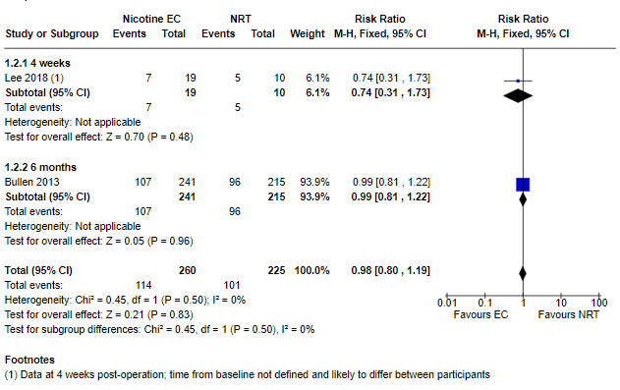
Nicotine e-cigarette versus NRT: Adverse events at 1+weeks
GRADE certainty of evidence: MODERATE (downgraded one level due to imprecision)

Slide 12
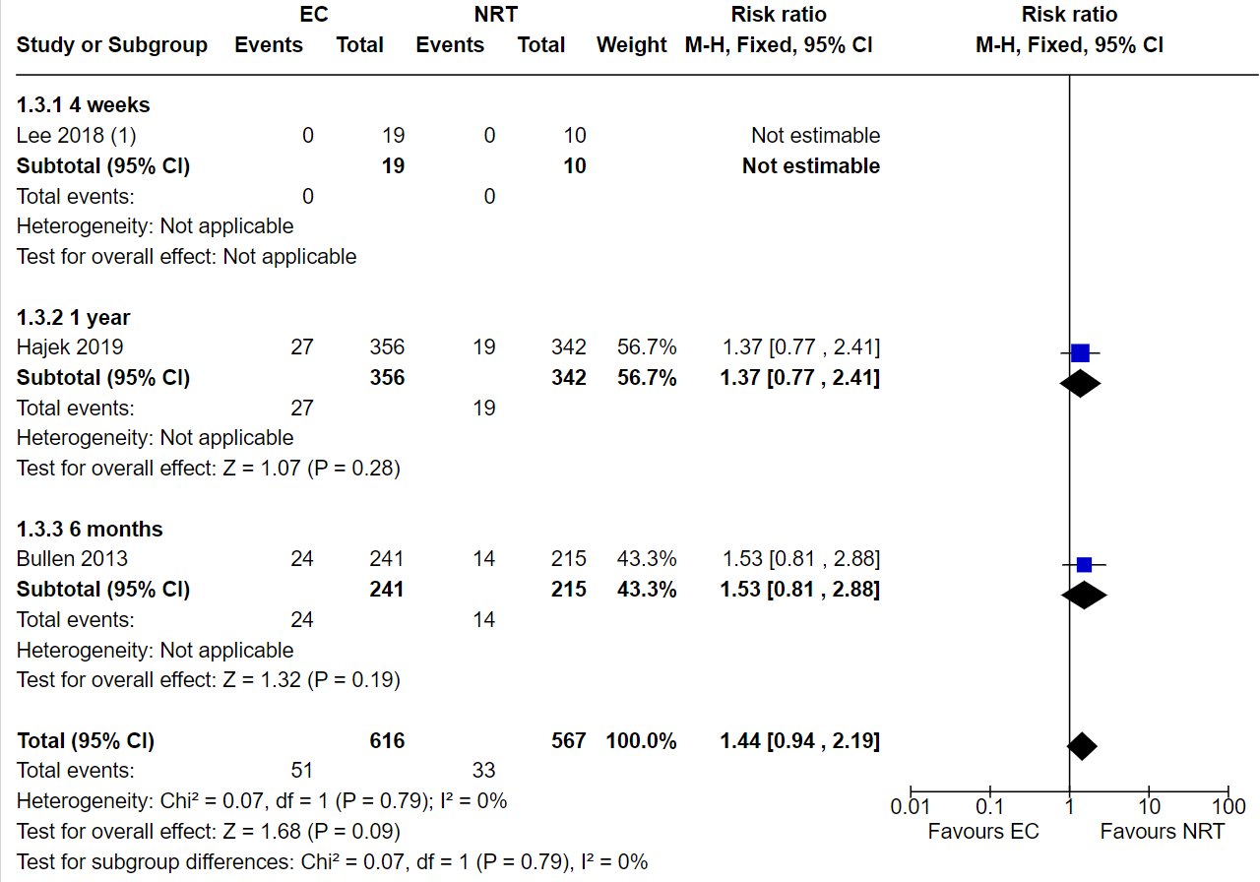
Nicotine e-cigarette versus NRT: Serious adverse events at 1+weeks
GRADE certainty of evidence: LOW (downgraded two levels due to imprecision)

Slide 13
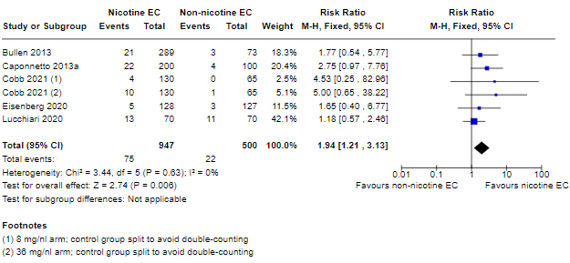
Nicotine e-cigarette versus non-nicotine e-cigarette: Quitting at 6+ months
GRADE certainty of evidence: MODERATE (downgraded one level due to imprecision)

Slide 14
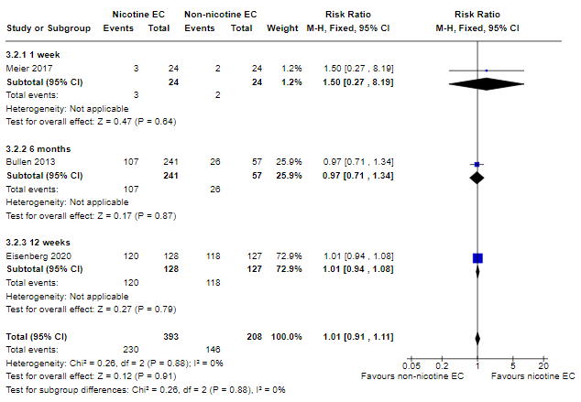
Nicotine e-cigarette versus non-nicotine e-cigarette: Adverse events at 1+ weeks
GRADE certainty of evidence: LOW (downgraded two levels due to imprecision)

Slide 15
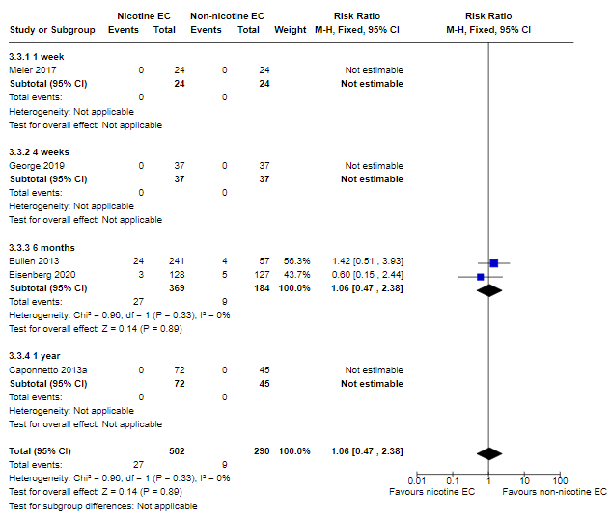
Nicotine e-cigarette versus non-nicotine e-cigarette: Serious adverse events at 1+weeks
GRADE certainty of evidence: LOW (downgraded two levels due to imprecision)

Slide 16
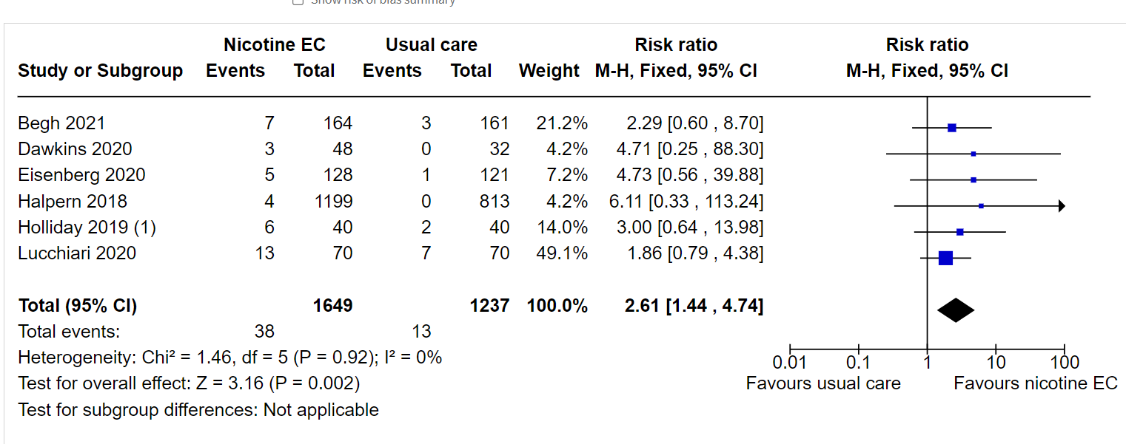
Nicotine e-cigarette versus behavioural support only/no support: Quitting at 6+ months
GRADE certainty of evidence: VERY LOW (downgraded two levels due to risk of bias; one level due to imprecision)

Slide 17
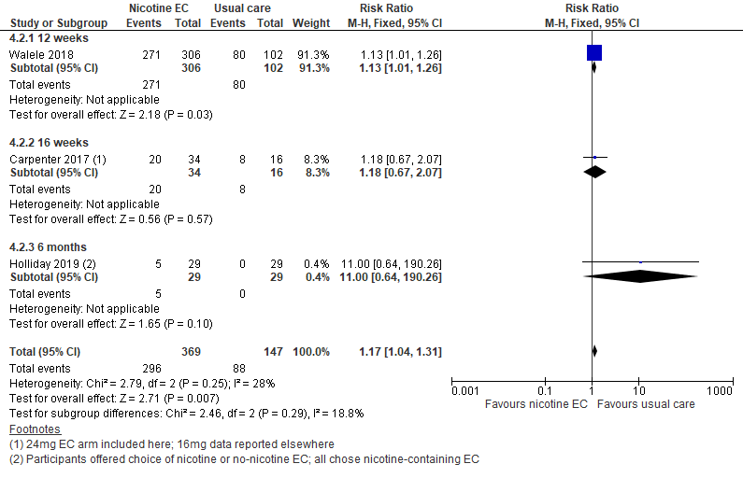
Nicotine e-cigarette versus behavioural support only/no support: Adverse events at 1+weeks
GRADE certainty of evidence: VERY LOW (downgraded due to risk of bias and imprecision)

Slide 18
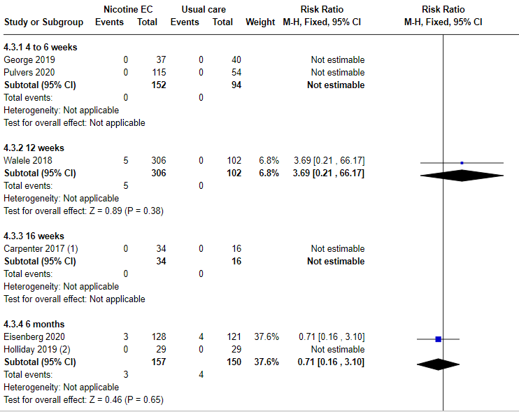
Nicotine e-cigarette versus behavioural support only/no support: Serious adverse events at 1+wks
GRADE certainty of evidence: VERY LOW (downgraded due to risk of bias and imprecision)

Slide 19
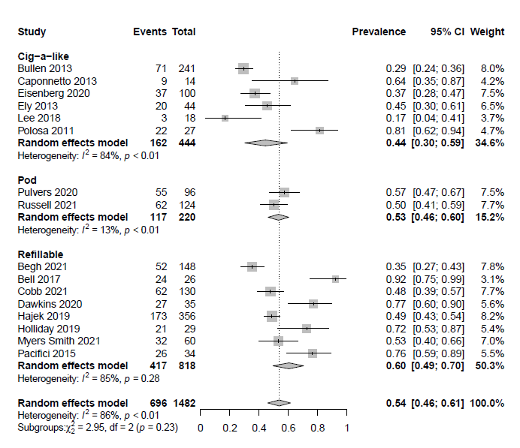
Preliminary analysis: long-term use
We pooled data on proportion of people using EC at six months or longer, combining data from the intervention arms of 16 studies (n= 1482) in which participants were given a nicotine EC at study start, and no other pharmacotherapy.
Of participants who had quit combustible cigarettes using a nicotine EC overall 70% were still using ECs at six months or longer (95% CI: 53% to 82%, I2 73%, N=215).
Prevalence of EC use at 6+ months grouped by device type

Slide 20
Preliminary analysis: biomarkers
Aim: to compare biomarkers of potential harm based on patterns of use.
Exclusive e-cigarette use was associated with lower levels of biomarkers of potential harm than exclusive use of combustible tobacco, or use of a combination of combustible tobacco and e-cigarettes.
This is consistent with other studies and broad scientific consensus that the greatest improvements in health come from ceasing combustible tobacco use in its entirety and that although not completely without risk e-cigarettes are a safer alternative.
There was insufficient data on populations abstinent from both EC and CC to be able to make any comparisons

Slide 21
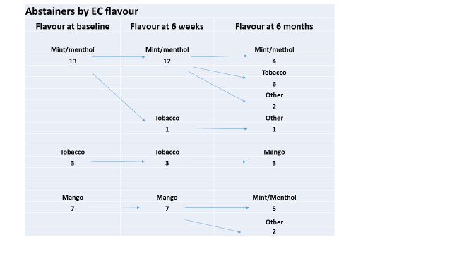
Preliminary analysis: flavours
Aim: investigate effect of EC flavour on smoking cessation and long-term EC use.
10 studies provided at least some relevant data
Participants’ flavour preferences differed across studies, with some studies showing similar levels of use across flavours, some showing a preference for sweet/fruit flavours, another for tobacco flavour, and another for menthol/mint.
In all of the studies that looked at flavour use over time, there seemed to be some flavour switching; however, in most cases it was hard to see the extent of this due to a lack of individual participant data.
We did not detect any clear links between flavours and our outcomes of interest, but we had very little data available with which to investigate this

Slide 22
Implications for practice
Evidence suggesting nicotine EC can aid in smoking cessation is consistent across several comparisons. There was moderate certainty evidence, limited by imprecision, that EC with nicotine increased quit rates at six months or longer compared to non-nicotine EC and compared to NRT. There was very low certainty evidence that EC with nicotine increased quit rates compared to behavioural support only or no support.
The effect of nicotine EC when added to NRT was unclear.
None of the included studies (short- to mid-term, up to two years) detected serious adverse events considered possibly related to EC use.
The most commonly reported adverse effects were throat/mouth irritation, headache, cough, and nausea, which tended to dissipate over time. In some studies, reductions in biomarkers were observed in people who smoked who switched to vaping consistent with reductions seen in smoking cessation.

Slide 23
See full review for
More detail on everything that’s been presented
Secondary outcomes
Other comparisons
Data from uncontrolled studies
Comparison with other reviews
Updates to and information on the living systematic review: https://www.cebm.ox.ac.uk/research/electronic-cigarettes-for-smoking-cessation-cochrane-living-systematic-review-1

