Slide 1
Dorset CARED Programme Building partnerships between Local Authorities and the NHS to support LTP implementation ASH webinar 4th November
Heidi Croucher
Dorset ICS Treating Tobacco Dependency Programme Manager

Slide 2
How collaboration has been developed ……
2015: 4 year SiPs pilot funded by PHD - Baby Clear Model
2017: MH and Community Hospitals went Smokefree
2018: P/T SiP Midwife secondment to PHD to strategically PM the SFP pathway across Dorset - Learns from SFP, MH pathways
2019: ICS TTD working group set up by PHD to plan implementation of the LTP. Well attended with representation from Director’s of Nursing, Respiratory Consultant, SiPs PM, MH Smokefree PM, General Practice, Local Authority, Community SSS & Local Pharmacy Committee
2021: F/T secondment with PHD to PM ‘CARED’ in Acutes, MH as well as Maternity
‘CARED’ - is our Dorset TTD programme based on Ottawa/CURE & SLaM

Slide 3
How collaboration has been maintained……..
Ownership by Dorset ICS –whole system approach (‘CARED’ SRO Head of PHD)
Development of sub TTD working groups within Trust’s
CARED Programme Manager – Clinical background (Midwife), employed by NHS but seconded to LA. Understanding of our Hospital’s systems, SMT structures, staffing capacity/rotas/procedures
Co-delivered the VBA staff training
On the wards training & supporting staff when each new admission area went ‘live’ with CARED

Slide 4
Pathway by the ‘admitting teams’ as TTD team not yet recruited……..

Slide 5
Local Authority & NHS collaboration is central……
CO equipment/ consumables ‘set up’ procured
by PHD. Trust’s pick up on-going costs (MH excl)
IT software development procured by Trusts.
Some Trust’s built this in-house
SSS assisted with the staff ‘live’ VBA training
supporting the referral element of the pathway
PHD building the dashboard data set to capture the outcomes from Trusts and SSS
2 weeks medication/e-cigs issued by the Trust’s. Out of hospital currently supplied/funded by LA

Slide 6
Enablers/Barriers and outcomes so far………
Referrals to SSS is poor (10%) Acute, (2%) MH.
Capture staff insights - PHD to do a piece of work (behavioural diagnosis) identifying the key barriers faced by hospital staff both in Acute and MH services in relation to this referral process and poor outcomes.
Early staff feedback is mainly around capacity – looking to add a direct referral link to the assessment, screening software.

Slide 7
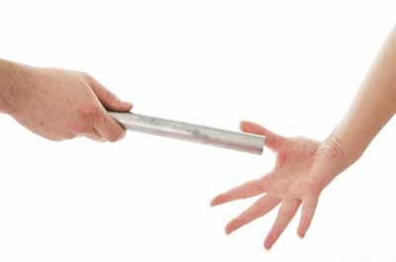
Passing the baton so to speak……
MH pathway – The new TTD Team will keep hold of patients on discharge and continue care/Rx in community.
In preparation for Pharmacy Enhanced Service…. PHD, CCG, Trusts & LPC have had meetings to ‘start thinking’ collectively how we join the dots for direct referral from hospitals to community pharmacies using Pharmoutcomes/DMS.
WiP!!!

