Slide 1
Mobilising to support smokefree generation
20th October 2023
Hazel Cheeseman
Deputy Chief Executive
Action on Smoking and Health (UK)
Hazel.cheeseman@ash.org.uk
@hazelcheeseman

Slide 2
Overview
Key points for communicating
Why engagement is needed and who with
How to engage and tools for support

Slide 3
Raising the age of sale: action needed
MPs and public less familiar with this policy: we need to engage and inform
Timeframes are tight
Free vote for Conservatives
Strong cross-party support important for continued momentum to make smoking history

Slide 4
Raising the age of sale: the case
Needed: Smoking is uniquely addictive and lethal, the leading cause of preventable death and health inequality. This is proportionate to the harm it causes.
Wanted: Strong public support for this policy and for reducing smoking rates
Workable: Age of sale already in place, teen smoking rate already low, alongside effective illicit strategy this will succeed.

Slide 5
Question At the Conservative conference this week Rishi Sunak made several announcements. In each case, please say whether you support or oppose the measure: A free vote in Parliament on whether to increase the minimum age to be able to buy cigarettes by one year, every year, so that people born after 2009 will never be allowed to buy cigarettes?
Poll following announcement by YouGov for The Times: https://d3nkl3psvxxpe9.cloudfront.net/documents/TheTimes_VI_AdHoc_231005_W.pdf

Slide 6
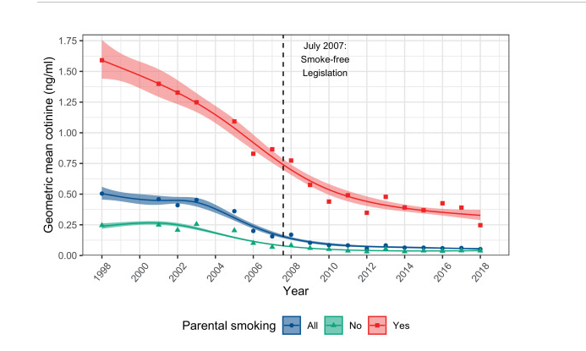
Communicating with the public
Tattan-Birch H, Jarvis MJ. Children's exposure to second-hand smoke 10 years on from smoke-free legislation in England: Cotinine data from the Health Survey for England 1998-2018. Lancet Reg Health Eur. 2022 Feb 3;15:100315. doi: 10.1016/j.lanepe.2022.100315. PMID: 35146477; PMCID: PMC8819129.

Slide 7
Vaping
Public consensus on action is clear
What is needed is detailed policy discussion, not further public debate
Focusing public debate on vaping may drown out the debate on smokefree generation
Responding to consultation important and also call for legislative and regulatory action to be swift

Slide 8
Who we need to engage with and why
Who | Why | How
MPs and Peers | To secure their vote in support of legislation | Letters/ emails Meetings Local ‘petitions’
Elected members | To secure vocal support and advance smokefree generation | Letter to MPs Briefings/ letters/ meetings Motion for council
Senior local government and NHS leaders | To secure vocal support and advance smokefree generation | Letter to MPs Briefings Put name to blogs, internal emails etc
The public | Engage them in the evidence and debate | Media stories Local communication channels Social media

Slide 9
Existing ASH tools

Slide 10
Further resources coming soon
ASH supported by Fresh, GM Health and Social Care Partnership, London Tobacco Alliance and Humber and North Yorkshire ICB
Template consultation response
Bank of template letters for MPs, councillors and others
Template motion for council
Media templates and regional polling
Social media assets e.g. vox pops, graphics etc #SmokefreeGeneration #SmokefreeFuture

Slide 11
Final thoughts
Get your organisations engaged
Don’t wait! Communicate as an individual with professional experience NOW
Tell us what you are doing so we can amplify

Slide 12
Notes:
Richard talked about the millions who’ve died. Everyone of them is an individual tragedy.
We got talking in the office about how many of those tragedies had touched us, losing friends and relatives long before their time. And out of that came the idea of commemoration page on the ASH website for all those who’ve died since ASH started in 1971. These are the images of the first few to go up on our website.
A friend of mine was keen to add her story, of how smoking has wiped out nearly her whole family.
Her parents both smoked heavily when she was a child and she and her four siblings all became smokers. Her parents died in their sixties from a stroke and COPD. Two of her brothers died in their fifties, one from lung cancer the other from throat cancer. Her third brother was diagnosed very recently, in his early sixties, also with throat cancer. Only she and her younger sister managed to quit smoking.

