Slide 1



the scimitar+ trial:
Bespoke smoking cessation for people with SMI
Simon Gilbody
Professor of Psychological Medicine
Dr Emily Peckham
SCIMITAR Trial Manager
MHARG University of York
On behalf of the SCIMITAR collaborative

Slide 2
Things I will talk about during the Webinar
Smoking and severe mental ill health: what we know?
SCIMITAR+: the largest trial of a behavioural intervention for people who smoke use mental health services
  History
  Design
  Findings
  Implications for services and policy
  Dissemination

Slide 3
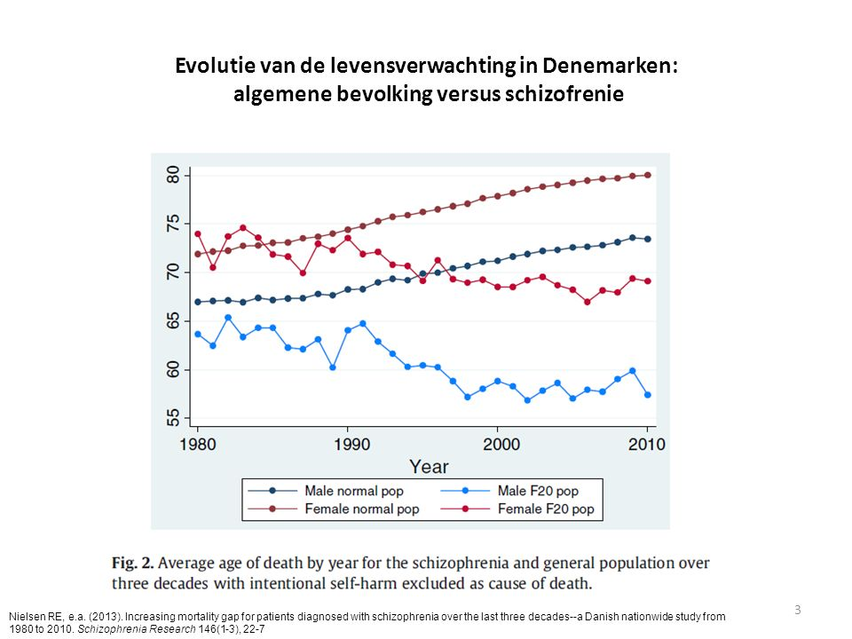
The Mortality Gap in SMI

Slide 4
The smoking gap in SMI

Slide 5
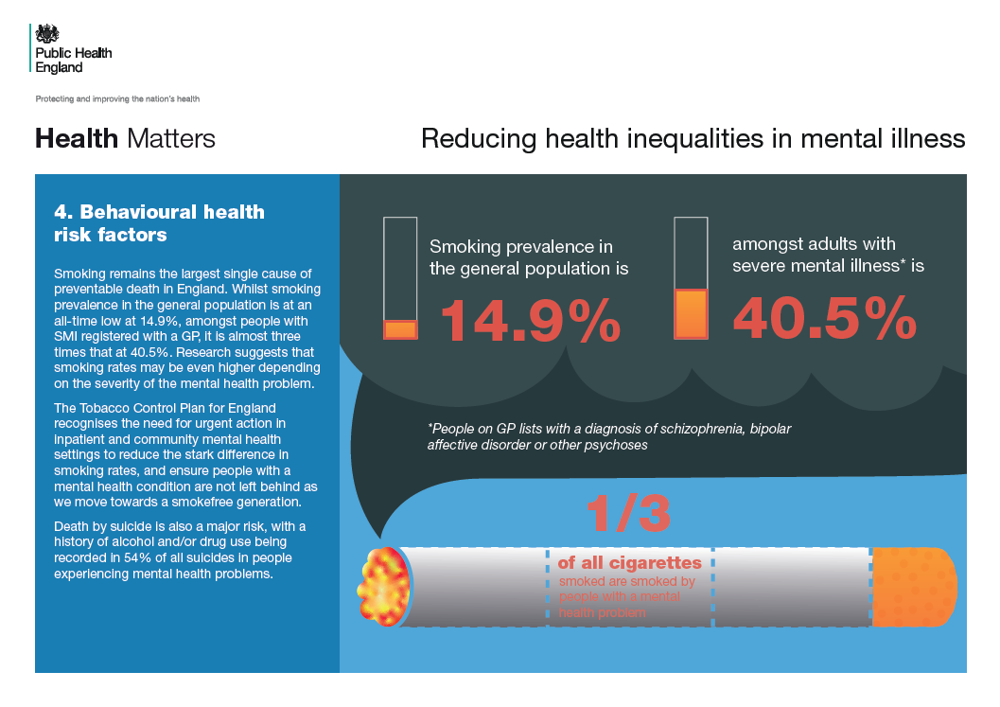

Slide 6
Consequences of smoking for those with SMI
Poor physical health
Early death 20 – 25 years
Tobacco poverty
Increasing health inequalities
Stigma

Slide 7
Smoking is the single most important modifiable risk factor in SMI

Slide 8
History of SCIMITAR

Slide 9
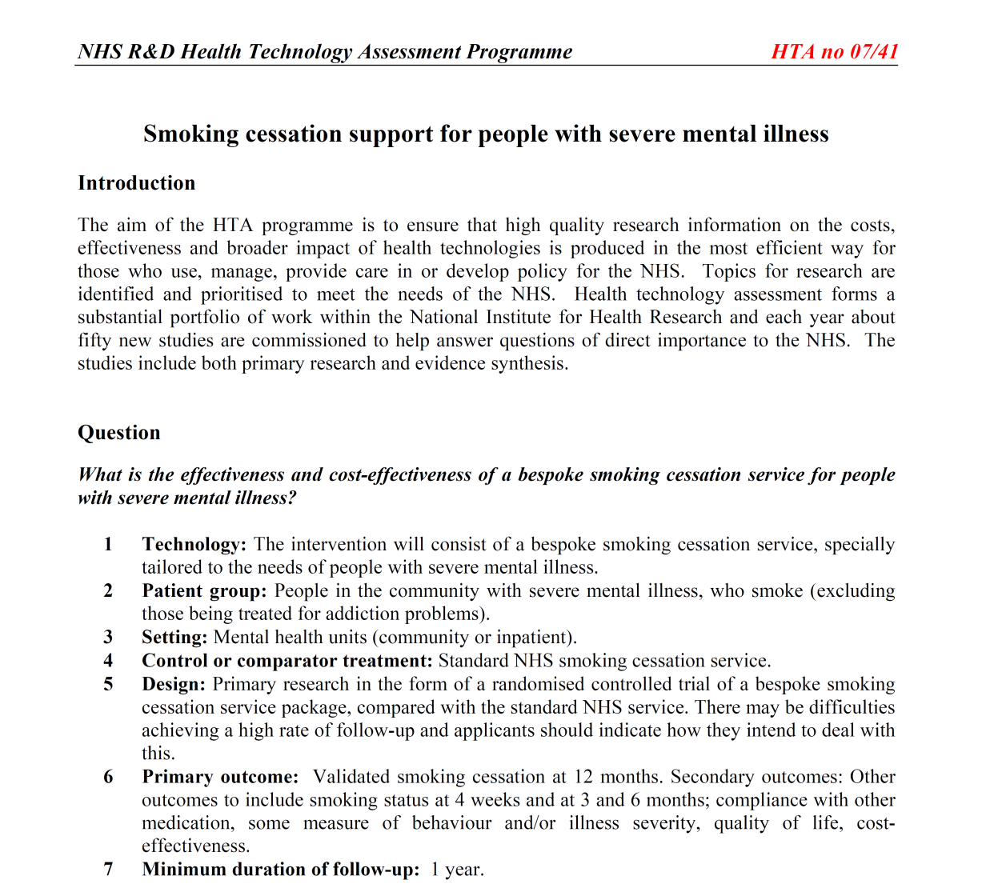

Slide 10
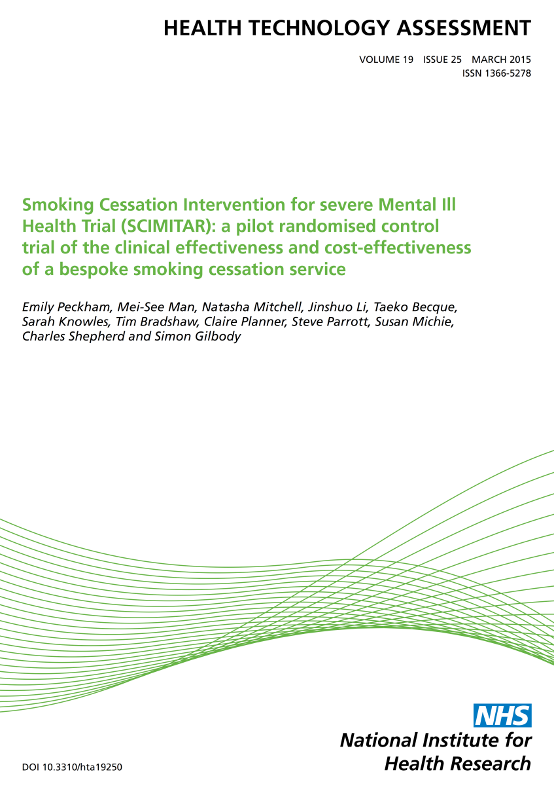
History of SCIMITAR
Important question, but funder risk-averse
Complex and challenging trial
Wanted a pilot first
  Develop the intervention
  Test its delivery in NHS
  Test our ability to undertake a trial

Slide 11
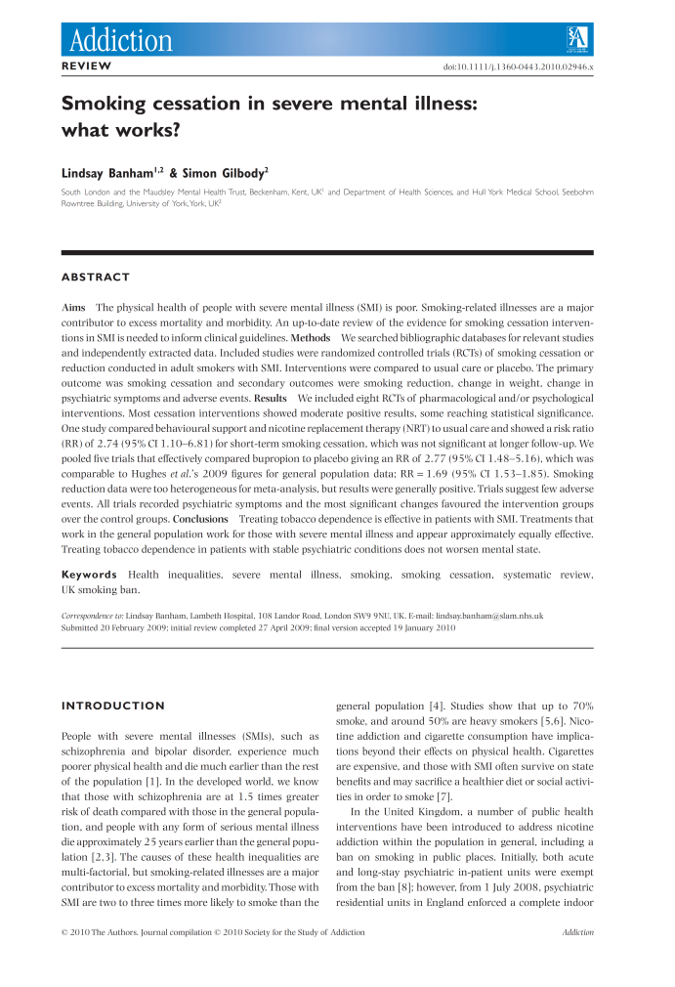
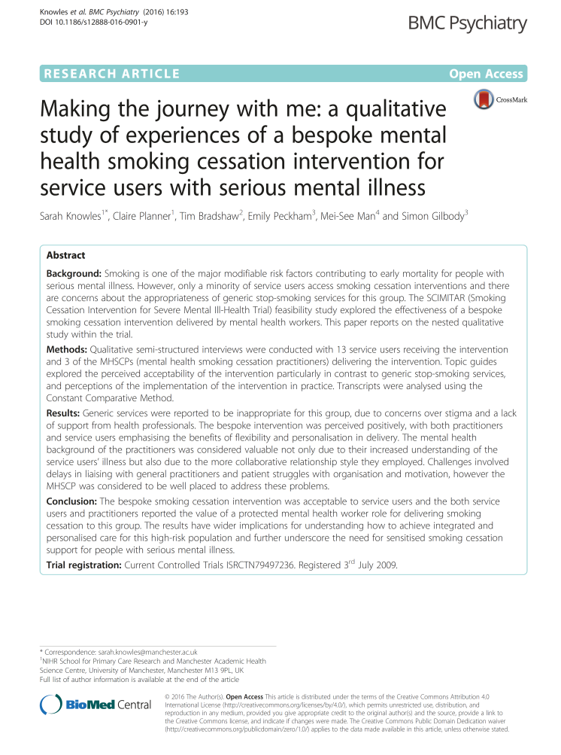
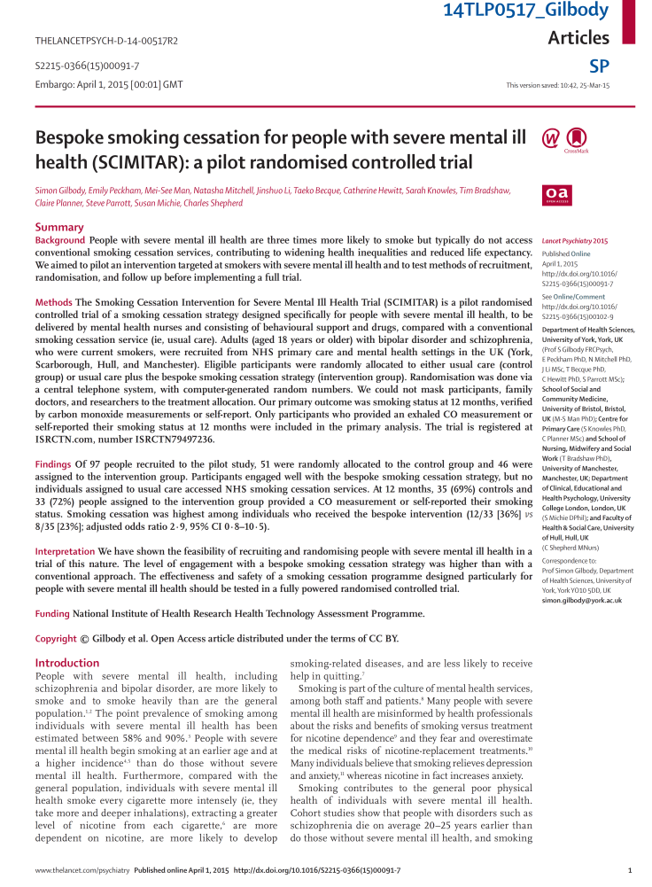
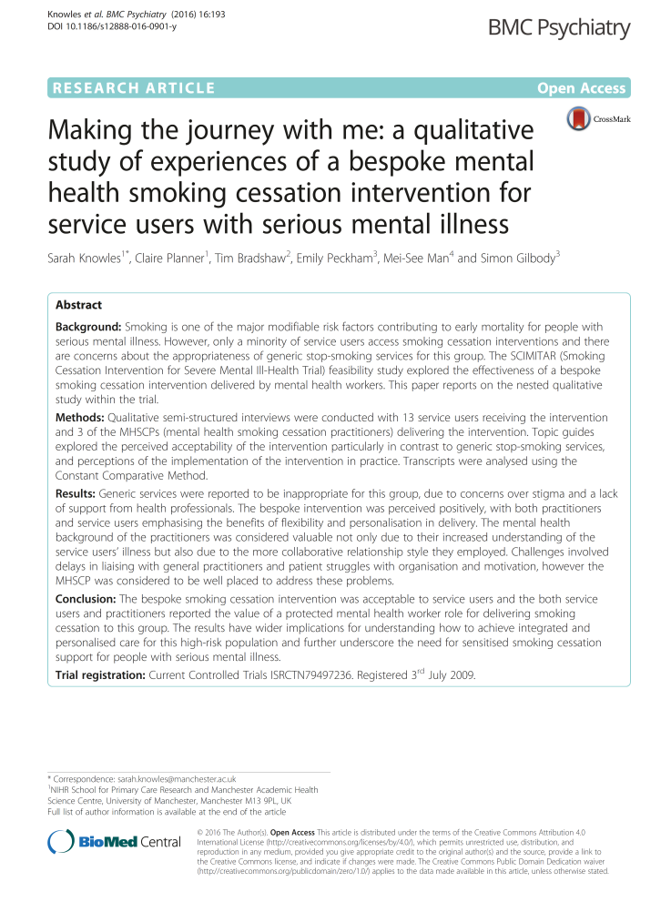
SCIMITAR+ built on strong foundations

Slide 12
Purpose of the pilot…..
Road test the intervention
Learn about recruitment, randomisation and retention
Established the parameters for the full trial
Preliminary estimates of effect
☑

Slide 13
SCIMITAR+ Bespoke Smoking Cessation
The intervention

Slide 14
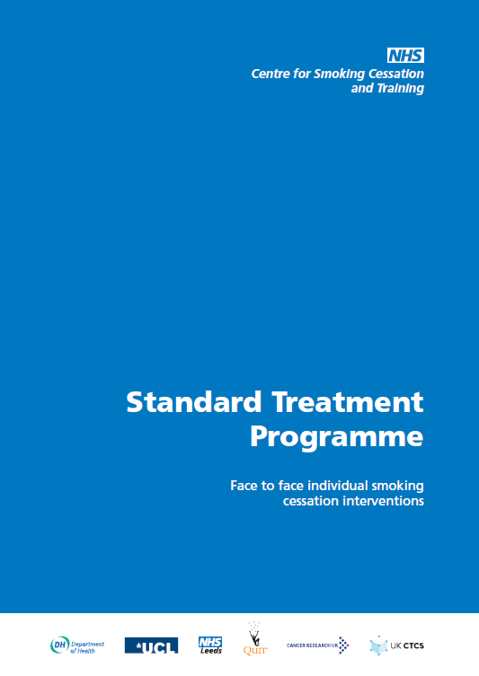

Slide 15
Bespoke features of the SCIMITAR intervention
Delivered by NCSCT L2-trained mental health professionals
Behaviour Change Techniques
NRT was the mainstay of treatment
Nicotine pre-loading & ‘cut down to quit’
Psychotropic medication management
Planning for quit attempt. What to do in place of smoking
Manual & supervision to ensure delivery

Slide 16
SCIMITAR+
A pragmatic randomised trial design

Slide 17
526 Heavy Smokers with SMI
Schizophrenia (65%), Bipolar (22%), Schizoaffective (12%)
Community-based, wanted to cut down or quit
21 NHS Trusts, Age = 47yrs, 30yrs smoking, BMI = 29.2, 24 cigs/day
Bespoke Smoking Cessation (n=265)
Usual care (n=261)
6 & 12 months outcomes
Sustained Quitting (CO<10ppm, 7/7 abstinent)
FTND, MTQ, PHQ9, GAD7, SF12, BMI
Medication and health service use

Slide 18
SCIMITAR+ recruitment

Slide 19
Who got what?
Bespoke Smoking Cessation
Usual Care
88% engaged
  Median 6 sessions
  34 minutes, FTF
NRT > 90%
E-cigarettes 33%
Varenicline 3%
Minimal SSS engagement
NRT OTC 31%
E-cigarettes 39%
Varenicline 3%

Slide 20
SCIMITAR+
What were the results?

Slide 21
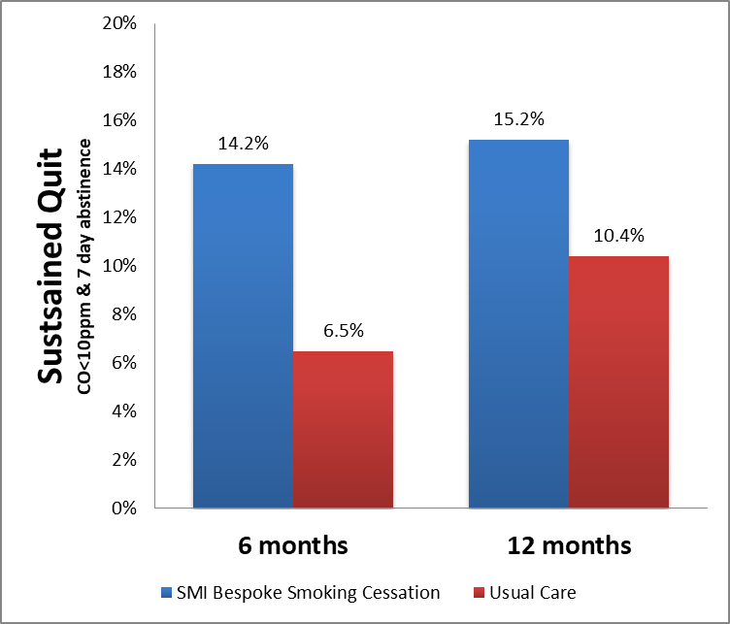
Did people with SMI quit?
P=0.01
P=0.08

Slide 22
SCIMITAR+ Power and Precision
Despite being the largest trial to date, SCIMITAR+ was still underpowered to detect a difference at 12 months.

Slide 23

Type 2 error

Slide 24
Reconciling SCIMITAR pilot and full trial

Slide 25
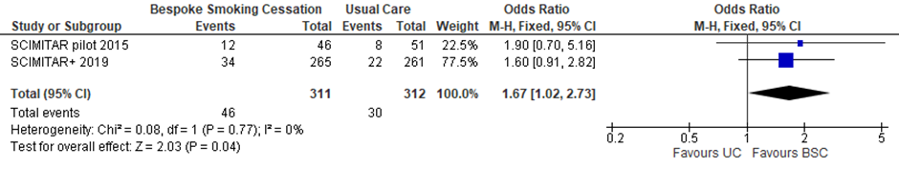
Meta-analysis of pilot and full trial data

Slide 26
Secondary outcomes
Reduction in number of cigarettes
Short term improvement in physical health (SF12 Physical Component Scale items)
No differences in depression or anxiety
Successful quitters gained weight (BMI 31.4 vs 30.1)

Slide 27
SCIMITAR+
Cost effectiveness

Slide 28
Costs and consequences
Short run cost effectiveness (1 year time horizon)
Some additional costs of delivery of bespoke service (training, delivery, meds and supervision)
Few people in usual care accessed SSS
57% likely to be less costly and more effective
Benefits of quitting likely to be achieved across the lifetime – haven’t measured this, but can model it
Smoking cessation is always one of the best investments for the NHS

Slide 29
Some reflections
WWW (What went well?)
EBI (Even better if……)
We have addressed the Q
Big trial, generalisable
Good long-term follow up
Feasible model, aligns with NCSCT STP
Capacity to deliver future research in this area
Take charge of the medication supply
Varenicline
Embrace e-cigarettes
Longer-term support
Younger people FEP
Less power than planned

Slide 30

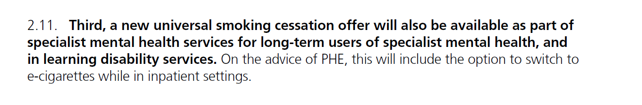

Slide 31
In summary
People with SMI have some of the highest rates of smoking in section of the population
Majority want to quit and cut down, but do not access (and have not benefitted from) conventional Stop Smoking Services
SCIMITAR tests a specialist intervention to enable people with SMI who want to quit, to quit
Results in good engagement and verified improvements in quit rates in medium and long term
Timely and evidence-supported model for service provision

Slide 32




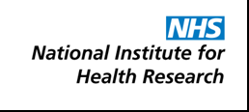

Slide 33
Thanks to
Lots of people

Slide 34
This project was funded by the National Institute for Health Research Health Technology Assessment (project number 11/136/52)
The views and opinions expressed therein are those of the authors and do not necessarily reflect those of the Health Technology Assessment programme, NIHR, NHS or the Department of Health.

