Slide 1
the scimitar+ trial: Embedding smoking cessation into mental health services
Simon Gilbody
Professor of Psychological Medicine
Dr Emily Peckham
SCIMITAR Trial Manager
MHARG University of York
On behalf of the SCIMITAR collaborative

Slide 2
Things I will talk about during the ASH Equally Well Webinar
SCIMITAR+: the largest trial of a behavioural intervention for people who smoke & use mental health services
What did the intervention look like?
What did we find?
What are the implications for mental health services and tobacco control policy?

Slide 3
In summary
People with SMI have some of the highest rates of smoking in section of the population
Majority want to quit and cut down, but do not access (and have not benefitted from) conventional Stop Smoking Services
SCIMITAR tests a specialist intervention to enable people with SMI who want to quit, to quit
Results in good engagement and verified improvements in quit rates in medium and long term
Timely and evidence-supported model for service provision

Slide 4
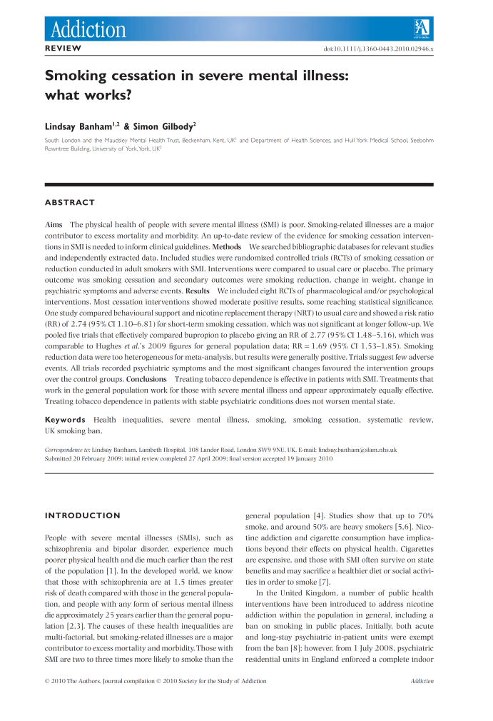
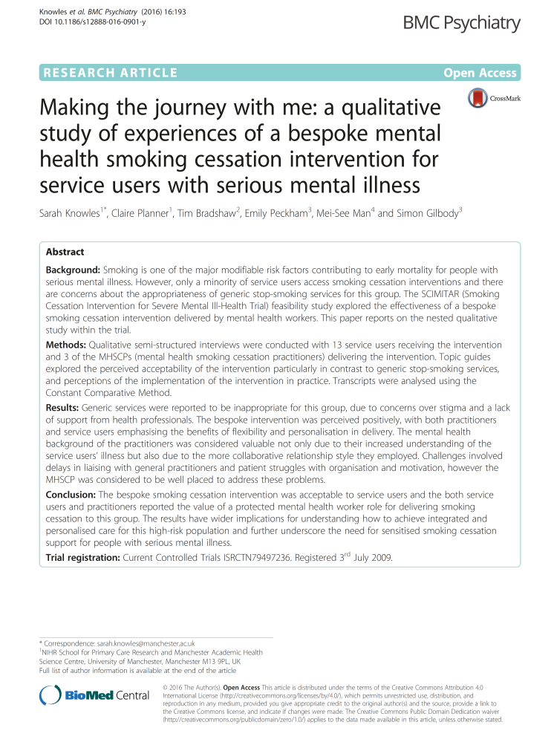
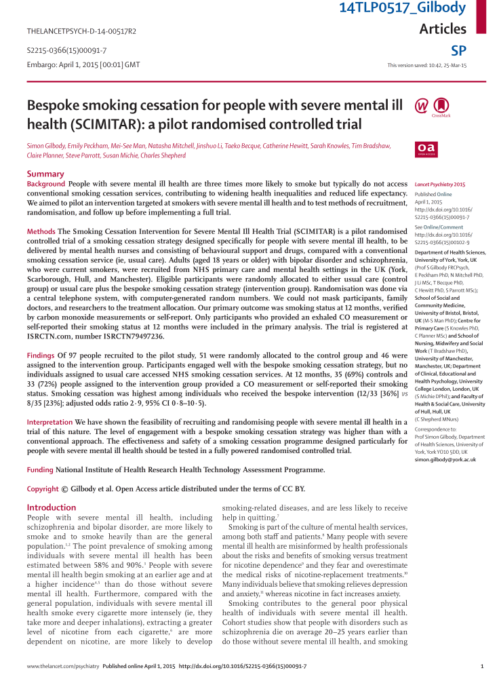
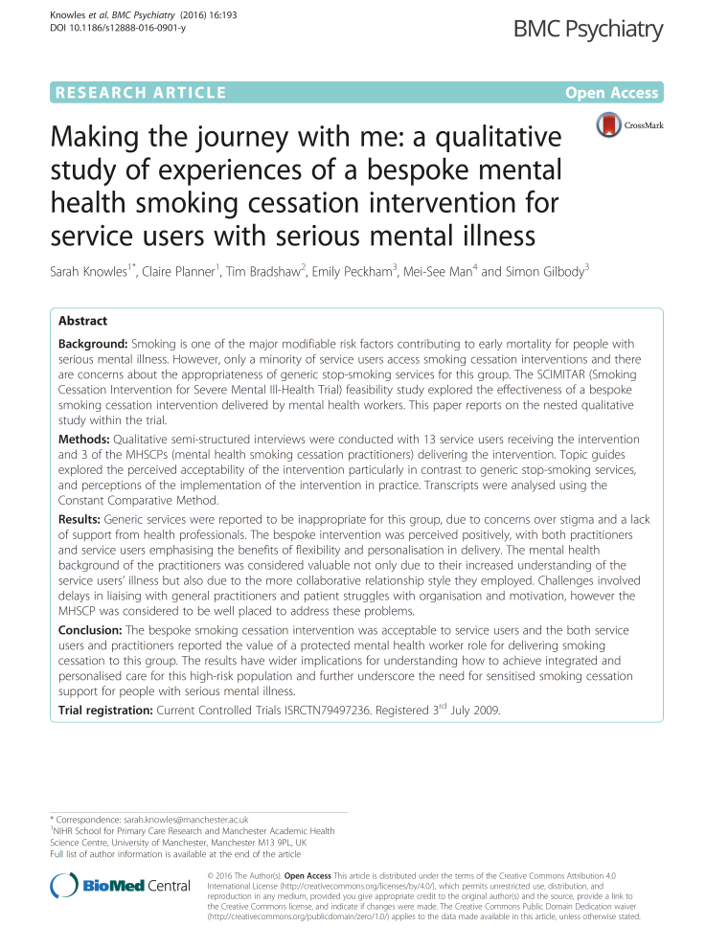
SCIMITAR+ built on strong foundations

Slide 5
SCIMITAR+ Bespoke Smoking Cessation
The intervention

Slide 7
Bespoke features of the SCIMITAR intervention
Delivered by NCSCT L2-trained mental health professionals
Behaviour Change Techniques
NRT was the mainstay of treatment
Nicotine pre-loading & ‘cut down to quit’
Psychotropic medication management
Planning for quit attempt. What to do in place of smoking
Manual & supervision to ensure delivery

Slide 8
526 Heavy Smokers with SMI
Schizophrenia (65%), Bipolar (22%), Schizoaffective (12%)
Community-based, wanted to cut down or quit
21 NHS Trusts, Age = 47yrs, 30yrs smoking, BMI = 29.2, 24 cigs/day
Bespoke Smoking Cessation (n=265)
Usual care (n=261)
6 & 12 months outcomes
Sustained Quitting (CO<10ppm, 7/7 abstinent)
FTND, MTQ, PHQ9, GAD7, SF12, BMI
Medication and health service use

Slide 9
SCIMITAR: What we found
Doubles your rate of quitting
People engaged really well
People liked the intervention
People liked that it was within mental health services

Slide 10
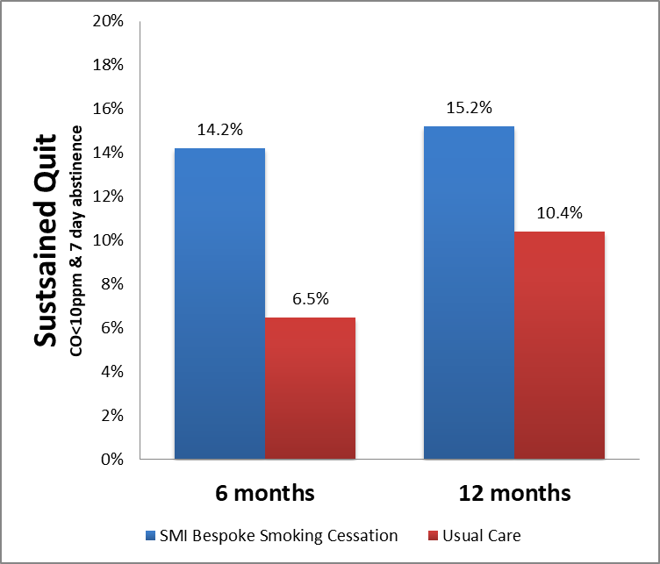
Did people with SMI quit?
P=0.01
P=0.08

Slide 11
Meta-analysis of pilot and full trial data

Slide 13
SCIMITAR: implications for training
Highlights the ability and advantage of people from within mental health services receiving training & deliver the intervention
Service users really liked this
NCSCT is a brilliant resource
Attitudinal barriers to smoking cessation. Don’t ask, don’t intervene

Slide 14
SCIMITAR: implications for delivery
Keep the moving parts to the minimum
One stop shop
Delivery within mental health services
Efficient provision of quit smoking meds

Slide 15
SCIMITAR: recommendations for training
Make every contact count: Ask Advise Act (3As)
All staff: Very Brief Advice
Some staff: skilled in Level 2 delivery, with some additional skills for mental health services
Non medical prescribing: quit smoking meds
Psychiatrists: medication management

Slide 16
This project was funded by the National Institute for Health Research Health Technology Assessment (project number 11/136/52) The views and opinions expressed therein are those of the authors and do not necessarily reflect those of the Health Technology Assessment programme, NIHR, NHS or the Department of Health.

