Slide 1
North East Regional Varenicline PGD
Joanna Feeney
Stop Smoking Systems Strategic Manager - Fresh & Balance

Slide 2
Objectives
Proposal
Parallel workstreams
Timeline
Context

Slide 3
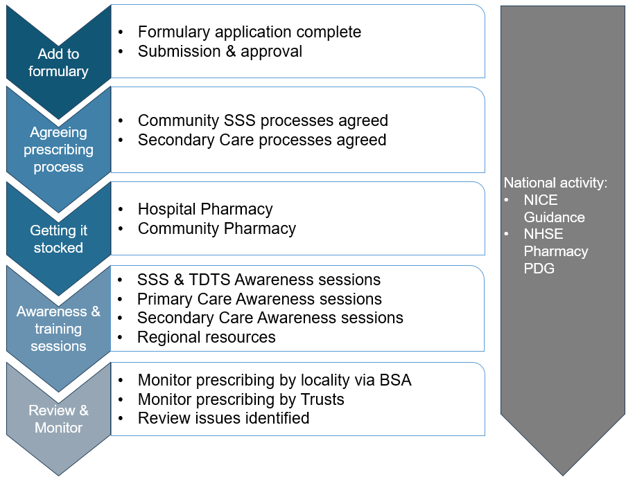
Background: March 2024
12 Local Authorities in the North East delivering Stop Smoking Services
Cytisine launched in UK in February 2024
Expected varenicline on market in Autumn 2024
NENC ICB Formulary had been harmonised from 3 previous
Formulary advisory group flagged concerns around lack of clarity
Opportunity to review formulary
Add cytisine
All stop smoking medications including Varenicline RAG rated green
Local commissioning processes removed, reflecting changing landscape
Strong rationale to ensure that first choice effective stop smoking aids were available in SSS

Slide 4
What did we do?
Undertook a mapping of local Stop Smoking Services:
Current processes used to provide medication
How Varenicline had previously been provided
Plans or intended processes to include cytisine or varenicline
Interest in exploring a regional PGD
Feedback from Tobacco Commissioners:
Some had experience with PGDs previously, some didn’t
Concerns over capacity required to engage with Primary Care & Pharmacy
Concerns over what needed to be done to develop & instigate PGD
Concerns that requesting prescriptions from GP’s were additional barriers
Feedback from Primary Care prescribers:
Concerns over capacity to respond to prescription requests for both varenicline & cytisine

Slide 5
What did we do next?
Formulary review application with the intention SSS will be independent of GPs
Reviewed previous varenicline PGDs
Reviewed current Pharmacy dispensing tariffs
Developed a model to calculate the impact and cost of incorporating varenicline & cytisine through a PGD:
25/26 ambitions for Quit Dates set
Local Authority & Region
North East modelling:
6% efficiencies in cost of medication
4% increase in quit success
Over 650 additional quitters per year

Slide 6
Proposal:
North East regional Pharmacy supply service PGD, managed through Pharmacy Services North East (PSNE)
MOU between lead commissioner & all LAs
Lead commissioner contract PSNE
PSNE manage the service in Pharmacies
PSNE invoice LAs product costs & supply fees

Slide 7
Benefits
Less capacity required
More efficient than 11 individual PGDs
Consistent approach across all LAs in relation to fees
Singular approach to training
Consistent processes, systems & payments
Consistent approach to training
More Pharmacies engaged
Access to evidenced based effective medications
Greater flexibility & choice for service users
No local boundary restrictions

Slide 8
Parallel workstream within Trusts
Template standard operating procedure (SOP) developed & approved for the provision of both varenicline & cytisine
TDTS are currently in the process of adopting & ratifying these locally

Slide 9
Timeline
SOPs finalised & circulated
SFNHS leads & localisation
Trust ratification
Launch
SOPs drafted
Training
October
November
December
January
February
Formulary approval
Local comms to GPs
T&F group:
finalising contracts, specifications, PGD etc
Consulting SSS
Commissioning, PGD authorisation, Pharmoutcome development
Pharmacy recruitment
PGD adoption
Training
Launch

Slide 10
Challenges
Procurement

Slide 11
Thank you
Joanna.Feeney@Fresh-balance.co.uk

