Slide 1
Use of electronic cigarettes in pregnancy Wednesday 11th January 2017
Linda Bauld,
Co-Chair Smoking in Pregnancy Challenge Group & Professor at the University of Stirling, UKCTAS, & Cancer Research UK
Chair: Sarah Williams, Director of Policy, ASH

Slide 2
Outline
Introduction to Smoking in Pregnancy Challenge Group
Latest evidence on e-cigarettes. Use, safety and smoking cessation
Evidence on e-cigarettes in pregnancy
Challenge Group resources on e-cigarettes

Slide 3
The Challenge
Smoking in pregnancy remains the main modifiable risk factor for a range of poor pregnancy outcomes.
This includes increased miscarriage, stillbirth, prematurity, low birth weight, perinatal morbidity and mortality and sudden infant deaths.
In England, 10.4 per cent of pregnant women were known to be smokers at the time of delivery (SATOD, Q2 16/17).
70,000 babies born to mothers who smoke per year in England.

Slide 4
The Challenge Group
The Tobacco Control Plan for England set out national targets to reduce smoking in pregnancy rates to 11% by 2015.
However, in 2012 rate of decline showed signs of slowing. The then Public Health Minister set a challenge to the healthcare community to reduce smoking in pregnancy rates.
The Challenge Group, ASH, the Royal College of Midwives, the Lullaby Trust, Tommy’s and others was established to help achieve the target.

Slide 5
What are we aiming for?
A new national ambition to reduce smoking in pregnancy to less than 6% by 2020

Slide 6
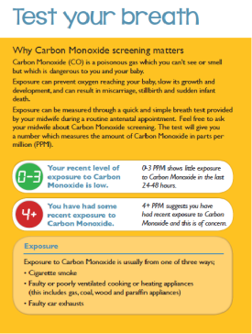
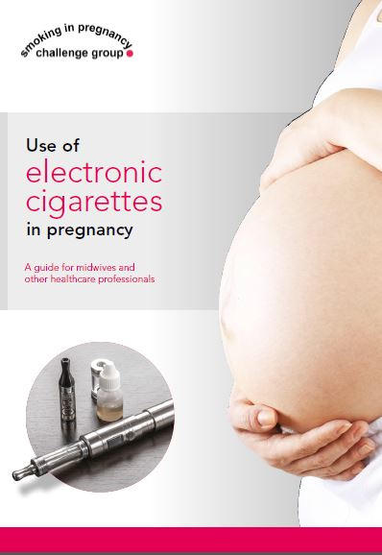
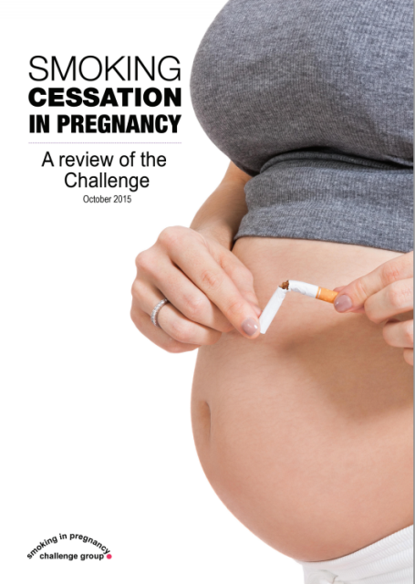
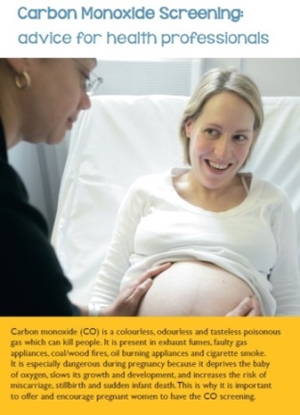
The Challenge Group
Resources available from:
http://www.smokefreeaction.org.uk/SIP/index.html

Slide 7
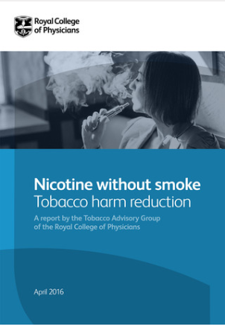
E-cigarettes
There is very limited evidence on e-cigarette use in pregnancy but a substantial amount of evidence on use amongst other adults and also teenagers
I’ll now briefly summarise what we know but key recommended reading is the recent Royal College of Physicians report
Nicotine without Smoke: Tobacco Harm Reduction
(April 2016)

Slide 8
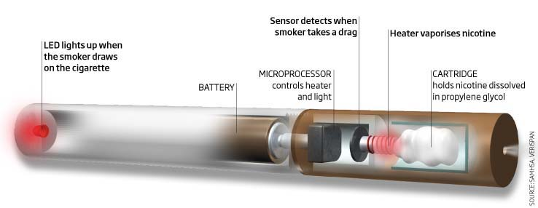
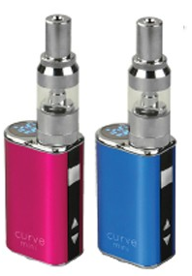
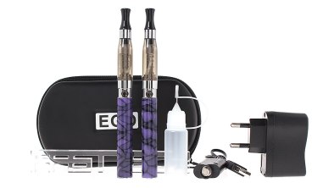
E-cigarettes are not a single product but come in many types.

Slide 9
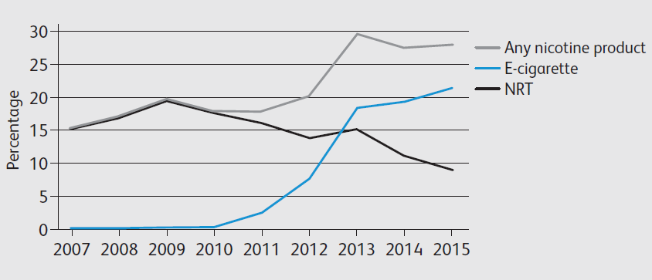
Current Smokers
The next four slides show data from the Smoking Toolkit
Study in England, conducted by Jamie Brown, Robert West + colleagues at
UCL and UKCTAS. These outline levels of e-cigarette use up to mid 2015
amongst current smokers, recent former smokers, longer term former
smokers and never smokers – all adults aged 16+

Slide 10
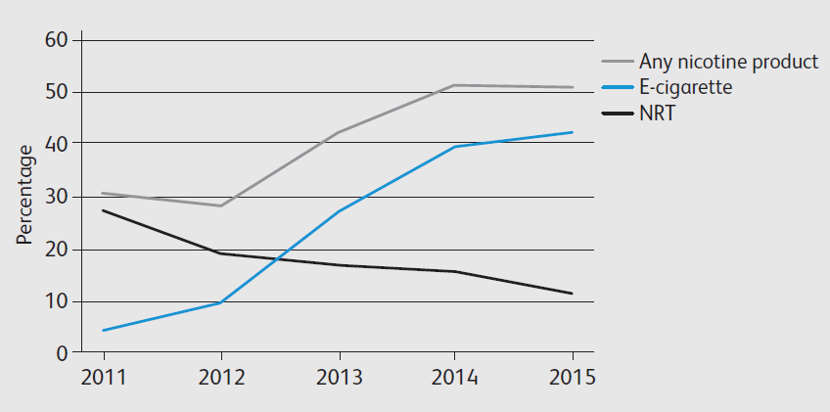
Former Smokers (recent)

Slide 11
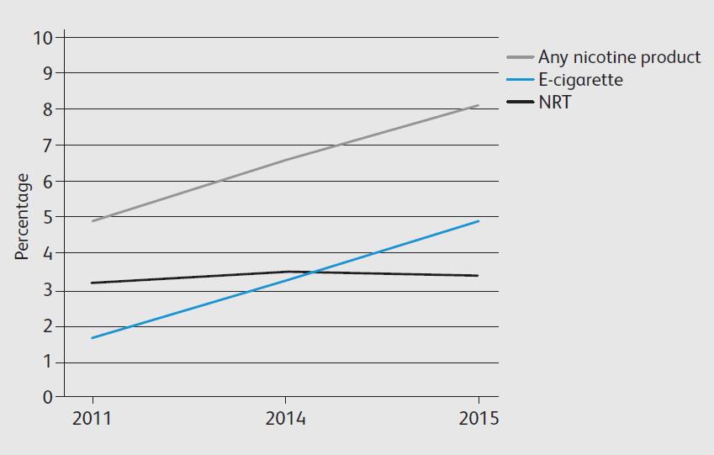
Former Smokers (long term)

Slide 12
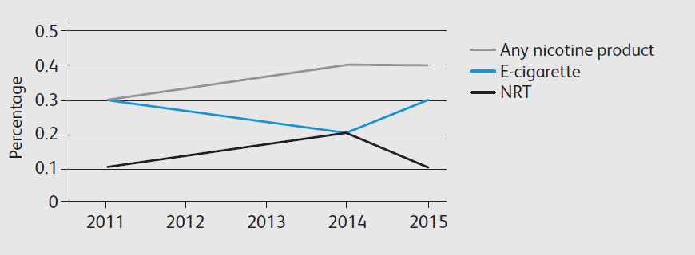
Never Smokers

Slide 13
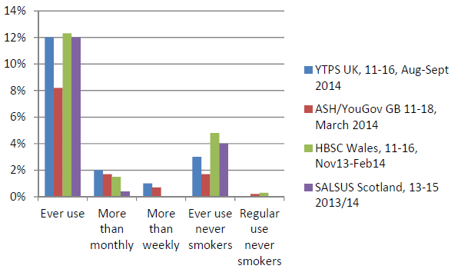
Regular e-cigarette use among children is confined almost exclusively to those who have smoked
Source: Bauld L, MacKintosh A, Ford A, McNeill A . Nicotine & Tobacco Research, 2015

Slide 14
Defining safety
Are electronic cigarettes safer than tobacco cigarettes?
Safer = less harmful
In discussions of safety the appropriate comparator is tobacco – both harm to users and bystanders

Slide 15
E-cigarettes as a harm reduction strategy
In contrast to ‘reduced risk’ cigarettes no combustion takes place in e-cigarettes
In contrast to smokeless tobacco, e-cigarettes are not tobacco products
They contain nicotine and flavourings which can be toxicants, but toxicants present are at much lower levels than in tobacco
All the evidence suggests e-cigarettes are safer than tobacco cigarettes

Slide 16
Not harmless but around 5% of the risks of smoking
EXTREME
Toxicity
Cigs - Combustibles
MUCH Less Harm
Non combustible
No Harm
= no use at all
Nutt DJ et al Estimating the Harms of Nicotine-Containing Products Using the MCDA
Approach – European Addiction Research March 2014
Notes:
The framework is anchored by the continuum of harm, with no use at all and toxic combustible use, at the extremes.
There are orders of magnitude differences in harm between combustibles and alternative nicotine delivery products like snus, NRTs, and e cigs.
They are substantially less harmful but not harmless compared with no use.
NO use is the best option for never users and speeding the obsolescence of all combustible use for current users

Slide 17
Toxicants in vapour
Source: Goniewicz et al, Tobacco Control, 2013

Slide 18
Risks to bystanders
Several studies now exist comparing second hand smoke to second hand vapour
Overall they show that e-cigarettes are a source of secondhand exposure to nicotine but not to combustion toxicants
Earlier studies have focused on vapour
exhaled by users but an additional recent
one measured PM2.5 levels in vaping,
smoking & non smoking homes. PM2.5
levels were similar between non smoking
& vaping homes but much higher in the
homes of smokers.

Slide 19
Aids used in most recent quit attempt
E-cigarette use for quitting is still increasing
N=11375 adults who smoke and tried to stop or who stopped in the past year; method is coded as any (not exclusive) use

Slide 21
UK observational studies (use during quit attempts)
Cross-sectional study, smokers in England who used e-cigarettes to quit were significantly more likely to quit than smokers using no help or OTC NRT (Brown et al, Addiction, 2014)
Cohort study, International Tobacco Control Policy Evaluation Study, smokers in England and US who used e-cigarettes to quit were more likely to quit than smokers using no help or NRT but no more or less likely than using varenicline/bupropion (Hitchman et al, 2015)
New study, 18,000 smokers quit in England using e-cigarettes who would not otherwise have done so (Brown et al, BMJ, 2016)
Notes:
Retrospective

Slide 22
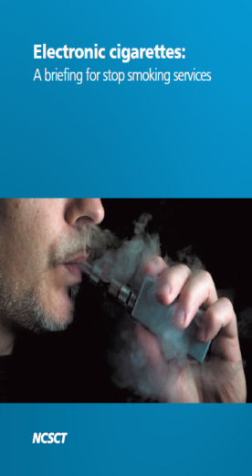
Advising on E-cigarette Use
NICE Recommendation 5: Advising on licensed nicotine containing products
NCSCT Recommendations:
Be open to e-cig use
Provide advice & support
Be positive about e-cigs
Many cessation services
now adopting
this approach.
PHE and Health Scotland agree that cessation services can offer behavioural support to those using e-cigs in a quit attempt

Slide 23
Preventing Accidents
See: http://www.rospa.com/home-safety/advice/product/vaping/
E-cigarettes are battery operated devices and many contain nicotine
While they present nowhere near the fire risk of conventional cigarettes, nor the poisoning risk of some household products, guidelines on safety should be followed

Slide 24
Perception of harm is going the wrong way
ASH Fact Sheet on the use of electronic cigarettes among adults in Great Britain, May 2016
Notes:
Total sample size of the survey was 12,597 adults

Slide 25
Use in pregnancy
To date we only have small surveys and qualitative studies on vaping in pregnancy
Pregnant women who smoke, or used to smoke, are using these devices. Up to one in four in some areas
What risks should we be concerned about?

Slide 26
Use in pregnancy
Nicotine use in pregnancy is safe in the form of Nicotine Replacement Therapy (Cooper et al, 2014). NRT is licensed for use by pregnant smokers + widely used in the UK
Nicotine is therefore not the main concern
Vaping around babies and children is unlikely to confer significant risk but PHE advice, particularly for childcare establishments, can assist https://www.gov.uk/government/news/vaping-in-public-places-advice-for-employers-and-organisations

Slide 27
Use in pregnancy
More evidence on use in pregnancy is needed particularly on effectiveness for smoking cessation amongst pregnant women and any impact on their children
A large randomised controlled trial will start later this year funded by NIHR to assess this in England and Scotland
In the meantime, we need to use what we know about e-cigarettes generally and the harms from smoking in pregnancy specifically in order to best support women.

Slide 28
Guide for midwives on use of e-cigarettes in pregnancy
Endorsed by:
Suggested responses to some frequently asked questions about their use during pregnancy.
Background information for healthcare professionals on electronic cigarettes.
Available here http://www.smokefreeaction.org.uk/SIP/files/eCigSIP.pdf

Slide 29
Infographic for women on use of e-cigarettes in pregnancy
Provides key information for pregnant women who are considering using electronic cigarettes to help them quit smoking
Designed to be used in face-to-face consultations with women.
Supports the detailed briefing.
Available here: http://www.smokefreeaction.org.uk/SIP/files/SIPe-cig%20infographic.pdf

Slide 30
Useful resources
All Challenge Group resources including the e-cigarette guide for midwives and the infographic for women are available here: http://www.smokefreeaction.org.uk/SIP/index.html
Email lnaylor@ipip.co.uk for details on how to access hard copies of the Group’s CO leaflets and e-cigarette materials
Additional Resources
ROSPA briefing: Use of e-cigarettes (vaping) in the home: advice for parents
NCSCT briefing: Smoking Cessation: a briefing for midwifery staff
NCSCT briefing: Electronic cigarettes: A briefing for stop smoking services
NCSCT E-learning: Very Brief Advice on smoking for pregnant women

Slide 31
Thank You. Questions?
Linda.Bauld@stir.ac.uk
Linda.Bauld@cancer.org.uk
Q&A Panel Members
Linda Bauld, Co-Chair Smoking in Pregnancy Challenge Group & Professor at the University of Stirling, UKCTAS, & Cancer Research UK
Jo Locker, Tobacco Control Manager, Public Health England
Sarah Fox, Professional Policy Advisor, The Royal College of Midwives
Hilary Wareing, Director, Improving Performance in Practice (iPiP)

