Slide 1
How much does the absence of the ‘hidden population’ from UK surveys underestimate smoking prevalence?
Epidemiology and Public Health
Dr Emma Beard
Lecturer in Statistics and Quantitative Methods

Slide 2
Population surveys
Annual Population Survey (APS)
Show trends in smoking prevalence over time
Guide policy development
Help identify at-risk populations
Provide information for health research
Allow cross country comparisons
Evaluate the success of public health initiatives
Figure 1: Smoking prevalence in the UK estimated from the APS
Notes:
Let’s start with a little information on population surveys. Population surveys estimating smoking prevalence are essential for monitoring public health trends and guiding policy development. These surveys also facilitate the efficient allocation of resources by revealing high-prevalence groups. Additionally, these surveys enable global comparisons, which allows countries to assess smoking trends and develop strategies to meet international health targets. Finally, they play a crucial role in evaluating the impact of public health interventions, such as assessing the success of smoking bans or tobacco control programs.
The main survey for evaluating smoking prevalence in the UK is the Annual Population Survey (APS), conducted by the Office for National Statistics (ONS). This survey takes places annually on around 320,000 respondents and provides key indicators on smoking behavior.
In the APS, a smoker is defined as someone who currently smokes, either daily or occasionally. Over the years, the estimated proportion of people who smoke in the UK has been steadily declining, reflecting the success of public health campaigns, smoking cessation programs, and tobacco control policies, such as smoking bans in public places and increased tobacco taxes. This decline is evident in the data shown in the accompanying figure, where we can observe a consistent drop in smoking prevalence since the APS records began in 2011.

Slide 3
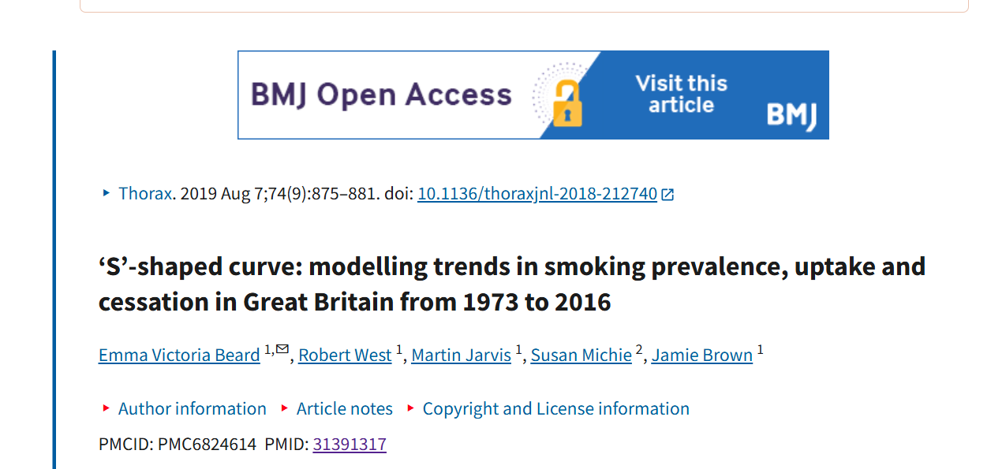
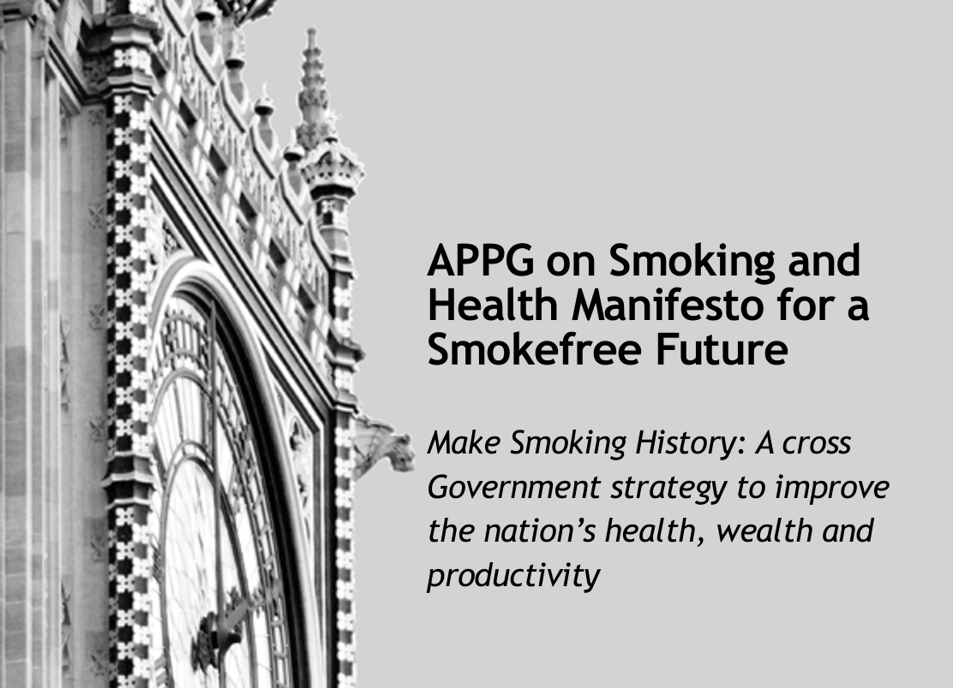
APS
Data have been used to estimate the impact of several policies, including increasing the legal age of sale year-on-year.
Smoking is more common in ages 25–34 and among lower socio-economic groups.
Researchers evaluated nicotine patches and vaping for smoking cessation success.
Stricter policies in Scotland and Wales led to faster declines in smoking rates.
NHS Smokefree Campaigns boosted cessation rates after public awareness efforts.
Notes:
This slide gives some examples of the impact of APS prevalence data on policies and public health research. For instance, it has been used to model the impact of several policies, including increasing the legal age of sale year on year. It has identified smoking as more prevalent among young adults (25–34) and individuals in lower socio-economic groups. Researchers have used this data to study the effectiveness of tools like nicotine patches and vaping. Additionally, it has shown cross-country differences, including stricter policies in Scotland and Wales contributing to sharper declines in smoking rates compared to England. Finally, it has demonstrated that campaigns like NHS Smokefree had notable success in encouraging smoking cessation.

Slide 4
Is the APS representative?
Under-recruitment of ‘hard-to-reach’ groups
E.g., Vulnerable migrants, sex works etc
Physical or social barriers to their recruitment
Weighting adjustments are used
Non-recruitment of ‘hidden populations’
E.g. long-stay hospitals, groups experiencing homelessness and Gypsy, Roma, and Travelers
Excluded from the sampling frame which only comprises of households
No adjustments are made
Non-coverage error
Notes:
However, concerns have been raised about the representativeness of the APS to the entire population. This is in part due to the under-recruitment of so-called ‘hard-to-reach’ groups. These groups, including vulnerable migrants and sex workers, may be difficult to reach due to physical or social barriers. Weighting adjustments are used to account for non-response among these groups, ensuring that participants reflect similar socio-demographic characteristics as non-respondents. However, effective bias reduction does rely on access to auxiliary information such as health indices and socio-demographic data. Another group, known as the 'hidden population', are entirely absent. This group lacks defined limits or sampling parameters, meaning there is no existing sampling frame for them. This is because the APS is a household surveys and so the probability sampling methods used typically exclude individuals in non-private households. Non-private households include communal establishments like care homes, long-stay hospitals, and some groups experiencing homelessness (such as those sleeping rough or those in temporary accommodations like bed and breakfasts). This category also encompasses communities like Gypsy, Roma, and Travellers, as well as students in halls of residence. Currently, the APS does not make adjustments for their exclusion and so this leads to noncoverage or coverage error, where the sampling frame does not match the target population.

Slide 5
Non-coverage error
Others excluded from sampling frame (e.g., geographic exclusions (remote rural areas and technological barriers (no telephone or internet)
Hidden population (non-household residents)
Target population
Sampling frame (household residents)
Notes:
The diagram illustrates the concept of non-coverage error in sampling frames by showing the relationship between the target population, the sampling frame, and the groups excluded from the frame. The largest square represents the target population, encompassing all individuals for whom the survey aims to estimate smoking prevalence. Within this, a smaller overlapping square represents the sampling frame—the portion of the target population included in the survey, typically residents of private households. Outside the sampling frame, shaded areas represent excluded groups. These include hidden populations, such as individuals experiencing homelessness, those in prisons, or in temporary accommodations, as well as others omitted due to geographic, demographic, or technological barriers. The diagram highlights how these exclusions create non-coverage error, as the excluded groups may have characteristics, such as higher smoking rates, that differ significantly from the included population, leading to biased survey results.

Slide 6
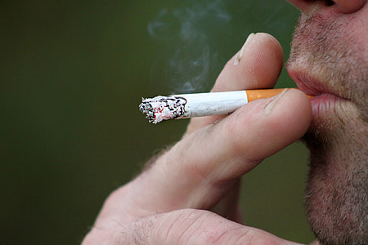
Why is this a problem?
Large numbers of individuals live in non-households (i.e. the ‘Hidden population’)
The size of the ‘Hidden population’ is growing
Smoking prevalence in ‘Hidden populations’ populations can be 4-8 times higher
Notes:
Why is this a problem? Hidden populations, such as those living in temporary housing, experiencing homelessness, or in institutional settings, make up a significant portion of the population. While these groups are often difficult to fully quantify, estimates suggest that the number of individuals living outside traditional household settings is substantial and growing. As these populations expand, surveys that only include individuals in stable housing become increasingly inadequate in capturing the full extent of smoking behavior.
Smoking rates within these hidden populations are also disproportionately high compared to the general population. Studies show that the prevalence of smoking in these groups is often 4 to 8 times greater than those living in households. These higher rates mean that excluding these populations from surveys leads to a significant underestimation of the actual prevalence of smoking in the UK.

Slide 7
Illustration
Parameters
General population smoking rate: 15%
Hidden population smoking rate: 60%
General population: 90%
Hidden population: is 10%
Total prevalence = (General population smoking rate X Percentage of the general population) + (Hidden population smoking rate X Percentage of the hidden population)
Total prevalence = (0.15 X 0.90) + (0.60 X 0.10)
Total prevalence= 19.5%
Notes:
Imagine a scenario where the general population has a smoking rate of 15%, comprising 90% of the total population, and the hidden population, making up 10%, has a much higher smoking rate of 60%. When both groups are included in the total prevalence calculation, the overall smoking rate increases to 19.5%. This 4.5% increase emphasizes the significant impact that hidden populations can have on public health estimates, illustrating how excluding these groups can lead to an underestimation of the true prevalence.

Slide 8
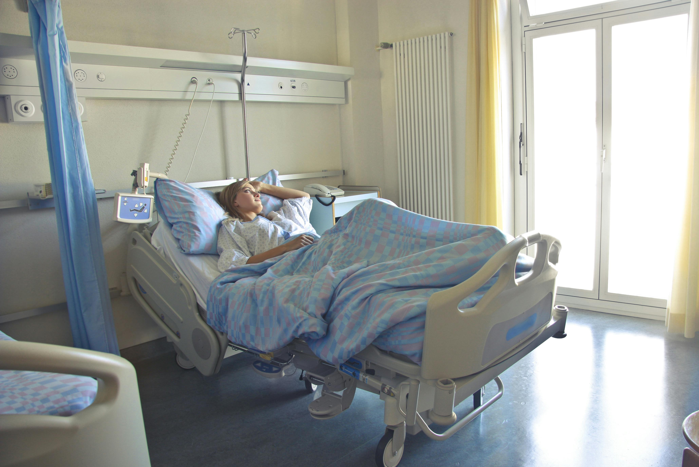
Characteristics of ‘Hidden populations’
Lack of stable and permanent housing
Institutional or collective living arrangements
Vulnerability to social and economic marginalisation
Limited autonomy and privacy
Poor health and/or safety risks
Dependency on support systems
Notes:
Ignoring hidden populations is also a problem from an inequality's perspective. Hidden populations are disproportionately vulnerable and face significant social, economic, and health challenges. The hidden population, is defined by unstable housing and marginalization, is frequently overlooked in health research and policy development, leading to an incomplete understanding of the true scope of public health issues, such as smoking prevalence. These individuals are often more vulnerable to poor health outcomes due to factors like limited access to healthcare, higher exposure to stress, and poor living conditions. In addition to these challenges, many people within the hidden population face safety risks, including violence, exploitation, and insecurity in their living environments. Their limited autonomy, often exacerbated by dependency on external support systems (e.g., social services, shelters, or charities), further complicates their ability to access care or make decisions that could improve their health. Addressing the needs of these groups is essential to ensure that public health interventions are inclusive, equitable, and effective in reducing health disparities across all segments of society.

Slide 9
Attempts to estimate the ‘hidden population’
The ONS has attempted to estimate their size:
Undocumented migrants in the UK
Individuals experiencing homelessness and rough sleeping
Post-census coverage surveys to estimate the undercount of various populations
There is no single published figure for the total ‘hidden population’ in the UK
Notes:
The Office for National Statistics has made several attempts to estimate the size of some sub-groups in the "hidden population” in the UK. These include undocumented migrants, individuals experiencing homelessness, and those sleeping rough. ONS also conduct post-census coverage surveys to try to estimate the undercount of various populations, such as ethnic minorities and young adults. However, there is no single published figure for the total hidden population in the UK.

Slide 10
Why?
Data gaps
Fragmented and inconsistent definitions
Individuals avoid research due to social stigma and fear of disclosure
Protecting the privacy and confidentiality of vulnerable populations
Transient nature makes it difficult to track and estimate their size over time
Notes:
The next question is why? A significant reason for not fully considering the impact of hidden populations is the fragmented and inconsistent definitions used to describe these groups. Many attempts have only considered people experiencing homelessness and undocumented migrants. Moreover, terms like "homelessness" can vary widely across different contexts, which complicates efforts to categorize and identify individuals accurately. In addition, data gaps exist, with hidden populations often reluctant to participate in research due to fears of social stigma, legal consequences, or discrimination. Ethical concerns around privacy and the potential exposure of sensitive information also complicate data collection. Furthermore, the fluid and dynamic nature of hidden populations, where individuals may move in and out of these groups, makes it difficult to track and accurately estimate their size over time.

Slide 11
What is the solution?
Approach | Description | Advantages | Challenges | Notes
Correction Factor | Adjust survey data to account for the hidden population by applying a correction factor. | Pragmatic, cost-effective, improves statistical robustness. | Dependent on quality and availability of auxiliary data. Needs regular updates for accuracy. | Must be applied to confidence intervals as well.
Mixed Modes of Data Collection | Combine household surveys with action-based sampling (e.g., homeless services). | Enhances survey coverage, allows for more comprehensive data collection. | Complex, time-consuming, and resource-intensive. | Requires careful planning and execution.
Including Communal Establishments and Temporary Residents | Incorporate communal establishments and temporary residents in surveys. | Expands survey coverage, provides more complete population data. | Challenges in maintaining data integrity and consistency. Highly intensive. | Requires careful adjustment to reflect all relevant populations.
Prior Inclusion in 'Hidden Population' (e.g., Sofa Surfing) | Ask respondents about past inclusion in hidden populations (e.g., sofa surfing). Weight responses from individuals with such histories more heavily. | Less intensive than other approaches, helps reflect the hidden population. | Risk of overcompensation due to complex weighting. Calibration and validation are difficult. | Needs careful calibration to ensure accuracy in representation.
Notes:
What is the solution?
One pragmatic and cost-effective approach to address the exclusion of the 'hidden population' from household surveys is deriving and applying a correction factor. This method involves adjusting collected survey data to account for the estimated ‘hidden population’. To ensure statistical robustness, the correction factor can also be applied to confidence intervals and must be regularly updated to maintain accuracy and relevance. Of course, the effectiveness of the correction factor approach is highly dependent on the quality and availability of auxiliary data.
An alternative approach is to enhance survey coverage by employing mixed modes of data collection, such as combining household surveys with action-based sampling among those using relevant homeless services. Including communal establishments in household surveys, leveraging census weighting, and adapting surveys to include temporary household residents are also options. However, these pose challenges for maintaining data integrity over time and are highly intensive.
A less intensive option involves collecting information on prior inclusion in a 'hidden population', such as asking respondents about past experiences like sofa surfing. Responses from individuals with such histories can be weighted more heavily to better reflect the 'hidden population'. This however would require complex weighting with a risk of overcompensation. Ensuring that the weighting appropriately reflects the proportion of the hidden population without exaggerating their numbers is difficult and requires careful calibration and validation.

Slide 12
Objectives
To estimate the size of the 'hidden population' excluded from household surveys.
To determine the potential impact of excluding the 'hidden population' on smoking prevalence estimates.
To derive and apply a correction factor to adjust smoking prevalence estimates.
Notes:
We therefore aimed to estimate the size of the 'hidden population' excluded from household surveys, assess the impact of their exclusion on smoking prevalence estimates, and develop a correction factor to adjust these estimates for greater accuracy. By identifying the number of individuals in groups such as those experiencing homelessness, those in temporary accommodation, and institutionalized populations, we seeked to quantify how their omission leads to underreporting of smoking rates.

Slide 13
Defining and estimating the ‘hidden population’
Category | Subcategory/Population | Definition
Communal Establishments | Care and Residential Homes | Facilities for individuals (elderly or disabled) requiring assistance with daily living activities.
 | Long-Stay Hospitals | Healthcare facilities for patients with severe or chronic medical conditions, including mental health disorders, receiving extended, specialized care.
 | Student Halls of Residence | Accommodation provided by educational institutions (e.g., universities, boarding schools) for students.
 | Prisons | Secure facilities where individuals convicted of crimes serve their sentences as part of the criminal justice system.
 | Hostels for People Experiencing Homelessness | Facilities providing shelter and basic amenities for individuals experiencing homelessness.
Immigration Detention Centres |  | Facilities where individuals are detained while immigration decisions are being processed, or deportation is pending.
Gypsy, Roma, and Travelling Communities |  | Ethnic groups living in temporary dwellings (e.g., caravans, trailers), often maintaining distinct cultural practices and traditions.
Temporary Accommodation | Bed and Breakfasts | Short-term accommodations with private bedrooms and shared facilities, often for those experiencing homelessness.
 | Unsupported Temporary Accommodation | Temporary accommodation with minimal support services, typically for individuals without stable housing.
Sleeping Rough |  | Individuals sleeping in outdoor locations (e.g., streets, parks) without safe and secure housing.
Sofa Surfing |  | People relying on friends, family, or acquaintances for temporary shelter without a stable, permanent residence.
Existing data was gathered from various sources such as government publications, academic studies, and official reports.
Notes:
The ONS non-private household definition was used. This includes people living in communal establishments, immigration detention centers, gypsy, Roma, and Travelling Communities, as wel as those in temporary accommodation, sleeping rough and sofa surfing.
Specific population counts for communal establishments (e.g., care homes, student accommodations, and other institutional settings) were obtained from official statistics, while estimates for more transient groups like those in temporary accommodation or sleeping rough were derived from surveys and reports from homelessness charities and local authorities. Data on Gypsy, Roma, and Traveller populations were accessed through community records and specific surveys targeting these populations, while information on immigration detention centers was gathered from government immigration records.

Slide 14
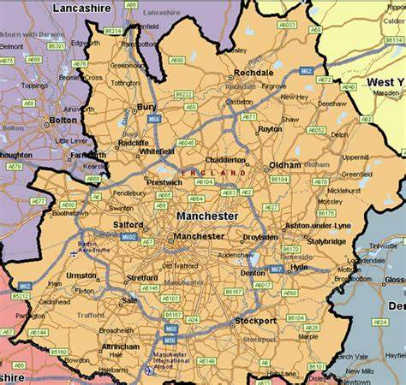
Size of the hidden population
Table 1: Estimate of the size of the ‘hidden population’ in the UK aged 18+
These estimate may under- or over-estimate the true prevalence given biases in data collection.
Hidden population | Estimated size
Communal establishments | 1,100,000
Immigration removal centres | 24,000
Gypsy, Roma, and Traveling Communities | 56,000
Bed and breakfasts and unsupported temporary accommodation | 132,000
People sleeping rough | 38,000
Sofa surfers | 562,000
Total | 1,912,000
This leads to an estimated 3.5% of the total UK population being hidden from household surveys
Notes:
We estimated that the size of the ‘hidden population’ aged 18+ in the UK is around 1.9 million, which reflects 3.5% of the total UK population. This is comparable to the population of Greater Manchester and Birmingham, meaning that the hidden population in the UK is of a size similar to these large urban areas, highlighting the significant scale of individuals excluded from typical population surveys. Of course, this estimate may under- or over-estimate the true prevalence given biases in data collection. For example, estimates of rough sleepers and Gypsy, Roma, and Traveler communities are more prone to bias, as these groups are harder to track due to their mobility, lack of stable housing, or underreporting in official surveys.

Slide 15
Smoking in the hidden population
Table 2: Estimated smoking prevalence among the ‘hidden population’ in the UK
Population | Weighting | Upper smoking proportion estimate | Lower smoking proportion estimate | Weighted upper smoking proportion estimate | Weighted lower smoking proportion estimate
Communal establishments | 0.575 | 0.586 | 0.442 | 0.337 | 0.254
Immigration removal centres | 0.013 | 0.190 | 0.100 | 0.002 | 0.001
Travellers in caravan sites | 0.029 | 0.490 | 0.460 | 0.014 | 0.013
Bed & breakfasts / temporary accommodation | 0.069 | 0.800 | 0.800 | 0.055 | 0.055
People sleeping rough | 0.020 | 0.800 | 0.800 | 0.016 | 0.016
Sofa surfers | 0.294 | 0.800 | 0.800 | 0.235 | 0.235
Total estimate: |  |  |  | 0.660 | 0.575
This would suggest that there are between n=1,099,960 and n=1,262,200 smokers in the hidden population (i.e. smokers not accounted for)
These estimate may under- or over-estimate the true prevalence given biases in data collection.
Notes:
Next we estimated the total proportion of the ‘hidden population’ who smoke as being somewhere between 58% and 66%. These two estimates were calculated by weighting the proportions of each sub-group who smoke derived from the previous literature by the contribution of the group of interest to the total population of hidden individuals. This would suggest that the number of smokers in the ‘hidden population’ is between approximately 1 and 1.2 million. Again, given biases in the data collection this could be an under or over-estimate.

Slide 16
What is the impact?
Table 3: estimated prevalence and attainment of the 2030 target prevalence below 5%
Estimate | Number of Smokers (n) | Smoking Prevalence (%)
Previous Estimate (APS 2022) | 6,746,700 | 12.9%
Upper Estimate (with hidden population) | 8,008,900 | 14.8%
Lower Estimate (with hidden population) | 7,846,660 | 14.5%
Year | APS estimate | Inflated APS estimate
2022 | 12.9 | 14.8
2023 | 12.4 | 14.3
2024 | 11.9 | 13.8
2025 | 11.4 | 13.3
2026 | 10.9 | 12.8
2027 | 10.4 | 12.3
2028 | 9.9 | 11.8
2029 | 9.4 | 11.3
2030 | 8.9 | 10.8
2031 | 8.4 | 10.3
2032 | 7.9 | 9.8
2033 | 7.4 | 9.3
2034 | 6.9 | 8.8
2035 | 6.4 | 8.3
2036 | 5.9 | 7.8
2037 | 5.4 | 7.3
2038 | 4.9 | 6.8
2039 | 4.4 | 6.3
2040 | 3.9 | 5.8
2041 | 3.4 | 5.3
2042 | 2.9 | 4.8
Coverage bias: 1.6% to 1.9%
Correction Factor: 1.12 to 1.15
(APS prevalence statistic vs. estimate including the 'hidden population')
Notes:
What is the impact of this? The Annual Population Survey (APS) estimated that in 2022, 12.9% of people aged 18 years and over living in households smoked cigarettes, equating to around 6.8 million individuals. However, when accounting for the excluded ‘hidden population,’ the number of smokers could be between 7.8 and 8 million individuals. This indicates an absolute percentage increase in smoking prevalence of between 1.6% to 1.9%. The correction factor, which adjusts for the exclusion of these hidden populations, is estimated at a ratio of 1.12 to 1.15, meaning that smoking prevalence estimates from the APS may be underreported by this amount.
This underestimation has significant implications, especially given the UK government's ambitious goal to achieve a smokefree England by 2030, with a target of reducing smoking prevalence to less than 5% for combustible tobacco. The delay in reaching this target is already projected to be approximately eight years, pushing the target date from 2030 to 2038 based on a projected decline in smoking prevalence of around 0.5 percentage points per year. However, accounting for the hidden population's contribution to smoking rates suggests that the target may be delayed even further, potentially until 2042.

Slide 17
What is the impact?
Table 4: Smoking prevalence across the UK estimated by the APS and new estimates with the correction factor 1.15 applied
Note: confidence intervals are not given for the UK by the APS
Countries | APS prevalence | APS prevalence Lower 95%CI | APS prevalence Upper 95%CI | APS prevalence with correction factor | APS prevalence Lower 95%CI with correction factor | APS prevalence Upper 95%CI with correction factor
UK | 12.9 |  |  | 14.8
England | 12.7 | 12.3 | 13.0 | 14.6 | 14.1 | 15.0
Wales | 14.1 | 13.2 | 14.9 | 16.2 | 15.2 | 17.1
Scotland | 13.9 | 13.0 | 15.6 | 16.0 | 15.0 | 17.9
Northern Ireland | 14.0 | 13.0 | 14.9 | 16.1 | 15.0 | 17.1
Notes:
Table 4 presents smoking prevalence estimates for the UK, as derived from the Annual Population Survey (APS), stratified by country, along with the corresponding 95% confidence intervals and adjusted estimates that account for the hidden population using a correction factor of 1.15. The data reveal that the APS estimates for smoking prevalence in England, Wales, Scotland, and Northern Ireland do not overlap with the inflated estimates' confidence intervals. This discrepancy suggests a significant underestimation of smoking prevalence in the original APS data, reinforcing the idea that the exclusion of the hidden population is contributing to inaccurate national smoking statistics.
Further sensitivity analyses indicate that, for the hidden population not to affect smoking prevalence estimates, their size would need to be as small as 60,000 individuals (assuming a smoking prevalence rate of 66% within this group). This would correspond to a correction factor of 1, meaning that even a relatively small hidden population would significantly impact the overall smoking estimates. This further emphasizes the substantial influence that the hidden population has on national smoking prevalence data.

Slide 18
Implications
Not to disrupt current population household surveys
Firs step to derive a correction factor to enhance the accuracy of historical prevalence data
Inform the public about the limitations of household surveys in fully capturing smoking prevalence
Notes:
Importantly, the goal of these findings is not to disrupt established time series or suggest a change in the methods of data collection that have proven valuable in monitoring smoking trends over time. Household surveys have been instrumental in providing consistent and comparable data on smoking prevalence, which is crucial for policy formulation and evaluation of public health interventions. Rather, this study is meant to provide a simple statistical tool in the correction factor that can be applied to historical timeseries to more accurately reflect actual smoking prevalence. Clearly there is a need for transparency in informing the public about the limitations of household surveys in capturing the full scope of smoking prevalence. The public’s statistical literacy has notably improved since the COVID pandemic and there is a growing awareness of the complexities involved in data collection methodologies. It is essential to openly address this by clearly stating that household surveys may not fully represent all segments of society.

Slide 19
Next steps
Integrating and linking cross-sector data | Linking data from different sectors (e.g., health and social services) to provide a more comprehensive view.
Centralized systems for data sharing | Developing centralized systems where various government bodies and institutions can share data.
Alternative data collection methods | Utilizing methods like capture-recapture models or big data to gather more accurate or supplementary data.
Interdisciplinary approach | Involving experts from various fields (e.g., health, social sciences, technology) to improve data quality.
Collaboration between governments, NGOs, and academics | Encouraging partnerships between government agencies, NGOs, and academic researchers for better data sharing.
Ensure correction factors are updated yearly | Regularly updating correction factors to maintain the accuracy and relevance of collected data.
Use of mathematical models | Applying mathematical models to analyze data and improve predictions and outcomes.
Notes:
To advance research estimating the size of hidden populations, it’s essential to refine data collection methodologies, integrate data across various sectors like health, housing, and social services, and develop centralized systems for data sharing between government agencies and researchers. Incorporating alternative data collection methods such as capture-recapture models and leveraging big data sources like mobile phone data and social media can offer deeper insights into hidden populations. A collaborative approach involving governments, NGOs, and academic researchers is essential for building a comprehensive, interdisciplinary framework. Moreover, to maintain the accuracy and relevance of population estimates, it's critical to regularly update correction factors and refine estimations, potentially employing advanced mathematical models to improve precision and adapt to evolving data.

Slide 20
Questions
e.beard@ucl.ac.uk

