Slide 1
ASH webinar – Building a business case for the CURE Model
23 March 2022, 10:30 – 11:15
Chaired by Hazel Cheeseman, Deputy Chief Executive, ASH

Slide 2
Agenda
10:30 – 10:40 – Introduction from the Chair
Hazel Cheeseman, Deputy Chief Executive, ASH
10:40 – 11:00 Building a Business Case for the CURE Model
Dr Matthew Evison, Clinical Lead, Make Smoking History & the CURE Project, Greater Manchester Health& Social Care Partnership
11:00 – 11:10 Q&A
11:10 – 11:15 Closing remarks
Hazel Cheeseman, Deputy Chief Executive, ASH

Slide 3
Housekeeping
The meeting is being recorded, and a recording of the event will be circulated to all attendees and uploaded to the ASH webinar page after the event.
Please can all panellists and attendees keep themselves muted and turn their videos off unless they are presenting. ASH staff will mute anyone who is unmuted and not presenting.
We encourage all attendees to submit questions and reflections in the meeting chat, to be discussed during the Q&A session.
If you have any other issues, please post in the meeting chat or email admin@smokefreeaction.org.uk

Slide 4
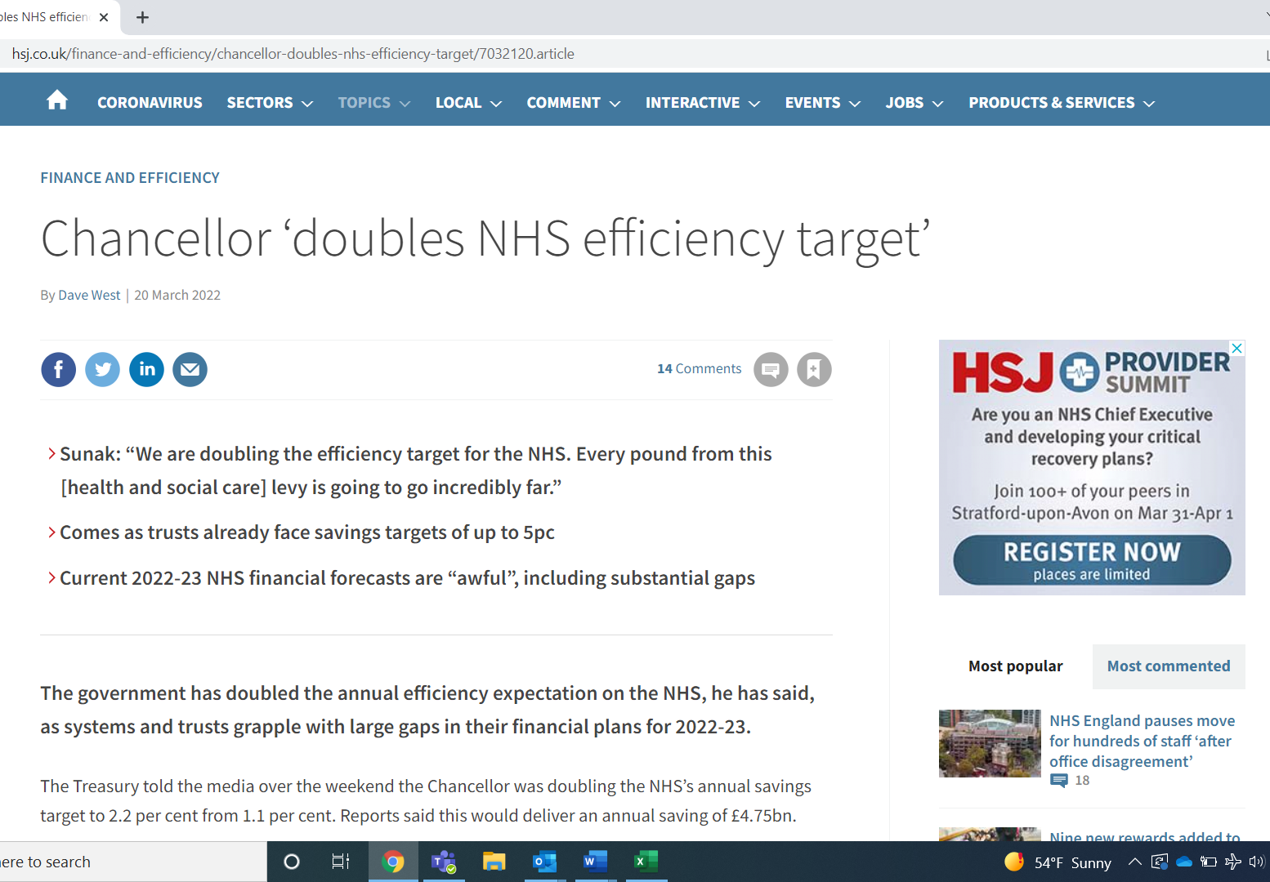
The Long Term Plan is… long term
The programme requires full implementation by 2023/24 and funding has been allocated to secure that
The full expectation is that funding will then be reoccurring
Local calls for funding assurances create challenges though
Funding for the NHS continues to be a political football with budget still unconfirmed
Cannot wait forever – areas need to get going to risk not being able to fully implement.

Slide 5
Building the case locally
Why Trusts may still want a business case
To review costs versus income
To assess risks and benefits
Securing leadership and buy-in important requirement for success – clarity in the business case can support this
Ensure the programme is grounded in a corporate understanding of the benefits to the Trust will better protect programme into the future

Slide 6
What is the business case?
Deliver better care – smokers have poorer treatment outcomes and more complications
Key strategy for reducing health inequality. Smoking is THE biggest driver of the difference in life expectancy
Human right – even someone with a terminal diagnosis can increase their healthy life expectancy
We can reduce demand for NHS services (and social care)
Short term CVD, surgical infections, respiratory exacerbations
Long term: cancer, particularly lung cancer

Slide 7
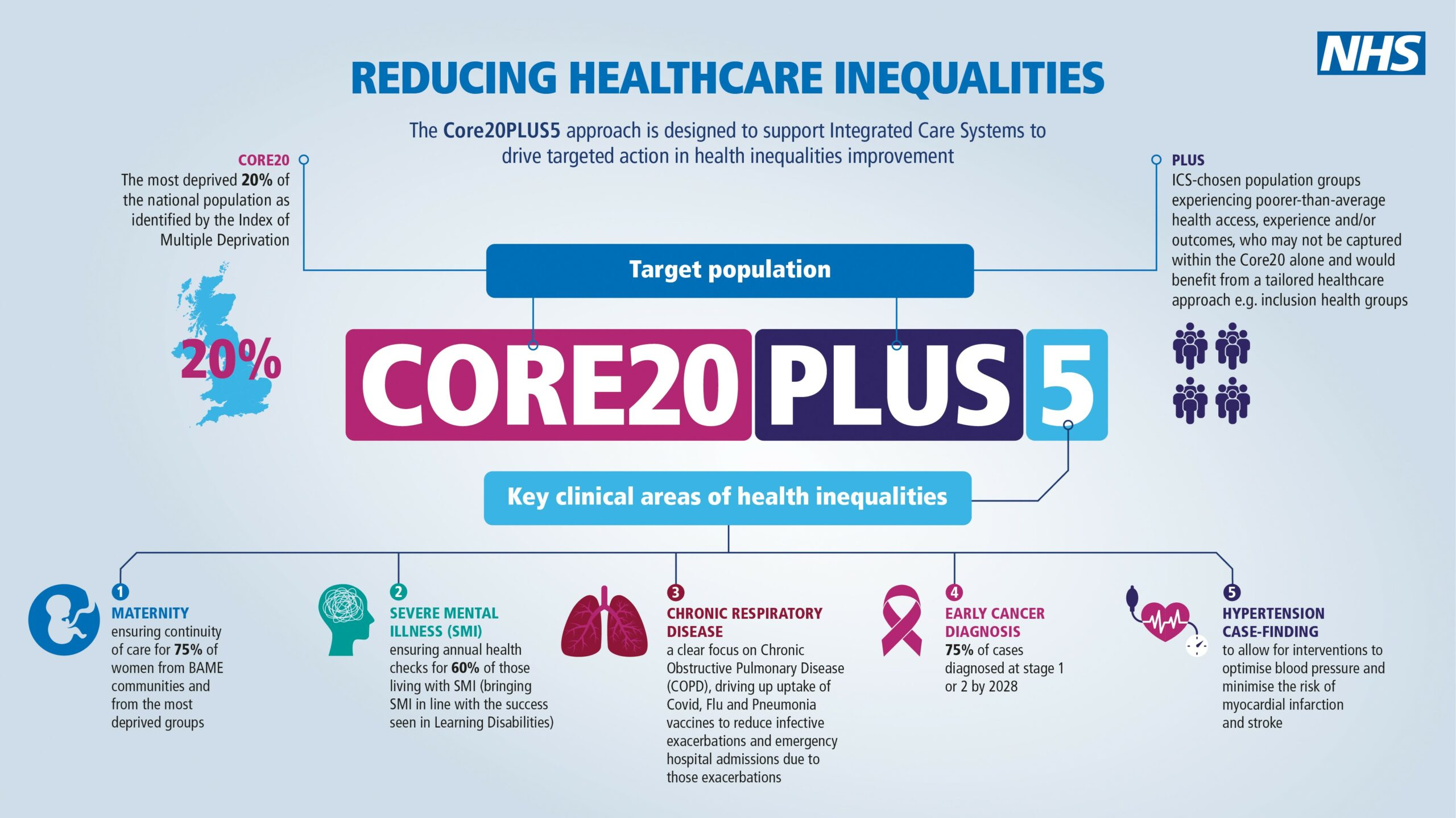
Part of a wider strategic vision in the NHS
Core20Plus5 – tackling smoking supports every aspect of this. Treating Tobacco Dependency programme will be a core part of local approaches to health inequalties
NHS operational guidance 22/23 requires prevention plans:
“We are asking systems to develop robust plans for the prevention of ill-health, led by a nominated senior responsible officer (SRO). These plans should reflect the primary and secondary prevention deliverables as outlined in the NHS Long Term Plan, and the key local priorities agreed by the ICS”

Slide 8
Summary
We have…
the strategic direction
the NHS planning guidance for the year that says we need to do this.
new and additional money flowing in
We can just “crack on”.
But trusts may require a case for their local governance and due diligence requirements and locally you may want to invest over and above allocated resources
Hopefully today’s session will give you more content to frame both the business and clinical arguments

Slide 9
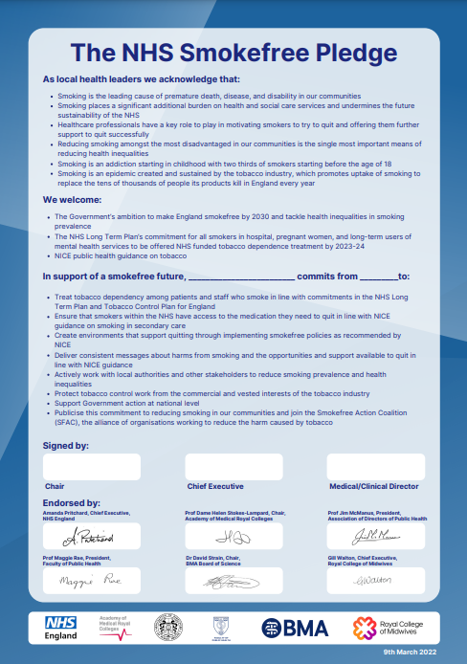
How can ASH help?
New ICS briefings coming soon
Existing cost of smoking and inequalities dashboards
NHS Smokefree Pledge
Updated briefing on smoking and surgery – focus on prehabilitation
Further webinars and resources – you tell us
Hazel.Cheeseman@ash.org.uk

