Slide 1




Financial Incentives for Smoking Cessation –
A Cochrane Review
Professor Caitlin Notley
Public Health Research Department
Norwich Medical School
University of East Anglia

Slide 2
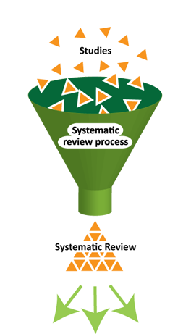
About Cochrane
WHAT?
International, non-profit organisation
Gathers and combines the best evidence from research to determine the benefits and risks of treatments/interventions
HOW?
By systematically reviewing the available evidence, with strong emphasis on quality assessment
Cochrane methods have been developed to minimise bias - considered gold-standard
WHY?
To help healthcare providers, patients, carers, researchers, funders, policy makers, guideline developers improve their knowledge and make decisions
https://www.cochrane.org/

Slide 3
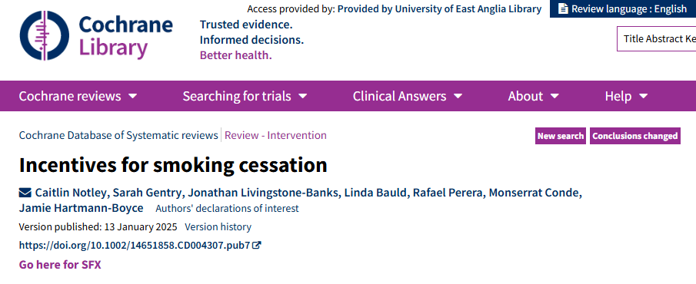
Notley C, Gentry S, Livingstone-Banks J, Bauld L, Perera R, Conde M, Hartmann-Boyce J. Incentives for smoking cessation. Cochrane Database of Systematic Reviews 2025, Issue 1. Art. No.: CD004307. DOI: 10.1002/14651858.CD004307.pub7.

Slide 4
Background: Incentives
Smoking remains the leading preventable cause of death worldwide (WHO 2023)
Incentive based programmes have been used to encourage positive health behaviour change, but are controversial:
Public acceptability?
Commissioning?
Time limited effectiveness?
Possible mechanisms of action (theory of behaviour change):
Operant conditioning
Delay discounting

Slide 5
Background: Incentives in pregnancy
Pregnant women who smoke are a high risk priority group
UK Government targets to reduce smoking in pregnancy rates to 5% or less have not been achieved
Interest in trialling alternative, non-pharmacological, approaches to address smoking cessation in pregnancy

Slide 6
Objectives
Primary
To assess the long‐term effects of incentives and contingency management programmes for smoking cessation in mixed and pregnant populations.
Secondary
To assess the long‐term effects of incentives and contingency management programmes for smoking cessation in mixed populations, considering whether incentives were offered at the final follow‐up point.
To assess the difference in outcomes for pregnant populations, considering whether rewards were contingent on abstinence or guaranteed.

Slide 7
Selection criteria
Studies: RCTs or cluster RCTs
Participants: Adults who smoke
Interventions: Incentive schemes to reward participants for (validated) cessation and abstinence
Controls: Usual care or other smoking cessation interventions
Outcomes: Long term smoking cessation (6 months or more), self-reported or biochemically validated (strictest available outcome)
Pregnancy outcomes: long term smoking cessation to at least the end of pregnancy and at longest follow up postpartum

Slide 8
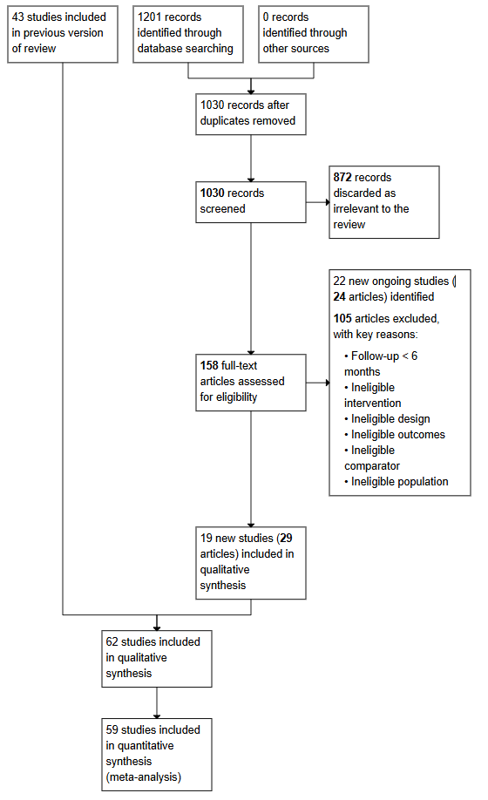
Main results:
Included studies
Combined prisma flow diagram – mixed populations and pregnancy trials

Slide 9
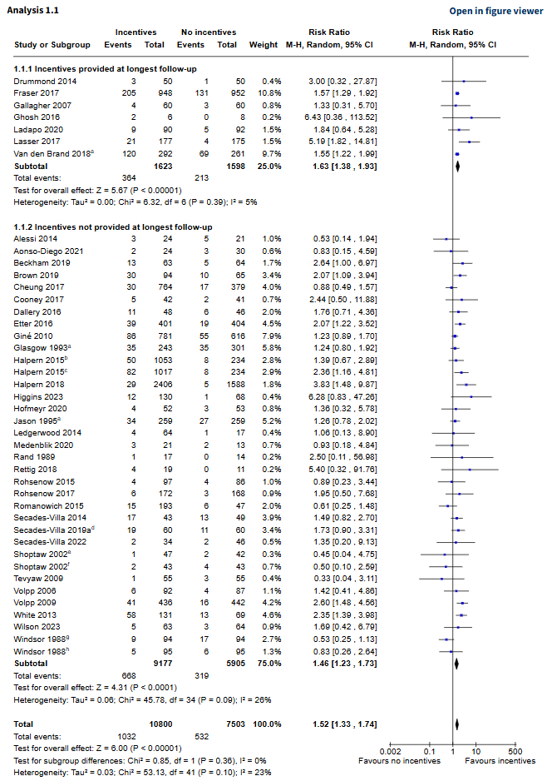
Main results:
Incentives vs.
no incentives at
6+ months –
Mixed population
trials
GRADE certainty of evidence: HIGH

Slide 10
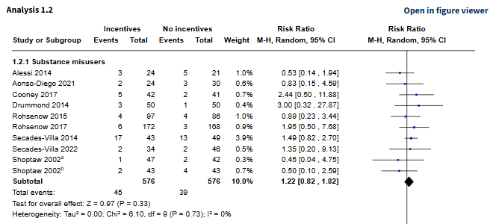
Incentives vs. no incentives at
6+ months – Substance misuse sub-group

Slide 11
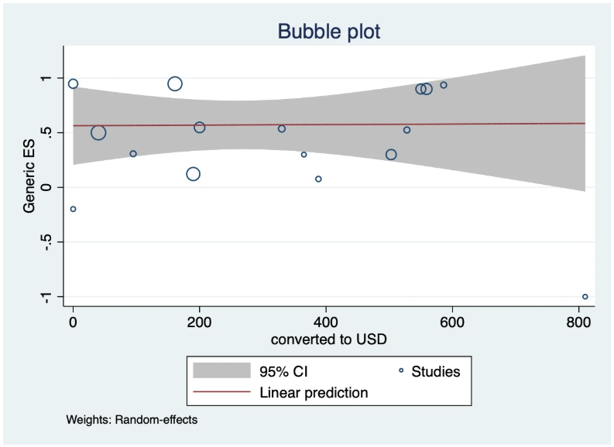
Amount of
incentives

Slide 12
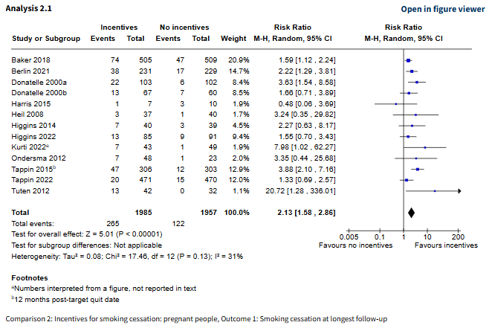
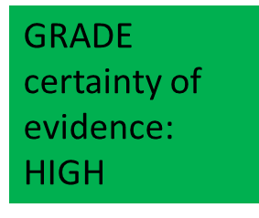

Main results:
Incentives vs.
no incentives at
Longest follow up –
Pregnancy
trials

Slide 13
Conclusions
High‐certainty evidence that incentives improve smoking cessation rates at long‐term follow‐up in mixed population studies
Effectiveness of incentives is sustained even when the last follow‐up occurs after the withdrawal of incentives
High‐certainty evidence that incentive schemes conducted amongst pregnant people who smoke improve smoking cessation rates, both at the end of pregnancy and postpartum – This represents increased certainty in the evidence compared to the last review update in 2019

Slide 14
Implications
This review includes a number of large new trials from diverse cultural settings, e.g:
Brown (2019) – using self-incentives in a community-based trial, UK, N=159
Secades‐Villa 2019a – recruiting people who smoke in inpatient treatment for depression, Spain, N=120
Van-Schayck 2018 – cRCT N=640 current smokers recruited from 61 companies in the Netherlands
White 2020 – cRCT recruiting 4190 employees across 101 workplace clusters in Thailand
Tappin 2022 – 944 pregnant people attending UK stop smoking services
….suggesting that the impact of incentives can be considered broadly generalisable
Incentives may particularly appeal to low-income populations, thus reducing health inequity
More evidence is needed from low- and middle-income countries
Current and future research might more precisely explore differences between trials offering low or high cash incentives and self‐incentives (deposits)
Strong support for incentives based interventions in practice

