Slide 1

Why we need to address smoking now
Prof Ann McNeill, Co-Chair of the Mental Health and Smoking Partnership
Professor of Tobacco Addiction
Vice Dean (Culture, Diversity & Inclusion)
Institute of Psychiatry, Psychology & Neuroscience
King’s College London

Slide 2


Smoking is a major cause of inequality
Substance use
14%
30-40%¹
60%²
>80%³
Psychosis
Depression & Anxiety
81 years
66 years
General population
Life expectancy gap general population vs mental illness⁴
1 RCP (2013) smoking and Mental Health
2. Wu C-Y et al. (2013). PLoS ONE 8(9): e74262. 3. Cookson C, et al (2014) BMC Health Services Research 2014, 14:304 , 4. Chang et al PLoS One 2011;6(5)

Slide 3
Shorter, sicker lives
For every person who dies from smoking another 30 are suffering a serious smoking related disease
On average, smokers report difficulty completing tasks 7 years earlier, and receive care support 10 years earlier, than never smokers
On average, smokers and ex-smokers receive 3.6 times as many hours care as never smokers indicating higher levels of overall need
Smokers are less likely to be employed than never smokers, linked to the much greater likelihood of working age disability
ASH, The Cost of Smoking to the Social Care System, 2021 https://ash.org.uk/wp-content/uploads/2021/03/SocialCare.pdf
ASH, Smoking, Employability and Earnings, 2021 https://ash.org.uk/information-and-resources/reports-submissions/reports/smokingemployability/

Slide 4
Smoking and poverty
Estimate for annual spending on tobacco by smokers with a MH condition range from £1200 to £2200/year
If we counted tobacco expenditure in our calculations of poverty many hundreds of thousands more would be in poverty
900K – 1.2m adults in the UK with a common mental disorder (CIS-R score >12) are living in poverty and are current smokers
T Langley, Mental health, smoking and poverty in the UK: Tessa Langley, European Journal of Public Health, Volume 26, Issue suppl_1, November 2016, ckw174.180, https://doi.org/10.1093/eurpub/ckw174.180

Slide 5
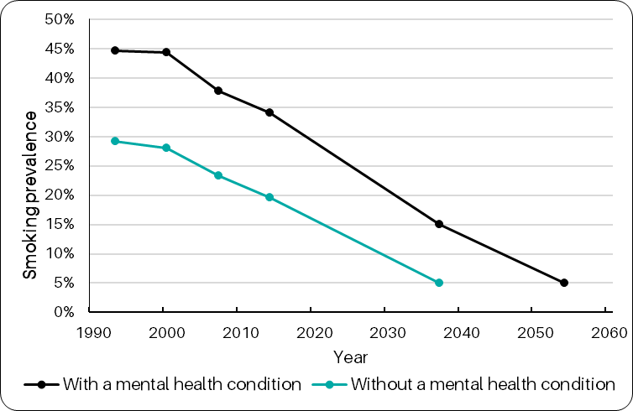
20 year gap in securing smokefree goals
Projected rate of decline among smokers with & without a mental health condition
People with MH conditions won’t reach smokefree (5% prevalence) until 20 years later than people without at the current rate of decline
Richardson & Robson (2021) Adapted from Richardson et al (2019) Smoking and quitting behaviours by mental health conditions in Great Britain (1993-2014) Addictive Behaviours 90:14-10

Slide 6


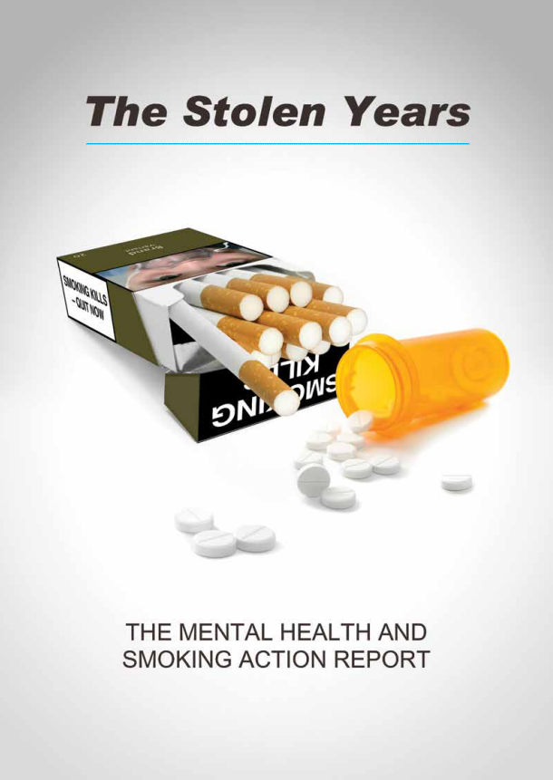
Journey to the Long Term Plan
“Persistent high prevalence of smoking reflects a major failure of public health and clinical services to address the needs of a highly disadvantaged sector of society.” (RCP & RCPsych, 2013)
In 2016, we called for exactly the kind of programme in the NHS Long-Term Plan

Slide 7
Implementation challenge: Training
ASH, Smokefree Skills: training needs of mental health nurses and psychiatrists, 2020
https://ash.org.uk/information-and-resources/reports-submissions/reports/smokefreeskills/

Slide 8
Implementation challenge: Myth of low motivation
Believe patients with mental health conditions are not motivated to quit
Community mental health professionals
ASH, Smokefree Skills: training needs of mental health nurses and psychiatrists, 2020
https://ash.org.uk/information-and-resources/reports-submissions/reports/smokefreeskills/

Slide 9
Implementation challenge: variable smokefree policies
How often staff accompany patients on smoking breaks on average adult mental health wards (all surveyed trusts)
ASH, Progress Towards Smokefree Mental Health Settings, 2019 https://ash.org.uk/wp-content/uploads/2019/10/PHE-mental-health-trust-2019-survey-full-report_v12.pdf

Slide 10
Implementation challenge: impact of COVID-19
There have been reports that policy implementation has been disrupted in some areas, particularly for smokefree policies
Evidence indicates that some smokers with a mental health condition have quit smoking with greater success during the pandemic BUT others are increasing their consumption of tobacco, relapsing, or taking up smoking for the first time. (YouGov COVID tracker; OWLS survey)
Consequently, the pandemic may be exacerbating the significant inequalities this group already face
The disruption of pandemic means the LTP is behind schedule and risks being deprioritised in the face of current pressures – will mental health service users be back of the queue again?

Slide 11
But even if we implement fully the NHS Long-Term Plan, it won’t be enough
We also need:
Similar systems in community mental health services
Better primary care support
Full engagement of smokers to use alternatives like using e-cigarettes

Slide 12
However, if we can reduce smoking we will…
Extend healthy life expectancy and reduce care needs
Reduce levels of poverty and promote employment
Improve levels of good mental health - quitting smoking has been shown to have = or > effect than anti-depressants six weeks after quitting, effects which last over many years (Taylor et al, 2021)
Reduce the level of some anti-psychotic medications (RCP/RCPsych, 2013)
Improve the treatment outcomes for drug and alcohol use and reduce use illegal drugs (Reed et al, 2021)

