Slide 1
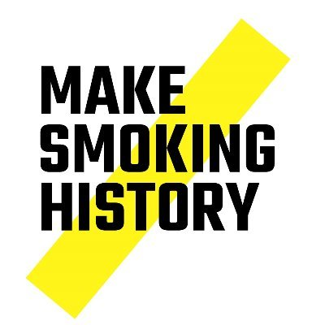
Building a Business Case for the CURE Project
Dr Matthew Evison
Consultant in Respiratory Medicine, Wythenshawe Hospital, Manchester University NHS Foundation Trust
Clinical Lead for the Greater Manchester CURE Project
Clinical Lead for the Make Smoking History Programme, Greater Manchester
Notes:
Welcome to this Royal College of Physicians e-learning module on tobacco addiction. I'm Dr Matt Evison, Consultant Chest Physician and the Clinical Director for the CURE Project in Greater Manchester, a regional hospital based tobacco addiction treatment service.
This e-learning module, intentionally, has a hard hitting title ‘From Negligence to Excellence’. This title is a reflection on both my own journey in this field and the current standard of care provided to patients with the disease of tobacco addiction in the UK. I look back at my own practice 3-4 years ago and feel ashamed. At the time, I would have confidently said that I was engaged with smoking cessation; that I would ask all my patients whether they smoked and if they did I recommended they stopped smoking. I look back now knowing that there are highly effective medications to treat this disease, highly effective medications that I am quite capable of discussing and prescribing that could have made significant impacts for all of those smokers I encountered. The failure to provide access to those medications, and to specialist support, for those smokers was, I believe, negligent. My practice has changed dramatically since then, to the point where I encourage every smoker to leave a consultation with a treatment plan and, very often, a prescription in their hand.
So this e-learning module, I hope, helps clinicians to change their practice immediately, by providing the knowledge and the skills to develop a treatment plan with a smoker. This module will describe that the best chance of helping a smoker to stop is with the combination of a medical intervention for the disease of tobacco addiction alongside the behavioural change support to change the deep seated habits of smoking. For clinicians, our responsibility lies in the medical intervention and that is the focus of this e-learning module.

Slide 2
Service Pathway to Routine Commissioning
Evidence base for clinical effectiveness
Translation to a clinical service model
Implementation / pilot phase
Real-world outcomes
Sustainable, resilient & adequately resourced roll-out

Slide 3
Building a business case for the CURE Project: real-world outcomes
Cost effectiveness
Experience of care
Clinical effectiveness

Slide 4
Service Pathway to Routine Commissioning
Evidence base for clinical effectiveness
Translation to a clinical service model
Implementation / pilot phase
Real-world outcomes
Sustainable, resilient & adequately resourced roll-out
‘The Hook’
Secure the support to proceed

Slide 5
Concentrated population of smokers
Sick smokers
Teachable moment
Motivation
Effective mitigation of withdrawal
Effective long term treatments
Immediate benefits to the patient, hospital and society
20,000 smokers in hospital on any given day in the UK
1 million smokers admitted to hospital at least once each yr
Smokers are 36% more likely to be admitted to hospital
Secondary Care
Perceived vulnerability
Fear for future
Realisation of impact
Link illness to smoking
Forced abstinence
Removed from normal home and habits
Intensive motivational interviewing
Immediate feedback
Monitoring
Compliance
Education

Slide 6
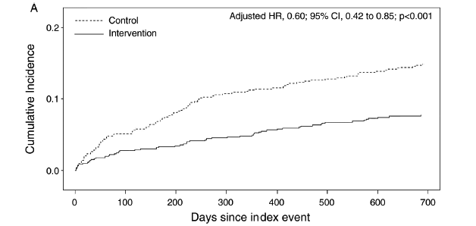
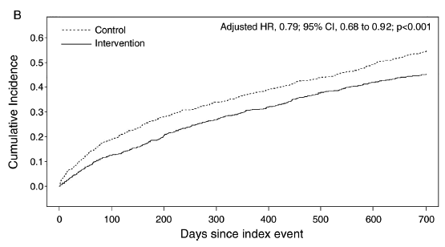
Ottawa model of smoking cessation
Mortality halved by 1 year
11.4% vs 5.4%; p<0.001
Mortality reduction at 2 years
15.1% vs 7.9%; p<0.001
Increase quit rates at 6 months 35% vs 20%
Re-admission halved by 30 days
13.3% vs 7.1%; p<0.001
Re-admission reduced at 1 year
38.4% vs 26.7%; p<0.001
Effectiveness of a hospital-initiated smoking cessation programme: 2-year health and healthcare outcomes. Mullen et al Tob Control 2016;0:1–7. doi:10.1136/tobaccocontrol-2015-052728

Slide 7
Applying the Ottawa Model to Greater Manchester:
Key benefits and outcomes
Conservative estimation of 263,900 adult admissions to hospital across GM per
Assuming 20% were active smokers = 52,780 smokers.
3273 readmissions prevented at 30 days
6176 readmissions prevented at 1 year
3141 lives saved in 1 year
18,473 successful quitters in the first year
The 2015 Department of Health Reference Costs state an average non-elective hospital admission costs £1609. Therefore, the estimated savings from prevention of readmissions by applying the Ottawa Model to Greater Manchester is therefore £9,937,184 per year.
The average length of hospital stay in England is 5 days (NGS Digital Data 2015-2016. The CURE project is estimated to save 30,880 bed bays per year, equivalent to 84 additional beds per day across Greater Manchester

Slide 9
Service Pathway to Routine Commissioning
Evidence base for clinical effectiveness
Translation to a clinical service model
Implementation / pilot phase
Real-world outcomes
Sustainable, resilient & adequately resourced roll-out
Service delivery model that works in the real-world

Slide 10
Successfully re-invent the wheel
Hospital-led service
Providing inpatient & outpatient pathway
Branding
Medicalise tobacco dependency
Engage the medical community
Empower the medical community
Nurse-led medical service
Attract a specialist workforce
Strong clinical leadership

Slide 11
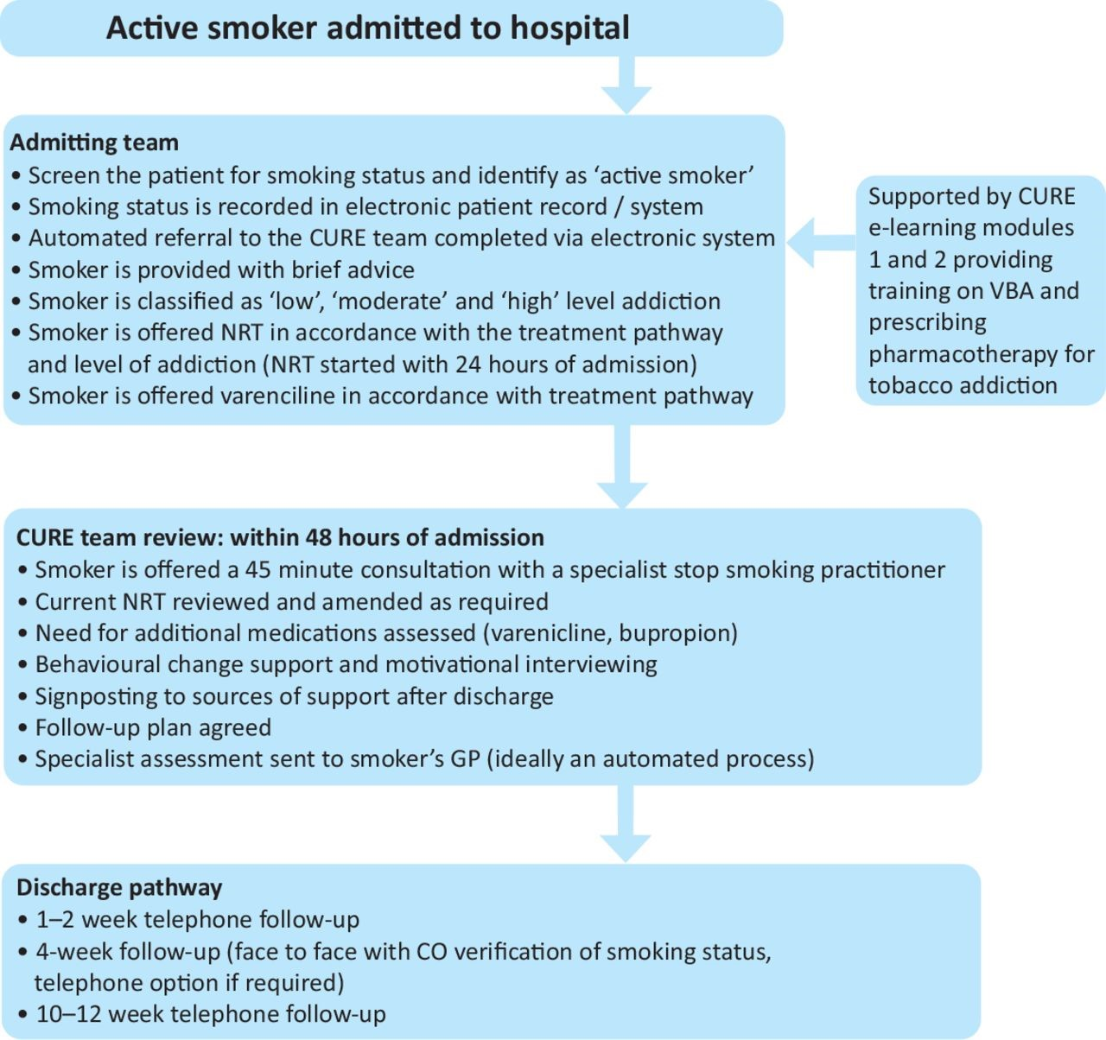

Slide 13
Service Pathway to Routine Commissioning
Evidence base for clinical effectiveness
Translation to a clinical service model
Implementation / pilot phase
Real-world outcomes
Sustainable, resilient & adequately resourced roll-out

Slide 14
Building a business case for the CURE Project: real-world outcomes
Cost effectiveness
Experience of care
Clinical effectiveness

Slide 15
Clinical Effectiveness: 6 month pilot
92% (13,515/14,690) of adult admissions were screened for smoking status
2,393 current smokers
96% were given brief advice to quit by the admitting team
61% patients completed inpatient behavioural interventions with a specialist CURE practitioner (69% within the first 48 hours of admission)
66% of smokers were prescribed pharmacotherapy
Over one in five of all smokers admitted during this pilot reported that they were abstinent from smoking 12 weeks after discharge (22%).
Evison et al. Clinical Medicine. 2020 Mar;20(2):196-202.
Feasibility, uptake and impact of a hospital-wide tobacco addiction treatment pathway: Results from the CURE project pilot

Slide 16
Evison et al. Clinical Medicine. 2020 Mar;20(2):196-202.
Feasibility, uptake and impact of a hospital-wide tobacco addiction treatment pathway: Results from the CURE project pilot

Slide 18
Building a business case for the CURE Project: real-world outcomes
Cost effectiveness
Experience of care
Clinical effectiveness

Slide 19
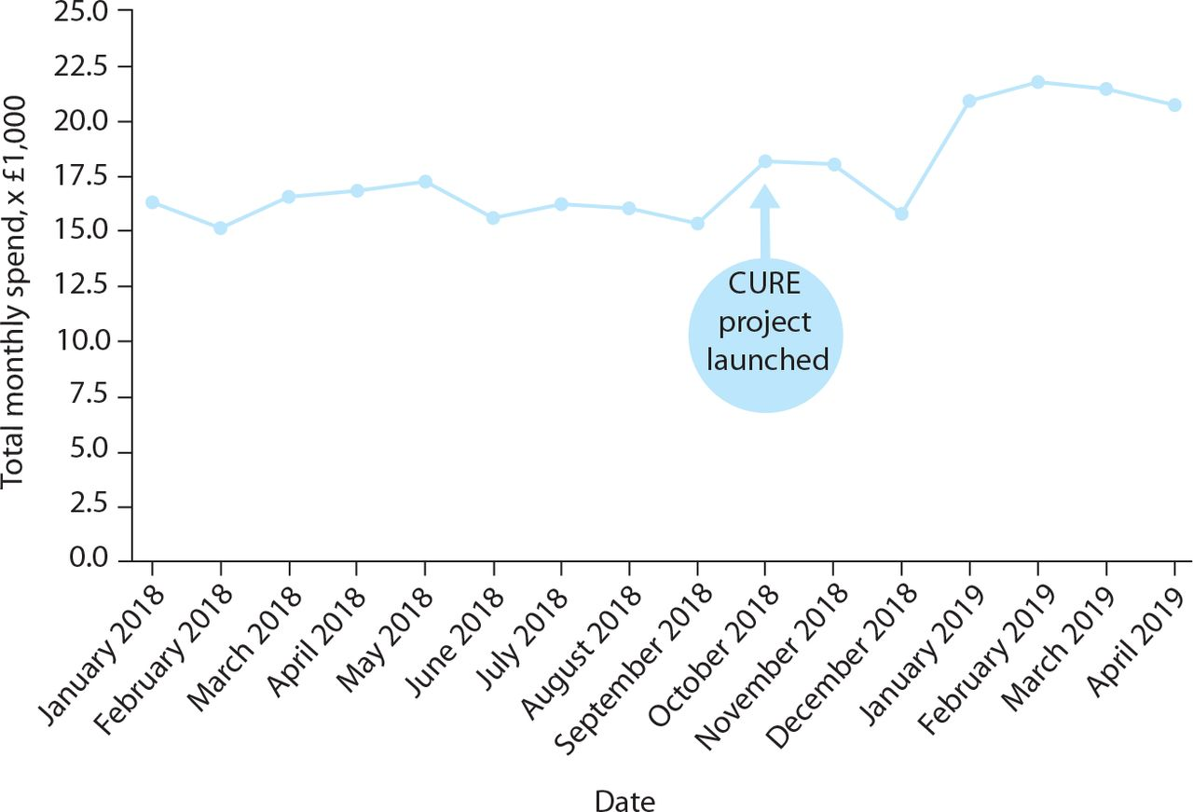
Cost-effectiveness analysis
Costs of CURE pilot
Overall hospital expenditure on stop smoking pharmacotherapy (NRT and varenicline)
Salary expenditure for the CURE specialist practitioners & administrative support staff
Ongoing pharmacotherapy costs post discharge estimated using additional community expenditure on stop smoking pharmacotherapy
Health economic analysis for the 'CURE Project' pilot: a hospital-based tobacco dependency treatment service in Greater Manchester. Evison M et al. BMJ Open Respir Res. 2021 Dec;8(1):e001105. doi: 10.1136/bmjresp-2021-001105.

Slide 20
Cost-effectiveness analysis
Total hospital intervention costs = £96,224
The total hospital intervention costs per patient who smokes = £40.21
The estimated average spend per patient discharged on medication = £97.40
Cost per quit for the CURE project pilot = £475
The CURE cost per quit is cheaper than:
North-West of England community stop smoking service average at £532
England community stop smoking service average at £490.

Slide 21
Cost-effectiveness analysis
The return on investment for the programme was calculated using the European Study for Quantifying the Utility of Investment from Tobacco (EQUIPT) tool. The values created from the EQUIPT tool were inputted into the Greater Manchester Cost-Benefit Analysis (CBA) Toolkit.
The tools calculate the treatment cost savings resulting from reduced levels of smoking caused disease for lung cancer, coronary heart disease, chronic obstructive pulmonary disease (COPD), myocardial infarction and stroke. In addition, it also estimates the increase in QALYs as a result of the programme.
The cost per quit for the CURE Project pilot was £475 (secondary & primary care costs)
The gross financial return on investment ratio was £2.12 return per £1 invested
Cashable financial return on investment ratio was £1.06 return per £1 invested
The public value return on investment ratio was £30.49 return per £1 invested
The Incremental Cost Effectiveness Ratio (ICER) for the CURE Project pilot was £487
Health economic analysis for the 'CURE Project' pilot: a hospital-based tobacco dependency treatment service in Greater Manchester. Evison M et al. BMJ Open Respir Res. 2021 Dec;8(1):e001105. doi: 10.1136/bmjresp-2021-001105.

Slide 22
Building a business case for the CURE Project: real-world outcomes
Cost effectiveness
Experience of care
Clinical effectiveness

Slide 23
Experience of Care study
July 2020 – September 2020
106 inpatients that smoke completed an experience of care survey
Average 37-year duration of smoking
87% reported that the hospital admission had made them consider a quit attempt
100% felt it was acceptable to be approached by the CURE team without agreeing to referral (opt-out model)
96% participants reported the treatment & support they had received during their admission had prompted them to consider a quit attempt.
Participants rated the care they had received during their hospital admission to support them to stop smoking as:
10/10 in 71%
9/10 in 11%
8/10 in 14%
7/10 in 3%
In submission, Hryhorskyj

Slide 24
Building a business case for the CURE Project: real-world outcomes
Cost effectiveness
Experience of care
Clinical effectiveness
We have demonstrated that the CURE pilot service:
Is clinically effective
22% abstinence at 12 weeks post discharge
Is cost-effective
£487 per QALY
£30.49 public value ROI for every £1 invested
Delivers exceptional experience of care
Patients want this!

Slide 25
Service Pathway to Routine Commissioning
Evidence base for clinical effectiveness
Translation to a clinical service model
Implementation / pilot phase
Real-world outcomes
Sustainable, resilient & adequately resourced roll-out

Slide 26
Business case – Greater Manchester CURE service

Slide 27
Summary
Used existing evidence base to build the case for implementation pilot
Designed a service model to secure optimal impact
Have demonstrated clinical effectiveness, costs-effectiveness and experience of care
Can build a robust business case for large scale sustainability
The future will require large scale data for system wide effectiveness
Data & outcomes are there for other teams to build a business case
Regional tobacco programmes are the perfect infrastructure for system wide business case and funding discussions
Evidence base for clinical effectiveness
Translation to a clinical service model
Implementation / pilot phase
Real-world outcomes
Sustainable, resilient & adequately resourced roll-out

Slide 28
Discussion & questions

