Slide 1
Treating Tobacco Dependency
Dorset’s Way
ASH Webinar 06.04.22
Heidi Croucher
Dorset ICS Treating Tobacco Dependency Programme Manager
Alex Szymanska
TTD Nurse University Hospital Dorset
Faye Ballard
TTD Advisor Dorset County Hospital

Slide 2
Background
Since 2016 - NRT has been provided as part of the MH inpatient service & SiPs by trained staff including level 2 trained ‘band 3’/HCA’s who can supply a full course under a homely remedy.
For majority of MH & SiP patients they are physically ‘well’.
In the Acute setting the majority of patients are physically ‘unwell’.
Trust’s DTC more cautious re what a Nurse could ‘authorise’ under their own registration along with additional restrictions from electronic prescribing systems and which nursing staff could have ‘permissions’ electronically to ‘issue’ under a discretionary medicine protocol. (NB Electronic prescribing not used within MH inpatient services or SiP outpatient services).
New TTD team established Jan/Feb 2022 (x 6 staff members)
Alex – was a Nurse on AMU @ UHD & Faye - previous role SiP Midwife
Neither are trained NMP

Slide 3
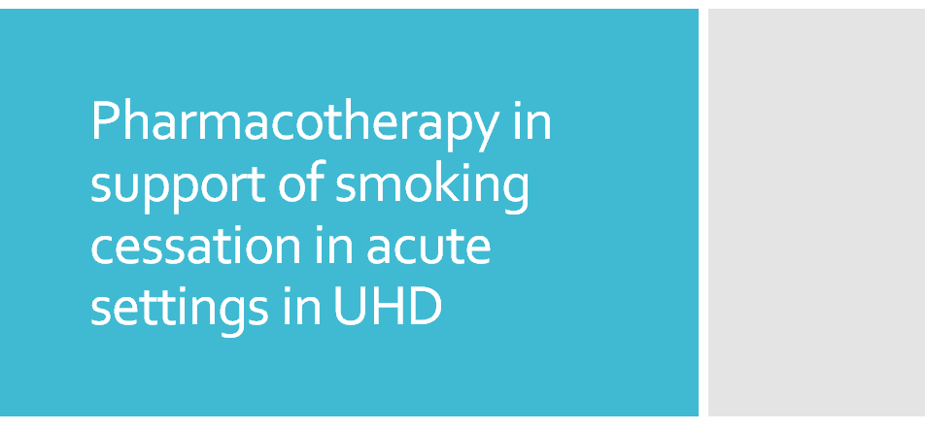

Slide 4
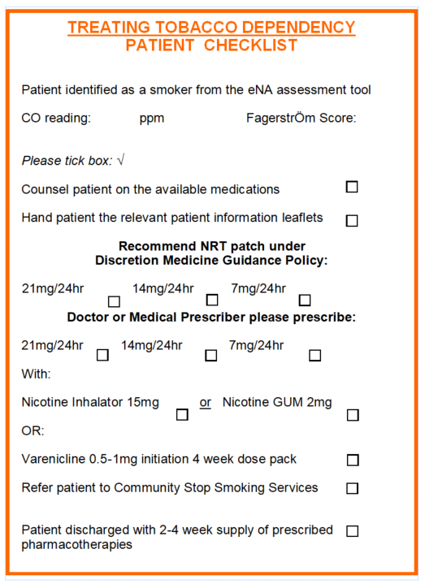
Patient consultation
NRT recommendation based on Fagerström assessment
Sticker summarizing the assessment for clear communication
Authorise NRT under nursing discretion where appropriate

Slide 5
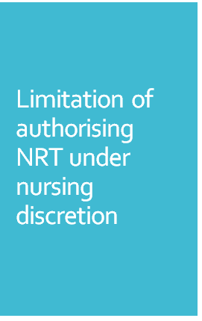
Most patient in acute setting meet caution criteria under NRT protocol such as recent cardiovascular disease, cerebral accident, renal or hepatic impairment, insulin dependency, uncontrolled hyperthyroidism or phaeochromocytoma, epilepsy, currently receiving antidepressant therapy using: Fluvoxamine, Clozapine, Clomipramine, Imipramine, Olanzapine. They require seeking advice from a doctor
Only patch can be authorised
Electronic prescription not always ‘active’
Exclusion criteria - patients under 12 years old, dermatological disorders such psoriasis, hypersensitivity to any components in the patches

Slide 6
Patient assessment and prescribe accordingly
Likely to be delayed due to workload
Prescribe regular dose
Add NRT to discharge medication

Slide 7
One off patch can be authorised by a nurse under discretionary medicines, there is an option to administer it as well, however access to the ward stock varies
1
Note to an administrating nurse as a reminder about regular NRT prescription
2
Note to pharmacist requesting 2 week worth discharge medication
3

Slide 8
Be able to authorise and issue the whole range of NRT products IF Appropriate
Hold stock as a specialist team to avoid problems with availability and access to the products
Goals

Slide 9
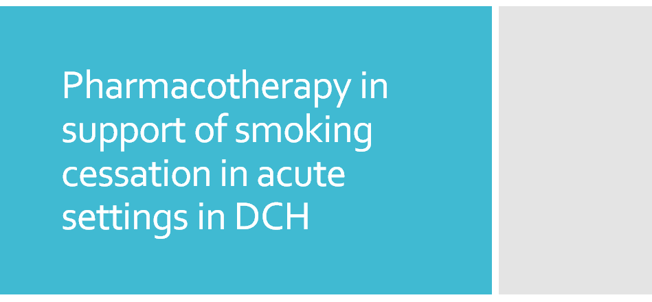

Slide 10
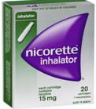
Dual NRT supply available under a homely remedy;
Admitting Nursing staff and the TTD Band 6's can ‘authorise’ and ‘supply’ 2 days worth of nicotine patch +/- an inhalator or gum
For other NRT options (eg mouth spray) or supply beyond the 48 hours/to go home with, it will need to ‘prescribed’ via the electronic prescribing system.

Slide 11
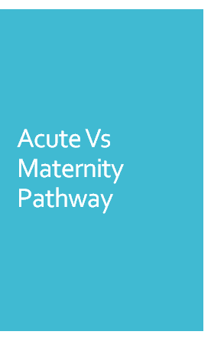
In my previous role as a SiP Midwife, I was able to offer and supply the full range of NRT under my own authority/NMC registration. If the patient fell under any ‘cautions’, I would discuss it with their Consultant team who always agreed it could be given.

