Slide 1
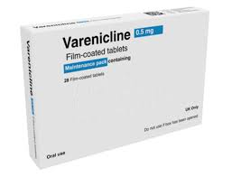
Life saving medications for
400,000 people using NHS and
Local Government services
https://thorax.bmj.com/content/79/Suppl_1/3

Slide 2
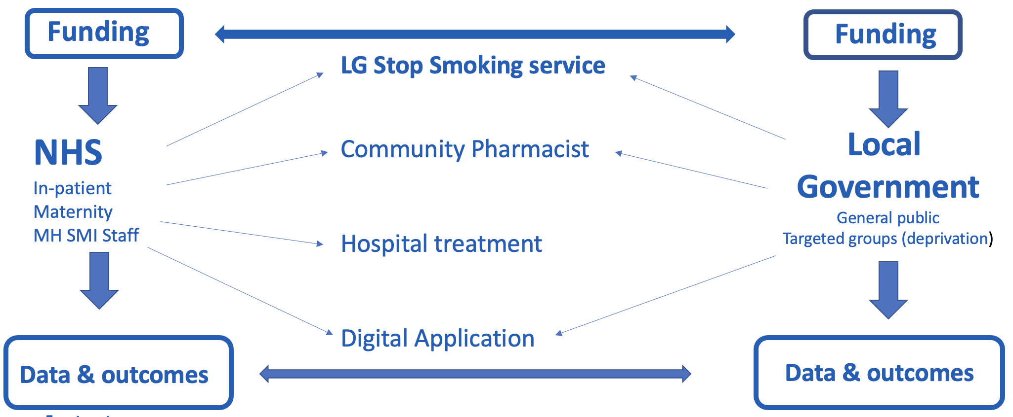
Implementation – local collaboration

Slide 3
Steps to start
Local formulary application – hospital and Primary Care
Hospital pharmacy procurement
E-prescribing for in-patients (hospitals)
Standard operating procedure (SOP)/Patient Group Directive (PGD)
Patient Information Leaflet (PIL)
Training- TDA’s & prescribers/ community stp smoking advisors
Hospital discharge medication/ out-patient supply (upto 12 weeks)
Community supplies

