Slide 1
Findings from the ASH Smokefree GB and Smokefree Youth surveys 2024

Slide 2
Who we are
ASH (UK) was set up by the Royal College of Physicians in 1971 to advocate for evidence-based measures to reduce the harm from tobacco
ASH is independent from all other ASH organisations internationally
ASH accepts no commercial funding: our main funders are the British Heart Foundation and Cancer Research UK

Slide 3
Our surveys
Smokefree GB survey (conducted by YouGov)
Started in 2007 and included questions on vaping in 2010
Sample size ~12k in each wave
18+ GB weighted to be representative
Fieldwork Feb/March each year
Smokefree youth survey (conducted by YouGov)
Started in 2013
Sample size ~2k - ~2.5k in each wave
11-18 year olds but most reported data 11-17 year olds
Fieldwork ~ March each year

Slide 4
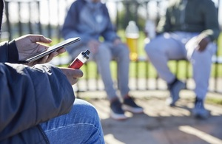
Underage vaping rates

Slide 5
Changes in patterns of youth vaping
11-17 yr old GB use of vapes
Fewer than one in five (18%) have ever vaped down from 21% in 2023
9.5% of 11-17s have tried vaping once or twice
7.6% current vapers: occasional use (3.1%) and regular use (4.5%).
First year that the rate of regular use is higher than occasional use
ASH Smokefree GB Youth Surveys, 2013-2024. Unweighted base: All 11-17 year olds (2013=1,895, 2014=1,817, 2015=1,834, 2016=1,735, 2017=2,151, 2018=1,807, 2019 =1,982, 2020 =2,029, 2021=2,109, 2022=2,111, 2023=2,028, 2024=2,587)

Slide 6
Clear age gradient of youth vaping
Ever vaping by age, GB youth (11-15, 16-17, and 18), 2013-2024
Ever tried in 2024
14% aged 11-15
28% aged 16-17
34% aged 18
ASH Smokefree GB Youth Surveys, 2013-2024. Sample sizes in 2024 Total: 2,889 11-15 yr old 1,650; 16-17 yr olds 937; 18 yr olds 302

Slide 7
Adult vaping rates

Slide 8
GB adults: Vaping trends
Use of vapes over time 18+
Still more GB smokers (6.2 million) than vapers (5.6 million)
11% of adults currently vape: an all-time high
Pre pandemic fieldwork
ASH Smokefree GB Survey 2024 and ONS mid-year population estimate 2022
ASH Smokefree GB Adult Surveys 2013-2024. Unweighted base: All adults (2013=12,171, 2014=12,269, 2015=12,055, 2016=12,157, 2017=12,696, 2018=12,767, 2019=12,393, 2020=12,809, 2021=12,247 2022=13,088, 2023=12,271, 2024=13,266)
Notes:
The rise in vaping looks steady over time, no evidence of a strong acceleration of vaping over the past few years

Slide 9
Most adults who vape are ex-smokers
Smoking status of adult current vapers
More than half (53%) of current vapers are ex-smokers ~3 mn
Nearly four in ten (39%) of current vapers also smoke ~2.2 mn
Fewer than 2 in 100 never smokers currently vape ~0.4m (8.0% of people who vape have never smoked)
ASH Smokefree GB Adult Surveys 2013-2024. Unweighted base: Adult current vapers (2013=325, 2014=498, 2015=614, 2016=667, 2017=669, 2018=738, 2019=854, 2020=787, 2021=826, 2022=1,089, 2023=1,079, 2024=1,408)

Slide 10
55% of people who successfully quit smoking in last 5 years used a vape in that quit attempt
GB Adult ex-smokers who quit smoking in the last five years using a vape | Currently vape | Have quit vaping | Can't recall/ invalid answer | ALL
% | 64% | 29% | 7% | 100%
Approx. number of people | 1.7 million | 800K | 200K | 2.7 million
Average duration of vaping ~1 year
Current vaping behaviour in GB Adult ex-smokers who quit smoking in the last five years using a vape, 2024
ASH Smokefree GB Adult Survey 2024. Unweighted base: Adult ex-smokers who quit in the last 5 years using a vape n=665

Slide 11
Adult perceptions of harm

Slide 12
Adult smokers’ perceptions of harm worsening
Do you think vapes (e-cigarettes) are more, less or as harmful as tobacco cigarettes? GB adult smokers 2024
ASH Smokefree GB Adult Surveys 2013-2024. Unweighted base: Adult current smokers who have heard of vapes (2013=1,720, 2014=1,705, 2015=1,945, 2016=1,639, 2017=1,569, 2018=1,566, 2019=1,679, 2020=1,599 2021=1,438, 2022=1,641, 2023=1,426, 2024=816) NB: sample size is halved in 2024 because the question was split to make sure that a small wording change didn't have a big effect. There was very little difference between the two wordings. The version of the question with the new wording is used here.

Slide 13
Harm perceptions appear to impact on reasons not to vape among current smokers
Main reason for not trying an e-cigarette among adult smokers, Great Britain (2024)
ASH Smokefree GB Adult Surveys 2024. Unweighted base: Adults who are current smokers, who have not tried vapes but had heard of them (n=388)

Slide 14
Youth perceptions of harm

Slide 15
11-17 perceptions of harm worsened most between 22 and 23
Compared to cigarettes, do you think vapes (e-cigarettes) are more or less harmful to the person using them, or is there no difference? GB youth (11-17) 2024
ASH Smokefree GB Youth Surveys 2013-2024. Unweighted base: 11-17 year olds aware of vapes (2013=1,190, 2014=1,483, 2015=1,700, 2016=1,607, 2017=1,968, 2018=1,687, 2019=1,863, 2020=1,909, 2021=1,905, 2022=1,916, 2023=1,917, 2024=2,349)

Slide 16
11-17 perceptions of harm worsened most between 22 and 23
Compared to cigarettes, do you think vapes (e-cigarettes) are more or less harmful to the person using them, or is there no difference? GB youth (11-17) 2024
ASH Smokefree GB Youth Surveys 2013-2024. Unweighted base: 11-17 year olds aware of vapes (2013=1,190, 2014=1,483, 2015=1,700, 2016=1,607, 2017=1,968, 2018=1,687, 2019=1,863, 2020=1,909, 2021=1,905, 2022=1,916, 2023=1,917, 2024=2,349)

Slide 17
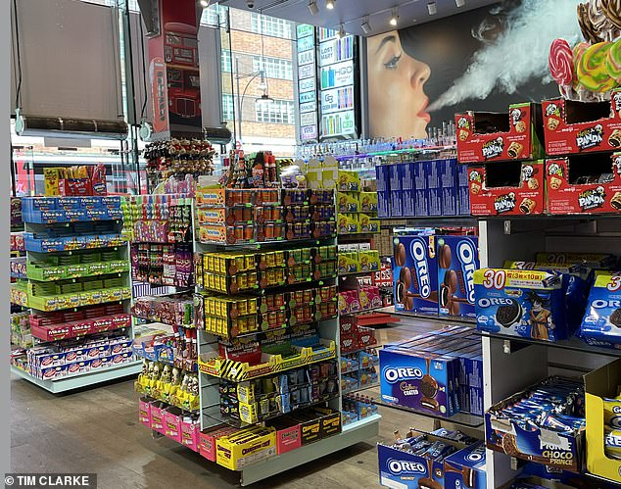
Promotion to children

Slide 18
Youth awareness of vape promotion highest instore
GB 11-17 year olds
One in five say don’t see vapes being promoted, down from nearly a third two years ago (31% to 19%)
More than half are aware of promotion in shops compared to a third two years ago (37% to 55%)
ASH Smokefree GB Youth Surveys, 2022-2024. Unweighted base: All 11-17 year olds aware of vapes (2022=1,916, 2023=1,917, 2024=2,349)

Slide 19
Among youth aware of online promotion
29% of youth aware of online promotion
Most likely source Tik Tok, then Youtube Instagram and Snapchat
Little change since last year
ASH Smokefree GB Youth Surveys 2023 & 2024. Unweighted base: 11-17 year olds aware of vapes who have seen them promoted online (2023=640, 2024=717)

Slide 20
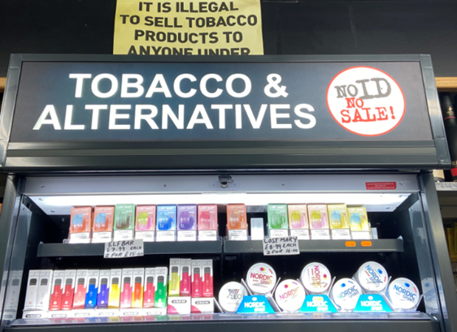
Access to products

Slide 21
Most current underage vapers buy their vapes
Youth vapers usual sources of vapes
(multiple selection allowed)
71% of 11-17s who currently vape buy their vapes
Most (58%) buy from a formal source (eg shop, market)
A quarter (27%) buy from an informal source (eg friend, family member, other)
52% are given their vapes by someone else (eg friend, family member, other)
Better awareness and enforcement of legislation about age of purchase and proxy purchase is required
ASH Smokefree GB Youth Survey, 2024. Unweighted base: 11-17 year olds who currently vape = 225

Slide 22
Adults and children purchase vapes differently
Adult and youth comparison of formal sources of vapes
Buying online is most frequently used source for adult vapers (32%) – but not under 18s (14%)
Buying from small shops such as a newsagent, corner shop or off-licence most frequent source for 11-17s (21%) followed by vape shops (20%)
ASH Smokefree GB Adult & Youth Surveys, 2024. Unweighted base: adults who currently use vapes (excluding vaped once or twice or DK frequency of vaping): 1,374, 11-17 year olds who currently use e-cigarettes: 225. Respondents allowed to tick more than one box if more than one usual source. Those who don’t purchase their vapes from commercial sources are included in the base but not represented in the bar totals

Slide 23
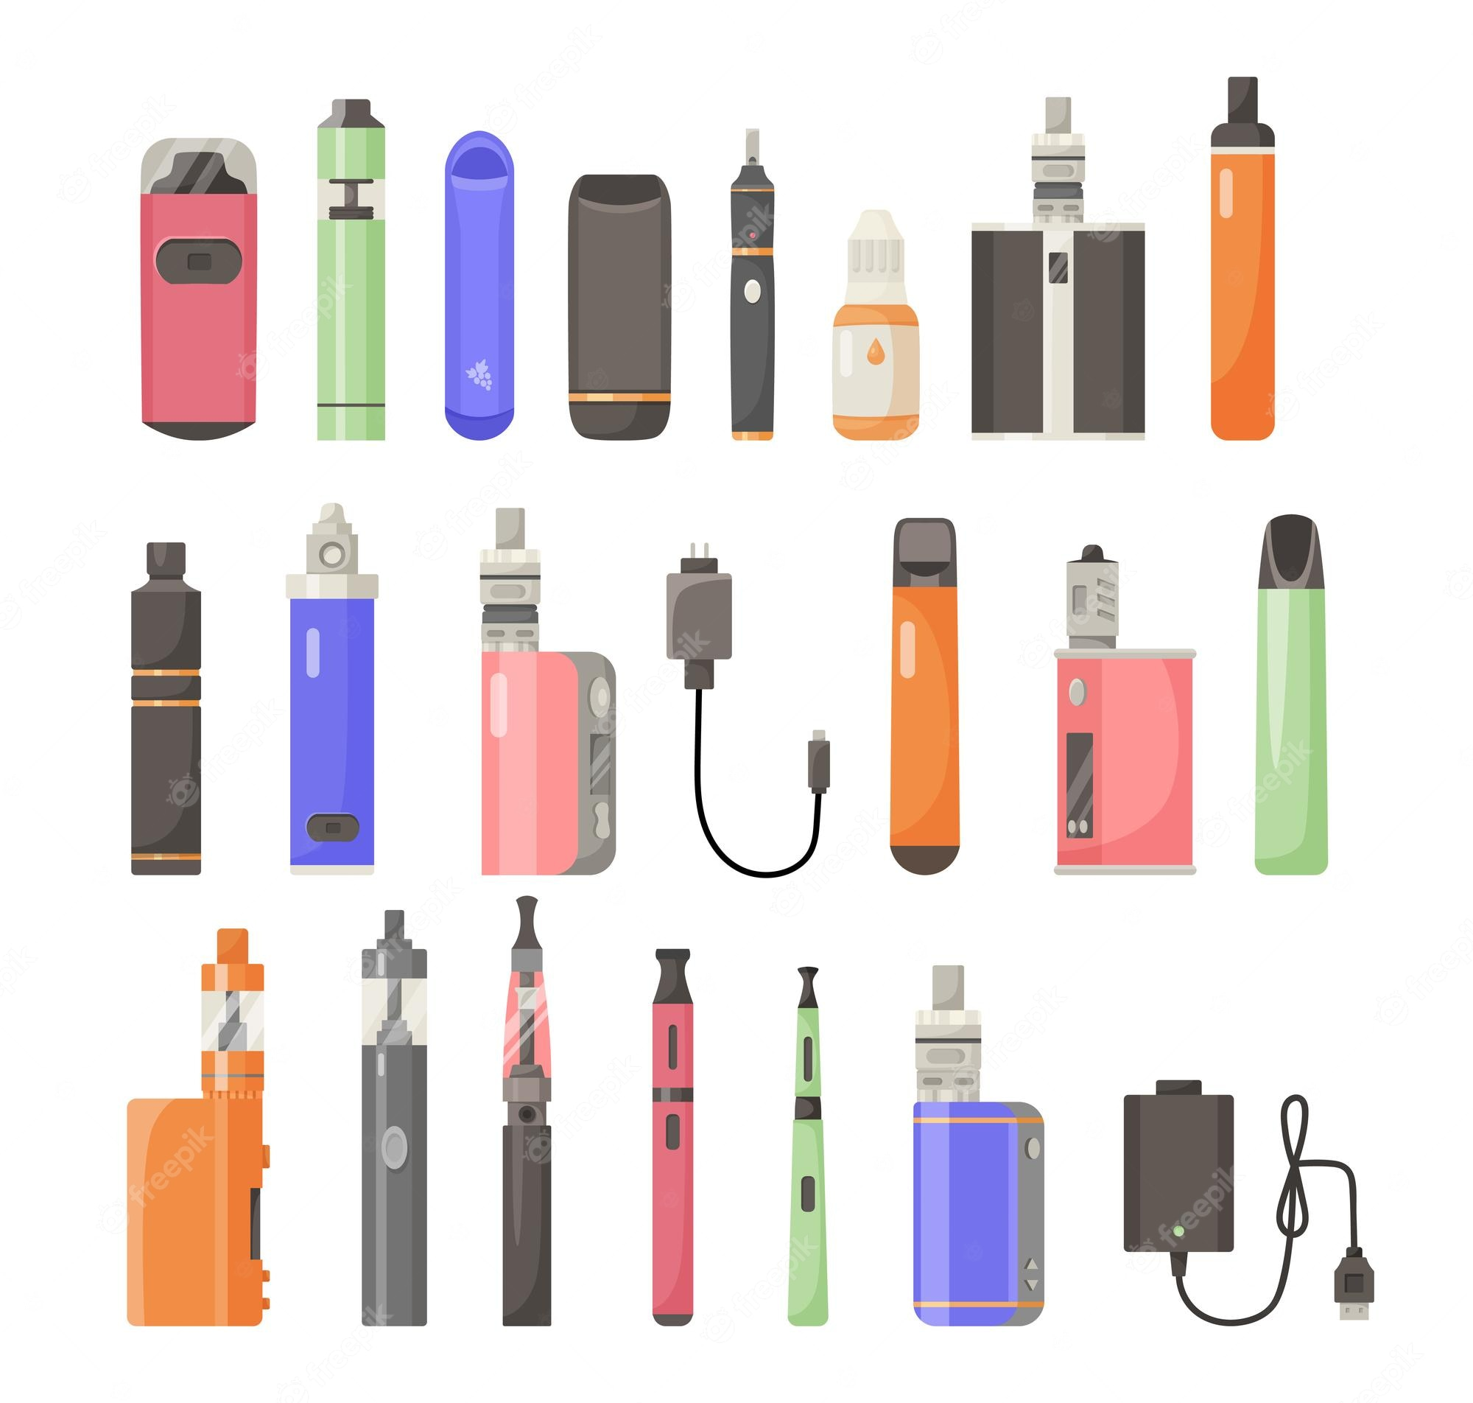
Products used

Slide 24
The market for disposable vapes may have peaked
Type of e-cigarette used, GB Adult vapers (2014-2024)
ASH Smokefree GB Adult Surveys 2014-2024. Unweighted base: Adults who currently vape, excluding 'once or twice' and DK frequency from 2017 onwards (2014=498, 2015=614, 2016=667, 2017=657, 2018=715, 2019=800, 2020=767, 2021=790, 2022=1,033, 2023=1,042, 2024=1,374)

Slide 25
Rapid rise in youth vaping 2021-23 associated with growth in use of disposable vapes
Proportion of vapers who mainly use disposable vapes, by age
Disposable vapes are most popular with young adult vapers 18-24 (52%) and youth vapers 11-17 (54%)
Age gradient so only 16% of 55+ vapers mainly use disposable vapes
All age groups show a significant increase in disposable use from 2021 to 2023
That rise seems to have peaked
ASH Smokefree GB Adult Surveys 2017-2024, ASH Smokefree GB Youth Surveys 2017-2024. Unweighted base: Adult and Youth (11-17) current vapers, excluding only tried once or twice and don't know freq. of use

Slide 26
Most popular disposable brands among children in 2024
Brands of disposable vapes tried, GB youth (11-17) ever disposable vapers, 2024
ASH Smokefree GB Youth Survey, 2024. Unweighted base: 11-17 year old respondents who had ever used disposable vapes; 394. Respondents asked to select every brand they have used.

Slide 27
Fruit flavours are the most popular for adults and children
Main choice of vape flavour, GB current vapers 2024
57% of youth and 47% of adults prefer fruit flavour vapes
Vapes with sweet flavours are more popular with children (17%) than adults (8.8%)
Tobacco/tobacco menthol and menthol flavours are more popular with adults (17% and 17%) than children (5.5% and 6.4%)
ASH Smokefree GB Adult Survey 2024 & ASH Smokefree GB Youth Survey 2024. Unweighted base: Adult current vapers=1,408; Youth current vapers=255

Slide 28
Adults increasing use fruit flavoured vapes
Flavours used by adult vapers, Great Britain (2016 & 2024)
ASH Smokefree GB Adult Surveys 2024. Unweighted base: Adults current vapers (2016=667, 2024=1,408)

Slide 29
Summary
Adults
Vaping is up ~ 5.6m
Reinforces evidence we have that vaping is key aspect of current quitting behaviour
Over time large numbers of people who vape to quit stop vaping – but many also continue
Wide range of flavours used
Harm misperceptions all time high
Children
Vaping has not gone up following previous years of increase
Evidence of more regular vaping within group that has vaped
Exposure to promotion remains high
Popularity of disposables prob peaked
Harm misperceptions all time high

