Slide 1
What do we mean by the ‘costs’ of smoking?
Dr Tessa Langley
Action on Smoking and Health Costs of Smoking Webinar
10th September 2026

Slide 2
Outline
What do we mean by ‘cost’?
Recent estimates of the cost of smoking in the UK

Slide 3
Background
Tobacco use creates a significant economic burden as well as a health burden.
Understanding the cost of tobacco use (and other behaviours) helps to:
Advocate for interventions
Target specific problems and policies
Identify gaps in data; research needs
Provide a baseline to determine impact of policies
WHO. International guidelines for estimating the costs of substance abuse.

Slide 4
Spending on tobacco i.e. direct cost to individuals
Costs to the economy
(and benefits)
e.g. jobs, productivity
Fiscal costs
(and benefits)
e.g. tax and public spending
Total costs
(and benefits) to society
e.g. capturing intrinsic value of lives lost

Slide 5
What do we mean by ‘cost’?
1) ‘direct costs’ – health and social care; fire (tobacco)
2) ‘indirect costs’ – typically labour and productivity
3) ‘intangible costs’ – pain, suffering, loss of life (e.g. value of a QALY)
1) + 2) + 3) = full economic welfare cost
1) + 2) = total financial cost
Moller & Matic. 2010

Slide 7
Some things to keep in mind when using cost estimates
  Cost estimates:
    - Use different methods
    - Have different data limitations
    - Make big (usually necessary) assumptions
    - Have different goals
    - Use data from different time periods

Slide 8
The impact of tobacco use on productivity in the UK
Tobacco smoking continues to create a major economic burden, particularly due to health harms in working-age adults
Tobacco use reduces productivity among smokers through unemployment, increased sickness-related absences (absenteeism), reduced productivity at work (presenteeism), early retirement and premature mortality
Reed (2026): Overall productivity losses due to premature mortality, reduced employment, reduced earnings and Gross Value Added (see next presentation) - £33bn

Slide 9
Total cost of smoking to UK society
Total cost to society (excluding cost of early deaths): £53bn
  £33 billion in lost productivity costs
  £17.6 billion in social care costs
  £2 billion in healthcare costs
  £455 million in costs linked to fires caused by smoking
Total cost to society (including cost of early deaths): £99bn
Reed, 2026

Slide 10
Do smokers ‘pay their way’?
Some critics of intervention in the tobacco market suggest that smokers ‘pay their way’ because they contribute to pensions, health care etc., and then die before they claim their benefits
Reed’s (2025) analysis suggests this is wrong:
  - Net impact of smoking on public finances (tax, social security, public service costs) - £10.8bn (Tax revenue ~£8.8 bn)
But also unethical!
Most studies do not place value on life per se
  Misleading to suggest that society is better off with these premature deaths

Slide 11
Spending on tobacco
Tobacco use is concentrated in the UK’s most deprived communities
Major financial burden in households that are already struggling financially
417,000 additional households classified as living in relative poverty after subtracting tobacco expenditure; substantially higher than previous estimates
Those who smoke are nearly three times as likely to use food banks as non-smokers (20% vs 7%)
Reed et al. 2026

Slide 12
The smokefree-dividend
There is therefore a large potential economic dividend to people who smoke and local economies if everyone were to stop smoking.
Tobacco use places significant financial burden on those who smoke.
93% of money spent on legal tobacco flows out of local economies.
There is a large potential economic dividend to people who smoke and local economies if smoking rates are reduced to zero.
The scale of the dividend varies by region:
Region | % of Income on Tobacco | Smoking Prevalence | Dividend (£m) | Dividend per capita | Dividend per smoker
East Midlands | 6.72% | 14.79% | £1,012 | £264 | £1,784
East of England | 6.37% | 13.70% | £1,199 | £245 | £1,791
London | 6.05% | 12.95% | £1,604 | £232 | £1,789
North East | 9.00% | 15.27% | £684 | £320 | £2,095
North West | 7.51% | 14.50% | £1,489 | £258 | £1,778
South East | 5.85% | 12.12% | £1,504 | £209 | £1,721
South West | 5.91% | 13.99% | £970 | £215 | £1,535
West Midlands | 7.69% | 14.03% | £1,206 | £260 | £1,855
Yorkshire and the Humber | 7.41% | 15.64% | £1,222 | £282 | £1,803
 |  |  | £10,890 | £246 | £1,776
Morris et al. 2024

Slide 13
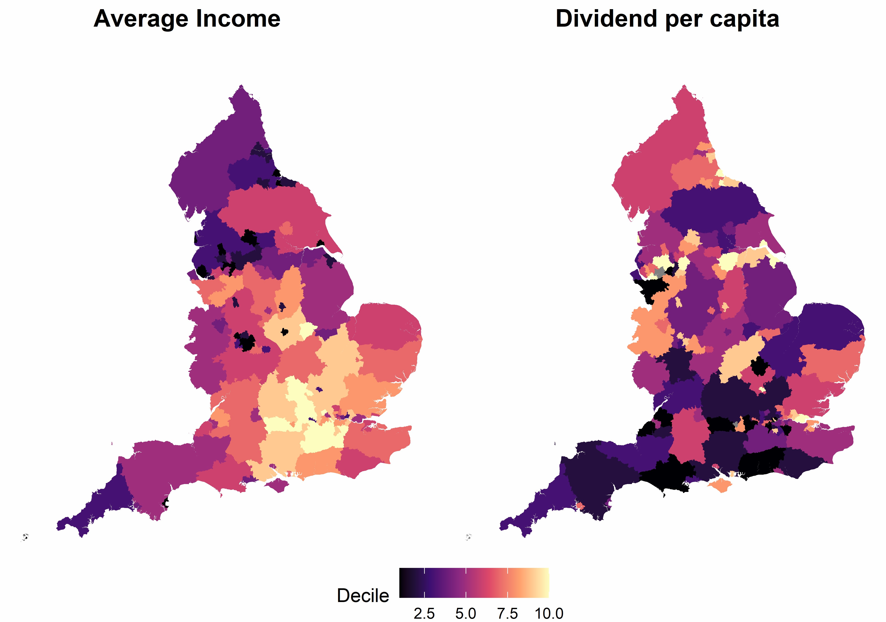
The smokefree dividend
Average income and the smoke-free dividend per capita by, local authority
The smokefree dividend per adult is largest in local areas with lower average incomes.

Slide 14
What happens to the economy when people stop spending in tobacco?
Every pound spent on tobacco is a pound that could be spent on something else
The economic impact of consumers switching from buying tobacco to other goods and services as smoking prevalence decreases is often overlooked
→ Talk 2: Dr Howard Reed

Slide 15
The economic case for reducing smoking
Health burden of smoking and its impact on health inequalities is well-established.
Critics of public health policies claim that they damage the economy.
Increasing evidence that reducing smoking delivers significant economic benefits.
The health and economic impact of tobacco use is greatest in the country’s most disadvantaged communities.

