Slide 1
Communicating the costs of smoking
Hazel Cheeseman
Chief Executive
10 September 2026

Slide 2
Communicating the costs of smoking
Who are we speaking to?
  Elected members
  Local NHS
  ICBs
  Strategic authorities
  Local people

Slide 3
What could we tell them?
Cost of smoking to society – what is presented in the ready reckoner
Cost of smoking to public finances – included in the cost benefit and public finance model
Quantifying the cost of lost lives – QUALY
Wider impacts e.g. on poverty, jobs etc

Slide 4
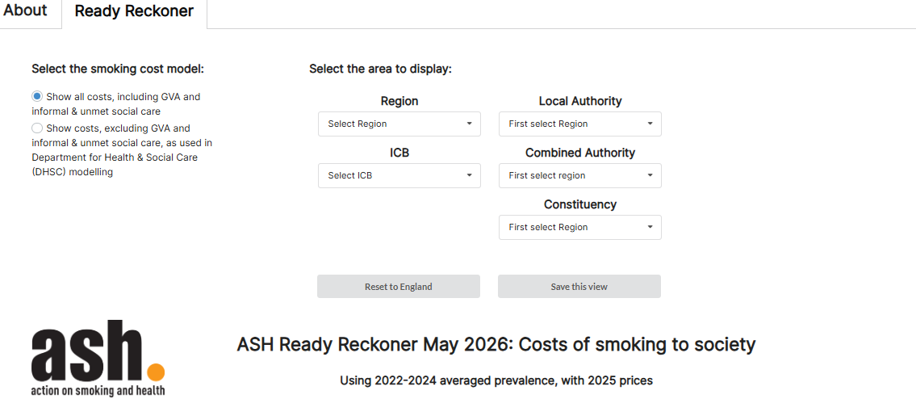

Slide 5
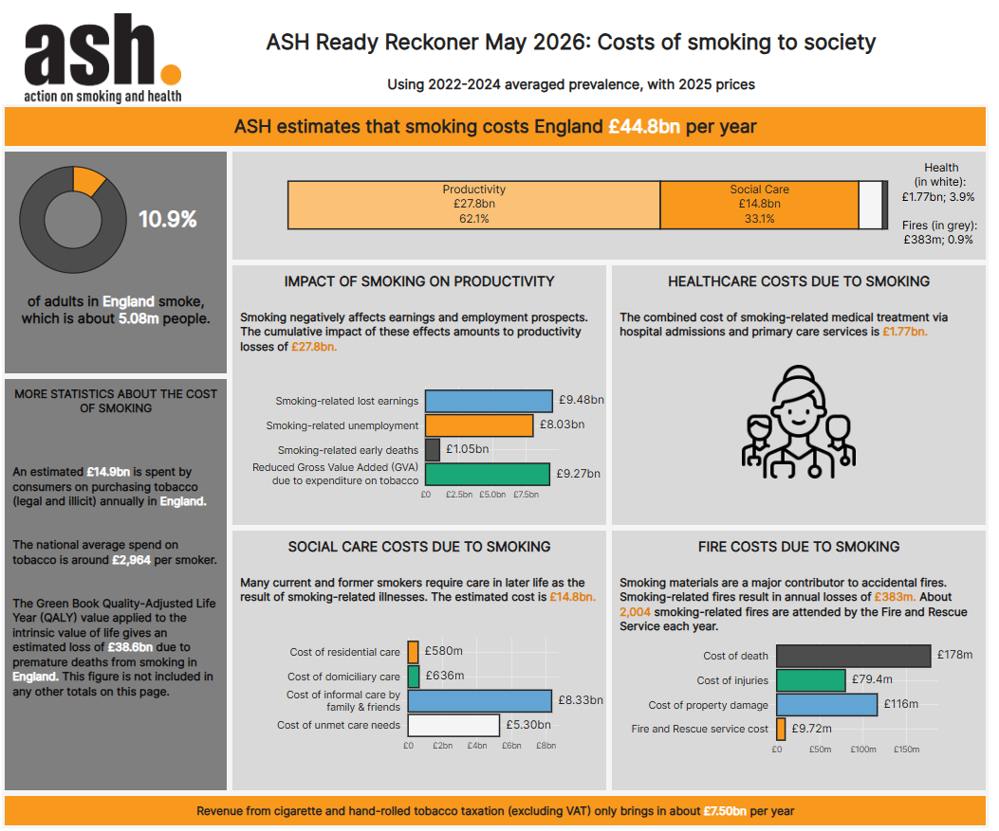

Slide 8


