Slide 1
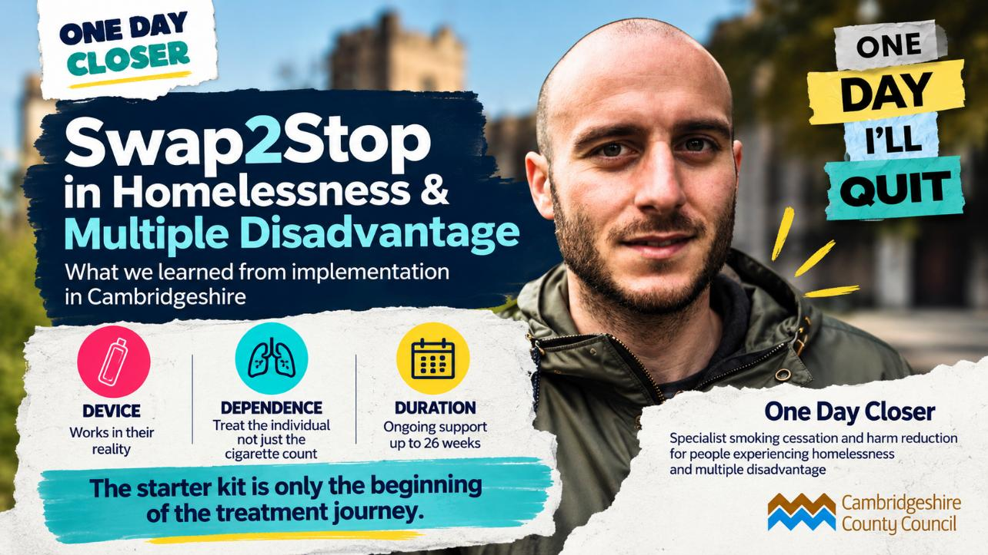


Slide 2
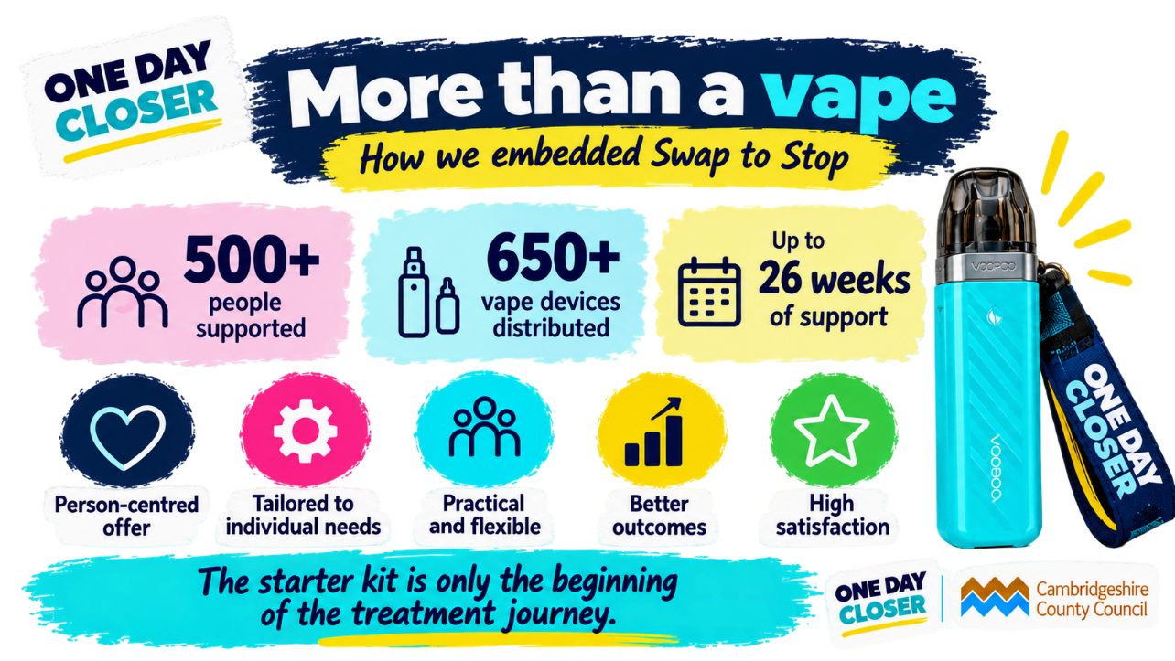

Slide 3
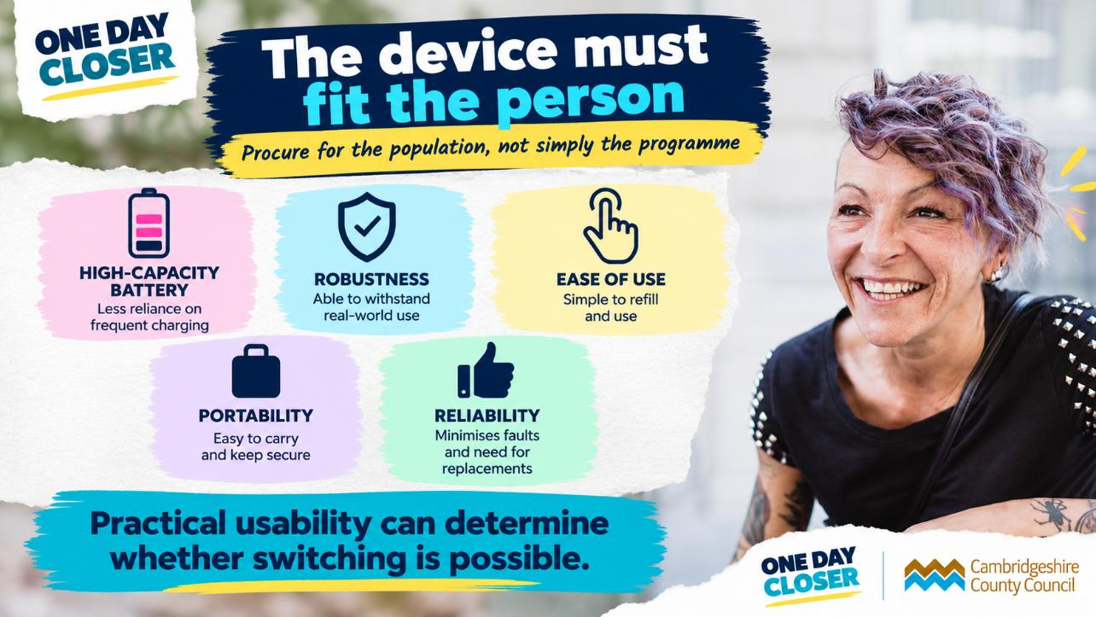

Slide 4
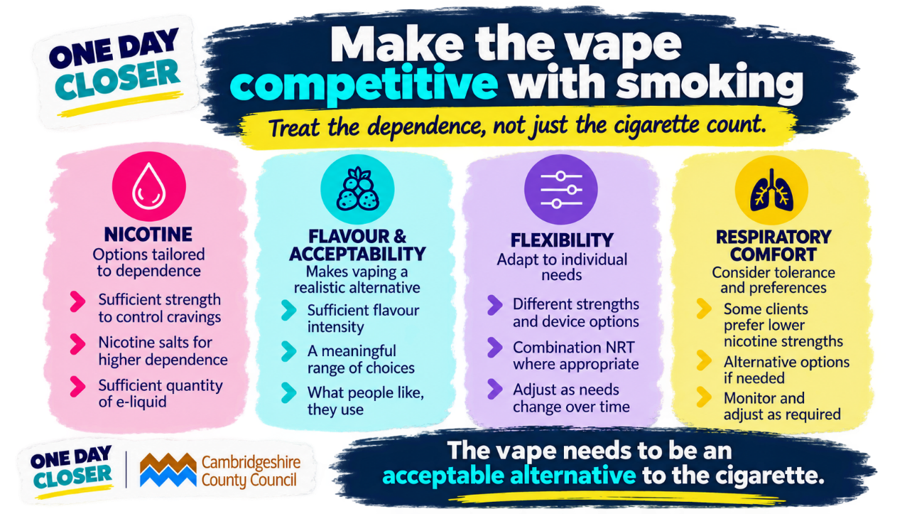

Slide 5
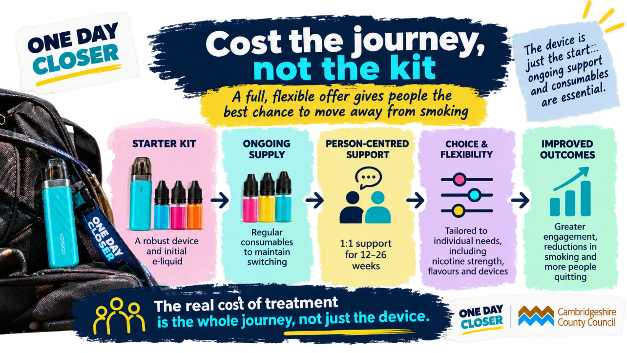

Slide 6
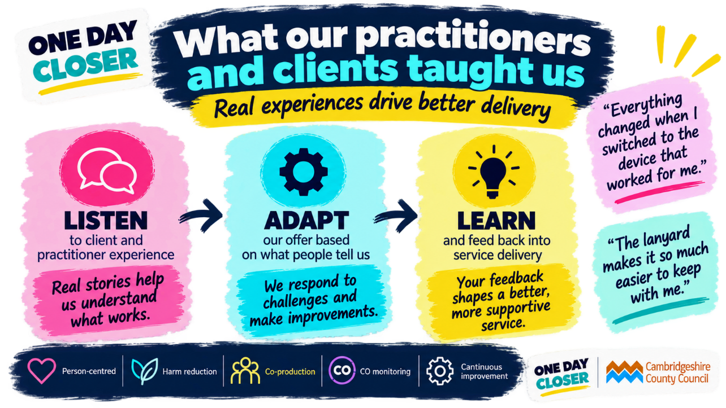
Continuous
Notes:
Some of our most valuable learning hasn't come from guidance or a specification. It's come from the practitioners delivering the service and the people actually using it.
We've tried to create a fairly simple feedback loop: listen, adapt and learn.
Our clients told us charging could be a barrier, we considered higher battery capacity.
When devices were being lost, we introduced lanyards.
When the nicotine offer isn't sufficiently controlling cravings, we look at strength, formulation, quantity or combination support.
One of our clients had tried several vaping devices previously and continued smoking alongside them. They told us that everything changed when they eventually tried our device and e-liquid flavours, it worked for them and they no longer felt that same urge to smoke.
That's an important lesson: Rather than interpreting difficulty switching as a lack of motivation, we need to ask, what is it about the previous device/e-liquid that wasn’t working for someone?

Slide 7
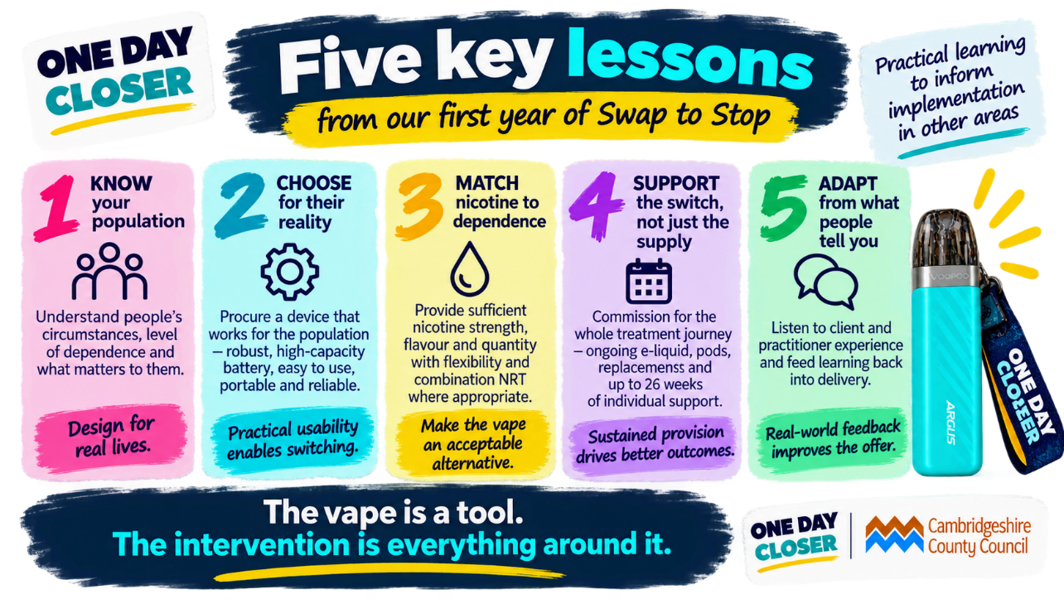
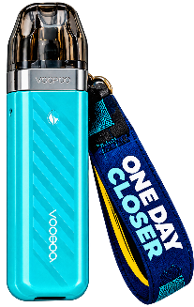
ts
Notes:
In summarising our first year, into five key lessons on implementing Swap to Stop… We’d suggest:
Know your population. Their circumstances and level of dependence should shape the offer.
Choose for their reality. Battery life, robustness and usability can matter just as much as the technical specification.
Match nicotine to dependence. One strength, flavour or quantity won't necessarily work for everybody.
Support the whole switch, not just the supply. Think beyond the starter kit for what somebody needs to sustain that change.
And finally, adapt from what people tell you. Your clients and practitioners will very quickly tell you what works in the real world.
Swap to Stop has given us an incredibly valuable opportunity to engage people who haven't always been well served by traditional approaches to smoking cessation.
But our biggest learning has probably been that success isn't simply about putting a vape into someone's hand.
It's about creating an offer that somebody can realistically use to replace smoking within the circumstances of their life.
The vape is a tool. The intervention is everything around it.
Thank you everyone ….

