Slide 1
Joanna Feeney Clinical Delivery Manager – Tobacco
Management of Acute Nicotine Withdrawal

Slide 2
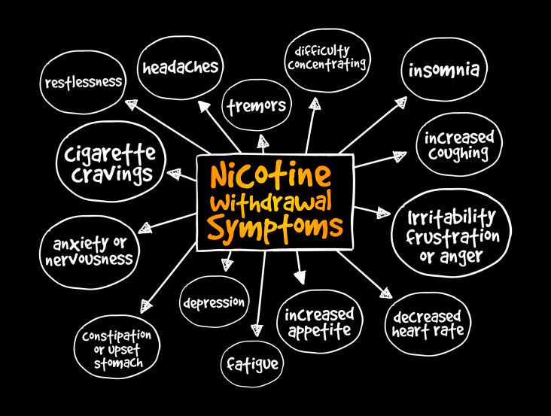
What is Nicotine Withdrawal?

Slide 3
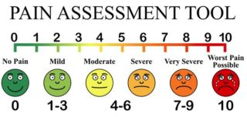
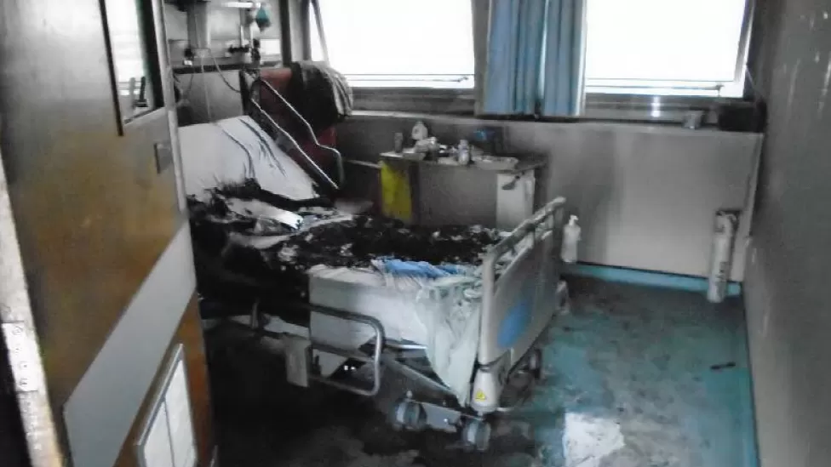
Impact of Nicotine Withdrawal in hospital settings?
Hide / exacerbate symptoms
Diagnostically confusing
Impact pain management
Increased risk of infection
Fires
Violence against staff
Undermines Smokefree NHS policy

Slide 4
Clinical Responsibility to treat nicotine withdrawal
Duty of care to treat acute nicotine withdrawal
Responsibility is not solely the inhouse Tobacco Dependency Advisor
Treatment within 2 hours of admission

Slide 5
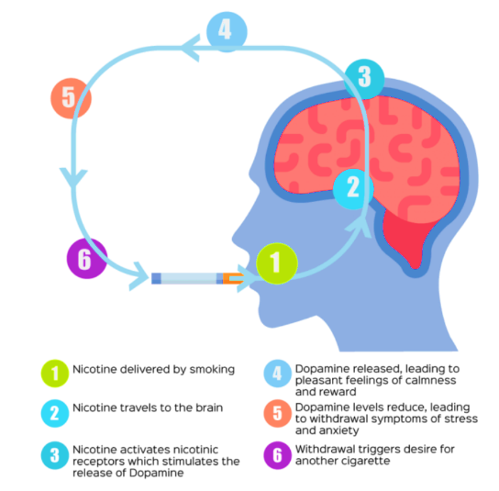
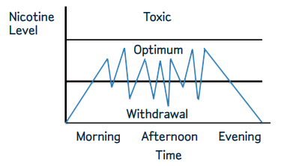
How Nicotine Dependency works
Nicotine from smoking
Nicotine level during abstinence
Nicotine from Nicotine Replacement

Slide 6
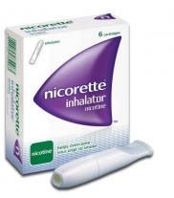
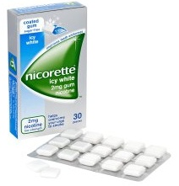
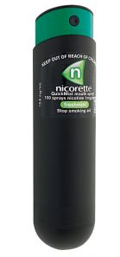
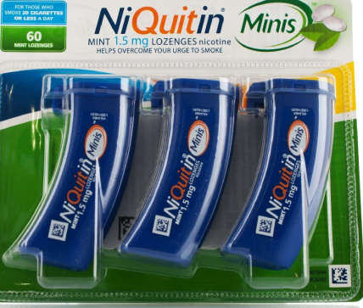
Provision of NRT in hospital settings
Prescribed
Prescribers only
Delays if prescribers not on ward
Patient Group Directive
Allows product to be issued without being prescribed
Restricted to registered Health professionals (TDA’s not able to use)
Specialist Pharmacy Service do not recommend PGD for GSL products
Local Protocol
Any trained staff can initiate, both admitting staff & TDA
Enables timely access to medication
Potential to include vapes

Slide 7
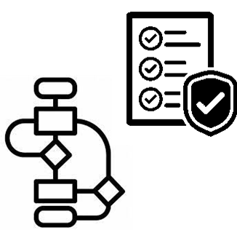
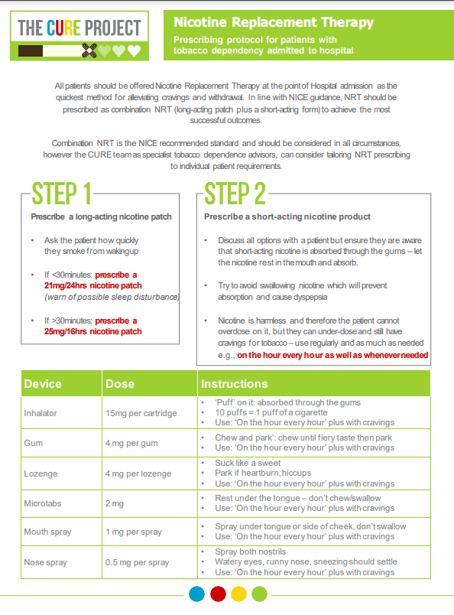
Enablers to Managing Nicotine withdrawal

Slide 8
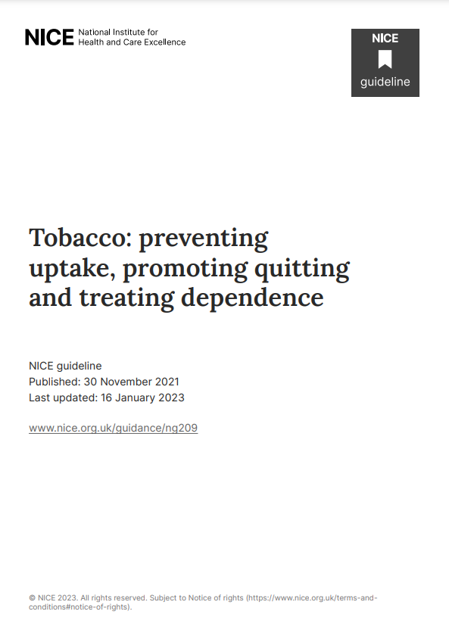
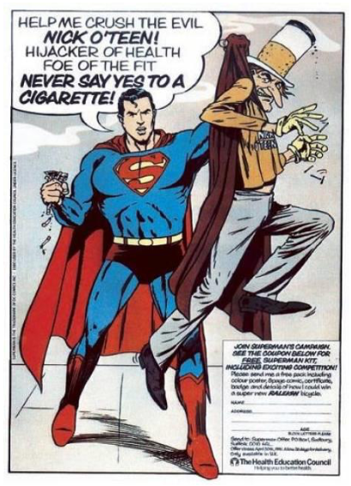
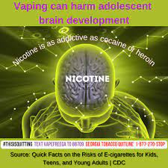
Myths about Nicotine
Over 40% of smokers believe that the harm from smoking comes from nicotine
11% of smokers believe that NRT is equal or more harmful than cigarettes
43% of adults believe e-cigs are equally or more harmful than cigarettes
However there is no evidence of
long term harm from nicotine use:
“Lifetime use is likely to be considerably less harmful than smoking” NICE

Slide 9
Summary
Acute management of Nicotine withdrawal is a clinical responsibility
It is unethical to allow patients in enforced abstinence to suffer withdrawal
Treating & managing nicotine withdrawal supports Smokefree policy
Treatment of nicotine withdrawal should:
be offered to all smokers, regardless of intention to quit
Easily accessible in a timely manner, ideally within 2hrs

