Slide 1
Implementation gap: how long have we known that interventions work
Simon Gilbody
Professor of Psychological Medicine & Psychiatric Epidemiology
University of York
January 2023

Slide 2
What works for people with SMI?
Chipping away at this question for 15+ years

Slide 3
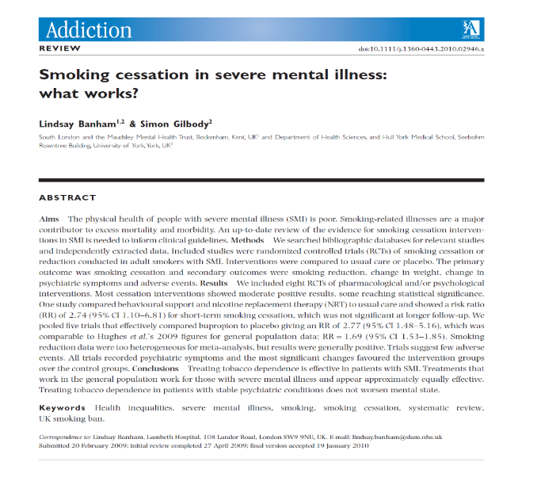
behavioural support + meds = double chances of quitting
Clinical trials
Evidence syntheses
A large pragmatic trial for ppl with SMI

Slide 4
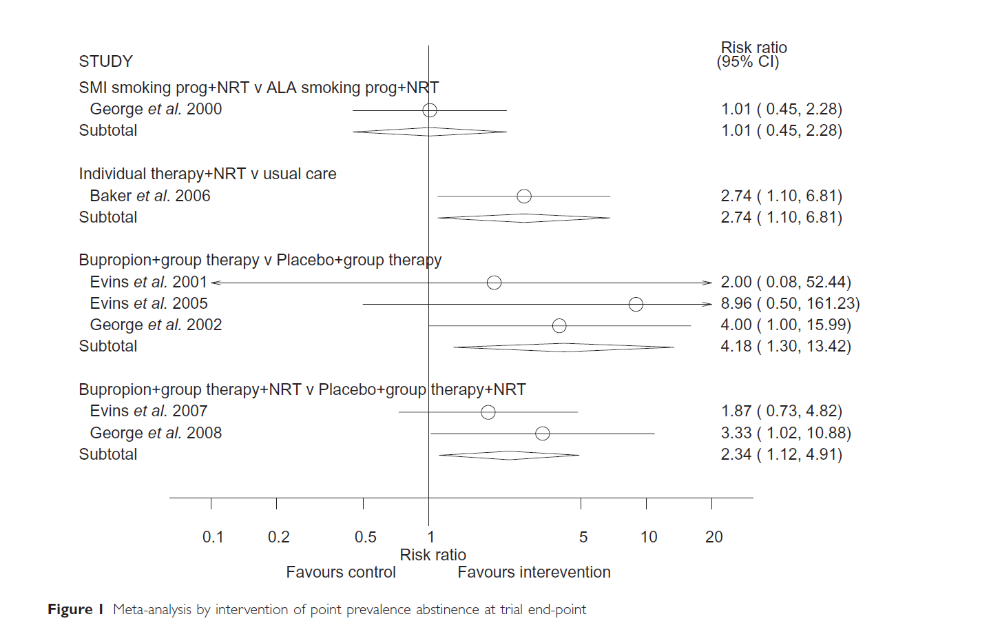
The same things work in SMI as for everyone else

Slide 5
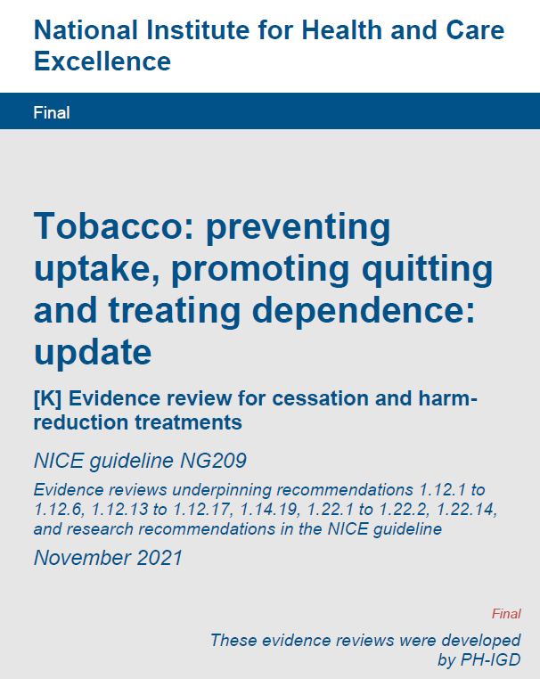
Level 1 evidence, based on systematic reviews, on the effectiveness of:
NRT
Bupropion
Varenicline (when it becomes available)
Behavioural support, following NCSCT & SCIMITAR model

Slide 6
Cumulative meta-analysis
Q: When should we have known this?
Q: How does this new trial change the story?
Useful for policy analysis

Slide 7
When should we have known this?
Cumulative meta-analysis of 25 trials
& linkage to key policy initiatives

Slide 8
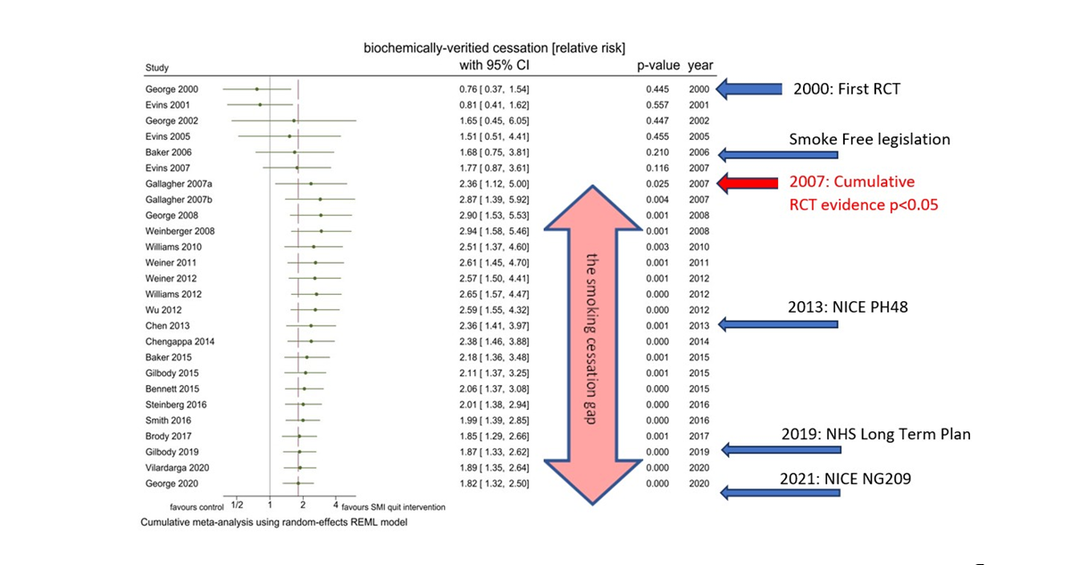
A cumulative analysis of all trials

Slide 9
A cumulative analysis of all trials

Slide 10
A cumulative analysis of all trials

Slide 11
NRT
Bupropion
Varenicline (when it becomes available)
Behavioural support, following NCSCT & SCIMITAR model

Slide 12
Disclaimer
The SCIMITAR trial was funded by the National Institute for Health Research (NIHR) Health Technology Assessment (HTA) Programme (project number 07/41/05). The views and opinions expressed by authors do not necessarily reflect those of the National Health Service, NIHR, the NIHR Evaluation, Trials and Studies Coordinating entre, the HTA Programme, or the Department of Health.

