Slide 1
@KingsNRG
The link between smoking & poor mental health
Debbie Robson, RMN, PhD
Senior Lecturer in Tobacco Harm Reduction & Mental Health Nurse
Nicotine Research Group, Addictions
Department, King’s College London
A smokefree future for people with mental health conditions. ASH 24/4/23

Slide 2
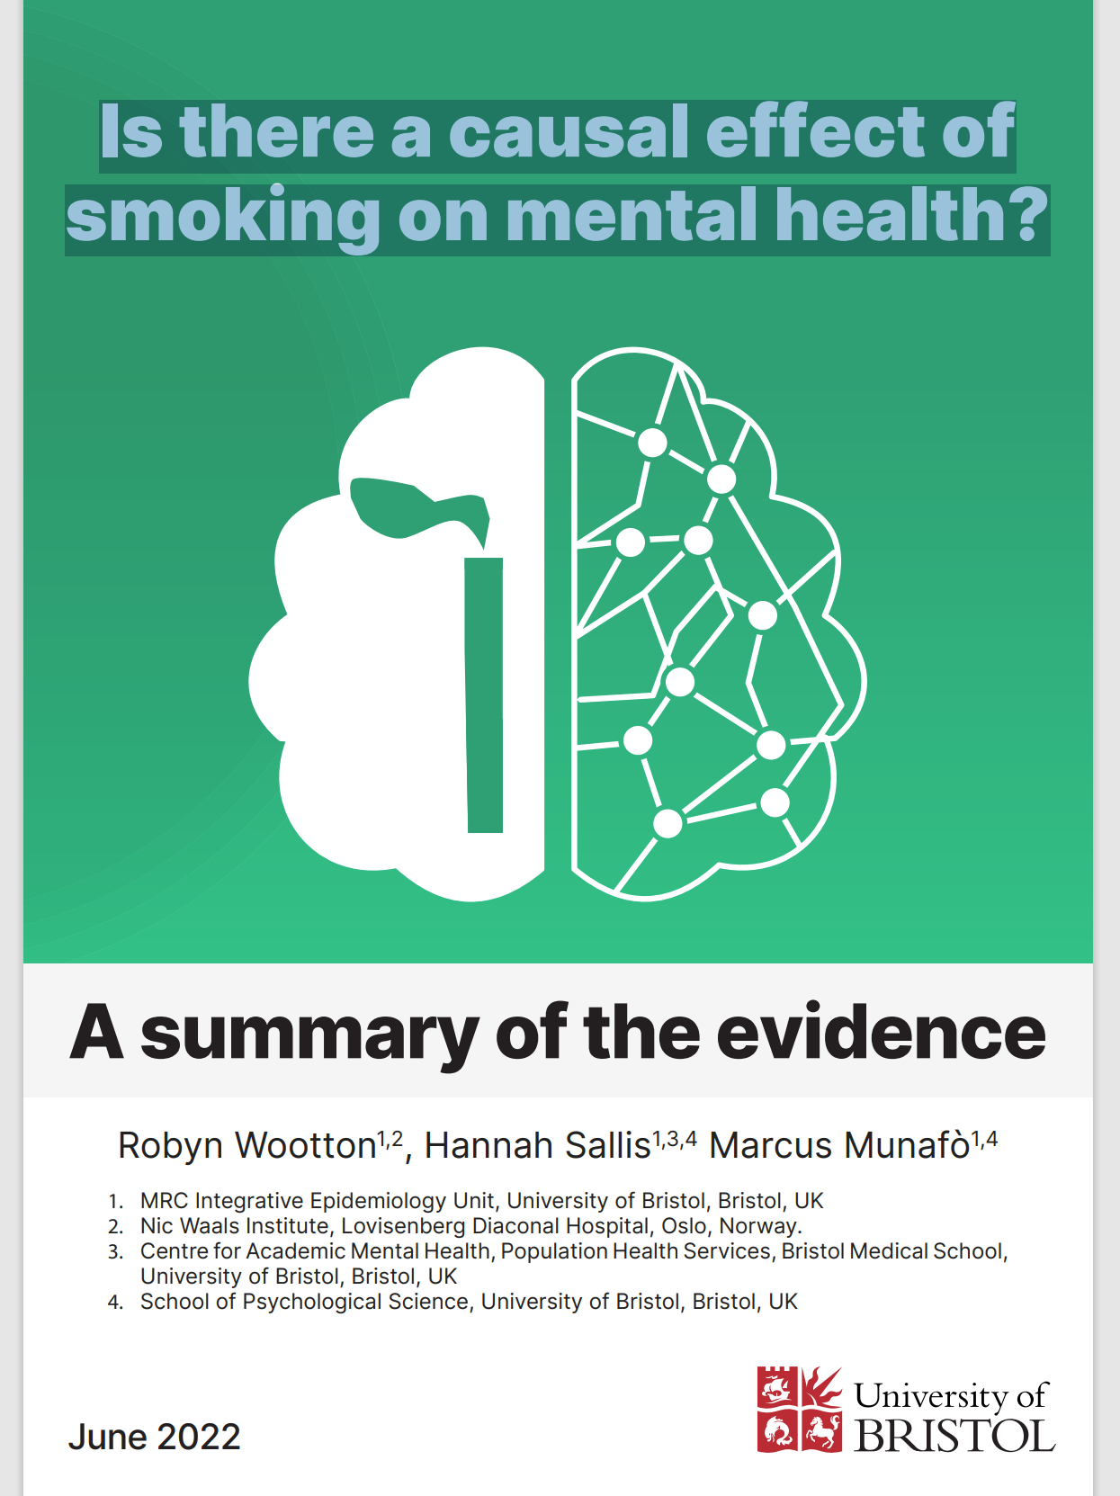
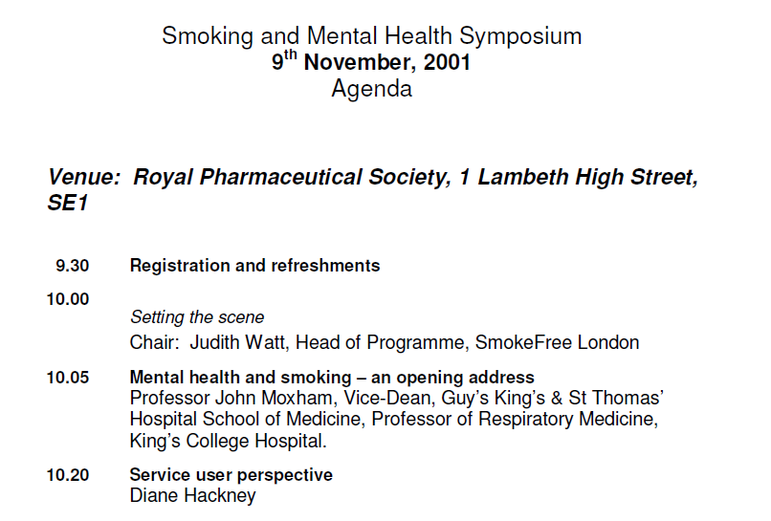
Link between smoking and poor mental health: ASH co-commissioned reports
Notes:
We’ve made slow but great progress in the 20 years since ASH commissioned Ann McNeill to write a review on mental health and smoking –this paper put smoking and mental health on the map – few people and certainly not policy makers were talking about mental health and smoking. We are now in the position where we have evidence and the acknowledgement the role smoking plays in the onset and maintenance of poor mental health – and ASH, together with other organisations have recently synthesised the current evidence base on this

Slide 3
Does smoking cause poor mental health or does poor mental health lead to smoking?
Self medication hypothesis
Misattribution hypothesis
Evidence of a causal relationship
Overview
Declarations of interest
My salary is funded by King’s College London through NIHR grants. I do not take funding from the tobacco or vaping industry.
I’m a Trustee of ASH

Slide 4
Self medication hypothesis
Poor mental health
Tobacco smoke
People with existing poor mental health smoke to self-treat their mental health symptoms
People who take medication to treat psychosis smoke to reduce/cope with the side effects of medication (movement disorders)
Problems with the hypothesis –
Heavy smoking – associated with poor mental health
Prescribed higher doses of medication to compensate for induction effects of smoking
Mental health improves when you stop smoking, and gets better the longer you stop
Historically used by (some) clinicians not to intervene – because they think it helps (calm) people and will make their mental health worse
De Leon et al (2006) Schizophrenia Research doi: 10.1016/j.schres.2006.05.009
Taylor et al (2021) Cochrane Database of Systematic Reviews 2021, Issue 3. Art. No.: CD013522

Slide 5
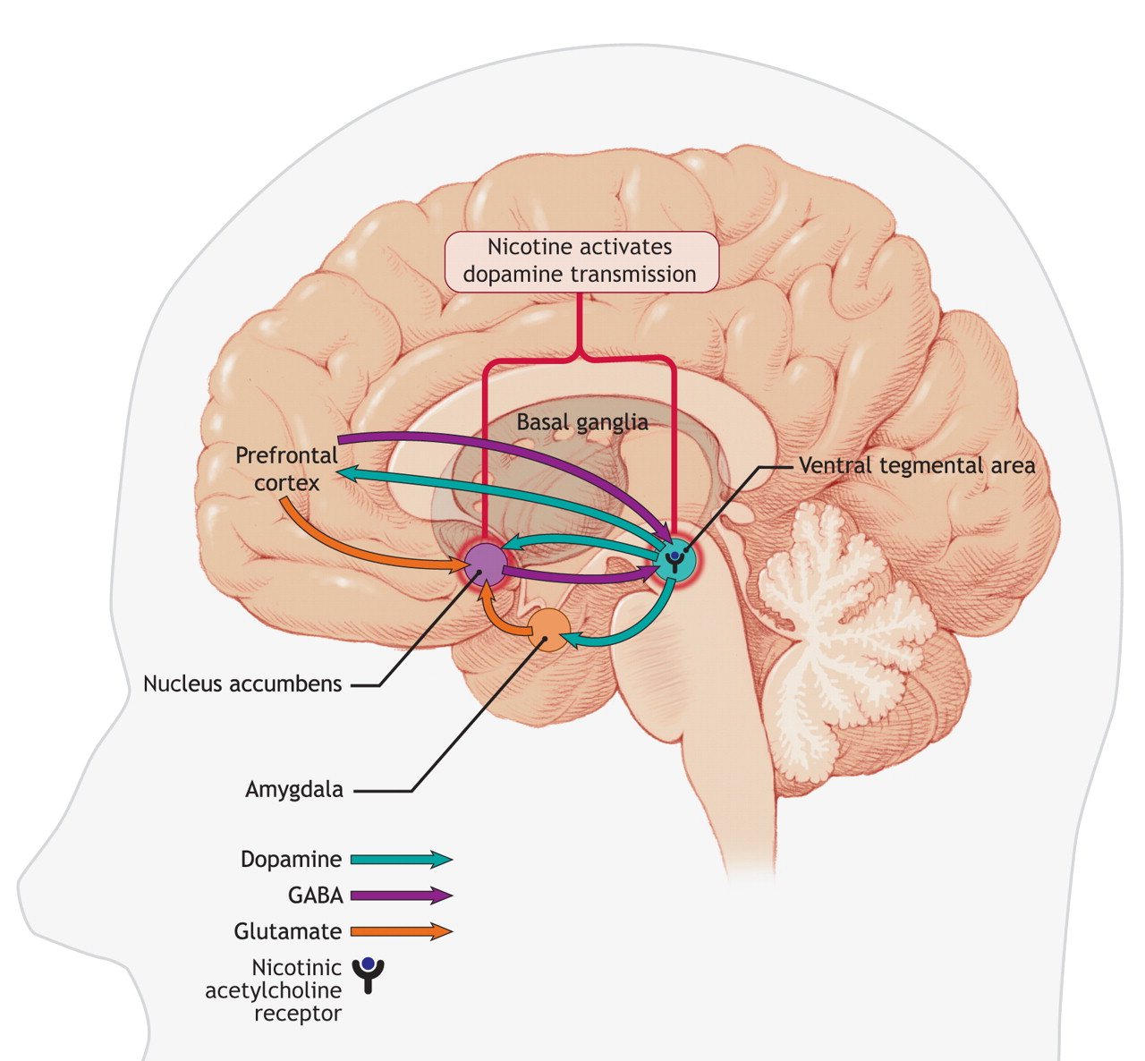
Misattribution hypothesis
Smoking
Reduced distress
Nicotine is delivered to the brain within a few seconds. Then stimulates nicotinic acetylcholine receptors which leads to the release of dopamine
POSITIVELY REINFORCING: The dopamine release ‘teaches’ the smoker to repeat the action of puffing on a cigarette
NEGATIVELY REINFORCING: Nicotine levels start falling soon after a cigarette is smoked - a half life of about 2 hours. If not topped up leads to withdrawal symptoms (depressed mood, anxiety, irritability). Smoking a cigarette stops these symptoms. This ‘teaches’ the smoker to smoke when symptoms of this kind occur.
People who smoke misattribute the ability of cigarettes to relieve withdrawal symptoms (depressed mood, anxiety, irritability) with their ability to reduce mental health symptoms
Replenishment of nicotine
Reduces withdrawal symptoms – reduces distress

Slide 6
We know from observational studies (cross sectional, longitudinal)
Depression increases risk of smoking
Schizophrenia increases risk of smoking
Smoking increases risk of depression
Smoking increases risk of schizophrenia
Limitations of observational studies – they can’t help us know which comes first
Gurillo et al (2015) Lancet Psychiatry, 2, 718–725. Scott et al (2018) Frontiers in Psychiatry, 9, 1–9. Kendler et al 1993) Archives of General Psychiatry, 50, 36–43

Slide 7
Relationship between smoking & poor mental health
Smoking
Poor mental health
Mendelian randomization studies take a genetic approach to help our understanding of the causes of illness. Group the genes from millions of people according their genetic code and look at genetic differences that affect behaviours (e.g. smoking) and illness (e.g. schizophrenia and visa versa.
Can help to work out which comes first and other factors that influence behaviour and outcomes
Other factors
(independently influence both e.g. Socioeconomic status; Environment; Adverse childhood experiences; cannabis use)

Slide 8
Mendelian randomization studies
People who smoke have an increased likelihood of developing
schizophrenia (of between 53% and 127%)
depression (of between 54% to 132%)
There is some evidence that smoking increases the risk of bipolar disorder
Little evidence for a causal effect of smoking on other mental health conditions (ADHD, anorexia nervosa)

Slide 9
Smoking: How does it impede mental health recovery?
People who smoke have more severe symptoms of psychosis - spend longer time in hospital
Smoking lowers plasma levels of clozapine and olanzapine (up to 30-50%) - Higher doses of medication
Poverty (clients spent approx a third of their income on cigarettes)
Exploitation & stigma (begging for cigarettes, picking up discarded cigarettes butts)
Coping skills (people who smoke are less likely than non-smokers to use alternative coping skills)
Notes:
75% of psychiatric patients who smoke report smoking most or all of their cigarettes while alone (Prochaska et al., 2006).

Slide 10
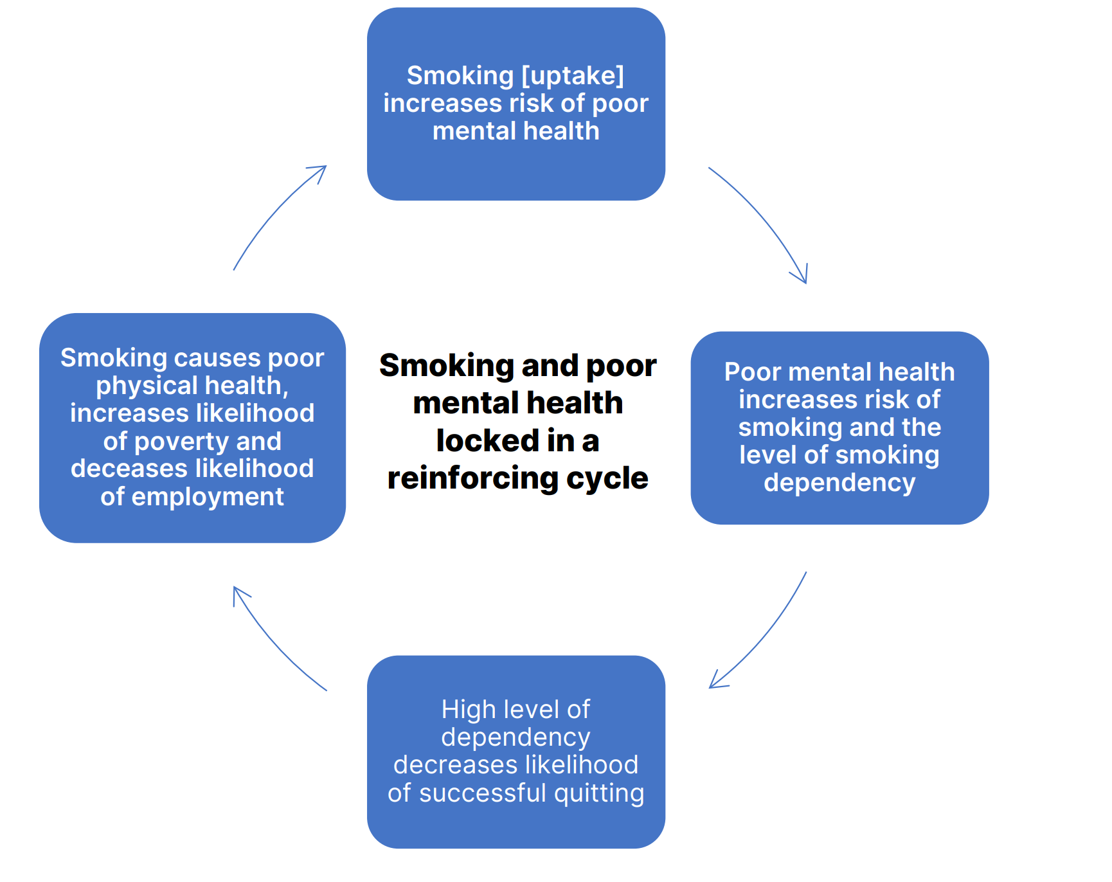
Locked in a cycle of smoking and poor health
Smoking contributes to the risk of developing a mental health condition as well as exacerbating mental health conditions, it can create a vicious cycle

Slide 11
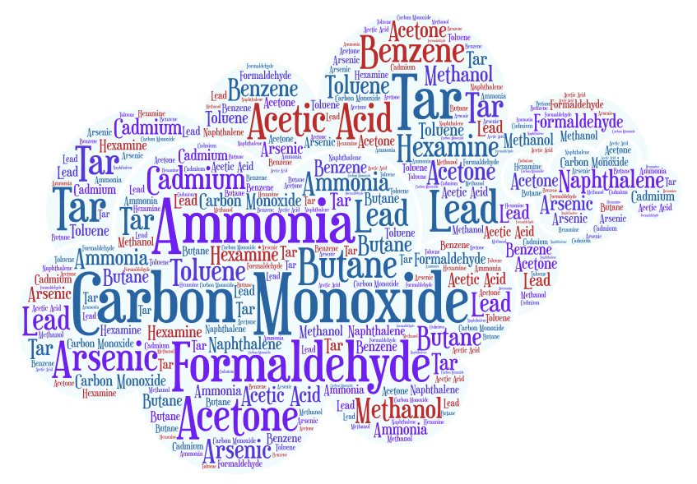
Link between smoking & poor mental health: research gap
More research about the role of nicotine in poor /improved mental health – uncoupled from tobacco smoke
NICOTINE

Slide 12
Summary
Poor mental health leads to smoking
Smoking leads to poor mental health

Slide 13
Increasingly – stronger evidence for smoking causing poor mental health
Quitting smoking leads to improved mental health
Important to research this further – as the more evidence we have that smoking causes the onset of poor mental health and makes it worse – the more we can do to change the culture of smoking in psychiatry
But…. the implementation of evidence based interventions (preventing uptake of smoking and smoking cessation) is also vital, as this is where we can have immediate and positive impact
Acknowledgements: Ann McNeill: ASH
deborah.j.robson@kcl.ac.uk

