Slide 1
Introduction of an approved supply chain for vaping products Crown Commercial Services: RM6202 Tail Spend Solution
17 May 2023
Notes:
Thank you everybody

Slide 2
LAs face vape procurement challenges
What product to chose?
What criteria to use?
How to protect services from tobacco industry vested interest?
What products have been used in trials?
What flavours and strengths are appropriate?
What products comply with MHRA standards?
Voucher or direct supply?
Can we work with local vape shops?

Slide 3
1. Produce procurement guidance
Aims
To increase quitting among the most disadvantaged smokers by increasing the use of effective consumer nicotine products in quit smoking attempts in settings such as local stop smoking services, hospitals, drug and alcohol services, homelessness and housing services.
Objectives
Provide services with
procurement advice and
an approved supply chain for suitably safe and effective nicotine vaping products.
Advice for services on making vapes available
Incorporating e-cigarettes into your Stop Smoking Service: Making the case and addressing concerns.
https://www.ncsct.co.uk/publication_service_advice_vapes.php
2. An approved procurement platform for vapes
Engaged Crown Commercial Services to develop the procurement solution.
Focus: Delivery of vaping ‘starter packs’ to public sector organisations in support of the delivery of tobacco cessation services.

Slide 4
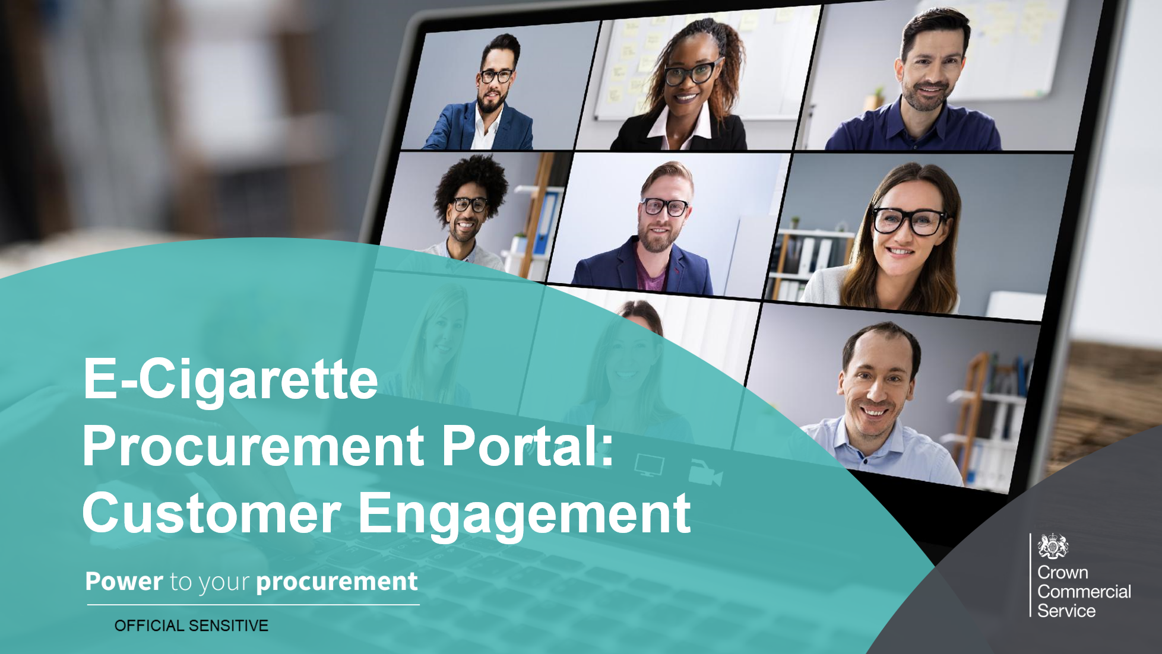
Market Engagement
Series 1: OCT 22 - insights gathering
Series 2: NOV 22 – sharing drafts
Series 3: DEC 22 – testing with vendors
Refine / Test conversations
Insights from i) existing services offering vape-supported quit interventions; and ii) vendors providing vapes to the public sector
presentation of draft procurement platform offer to customers
Testing product and service specifications with vendors
Continue to have conversations with customers and vendors to refine/test.

Slide 5
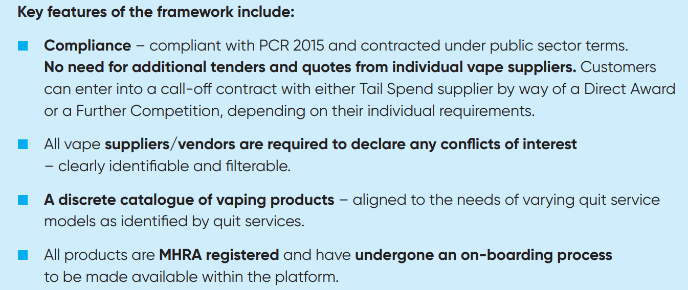
Solution Overview
OHID and Crown Commercial Services commission the inclusion of a ‘vaping product category’, within the existing Tail Spend Solution procurement framework (RM6202)
https://www.ncsct.co.uk/publication_service_advice_vapes.php
Available but not mandatory
Two platform providers offering vaping product categories
Tendering requirements “pre-met” (therefore, no need to obtain further quotes)
“Starter packs” and product bundles
Any conflicts of interest clearly flagged (such as tobacco interests)
MHRA notification details specified
Option to refer vape providers to the platform

Slide 6
Framework Suppliers and Contracting Options
The Framework consists of two suppliers:
Customers can enter into a call off contract with either supplier by way of:
Direct Award - A Customer may award a Contract under this Framework Contract without holding a further competition by:
developing a clear Statement of Requirements
applying the direct award criteria set out in the Framework Contract to establish whether which provides the most economically advantageous solution (MEAT)
Further Competition - conducting a Further Competition Procedure by inviting both suppliers to submit a tender response in writing to the customer requirements set out in its invitation to tender
When you have established which supplier best fits your requirements you will need to award a Call-Off Contract to the supplier through the Tail Spend Solution RM6202 framework.
Full support is provided by CCS and the framework suppliers during this process.

Slide 7
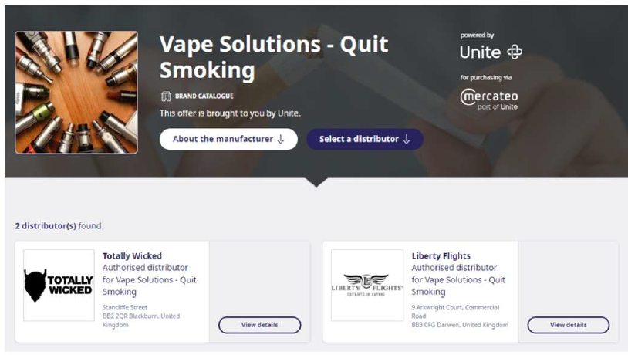
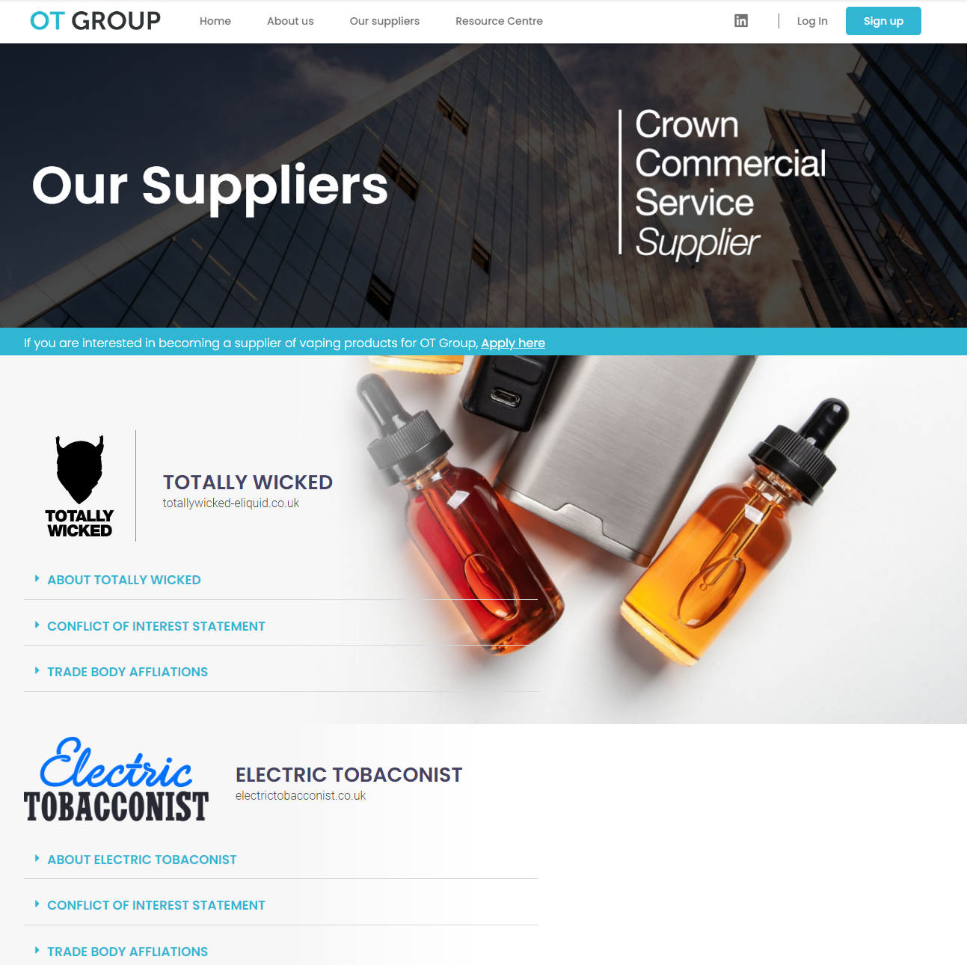
Meet the suppliers 1
www.unite.mercateo.com/vapesolutions
www.otgroupltd.co.uk/vaping-solutions
Email: CCStailspend@unite.eu
Tel: 0292 150 9669
Email: cspublic@otgroupltd.co.uk
Tel: 0330 165 4452

Slide 8
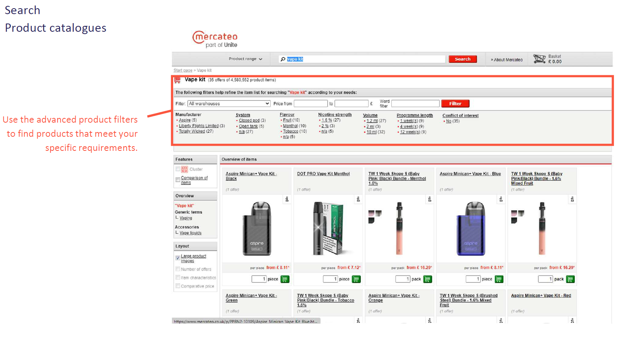
Meet the suppliers 2
You can discuss your service requirements directly with suppliers
You can invite vape suppliers to join the framework
Create bespoke product bundles
Explore call-off delivery orders; and voucher schemes

Slide 9
Key messages
This is not a brand new procurement portal/framework. What is new, is the introduction of a specific product category within an existing public sector procurement framework.
Framework is available but not mandatory
Two platform providers offering vaping product categories
Tendering requirements “pre-met” (therefore, no need to obtain further quotes)
“Starter packs” and product bundles available
Any conflicts of interest clearly flagged (such as tobacco interests)
MHRA notification details specified
Option to refer vape providers to the platform
Public sector partners only

Slide 10
Support
Crown Commercial Services
Framework Suppliers
Further information on the framework, including an introductory webinar, can be found on the CCS homepage at https://www.crowncommercial.gov.uk/agreements/RM6202
Of interest to Procurement Specialists:
Link to Short Tail Spend Solution Animation
Link to RM6202 Introduction and Overview Webinar
www.otgroupltd.co.uk/vaping-solutions
Email: cspublic@otgroupltd.co.uk
Tel: 0330 165 4452
www.unite.mercateo.com/vapesolutions
Email: CCStailspend@unite.eu
Tel: 0292 150 9669
OHID
Contact your OHID Tobacco Regional Lead, and/or Allan.Gregory@dhsc.gov.uk

