Slide 1
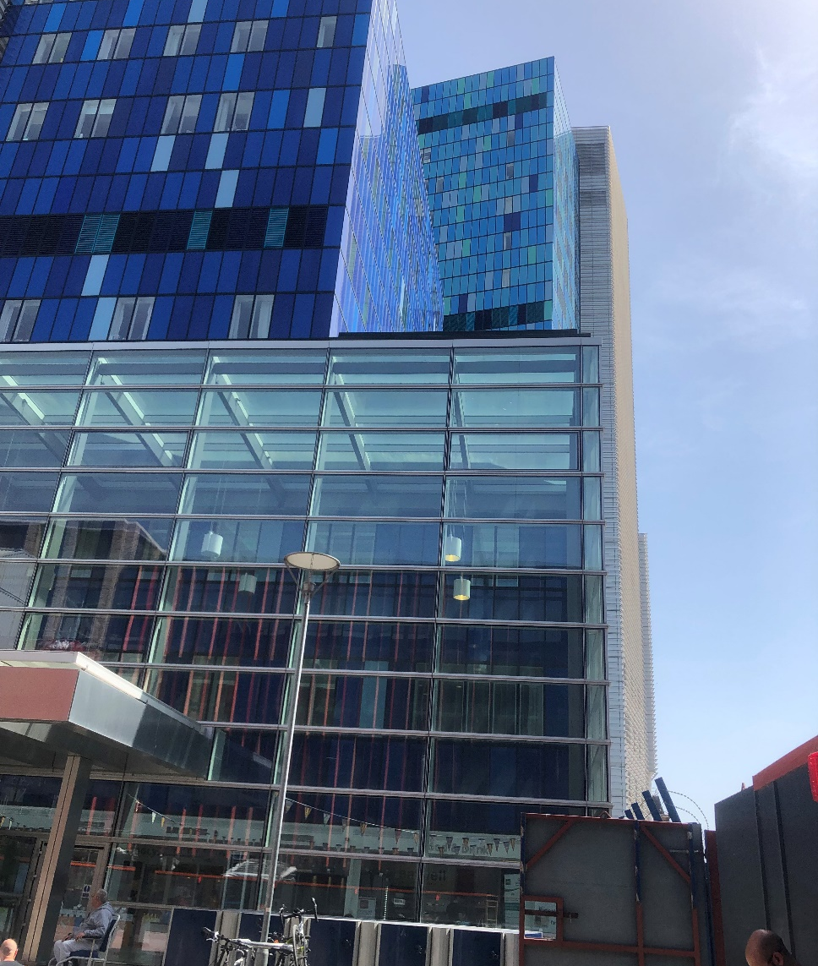
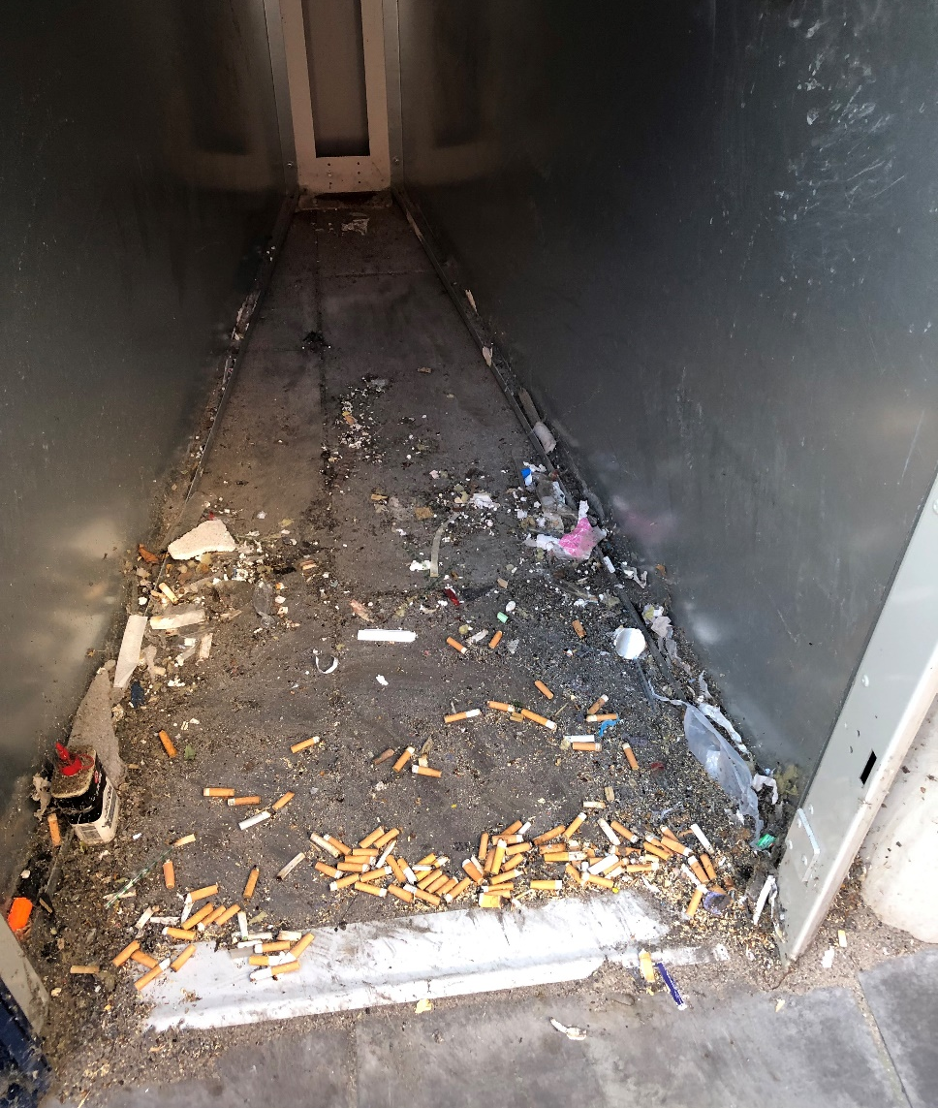
Overcoming obstacles to smoking cessation in general hospitals: national → local actions
Follow NICE guidelines
on tobacco use
https://www.nice.org.uk/ng209
Brief intervention /
behavioural support
Offer combined NRT
and/or *varenicline
Referral to Smoking
Cessation service
Stop smoking
Anticipate impact on
antipsychotic drug
metabolism; alter
dose appropriately
Peter byrne, consultant liaison psychiatrist, Royal london hospital

Slide 2
Focus of this talk: where / how we work, aimed at clinicians (positions of influence)
Nationally, falling smoking rates (<15%) except in people with mental health (MH) conditions evidence of return to smoking / increased rates in severe mental illness (SMI) rates during pandemic, pandemic’s secondary effects on health / care services and ongoing cost of living crisis. Start with data & known comorbidities → harm.
General hospitals: even before Covid but increasing since the end of lockdowns people with SMI / PD / dementia / ID / Addictions etc. are admitted more often to general hospitals than psych hospitals. (Shorter duration stay with unfamiliar teams)
Treatment gap in MH conditions (other than psychosis, only a minority get any treatment) has a parallel with policy-practice gap in general hospitals
The not-with-MH-services people with mental disorders: there is no funding for GPs to prescribe Nicotine Replacement Therapy; will IAPT ask about smoking? The short lengths and reactive natures of admission put excess pressures on GP, community

Slide 3
Byrne, 2023: Irish Journal Psychological Medicine

Slide 4
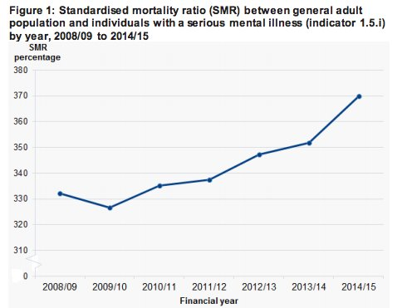
UK Gov data as Fingertips SMI and Public Health Outcomes Framework 3 years to 2010: “adults with SMI were 2.5 to 7.2 times more likely to die before aged 75… two thirds from preventable physical diseases”

Slide 5
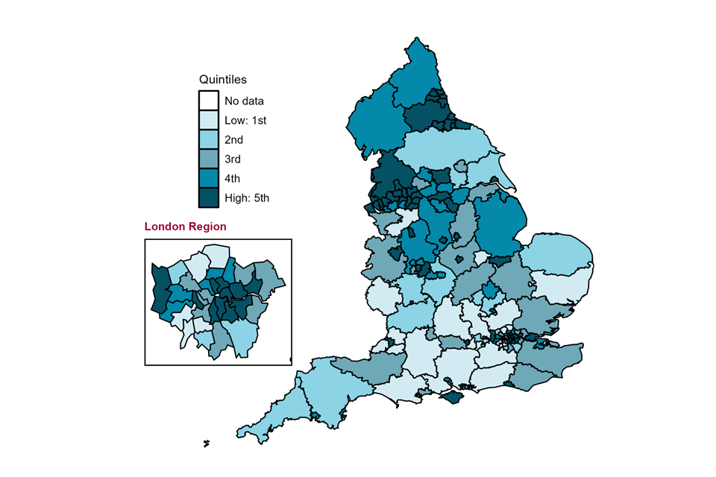
UK Gov / fingertips, PHOF
map of upper tier local authorities (April 2020 to March 2021) in England for premature mortality in adults with severe mental illness. Directly standardised rate - per 100,000, 2018 to 2020

Slide 6
Are people with Mental disorders (1 in 4 of us) a different species? No, some solutions differ
It only took seven decades to reduce smoking rates - taxes on products, bans on advertising, fall in tobacco production (incl State subsidy) & more - achievements by public health, ASH…
People with severe mental illness (SMI) have smoking rates of 40%; Addictions, PD, ID even higher
Alongside more MH awareness, better coping strategies other than cigs. Growing awareness that smoking adds to mental disorder symptom burden (smoking is not a relief against these)
More addicted to nicotine, more vulnerable to complications of smoking (especially if alcohol excess) and further negatives (↑Meds doses; tobacco poverty; social isolation) but ppl with MH probs want to quit just as much as other smokers
Evidence-based treatments +++ and quits even in lock up psychiatry wards do NOT increase violence/aggression
General hospitals speak of “patient journey” – true, but it’s less a country stroll and more of a roller coaster

Slide 7
Obstacles to screen + intervene
Psych wards | Community MH teams | Gen Hospital
Risk to self and others #1, other priorities trump | Time pressures, delegate to GP, acute care, other | Enforced cessation when in plain sight
“we have to focus on the things we have to fix now” | “we have enough to do without being her GP as well” | “as long as he’s here for the ward round, let him smoke”
NRT  Varenicline ? E cigs  | Wide variation between teams | NRT  Varenicline X E cigs X
Fragmentation of heath services, education (medicine V psychiatry), with public health / addictions separated from mainstream services
Just like smoking cessation in clinical contexts is “everybody’s job”, does the same thing happen (NOTHING) within national governments, health structures, arms length bodies, local authorities, now ICS Boards?
We have all the evidence we need but (1) training gap and (2) institutional barriers to implement what works

Slide 9
Leadership at all levels, and not stop-start
At individual level, the patient-clinician relationship: “to help people to live the lives they have reason to value”. Is smoking a choice? Really? Return the focus to health
We are NOT forcing patients or staff into Nicotine withdrawal: generous NRT (2 sources), E Cigs and anti-nicotine craving medications; pair break from ward with NRT
How organisations communicate SmokeFree Policies and enforce them: NO SMOKING means no smoking; close the smoking shelters, meeting points, end “fresh air breaks”
The inequalities of Smoking and the inequalities of access / preventable smoking deaths are important. Resource staff with time: training & practice, “supervision”
At the very top, we have Dr Bola Owalabi’s CORE 20 plus 5 (tobacco crosses all five) and the NHS Tobacco Dependence Stakeholder Group (Chair, Dr Sanjay Agrawal) … NCCMH / RCPsych’s QUITT programme pilot sites (comm MH and acute Trusts)

Slide 10
Driving change / key areas
Keeping tobacco on every agenda across fragmented health / care services
Comorbidities: resp and MH and cardiac and more. NO MORE either / or thinking
Snapshots of rates of smoking and training: hospital Comms; end harms too
Electronic and supervision reminders for clinicians, all patient-facing staff
Policy → Practice
Very brief advice, Vaping and Varenicline
The challenges of directive-fatigue, competing priorities
When to activate enforcement (no smoking rules)

Slide 11
Theory of change in one slide
Establish norms
Educate + Sustain
Explore
Evaluate openly
Coproduce, co-create
Experiment, QI
Hug Smack
Nudge Shove

